Slide 1
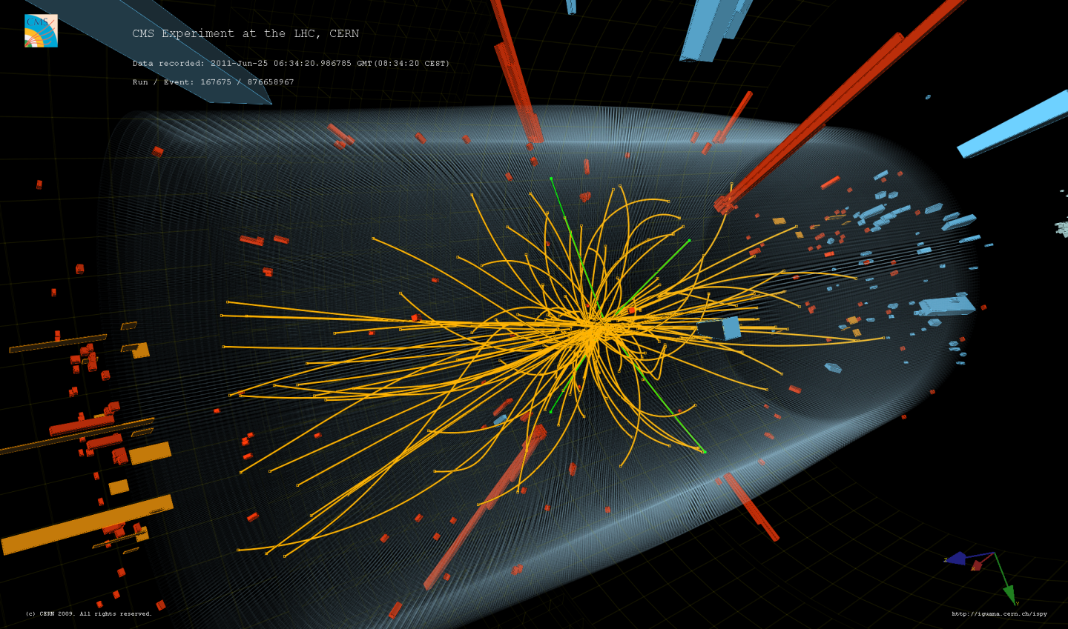
The Higgs boson: from concept to discovery
C. Charlot, LLR-École polytechnique, CNRS&IN2P3
Univ. Split, Split, January 2021
Notes:
Presenting myself, decade of search for the Higgs boson

Slide 2
From concept to discovery
Why a Higgs boson?
How did we search for and finally discover it?
Status of current experimental measurements / knowledge
What’s next?
Notes:
At the end of this lecture I hope you will understand all this better, why it took decades to find it and also why it is so important

Slide 3
Part 1: Why a Higgs boson?
Notes:
Physics at hadrons colliders

Slide 4
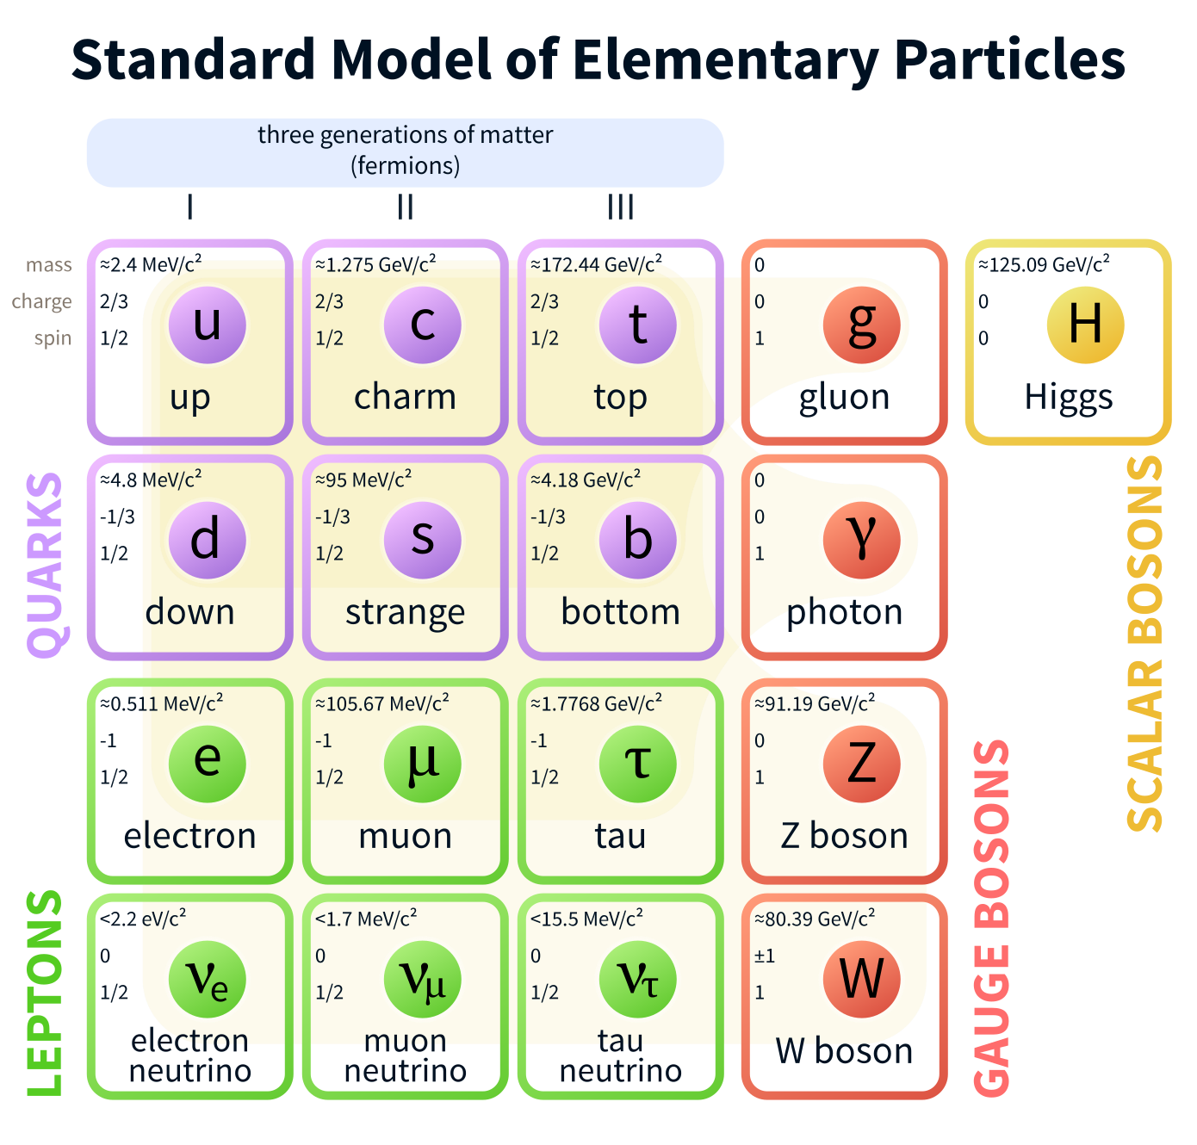
Fundamental particles & interactions
Matter particles:
Fermions, spin ½, chiral spinors
Quarks and leptons
3 families (we don’t know why …)
Notes:
Matter particles
Fermions, quarks and leptons
3 families or generation we don’t know why

Slide 5
Fundamental particles & interactions
Caveats:
Particles are point like objects
Particles have anti-particles associated
Particles in these drawing correspond to quanta of relativistic quantum fields (QF)
QF can create or annihilate particles (relativity)
QF correspond to well defined quantum numbers
Notes:
caveat

Slide 6
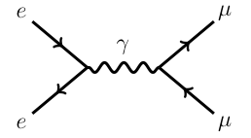
Fundamental particles & interactions
Interactions: bosons, spin 1
Electroweak, strong
Gravity is too weak at our energies (spin 2 graviton, although consistent theory requires supersymmetry and higher space dimensions)
Interaction = particle exchange, emerge in QFT from requiring local gauge invariance
space
Q: there is a mistake in this diagram, strictly speaking, can you find it?
time
Notes:
Boson are geometrical objects, see later. But you can see that on the Feynman diagram below the gauge boson connects space time point.
There is one mistake strictly speaking on the diagram below, find it.

Slide 7
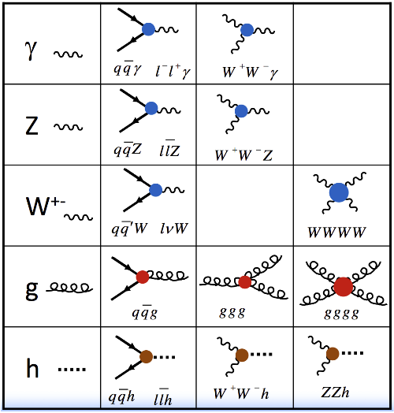
Fundamental particles & interactions
Gauge bosons’ interactions
Interactions: bosons, spin 1
Electroweak, strong
Gravitation is too weak at our energies (spin 2 graviton, although consistent theory requires supersymmetry and higher space dimensions)
Interaction = particle exchange, emerge in QFT from requiring local gauge invariance
space
time
Notes:
Gauge interaction model of QED is extended to other gauge interactions.
No mention here of the Higgs which is a different interaction.

Slide 8
Fundamental particles & interactions
Higgs boson: spin 0 (unique)
Discovered in 2012 by ATLAS and CMS experiments
Resolve conflict between gauge interactions and masses
Totally new interaction
It is the subject of this lecture!
Notes:
Spin 0 or scalar

Slide 9
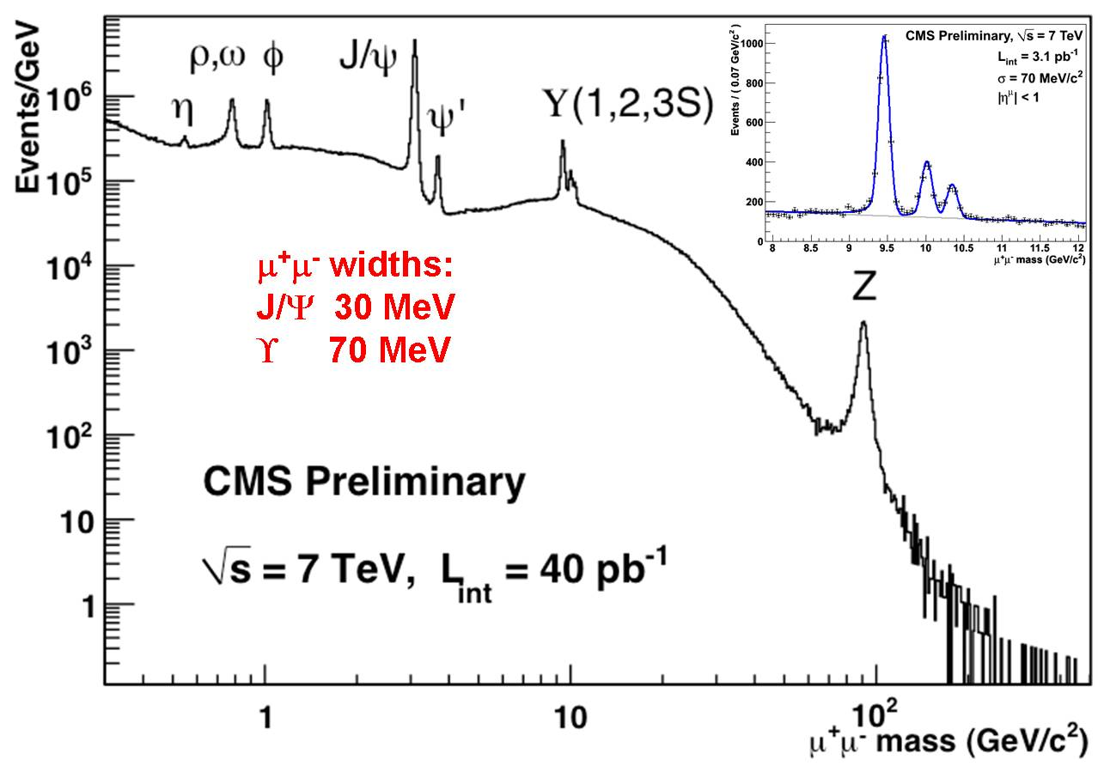
SM measurements
ρ,ω,φ,Ψ, Υ:
vector mesons, qq bound states
Ζ: gauge boson, fundamental
All are unstable
(could you tell why?)
Beyond the mathematical formulation, these objects are real!
Notes:
All these particles are unstable (apart from electron, photon and the neutrinos that are stable)
Q: why are they stable? A: because there is no other particle of lower mass to which they could decay
Photon as m=0 as far as we know, neutrinos have very low mass and cannot decay into photon because they carry leptonic number that is conserved
Electron cannot decay to neutrino because it would violate charge conservation (and eventualy lepton conservation)

Slide 10
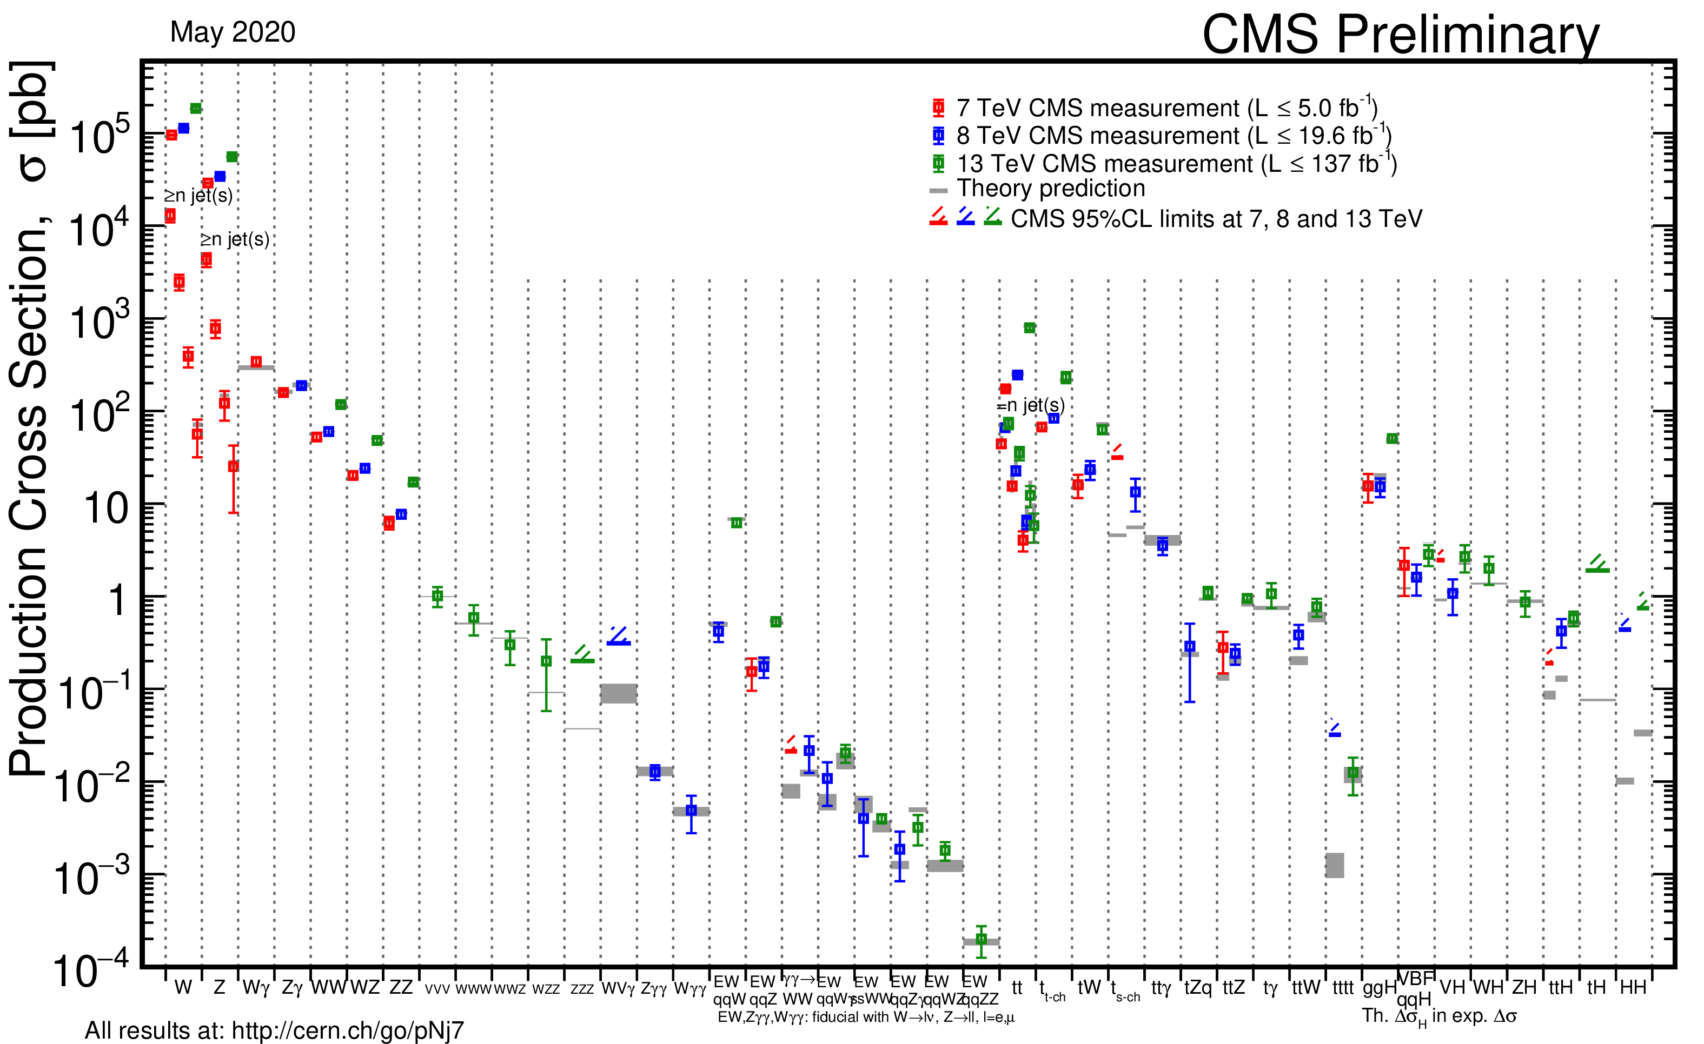
SM measurements
SM is not just a nice mathematical theory: it works extremely well !
Notes:
X section measurements
Over orders of magnitude

Slide 11
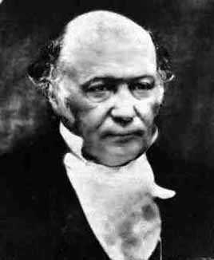
Lagrangien, symmetries and EWSB
George Hamilton (1805-1865)
Irish mathematician and astronom)
Swiss mathematician and physcist
French mathematician and astronom)
German mathematician
This construction started back in the XVIIIth century!
Notes:
Now i will go to a bit of theory on spontaneous symmetry breaking
Noether theorem: « To each infinitesimal transformation that leaves the action invariant corresponds a conserved quantity in time »
Euler & Lagrange: analytical formulation of classical mechanics, that apperas to be the formulation that can be easily extended to described quantum mechanics and quantum fields

Slide 12
Lagrangian in classical mechanics
The equations of motion of a system can be derived from a scalar Lagrangian function of generalized coordinates and time derivatives of the coordinates (velocities)
And from Euler-Lagrange equations
(from Hamiltonian variational principle)
Notes:
Q: do you know what is a variational principle?
Hamilton principle: the integral over t of the Lagrangian should is extremized by the actual trajectory q(t)

Slide 13
Lagrangian in classical mechanics
For a particle in a conservative potential V, the Lagragian is
So the derivatives are (here for x)
and Euler-Lagrange’s equations
finally give us the usual second Newton’s law

Slide 14
Symmetries and conserved quantities
Noether’s theorem: “to each infinitesimal transformation that leaves the Lagrangian invariant corresponds a quantity that is conserved in time“
Simple case: coordinates not explicitly appearing in the Lagrangian => invariant under a continuous transformation of the coordinates
Example: mass m orbiting in the gravitational field of a fixed mass M
Since the Lagrangian doesn’t depend explicitly on φ (symmetry with respect to space rotations), the Euler-Lagrange equations give
So that the angular momentum J is a constant of motion!

Slide 15
In quantum mechanics
Imagine space as a continuum of springs and balls connected with its neighbors by elastic bands
=> Particles are excitation of the field
Quantum fields allows to account for both QM and SR basic principles
Notes:
Why fields is needed?
Particle are not localized from quantum mechanics
Exciotation/desexcitation -> need to create /annihilate particles from special relativity

Slide 16
In quantum field theory
Generalized coordinates are now fields (each spring becomes a field)
In a relativistic theory one must treat space and time on equal footing, so the derivatives in the classical equations are now
Instead of Lagrangian we have a Lagrangian density (we also call it Lagrangian to make things more confusing ☺)
The new Euler-Lagrange equation becomes
Notes:
Second quantization
VOIR ICI SI JE SUIS EN AVANCE, J’AI 1H45 EN TOUT DONC JE DOIS ETRE ICI A 3/4H ENVIRON

Slide 17
Gauge invariance
Consider the Dirac Lagrangian for a spinor field Ψ representing a spin-1/2 particle, for instance an electron
It is invariant under a global gauge transformation like
Where χ is constant
Notes:
- = hermitian conjugate

Slide 18
Local gauge invariance
If χ depends on the position, χ=χ(x), we get extra terms in the Lagrangian
and to preserve gauge invariance we need to add a new field A_{μ}, that transforms as
in such a way that
is invariant under the local gauge transformation
interactions arise by enforcing local gauge invariance
the field A_{μ} is the photon field, the mediator of the e.m. interaction
there is no mass term A_{μ}A^{μ}, as it would break the local gauge invariance, it is OK since the photon as m=0, but is not OK for weak interaction (m_{W} and m_{Z} ~100 GeV)
Where X is constant
=> Interactions arise by enforcing local gauge invariance
=> The field A_{μ} is the photon field, mediator of em interaction
=> There is no mass term A_{μ}A^{μ} as it would break gauge invariance, it is OK for the photon as m_{γ}=0, but is not OK for the weak interaction (m_{W} and m_{Z} ~100 GeV)
Notes:
Prove the intermediate steps
Demonstrate that a mass term would brake gauge invariance
mAA -> m(A-dm)(A-dmX) = mAA –mAdmX –mdmA
Why a mass term is ~mAA?
Scalar combinations: AA, δAdA, or γdA, not much choice
Then derivative of field correspond to momentum (d/dt(q)) so it cannot be this

Slide 19
Why gauge bosons must have 0 mass?
Suppose a gauge field theory on a lattice
Under a global phase transformation (h constant), the following field terms
are invariant.
Under a local phase transformation, h=h(x), the terms i,i+1 involving subsequent points on the lattice becomes
We need a field that connects the point i and i+1and transforms as
On the lattice the local gauge invariance introduce a long range correlation
The gauge bosons have m=0! It is a geometrical property!
Notes:
Iliopoulos’s poorman’s view on the lattice
The field corrects for the change of phase in next space-time point
The problem also holds for fermions masses

Slide 20
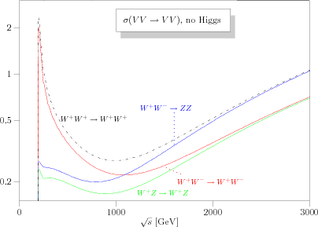
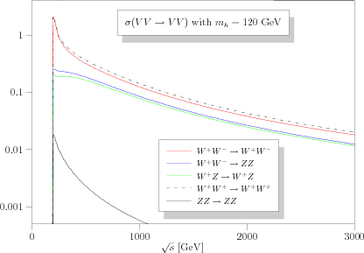
Another problem in the SM
In the absence of the Higgs, the cross section for weak bosons longitudinal scattering grows with energy and ultimately breaks unitarity!
The addition of a scalar boson exchange regularizes the cross section through a negative interference with amplitudes involving triple and quartic gauge couplings
This cancellation happens if and only if the coupling of the scalar boson to the gauge fields is that of the Higgs boson (ie ~m_{V}²)
Unitarity violation
(no Higgs)
Unitarity restored (with Higgs)
Notes:
Iliopoulos’s poorman’s view on the lattice
The field corrects for the change of phase in next space-time point
The problem also holds for fermions masses

Slide 21
Spontaneous Symmetry breaking
There are many cases in physics where the system has symmetry while the ground state (minimal energy) doesn’t has the symmetry
A stick with a vertical force applied on top of it will bend (F<F_{c}) to a state of lower energy that breaks the azimuthal symmetry
The system has an infinity of states with lower energy
The symmetry is still present in the equations but the ground state has a non-0 energy
With a suitable choice of the potential it is then possible to ‘generate’ quadratic terms in the Lagrangian
Notes:
Why non-0 energy? In this case it is potential energy, if you remove the force the system will go back to the straight stick

Slide 22
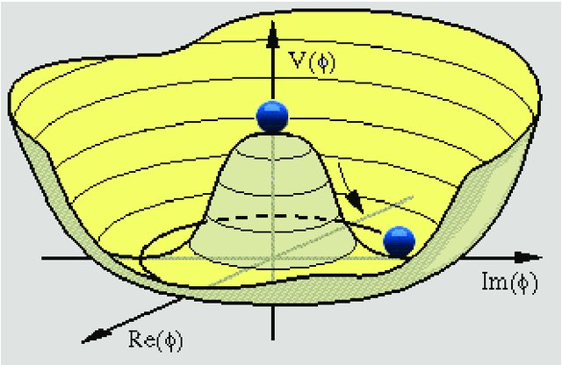
The BEH mechanism
Introduce an SU(2) doublet of complex scalar fields
The Lagrangian is
And with a particular choice for the potential
For λ>0 and μ²>0 there is a unique vacuum with <0|φ|0>=0
For λ>0 and μ²<0 the true vacuum is at
The choice of the vacuum breaks the symmetry and 4 Goldstone bosons of 0 mass appear
3 are ‘gauged away’ from the scalar sector and reappear as longitudinal degree of freedom for the Z and Ws, which become massive
The 4th Goldstone boson remains as a new neutral scalar particle, the Higgs boson
Notes:
v=vev
v is fixed by the Z and W masses v =246 GeV
Ony one parameter remains, lambda or the Higgs mass -μ2

Slide 23
Is this reality?
Notes:
Don’t listen to theorists that explain you it could not be differently, before the Higgs discovery there were tons of papers on alternative explanations!

Slide 24
Yes
Notes:
It is important because it is how nature is
Don’t listen to theorists that explain you it could not be differently, before the Higgs discovery there were tons of papers on alternative explanations!

Slide 25
Intermediate summary
The SM is a gauge theory where interactions arise from gauge symmetries
The natural mass for gauge bosons is 0, but weak bosons are massive!
SSB allows to reconcile mass terms with gauge symmetries, introducing a doublet of scalar fields
EWSB gives rise to 4 Goldstone bosons, three of them combine as longitudinal components with the transverse ones for the Ws and Z, ‘giving’ mass to Ws and Z
A new scalar boson must remain, the Higgs boson
Its mass is the only unknown parameter (assuming simplest possible field content and potential, and neglecting the mass parameters needed for fermions…)
This description was put in place in the early 60’s, we now know that it is reality
Notes:
Contradiction
QUESTIONS ON THIS PART?
VOIR OU EN EST LE TIMING ICI,JE DOIS ETRE AUX ENVIRON D’UNE HEURE, SINON => PAUSE

Slide 26
Part 2: How did we get there?
Notes:
Why start by QCD?
QCD Unavoidable at hadron colliders
Because we use incoming protons (PDF) and we dectect product of hadronization, fragmentation

Slide 27
First attempts at a systematic search

Slide 28
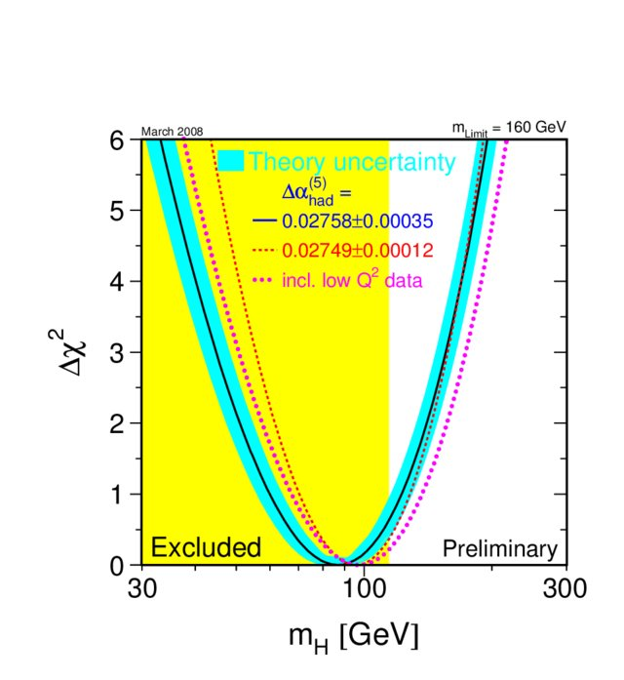
LEP searches (1981-2000)
SM relates m_{t}, m_{W/Z} and m_{H} through radiative corrections
Direct searches: m_{H}>114.4GeV@95%CL
Fits to EW data (indirect)
m_{H}<160 GeV @95%CL and MPV = 87⁺³⁸₋₂₇ GeV (indirect)
m_{H}<190 GeV if direct search result included
Light Higgs favoured, assuming it exists and SM is correct!`
LEP legacy
(2008)
Higgstrahlung:
pp → ZH
Notes:
Direct vs indirect searches -> we never discover something with indirect searches
But assuming it exists one can put somehow strict bounds
1-sigma uncertainty are tight here, but again reflect assumption that it exists, otherwise discovery needs 5sigma significance as we will see later on
Never say that from LEP results we knew already that the Higgs should have mass 87+38/-27
And remind the many other theories at that time (strongly coupled, no fundamental Higgs, technicolor, ..)

Slide 29
Tevatron results (2001-2011)
Tevatron combination: CDF + D0
Summer 2008
Low mass Higgs
(m_{H}<135 GeV)
Low mass search: pp → VH in vvbb, llbb, lvbb, jjττ, ττbb
Very sophisticated analyses, many channels, BDTs
Discovery out of reach except ~2m_{W} (H → WW)
Notes:
Ajouter qques details sur comment on le cherche au Tevatron: ZH, WH->bb

Slide 30
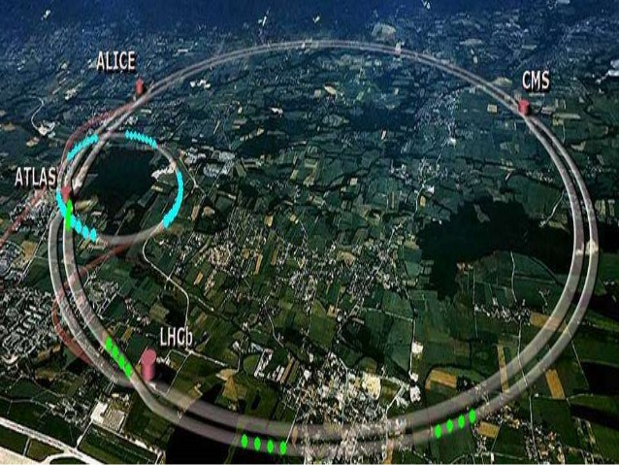
The Large Hadron Collider
6.5+6.5 TeV
A 27 km circumference accelerator located at the Franco-Swiss border, 100m underground
Accelerates protons to nearly the speed of light, in two counter rotating beams

Slide 31
Proton-proton collisions
E=6.5TeV (LHC)
E=6.5TeV (LHC)
p
Incoming beams composite: partons
p
Actual collisions occur between quarks and gluons (partons densities)

Slide 32
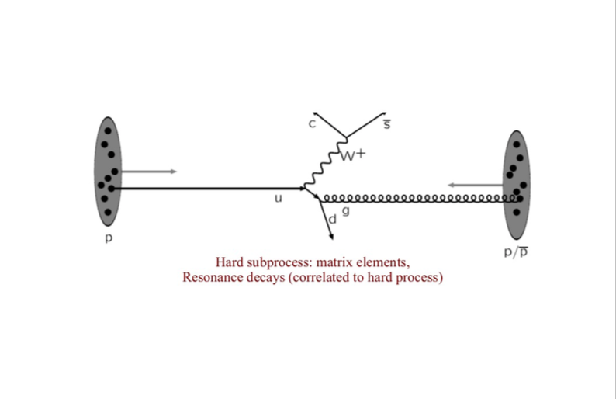
Proton-proton collisions
p
Hard interaction: rate (cross-section) computable from theory, including resonance decay
p

Slide 33
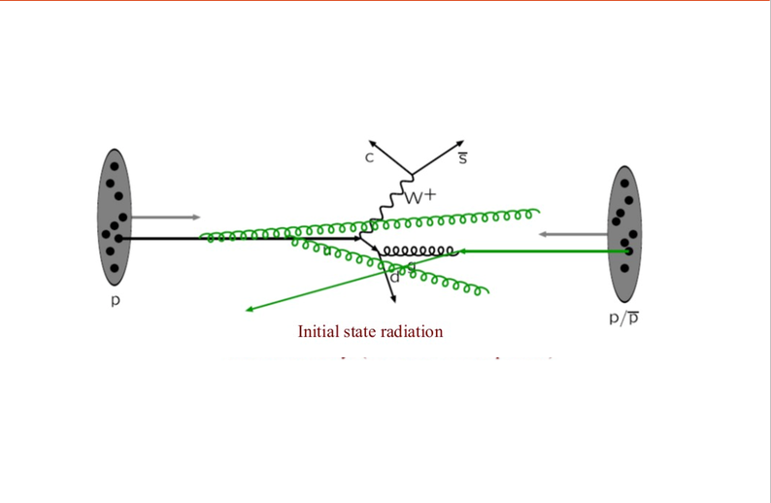
Proton-proton collisions
p
p
Initial state radiation (ISR)

Slide 34
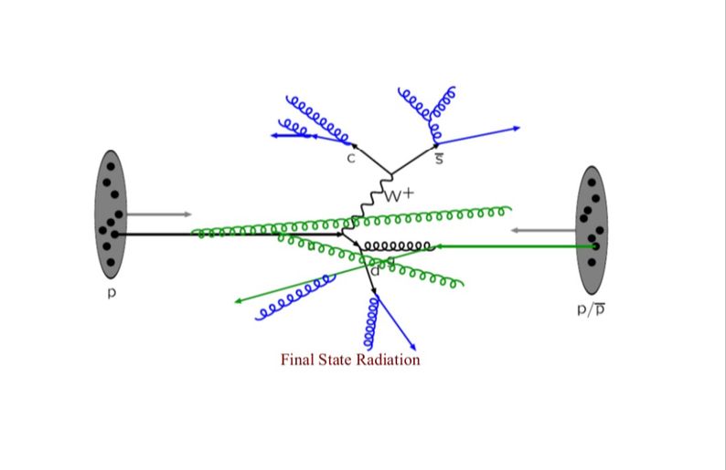
Proton-proton collisions
p
p
Final state radiation (FSR)

Slide 35
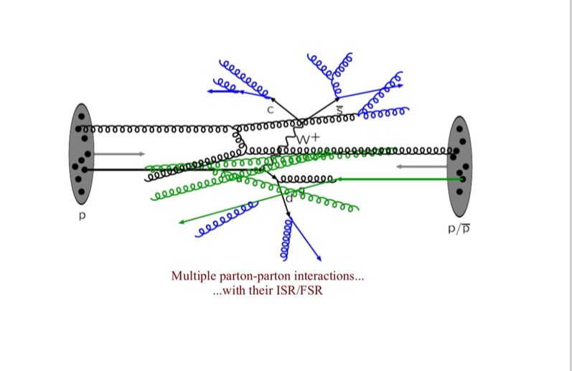
Proton-proton collisions
p
p
Multiple parton/parton interactions ... … with their ISR and FSR

Slide 36
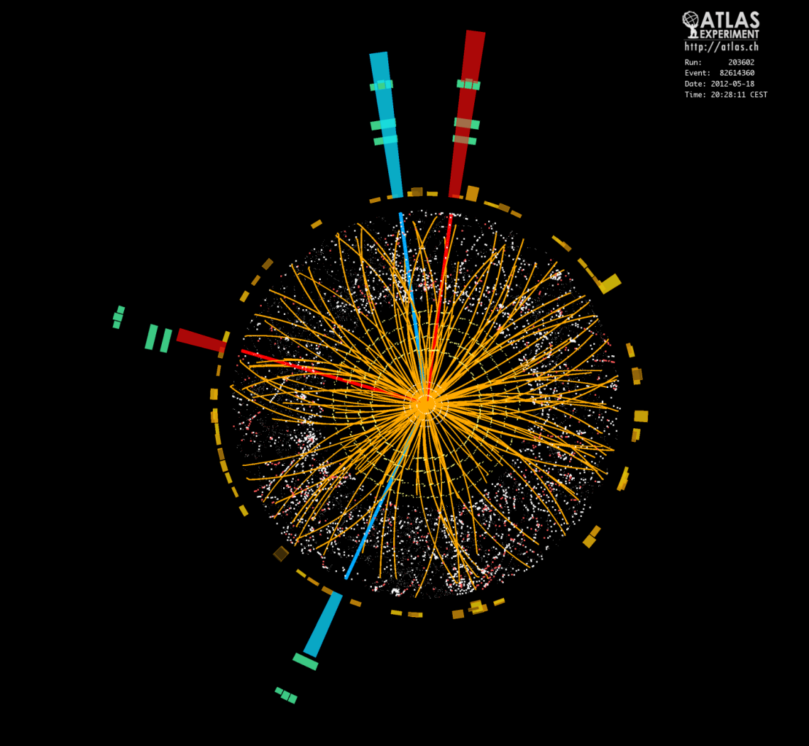
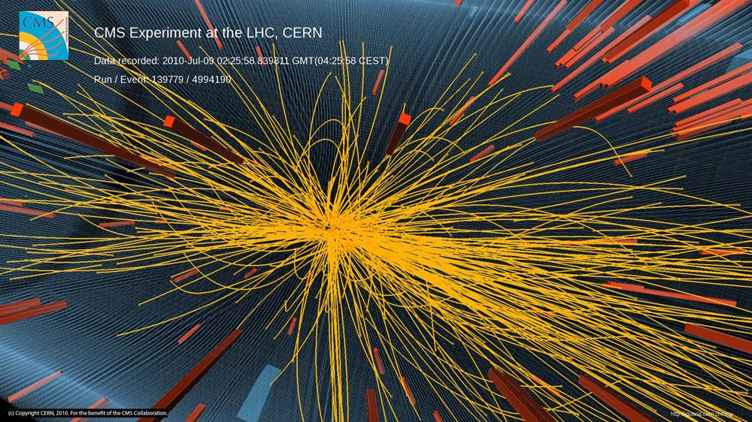
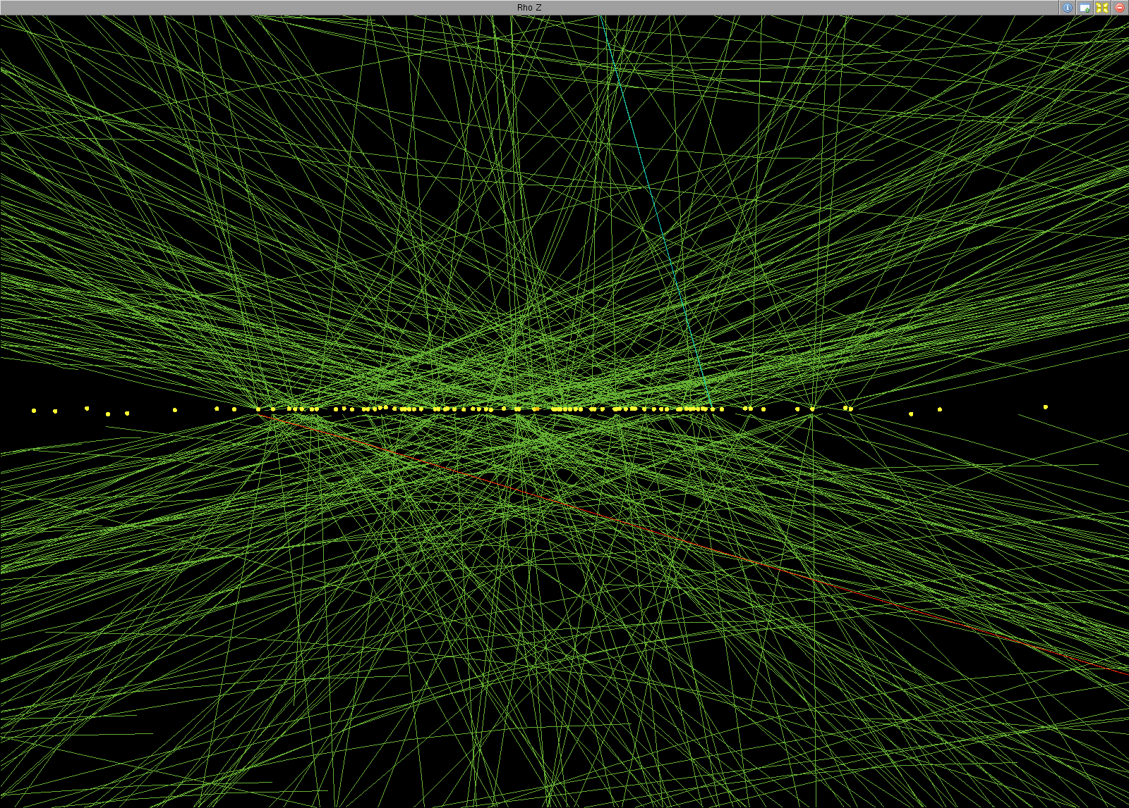
Events at LHC
and pileup …
Notes:
All this lead to complicated events at hadrons colliders, many particles produced, many tracks, jets in the caorimeters
In addition to the previous cartoon there is also more than one pp interaction per bunch crossing (all what I described before corresponded to a single pp collision)

Slide 37
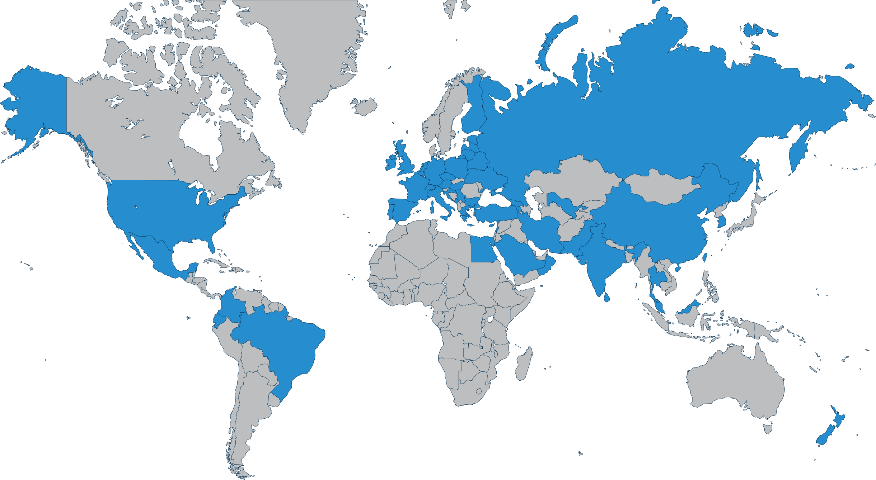
Experimental collaborations
CERN
The membership of the CMS collaboration is currently 229 institutes and 51 countries
~3000 physicists (including ~1000 students) ~1300 engineers and technicians

Slide 38
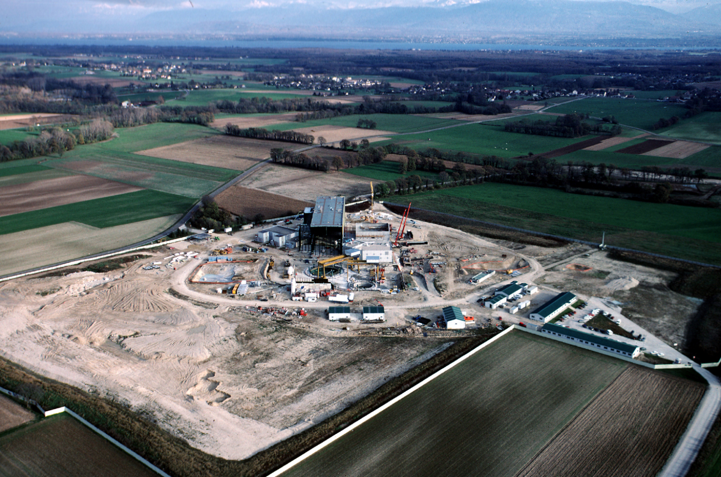
CMS P5 construction (1998-2005)
It took ~10 years to construct the CMS cavern underground and the CMS detector. Infrastructure construction at P5 at Cessy starting in 1998.
Notes:
Geneva lake at the back

Slide 39
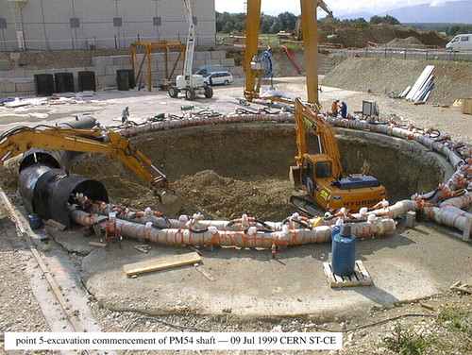
CMS P5 construction (1998-2005)
Unlike ATLAS that was built in situ, CMS was designed in modules to be assembled on the surface and lowered down through a ~100m deep 22m diam. shaft
Notes:
1999: start of shaft excavation, ~100m deep, 22m diameter. There is another shaft for services.
Shaft = fosse, grand puits

Slide 40
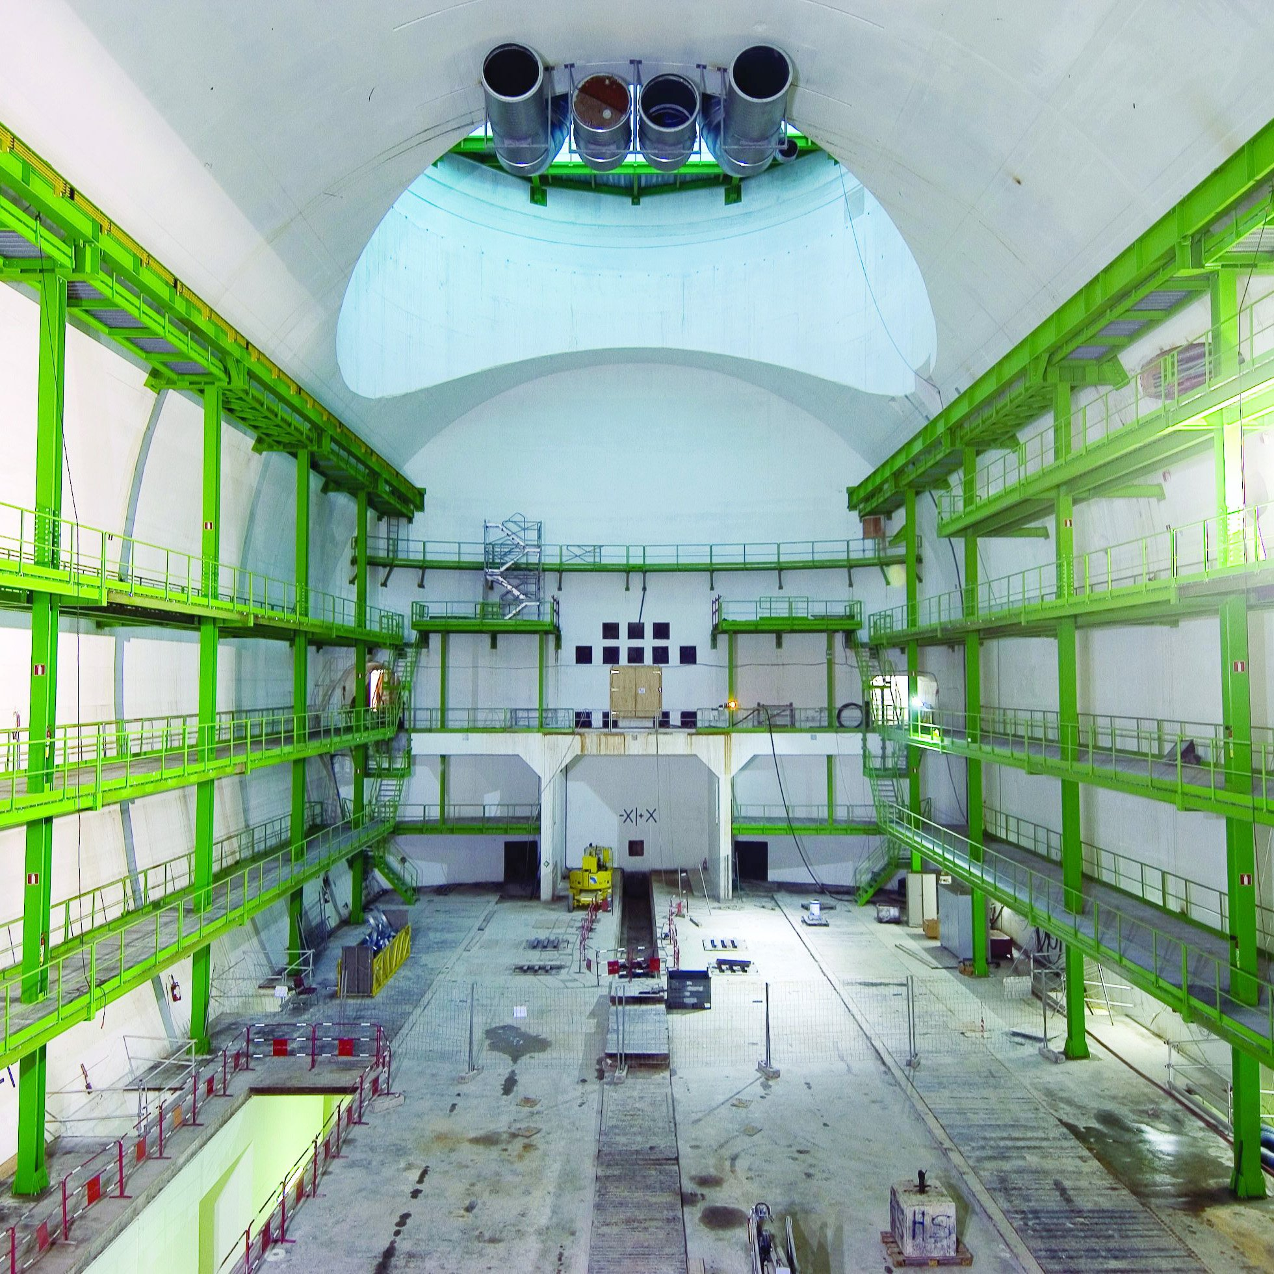
CMS P5 construction (1998-2005)
CMS cavern ready to receive the detector (2005)
Notes:
2005: CMS cavern at P5 finalized

Slide 41
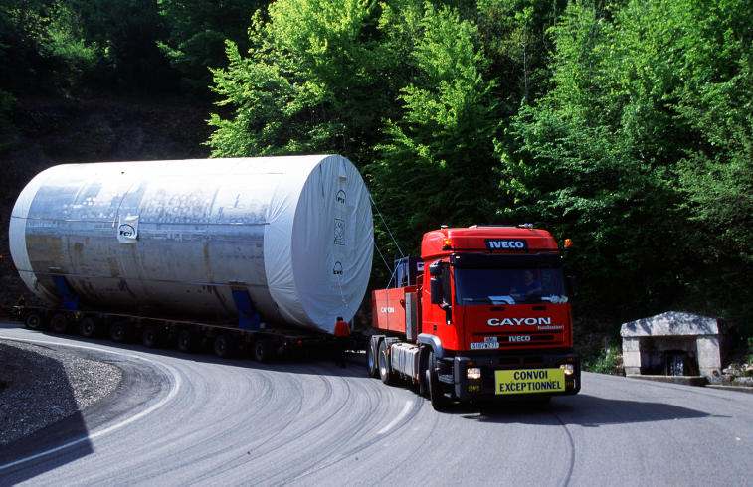
CMS construction (2001-2008)
Transport of the vacuum tank of the CMS solenoid at P5 (2001). 1 week was necessary to transport it from Long-le-Saugnier (France) to Cessy CERN P5 (120km)
Notes:
CMS solenoid supra at 4K
I SHOULD BE ABOUT TO STOP HERE

Slide 42
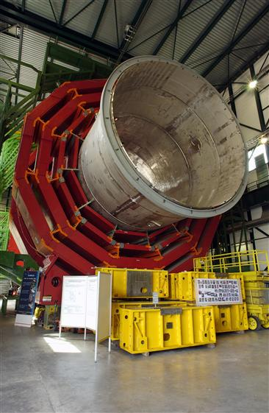
CMS Installation (2001-2008)
CMS magnet assembly. The vacuum tank consists of inner and outer stainless-steel cylinders and houses the superconducting coil (4K)
Notes:
CMS magnet assembly. The vacuum tank consists of inner and outer stainless-steel cylinders and houses the superconducting coil.

Slide 43
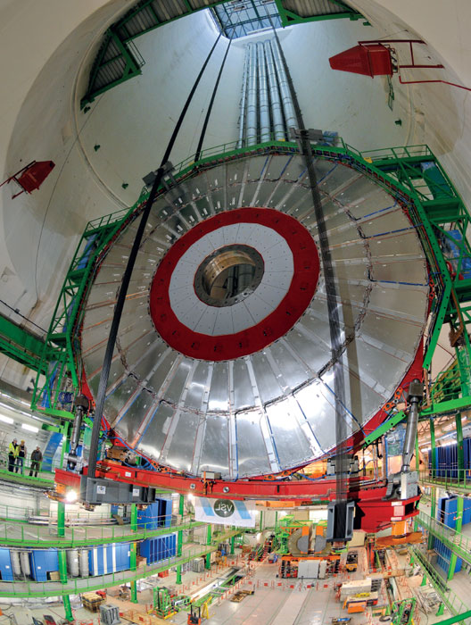
CMS Installation (2001-2008)
The first endcap disk of the magnetic field return-yoke, equipped with the endcap muon chambers is being lowered through the shaft!
Notes:
Magnet divided in 5 barrel pieces + 3 endcaps pieces at each end, each assembled on surface and lowered through the shaft.

Slide 44
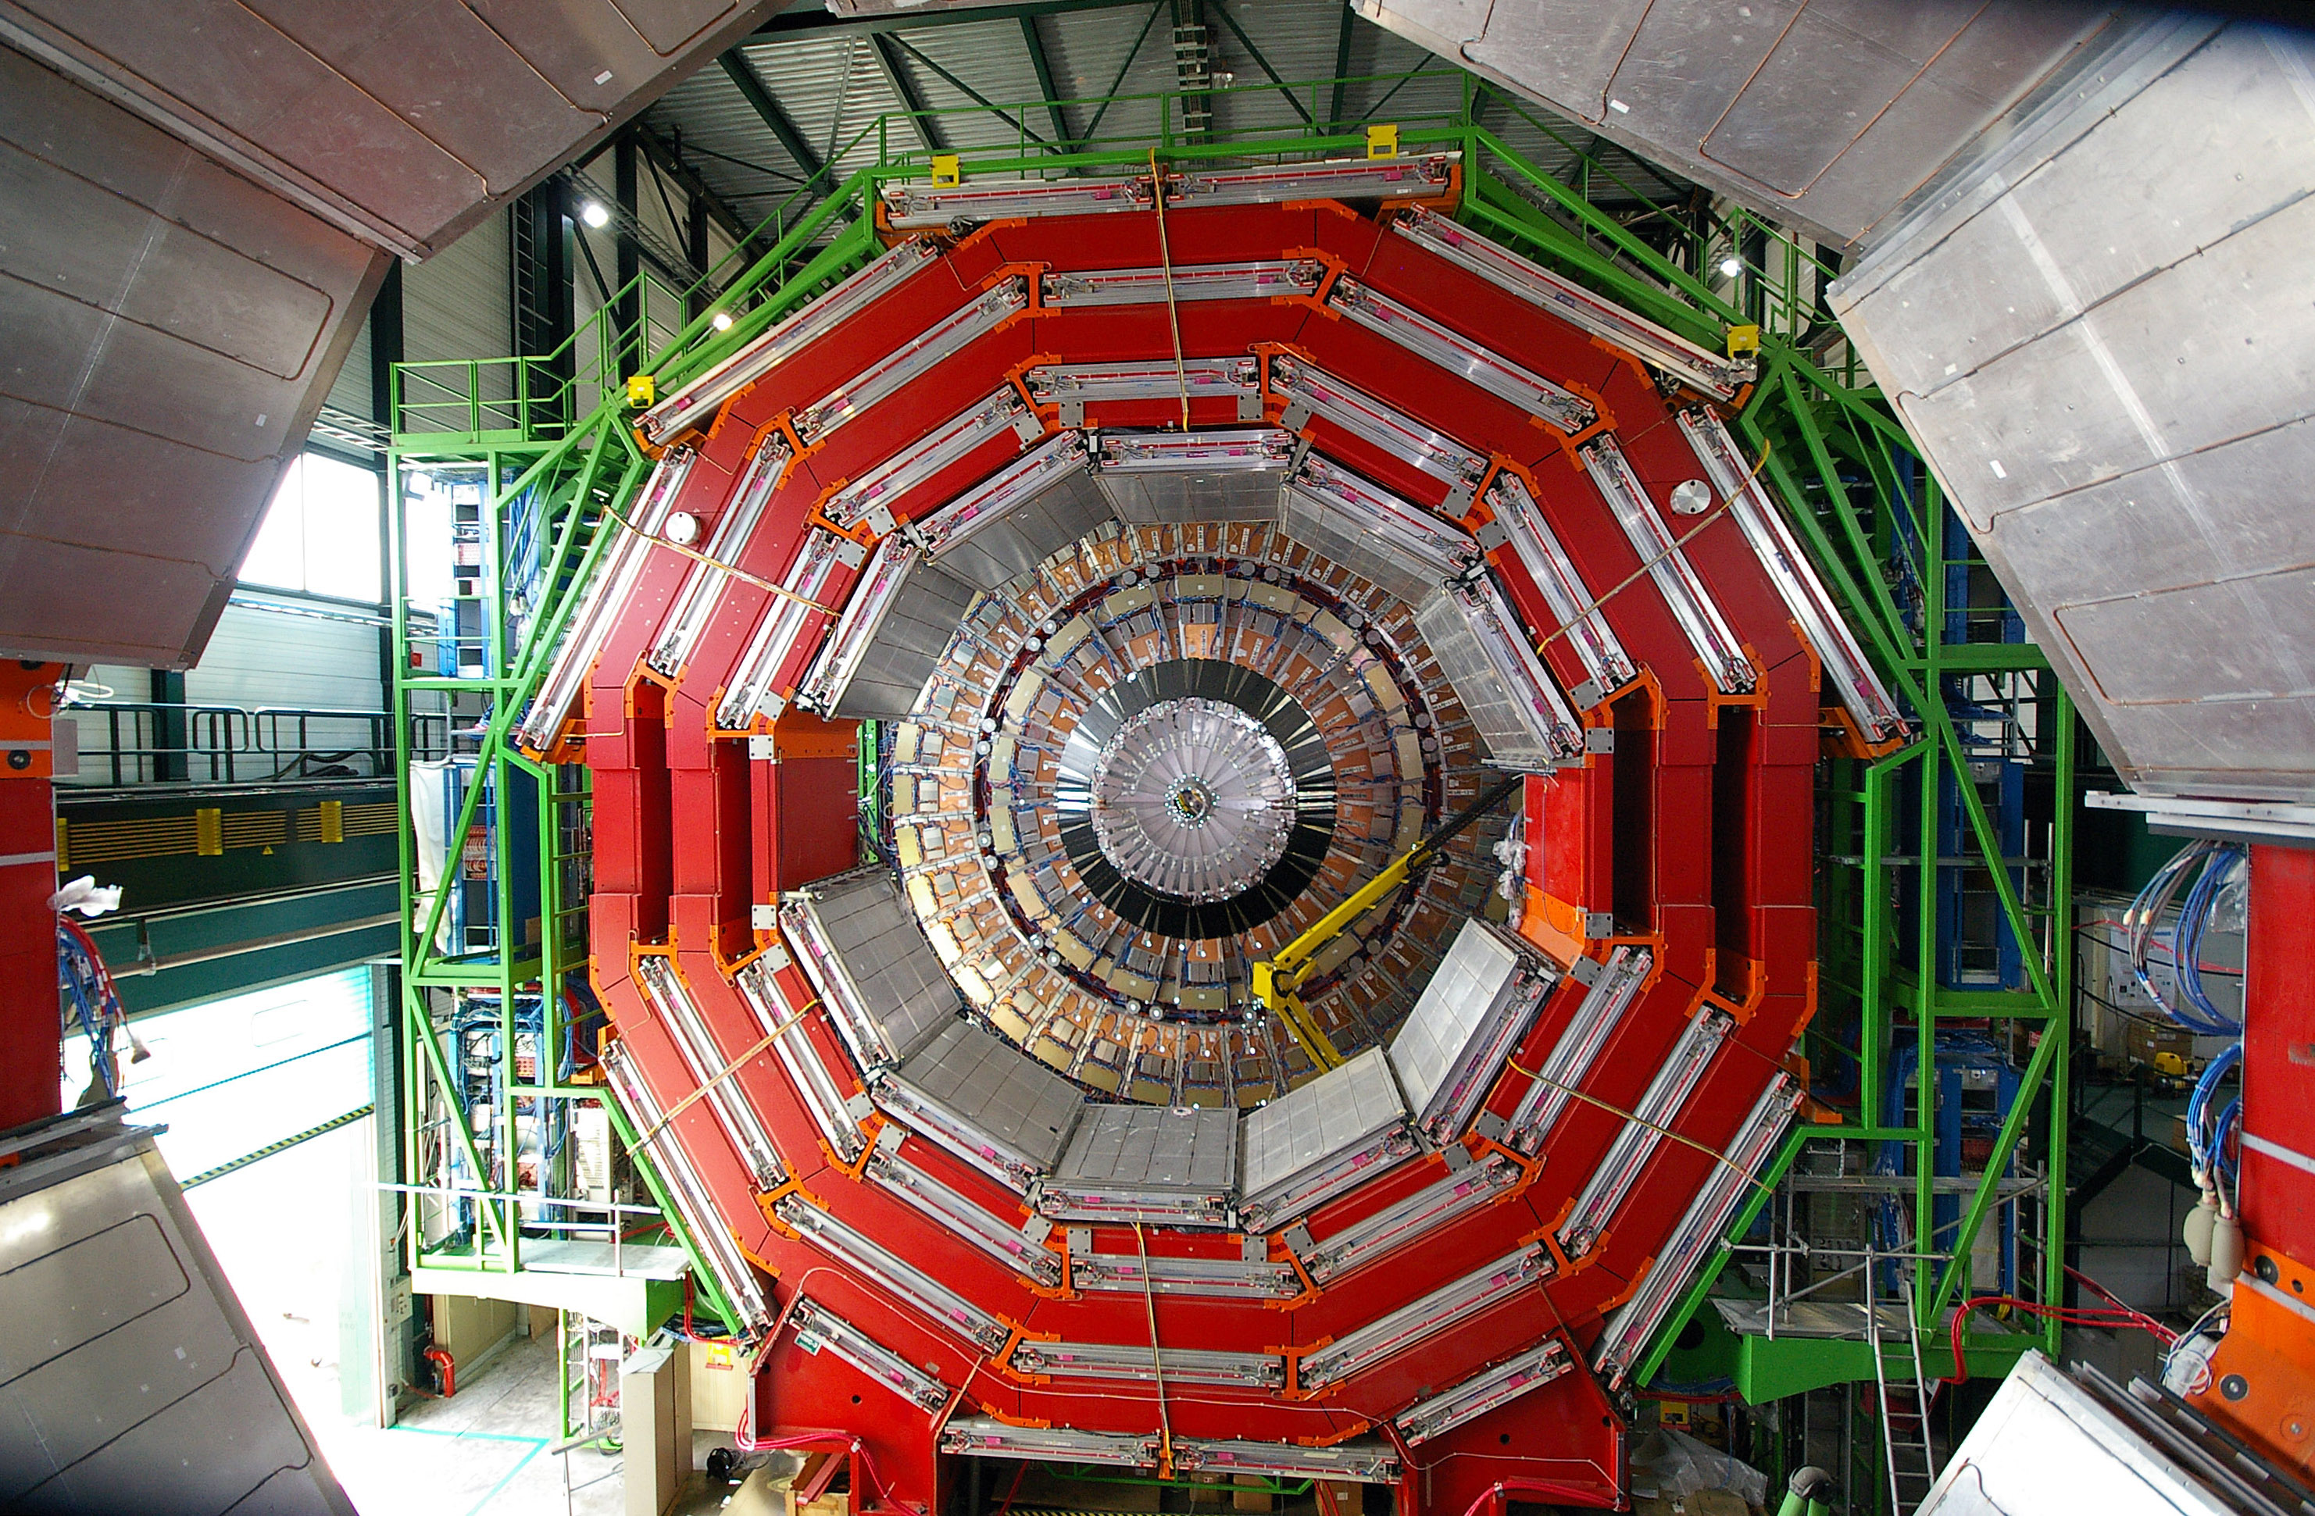
CMS Installation (2001-2008)
Assembly of the magnet and muon chambers in the central part
Notes:
We see the endcap equipped with muon chambers at the rear

Slide 45
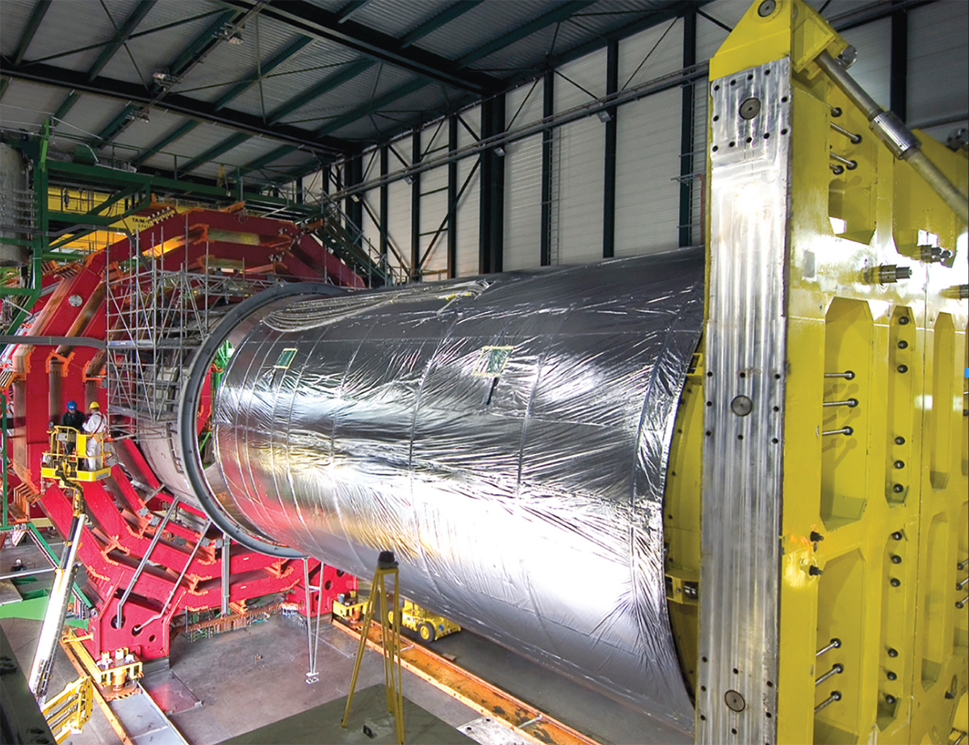
CMS Installation (2001-2008)
The solenoid is being installed inside the cryostat
Notes:
The solenoid about to be installed inside the cryostat

Slide 46
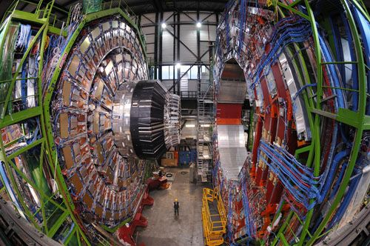
CMS Installation (2001-2008)
CMS ready and closing before filling the LHC with the beams
Notes:
12 000 tonnes, 12 m

Slide 47
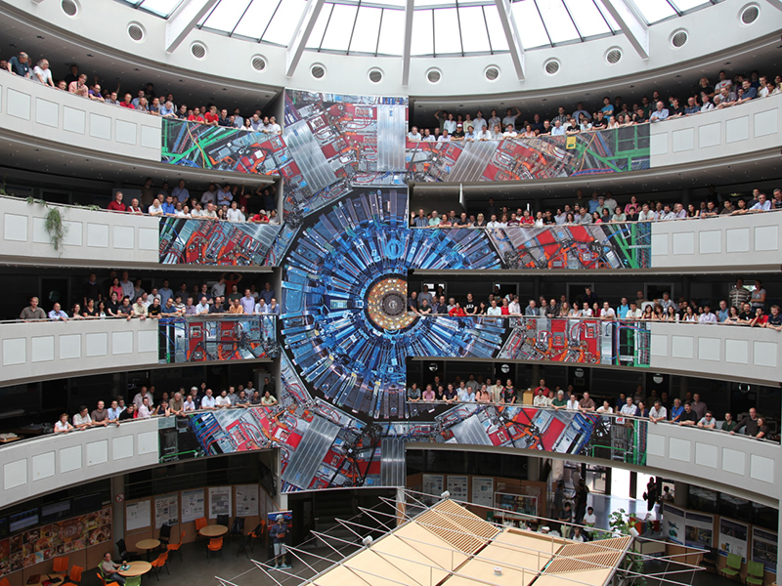
Bdg.40 at CERN

Slide 48
The Higgs boson: from concept to discovery
C. Charlot, LLR-École polytechnique, CNRS&IN2P3
Univ. Split, Split, January 2021
Notes:
Presenting myself, decade of search for the Higgs boson

Slide 49
From concept to discovery
Why a Higgs boson?
How did we search for and finally discover it?
Status of current experimental measurements / knowledge
What’s next?
Notes:
At the end of this lecture I hope you will understand all this better, why it took decades to find it and also why it is so important

Slide 50
CMS Installation (2001-2008)
CMS ready and closing before filling the LHC with the beams
Notes:
12 000 tonnes, 12 m

Slide 51
While CMS is being constructed ..
2003
2003
Many channels to look for, depending on Higgs mass
H → ZZ → 4l has high discovery potential, except for m_{H}<120 and m_{H}~170 GeV
1998
Realized very early that the efficiency of leptons detection would be the limited factor at low m_{H}
Additional pb of electron bremsstrahlung in the tracker material
And also internal bremsstrahlung, see later..
Notes:
We were lucky enough that mH not <~120 GeV has it would have then be first found in gg
It took much less than initially anticipated to discover the Higgs boson
Higher x section (NLO corrections)
Low pT effort
Background and efficiencies from data

Slide 52
Higgs production at LHC
Main Higgs roduction processes at the LHC
Notes:
Main production mechanisms (there are others)
Final version in 2012m we did not have these calculations before.

Slide 53
Higgs decay at LHC
Many decay channels accessible for m_{H}=125 GeV
(could have been very different..)
Notes:
Many decay channels accessible for a Higgs at a mass of 125 GeV
Could have been very different

Slide 54
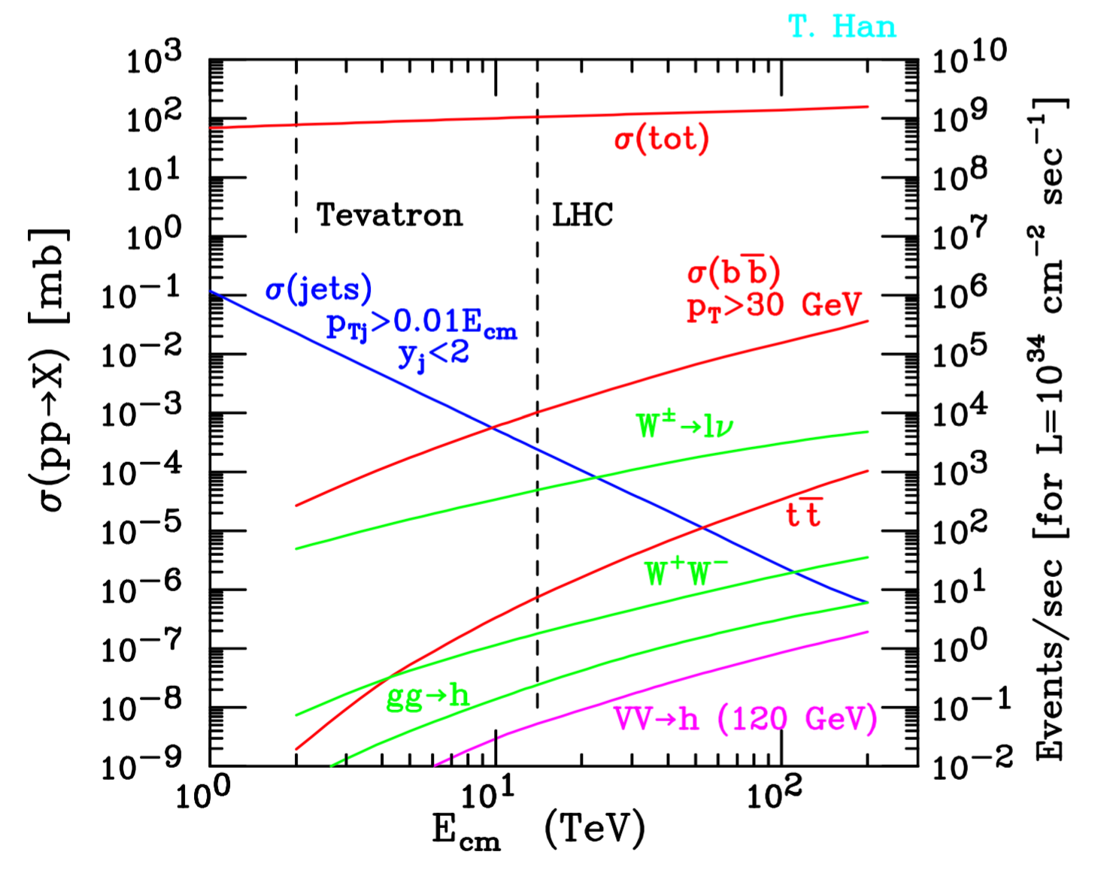
Higgs events do not come alone..
High collision rate needed to produce enough Higgs events: ~10⁹ interactions /sec
Corresponds to σ_{tot}~100mb
b-quark (B factory)
W±→l±ν, Z⁰→ll, tt, dibosons, Higgs in gluon fusion, in VBF
Rates increase with energy
Higgs rather copiously produced, ~0.1/sec, the problem is to identify it from the many other processes
→ need to look for rare decays with less backgrounds: e.g.. H→ZZ→llll with H→ZZ and Z→ll ~ 3% at m_{H}=125 GeV)
Notes:
Signal doesn’t come alone at LHC
All rates are increasing with energy (except jets but is because there is a cut in fraction of Ec.m.)
Total ~10^9 interactions/sec <-> ~100mb
then b quark production (B factory)
then W->lnu and Z->ll, ttbar, dibosons, Higgs in gluon fusion and Higgs in VBF
- You notice that Higgs is copiously produced, ~0.1/s, but the problem is to identify it from the many other processes => need to look for rare decays that have less background

Slide 55
The H → ZZ^{(*)} → 4l channel
Simple analysis: search for a localized excess in the four-lepton mass spectrum
Higgs signal
Background from non-resonant production
+ reducible background from WZ+jet, Z+2jets where 1,2 jets fake a lepton
Among the cleanest channels (S/B~1) over a wide mass range (m_{H}=120-800 GeV)
But low yield from small BR(Z → ll)
=> should maximize detection efficiency, in particular at low m_{H}
Notes:
Mass region was defined a priori before looking at the data
Most important: background is extracted from data, almost no use of MC in this analysis => very robust
Preapproval means strategy fully defined

Slide 56
The H → ZZ^{(*)} → 4l channel
Select events with 4 leptons (e or μ), compatible with two Z^{(*)}
Two opposite-sign same-flavour pairs with mass compatible with m_{Z}
signal
m_{ll}
Reject (reducible) WZ+jet and Z+2jets backgrounds where jet(s) fake(s) lepton(s) by requiring well identified and isolated leptons
Data-driven methods
Efficiency from Z → ll, WZ+jet and Z+jets backgrounds from data
Analysis blind to the mass spectrum in the search region up to preapproval and until efficiencies and background composition checked
Notes:
Mass region was defined a priori before looking at the data
Most important: background is extracted from data, almost no use of MC in this analysis => very robust
Preapproval means strategy fully defined

Slide 57
A Higgs → 4l candidate event
Notes:
Get m1 and m2 for this event
We collect event and then the analysis is statistical, we don’t claim discovery with 1 event

Slide 58
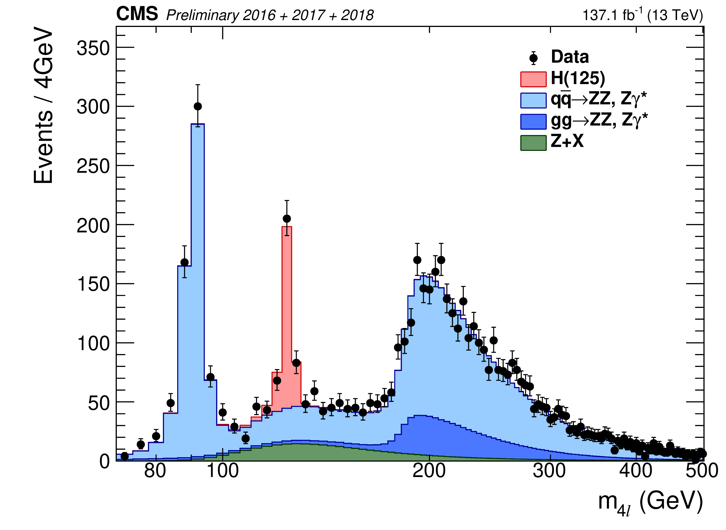
The growing signal
At the beginning only fluctuations here and there => more data needed!
Oct.2011
Dec.2011
End 2018
Jul.2012
End 2013
Accumulating data the signal started to show up, discovery announced in 2012 (together with other channels).Now the resonance is there and will stay forever
Notes:
Started with 7 TeV beams in 2010-2011
Then 8 TeV in 2012
Discovery in July 2012 with 5.1fb at 7 TeV and 5.3fb at 8 TeV

Slide 59
Intermediate summary
Higgs search started at LEP and Tevatron
The LHC machine was built in particular to find the Higgs boson
This involved very large collaborations, ending up with different concepts for the detectors
After long R&D and test beams to define and characterised the new technologies to be used for the detectors, physicists moved to the preparation of the physics
The LHC started in 2009 after an incident on the magnets
Less than 3 years after the Higgs boson discovery was announced to the world in a CERN seminar
For those working directly on it, the excess of events was starting to build up since end 2011

Slide 60
HCP (nov.) 2011
1.1-1.7/fb in the combination from data up to summer
~5/fb planed by end of the year
CMS and ATLAS preparing for discovery
Agreement not to show updated result at HCP
And to prepare a combination
Results with the entire 2011 datasets to be shown at CERN jamboree in December

Slide 61
HCP (nov.) 2011
>~2σ fluctuations at ~119 GeV and 140 GeV, but not significant
That at ~119 GeV with rate consistent with expectation from SM Higgs…
Full 2011 dataset being analyzed with x3-5 more statistics
Exciting times ahead!

Slide 62
CERN december ‘11 jamboree
H → ZZ → 4l
H → γγ
Mis-calibration pb? FSR?
Claude, are you there?
(phys. plenary meeting, Dec.1)
Notes:
Dec.1
Can anything shift the peak in the 4l case?
Miscalibration?
FSR?

Slide 63
6 months later and ~3 months of 8 TeV data added
Discovery announced at CERN
Notes:
The LHC restarted on april 2012 after the usual EOY shutdown
~3months of datataking (april-june) -> discovery announcement at CERN
You can see some familiar face
With adding ~2 months of running at 8 TeV
Let’s analyse what was shown at this moment

Slide 64
The Higgs discovery results
Modelling of the non- resonant ZZ (irreducible) background
Data point and its statistical uncertainty
Modelling of the Z+jets (reducible) background
Modelling of H→ZZ→4l signal
Around 125 GeV, 7 events in excess of backgrounds’ predictions, compatible with expectation from a Higgs signal. Is it enough? Need to quantify…
Notes:
HZZ4l mass spectrum at discovery time
KD in the inset, will talk on this later on
Data points are compared to a model of S+B
Not an adjustment (no free parameters)
Small excess at !25 GeV

Slide 65
The Higgs discovery results
KD discriminant: P(S)/P(S)+P(B)
K_{D}=1: signal-like
K_{D}=0: bkgd.-like
Built from expected kinematics of the two processes (ME)
Beyond 1D one can look at more observables: here KD is optimized to separate Higgs signal from non resonant ZZ production (blue background)
Some events around the mass of the excess cluster at high KD values ⬄ more signal like
Notes:
KD = P(S)/(P(S)+P(B))

Slide 66
The Higgs discovery results
Remind: simple counting experiment, ΔN=sqrt(N) (only in the region of large N, else ΔN>sqrt(N))
In the signal and background regions, observed yields are compatible with expectations from S+B in all subchannels 4e/2e2mu/2mu2e/4mu
Are they incompatible with expectations from B only?

Slide 67
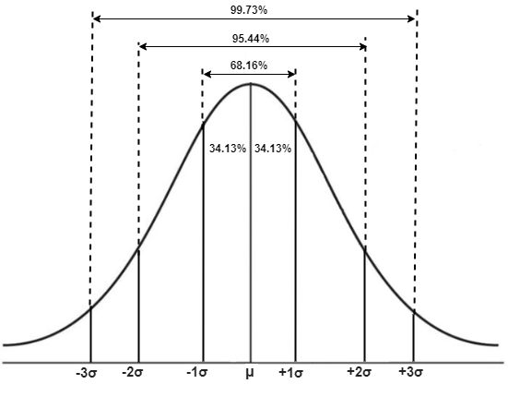
The Higgs discovery results
Probability that B accounts for the observed yields
Significance
In the excess region the probability that B only accounts for the observed data is very low..
The probability is often translated in Gaussian equivalents: 2σ=~5%, 3σ<~1%, … Here p_{min}~7.10⁻⁴
Is this enough? No! HEP discovery requires 5σ, this is equivalent to p_{min}~0.3 per million for a false positive!!!
Notes:
P-value is actually a quantile, P(NB>=N)

Slide 68
More on Significance
Simple example: counting experiment
Assume we expect <N_{S}> signal events, <N_{B}> bkgd events
Both S and B fluctuate and we measure only the sum: N_{data}=N_{S}+N_{B}
Actual N_{S} and N_{B} in the measurement are unknown
Approximate (Gaussian) significance:
Exp.: significance = <N_{S}>/ΔN_{B} = <N_{S}>/sqrt(<N_{B}>)
Obs. Significance = (N_{data}-<N_{B}>)/ΔN_{B} = (N_{data}-<N_{B}>)/sqrt(<N_{B}>)
N
<N_{S}>
<N_{B}>
Only valid when N_{S} and N_{B} are high (>~10) for ΔN=sqrt(N) to apply

Slide 69
A better significance: log-likelihood ratio
Likelihood function L measures the goodness of a fit to the data (N)
For Poisson probability, L is exp(-λ)λ^{N}, where λ = <N> is the expectation (from model)
L for bkgd is exp(-<N_{B}>) <N_{B}>^{N}
L for S+B is exp(-<N_{S}+N_{B}>) <N_{S}+N_{B}>^{N}
Likelihood ratio Q = exp(-<N_{S}+N_{B}>) <N_{S}+N_{B}>^{N} / exp(-<N_{B}>) <N_{B}>^{N}
so that Q = exp(-<N_{S}>) <N_{S}+N_{B}>^{N} / <N_{B}>^{N}
and lnQ = -<N_{S}> + N ln (1+<N_{S}>/<N_{B}>)
Significance = ⎷(-2lnQ)
Exp. Significance: lnQ = -<N_{S}> + <N_{S}+N_{B}> ln (1+<N_{S}>/<N_{B>})
Many bins:
L = Π L_{i} (independent probabilities)
lnQ = -<N_{S}> + N Σ ln (1+<N_{S}>^{i}/<N_{B}>^{i})
Formula more accurate and easily extended to many (independent) channels/bins
Each channel/bin contributes with weight: ln (1+<N_{S}>^{i}/<N_{B}>^{i})
Formalism also allows to include systematic uncertainties (not discussed here)

Slide 70
The Higgs discovery results
Combining with the other channels (and in particular H→γγ), we now get 5σ
Each channel contribute with his own sensitivity
Note: the observed sensitivity (p-values) are shown here individually, comparison of channels performance should be based on expected sensitivity (Asimov dataset)

Slide 71
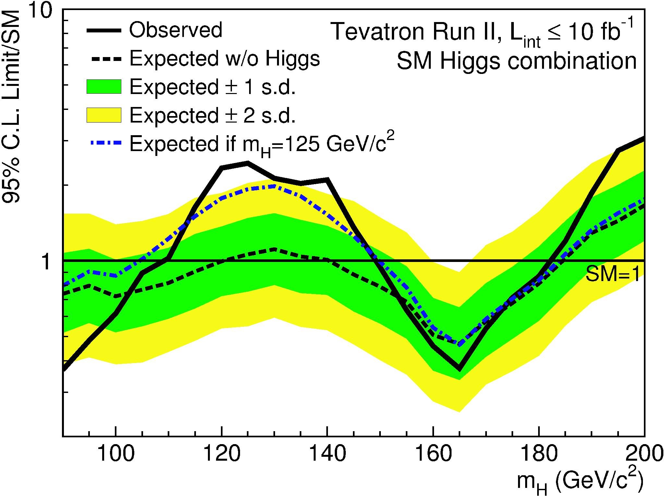
Tevatron results (2012)
Summer 2012
3σ excess around 125 GeV
Seems close to it but:
From 3σ → 5σ needs, lumi x3 (w/o syst.) => +20 years
Measurement had large systematic uncertainties
Knowing the mass to look for always makes things much easier 😀

Slide 72
Interlude: the HX (no) discovery result
In mars 2019, a french immunologist and his team, who had forgotten their statistical lectures, pretended that HydroxyChloroquine (HQ) was able to cure Covid19
HQ treatment: 14 patients
HQ+Azythromicyn: 6 patients
Wants to measure benefit of treatments when <N_{B}> = ~80% (~90-95% if considering those patients in ICU, i.e. who need respiratory assistance)
Q: what is the p-value here assuming all the 6 patients treated with HQ+A got cured? Does it satisfies HEP discovery standards?
In low statistic processes one must be very careful before claiming a discovery
A background event can mimic a discovery, even if rare!
There is no other solution than to require a very low p-value, set based on the number of times you would have claimed wrongly for a discovery
5σ is the adopted convention in HEP (though there are some physicists arguing it is not sufficiently low..)

Slide 73
Part 3: Current status and next steps
Notes:
Physics at hadrons colliders

Slide 74
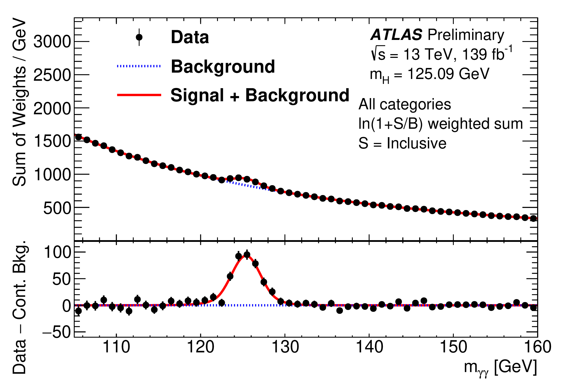
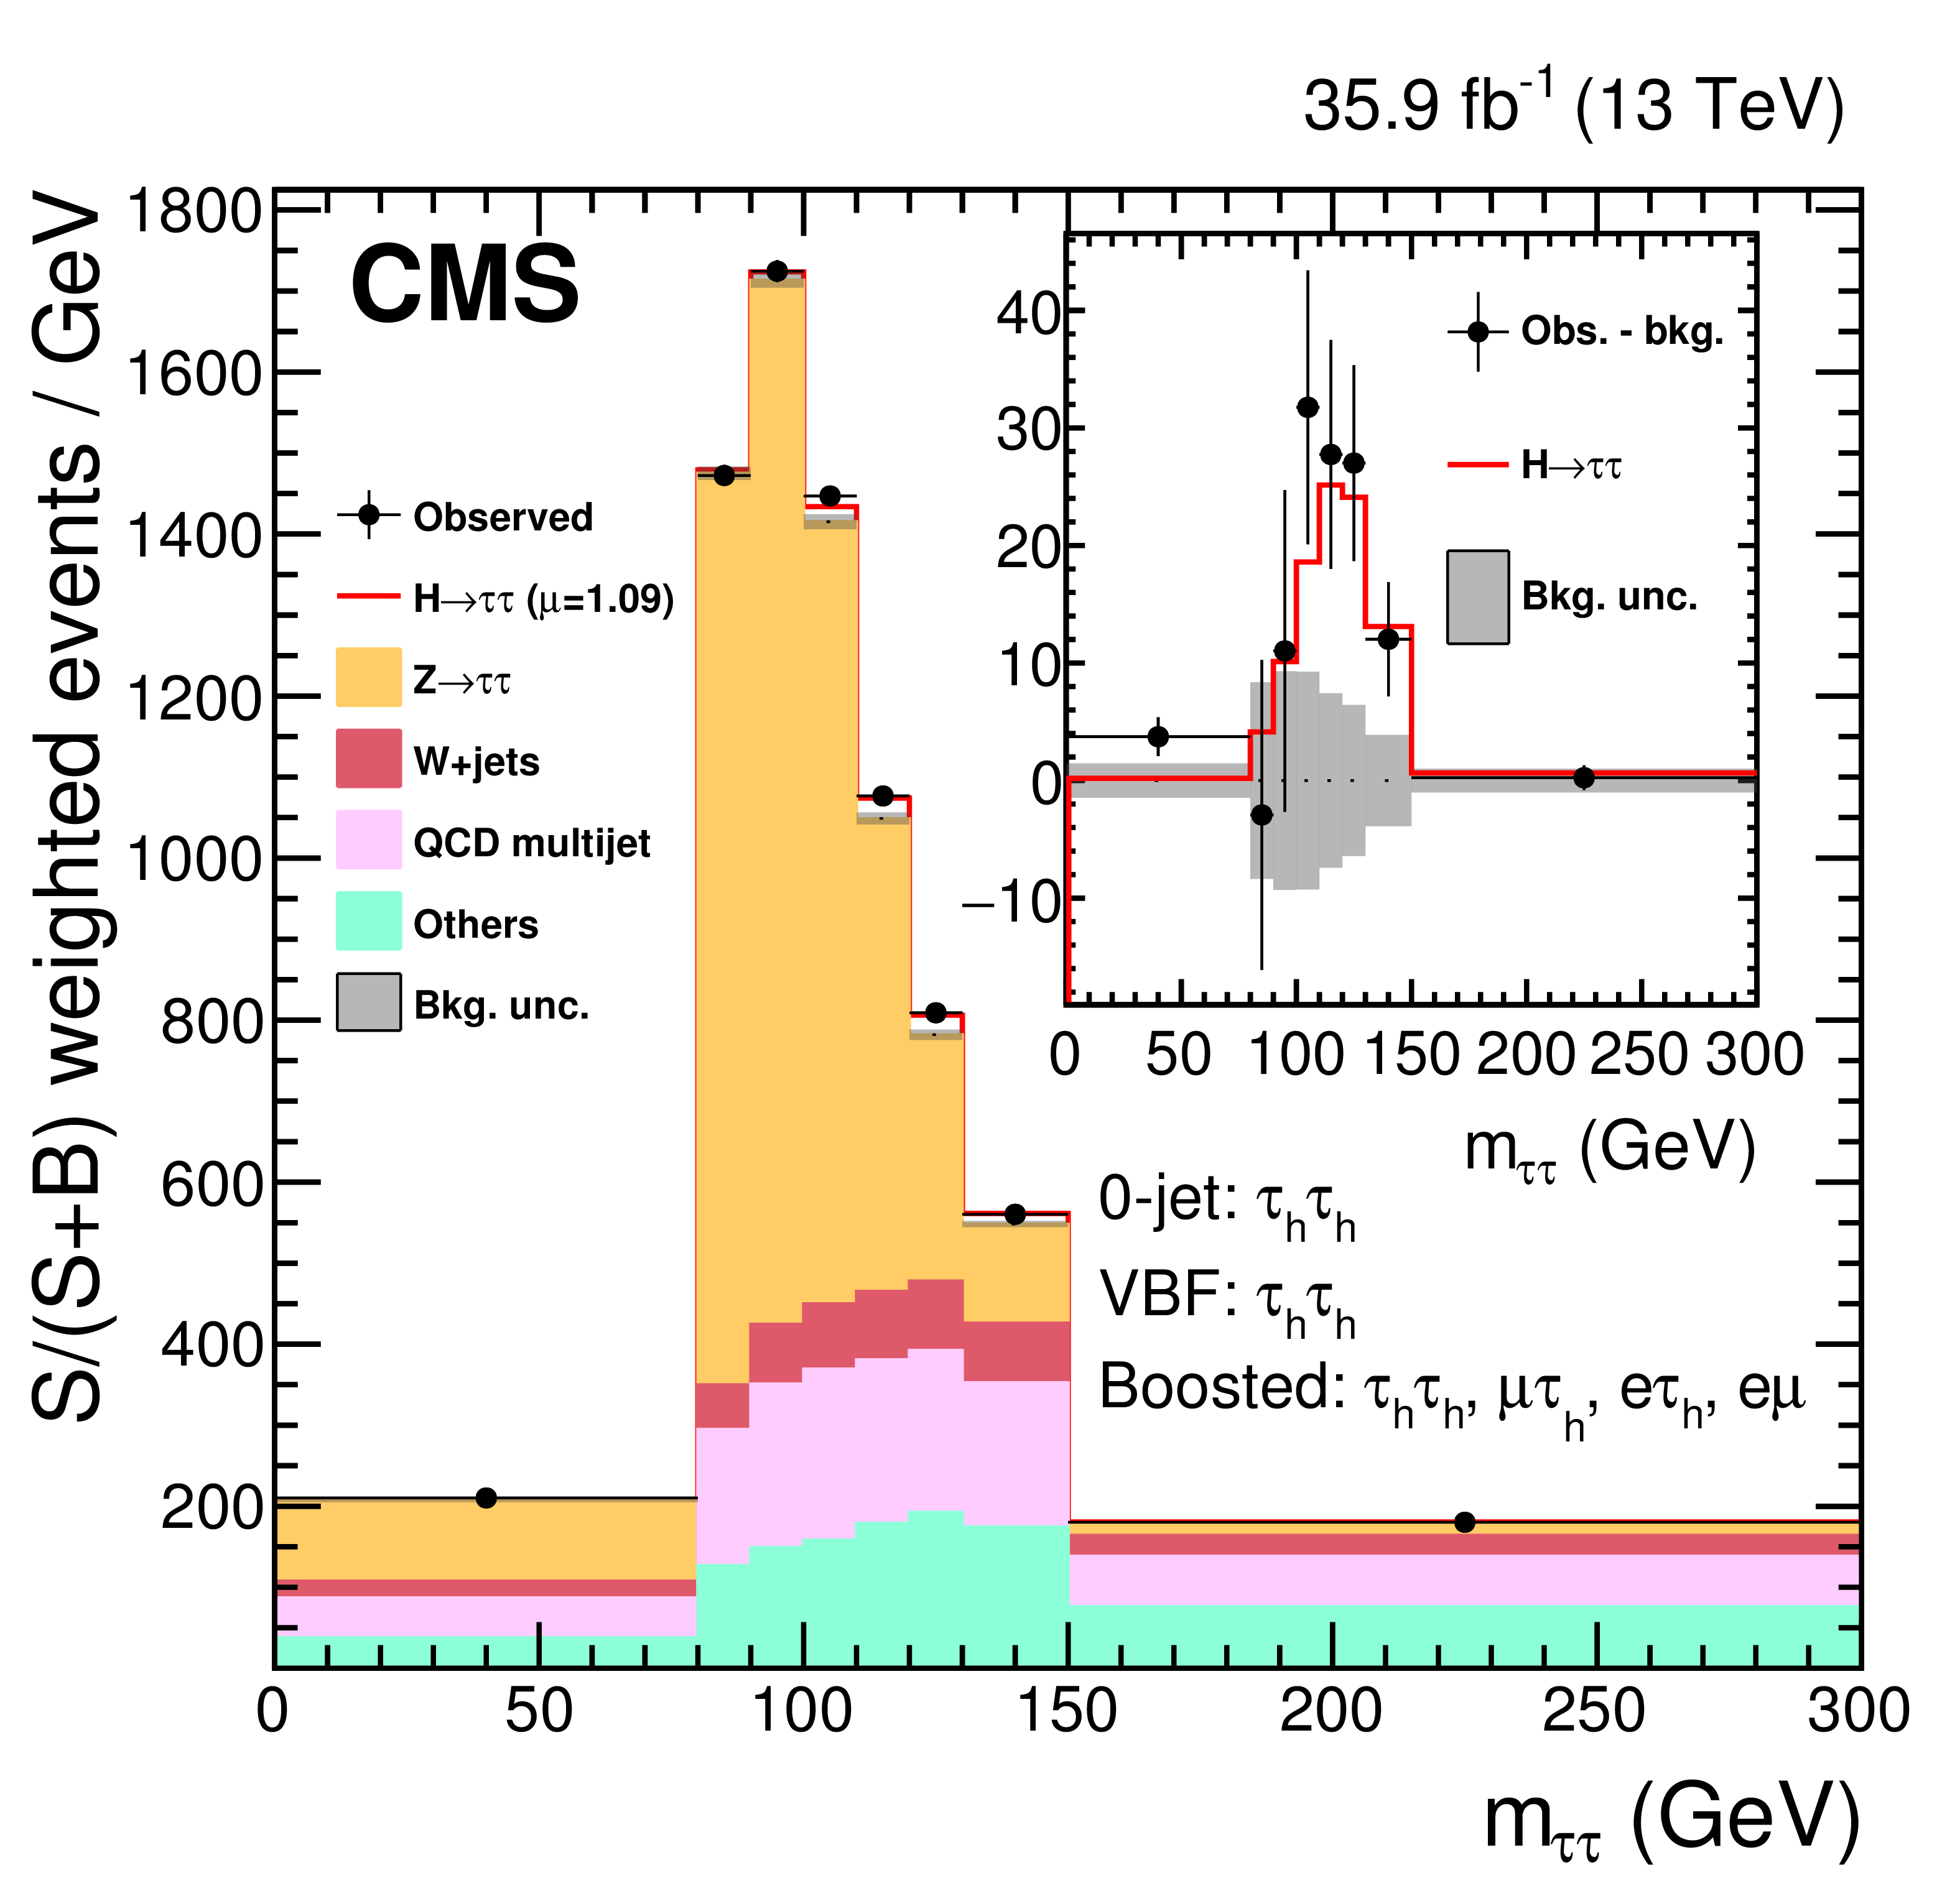
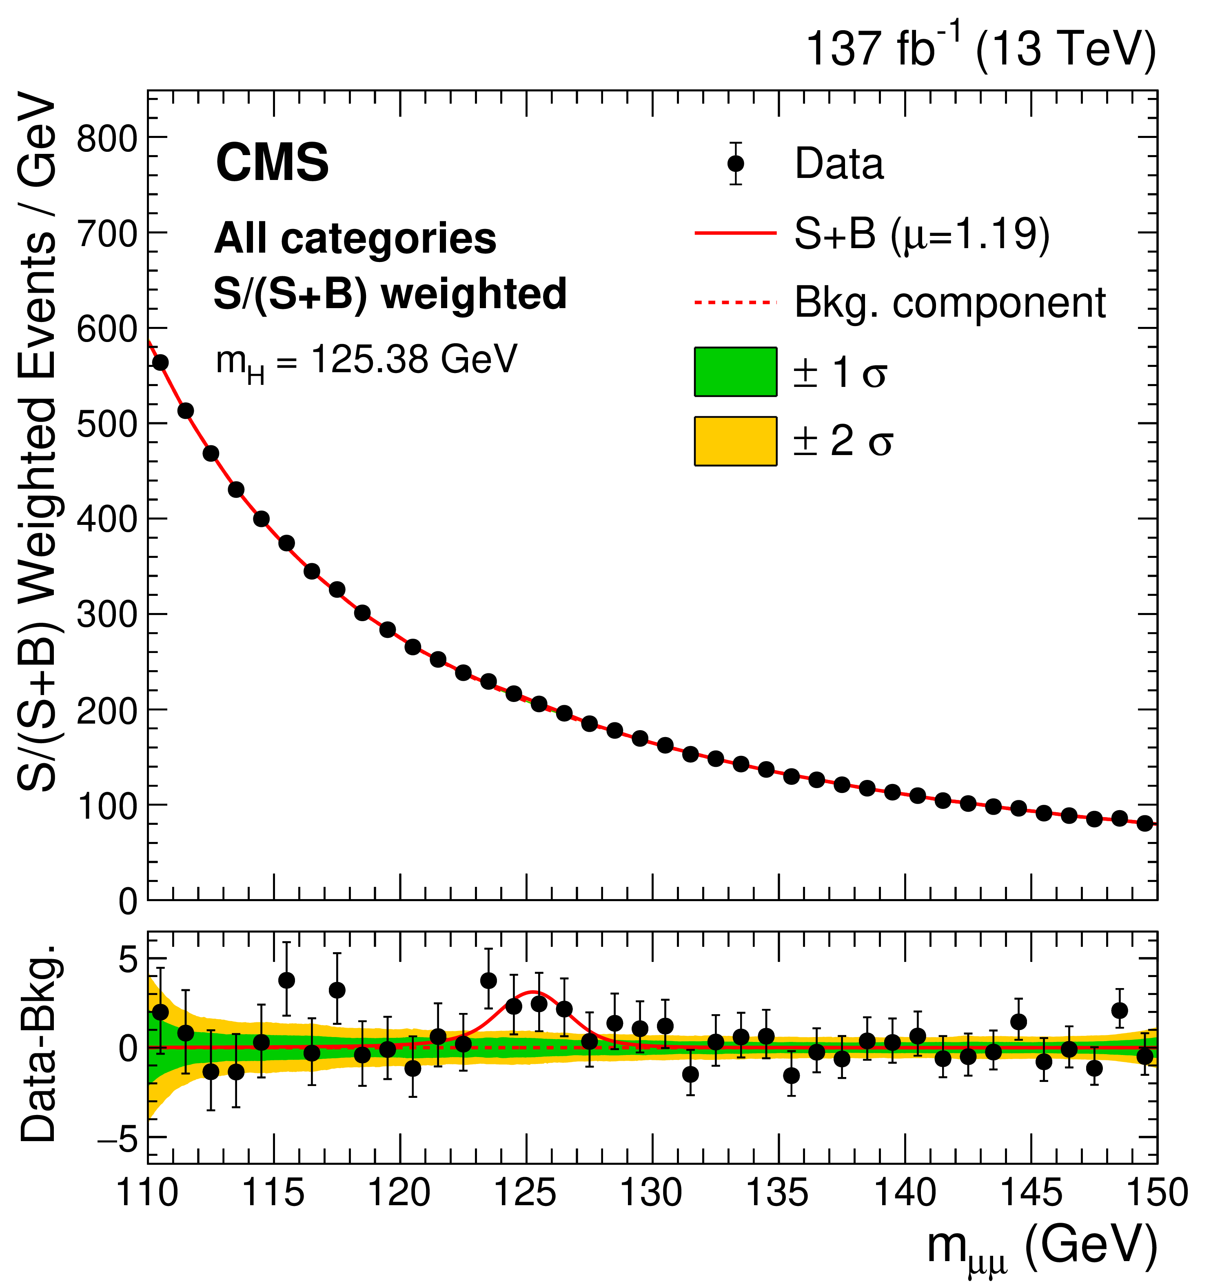
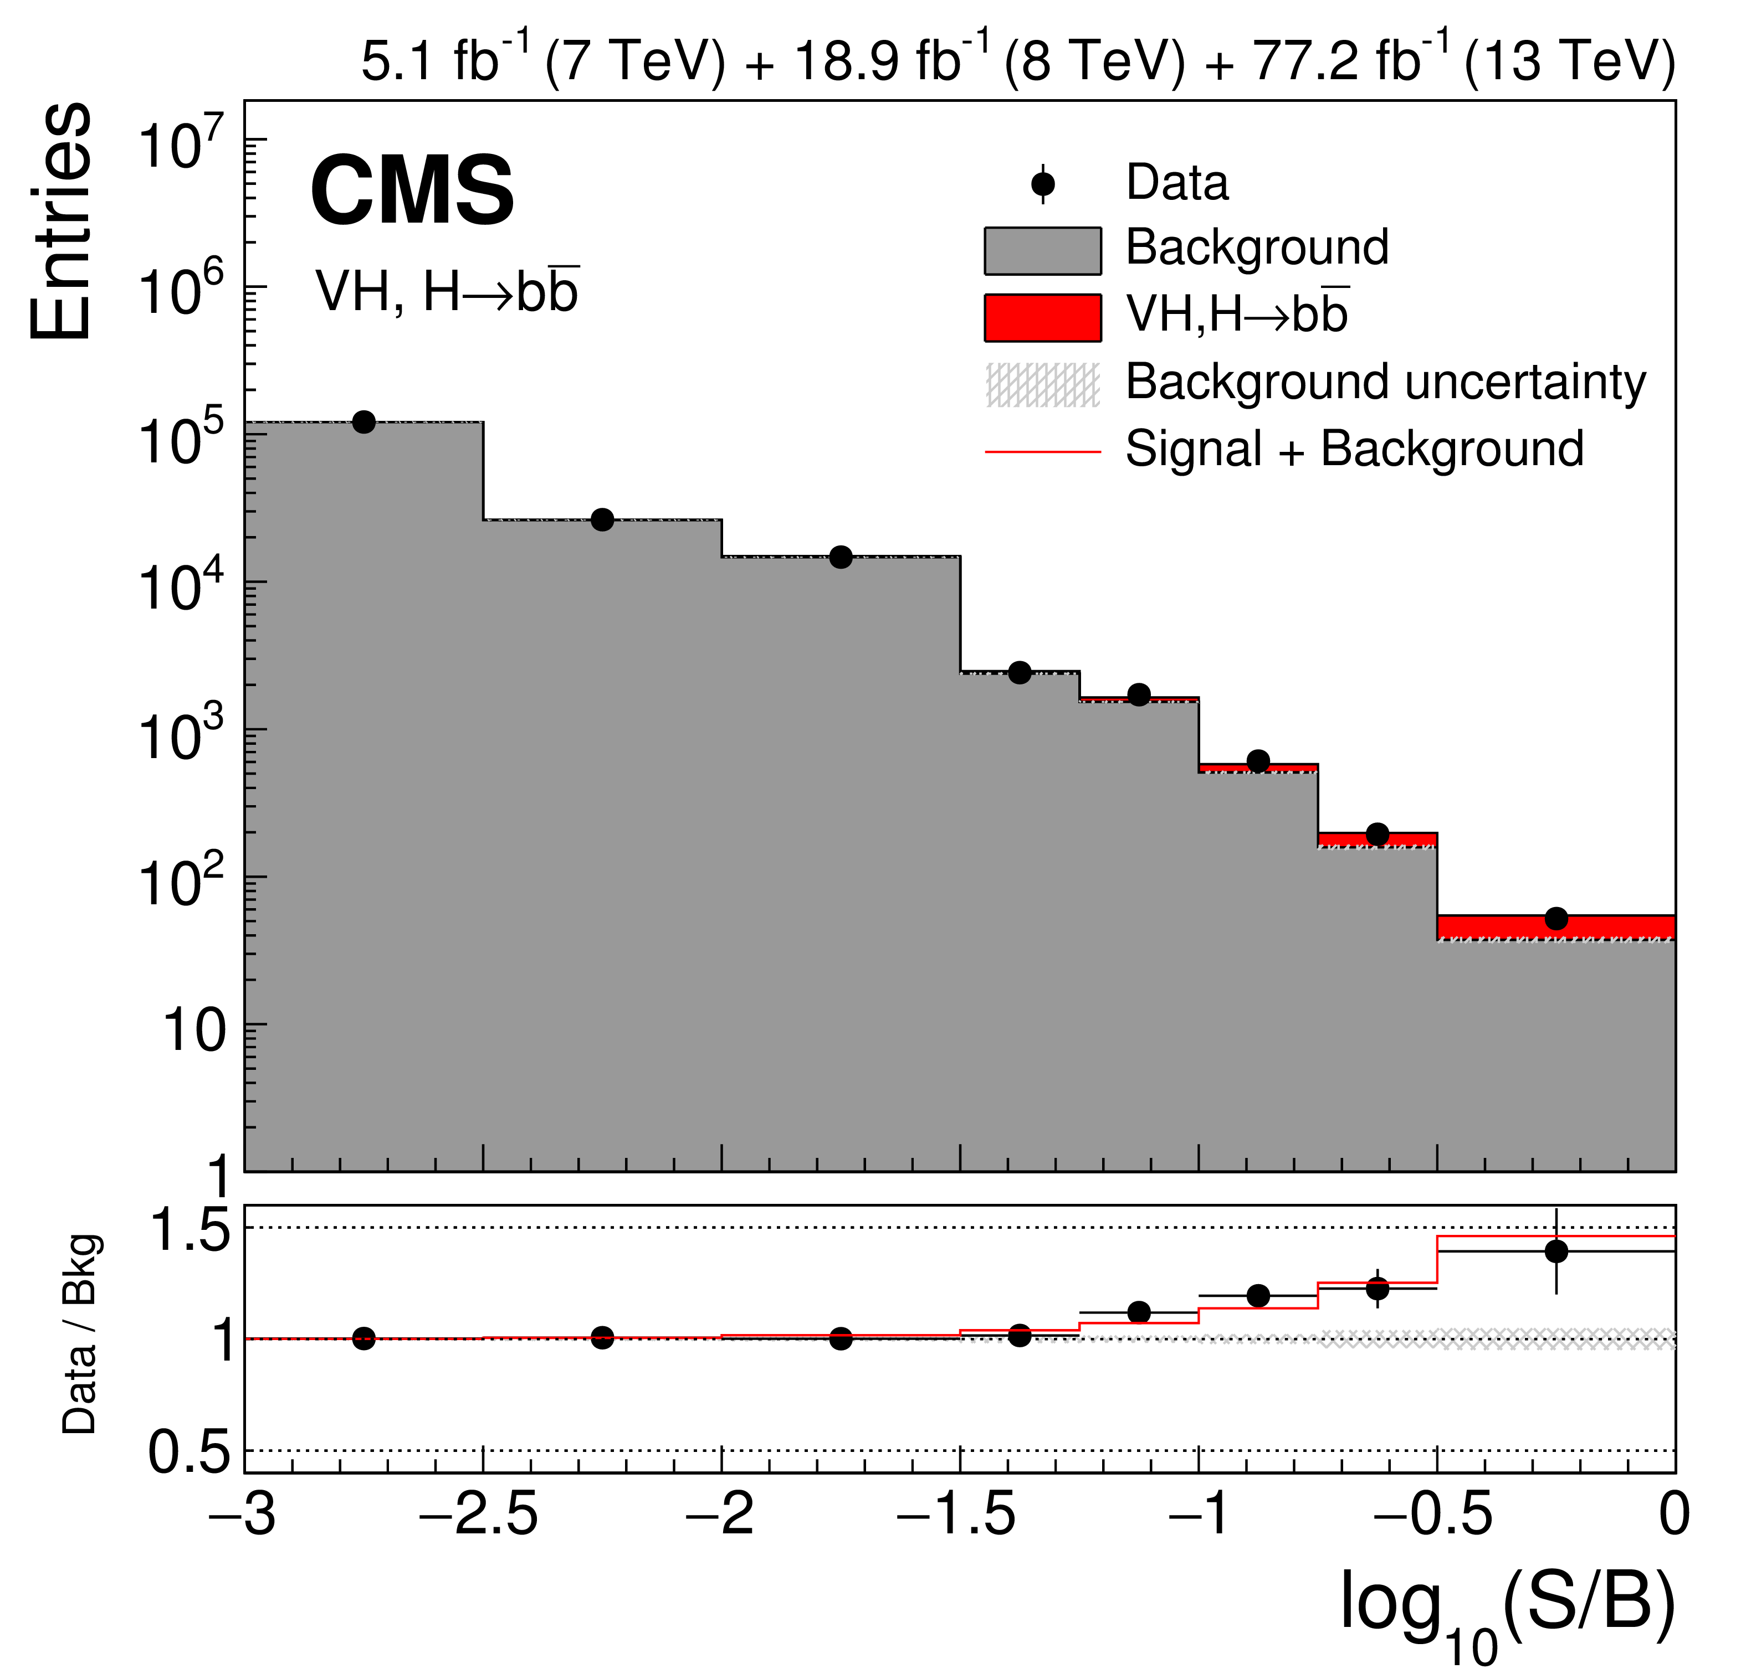
8 years after the discovery
H→ZZ
H→γγ
The Higgs is observed and measured now in many decay channels (also H→WW, ttH not yet at 5σ)
H→bb
3σ evidence in H→ μμ!
H→ττ
Notes:
Status
Seen in ZZ, WW, gg, bb, tautau, not yet but close to in mumu

Slide 75
Higgs mass
The only free parameter of the Higgs (minimal) Lagrangian
Result from Run I ATLAS+CMS combination
Notes:
Some tension between ATLAS ZZ and ATLAS gg results: ZZ lower than gg
For CMS it is the contrary ZZ higher than gg

Slide 76
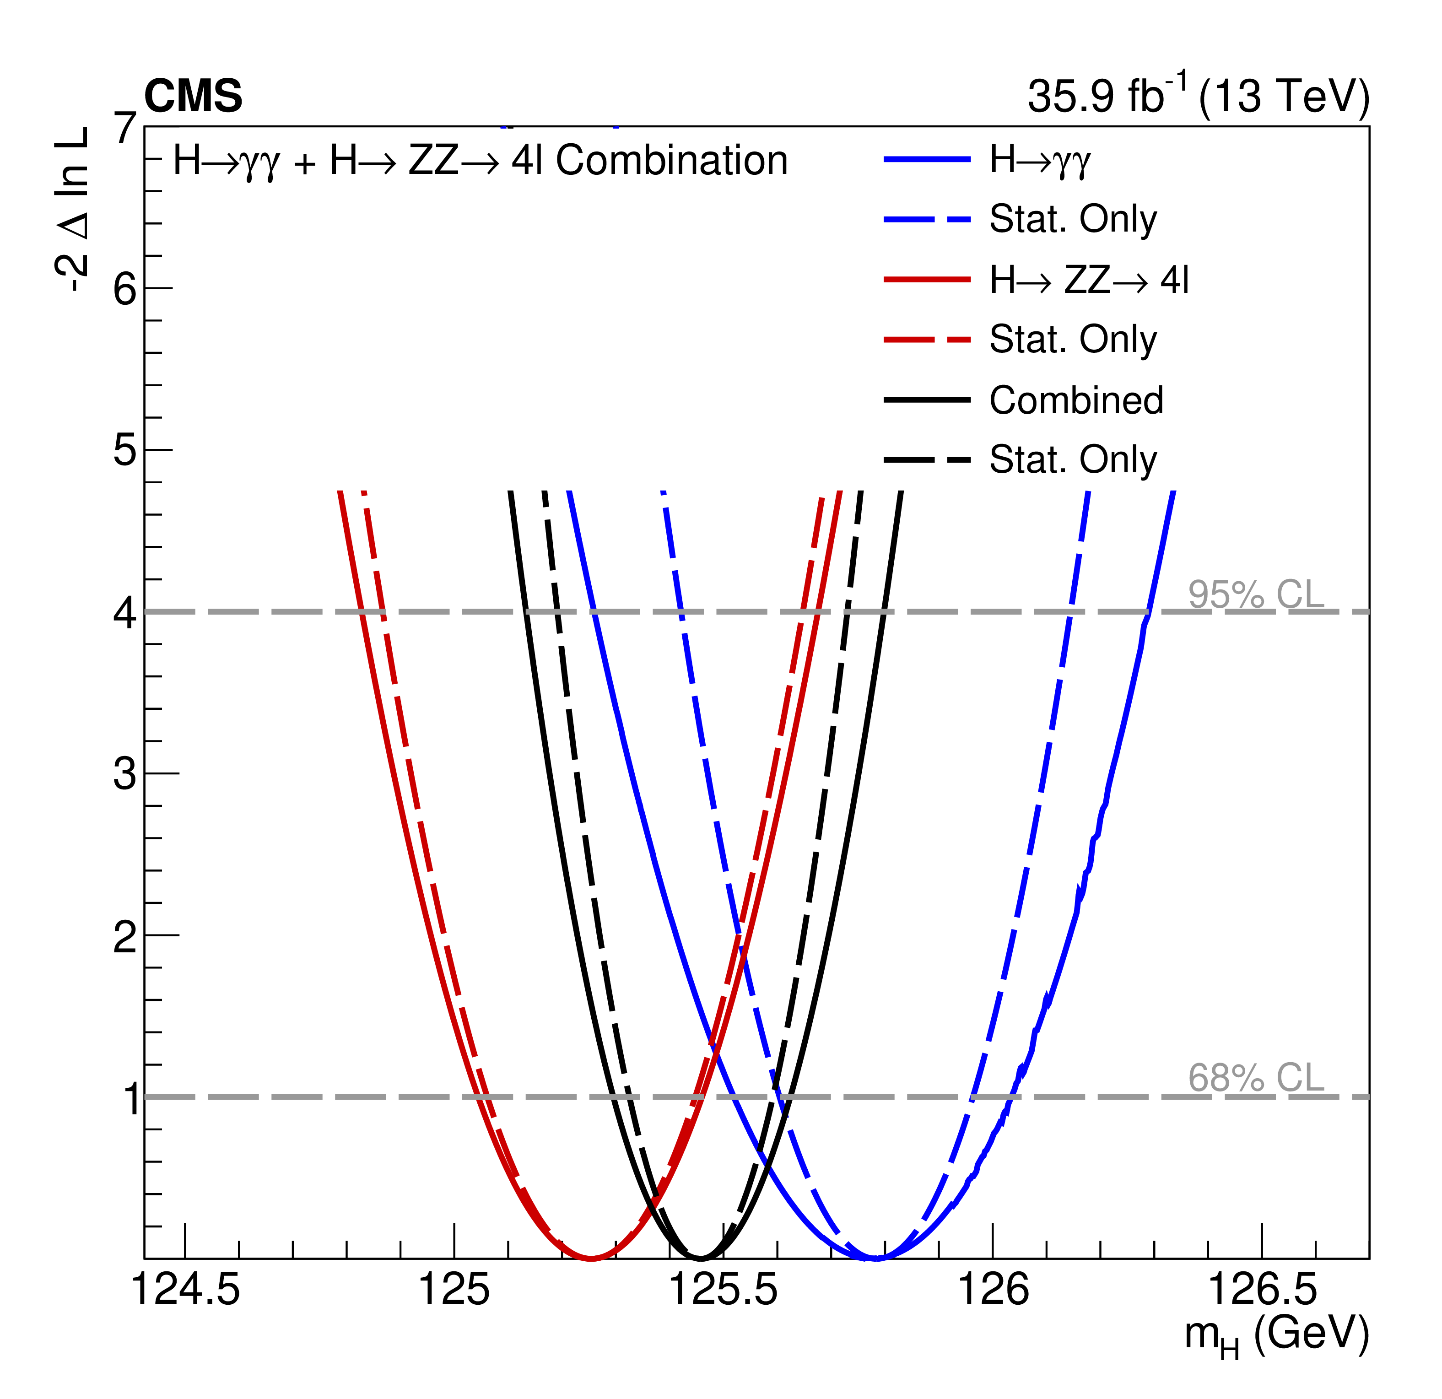
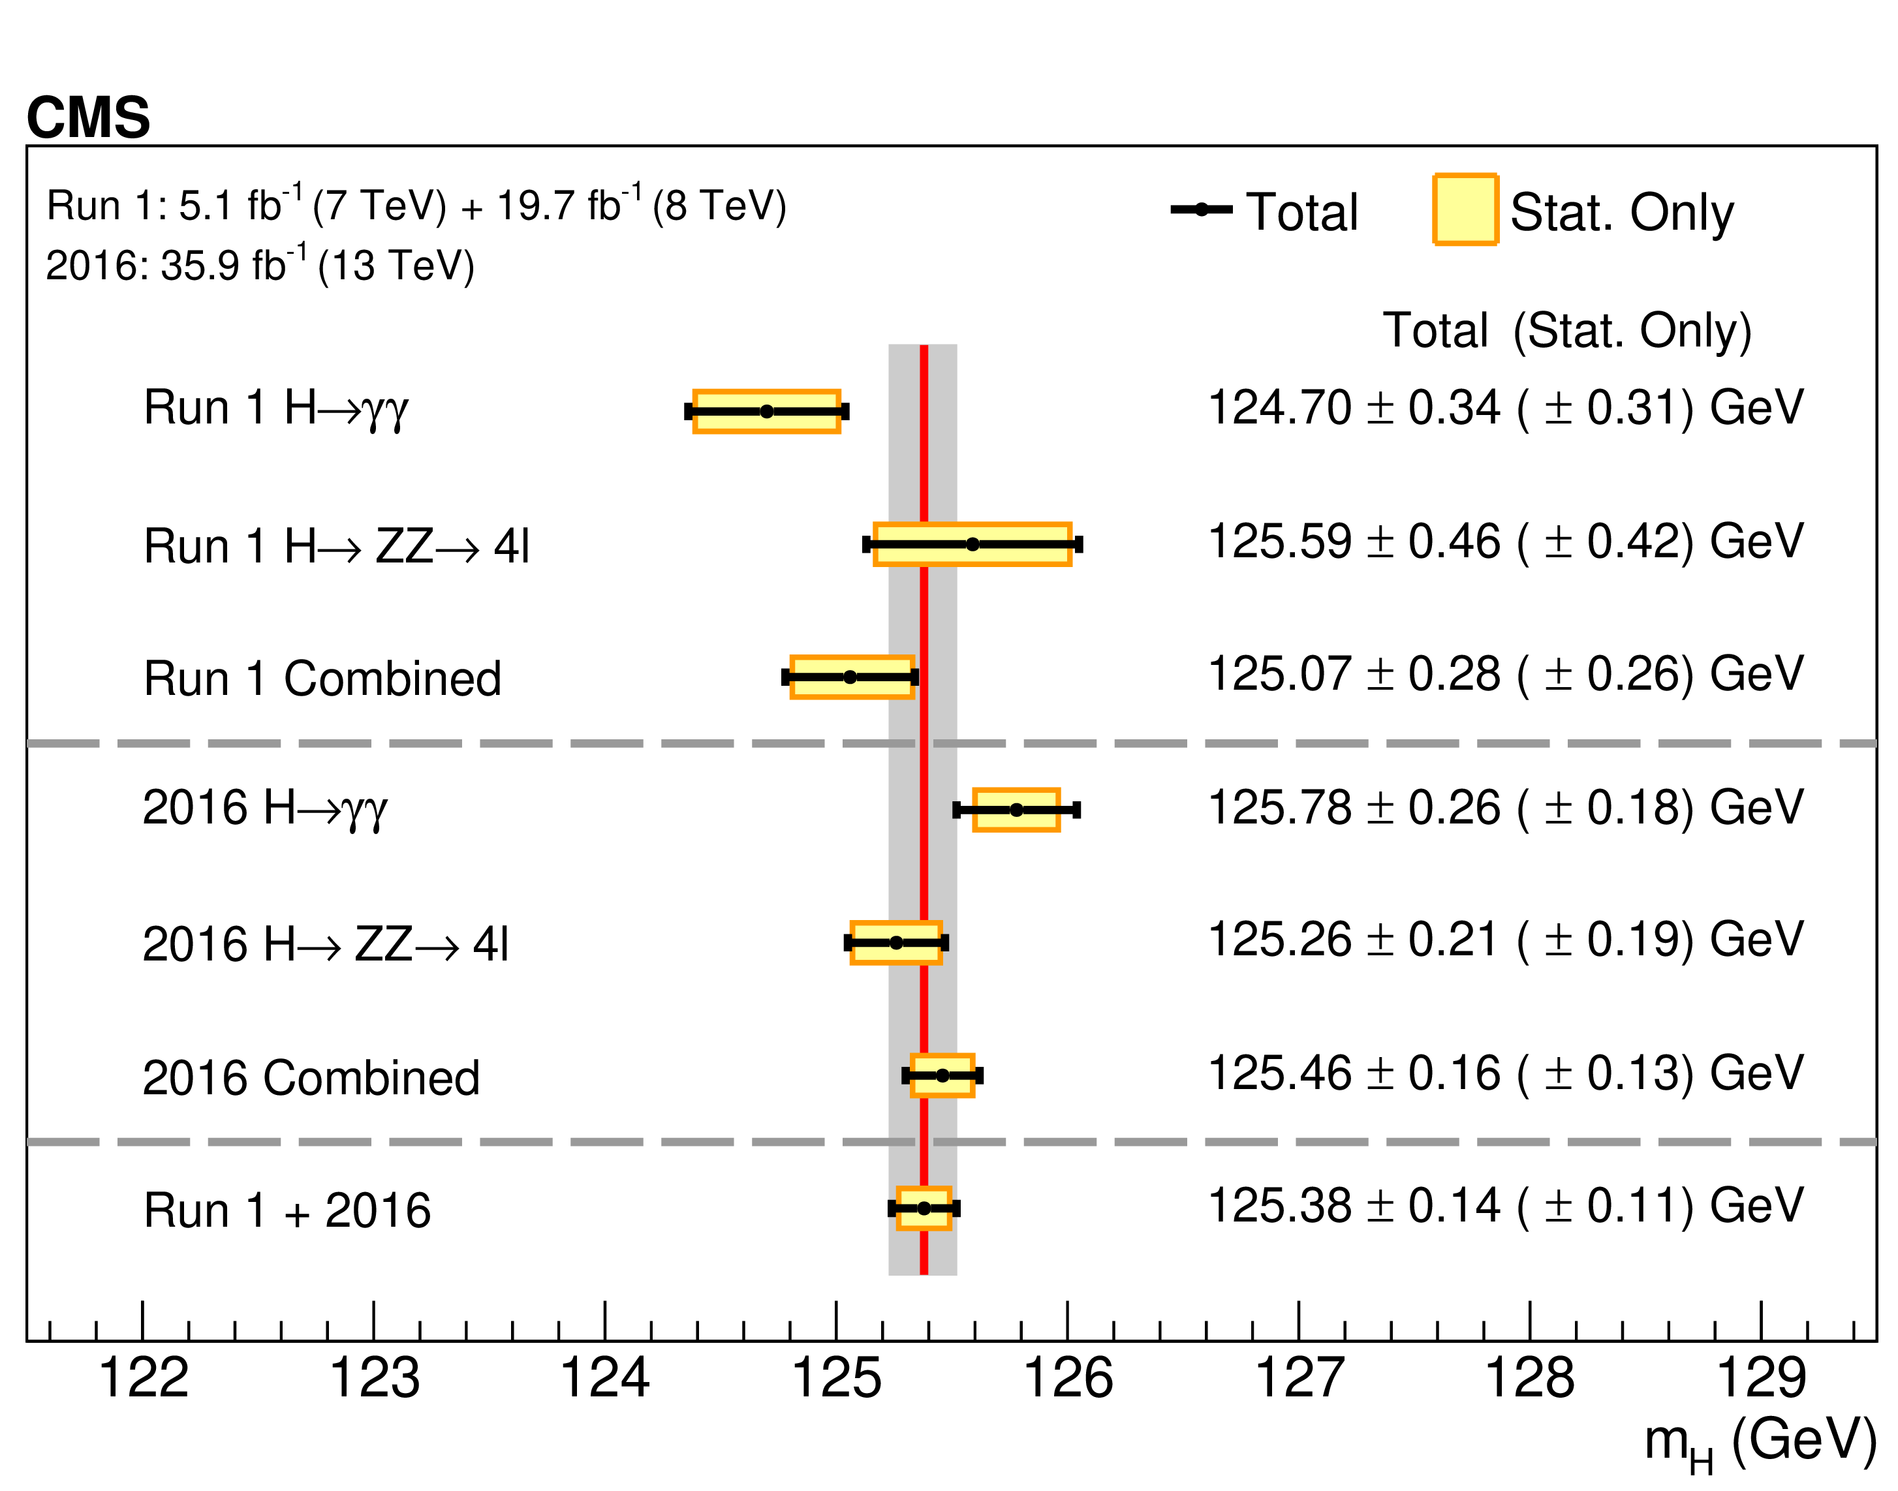
Higgs mass (CMS 2016)
m_{H} = 125.38 +/- 0.11 (stat) +/- 0.08 (syst) GeV
Results from CMS Run I +2016 (run II) data
Notes:
To date the best Higgs mass measurement, ongoing effort to include full run II dataset (2015-2018)
CMS gg value now higher than ZZ -> fluctuations
CMS gg 2016 value in better agreement with ZZ value

Slide 77
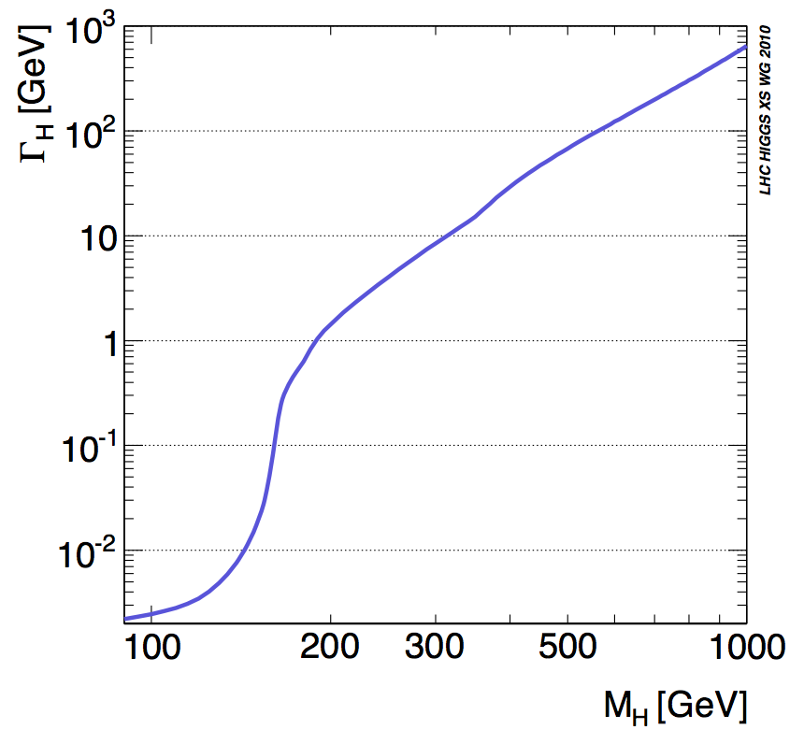
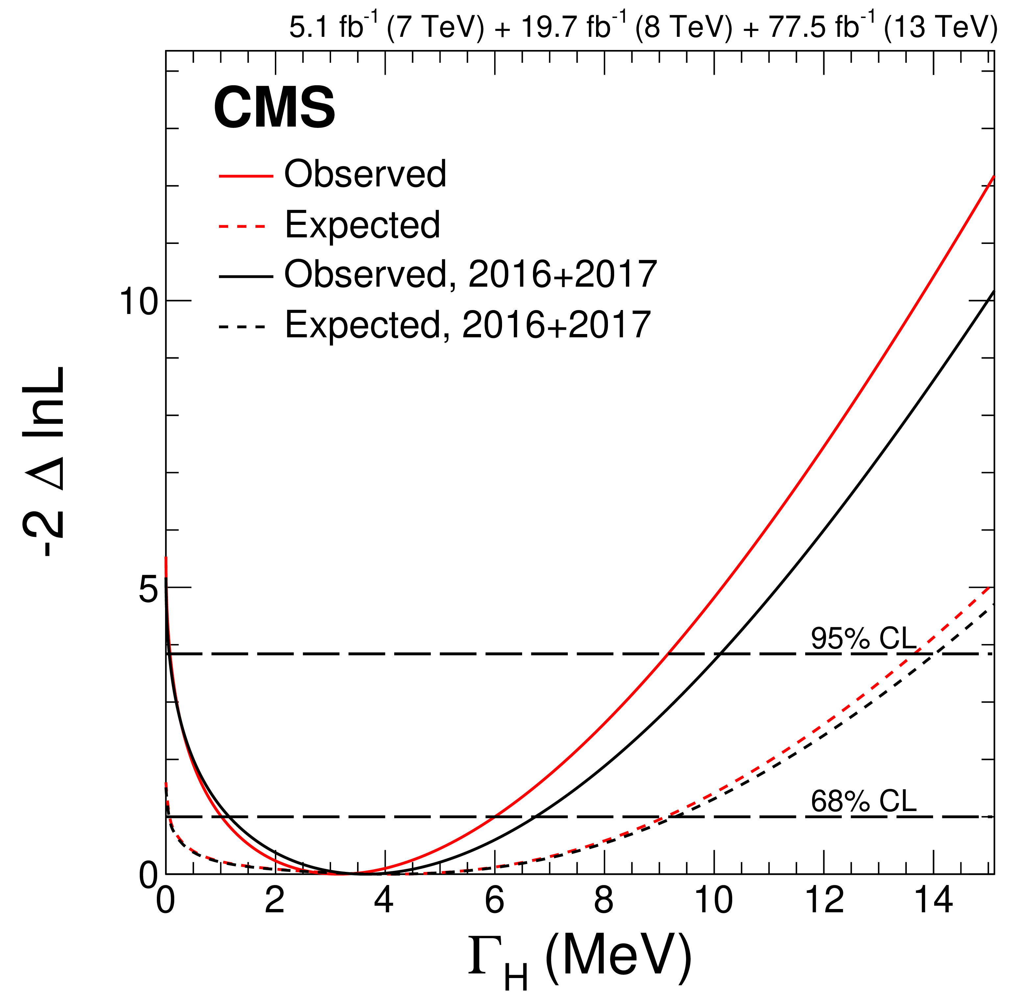
Higgs width
The decay width is a fundamental parameter
Relates to the couplings to all (massive) particles in the spectrum, therefore sensitive to BSM physics and dark matter
Experimental resolution far off for a direct measurement
σ_{m}/m ~ 1% for H → ZZ* → 4l and H → γγ and m_{H}~4 MeV
New idea: use off-shell production to constrain the Higgs decay width
Notes:
Gamma(H)=4.15 MeV

Slide 78
Higgs Spin - parity
J^{P} = 0⁻, 1+, 1-, 2+, .. excluded at >97.8% CL

Slide 79
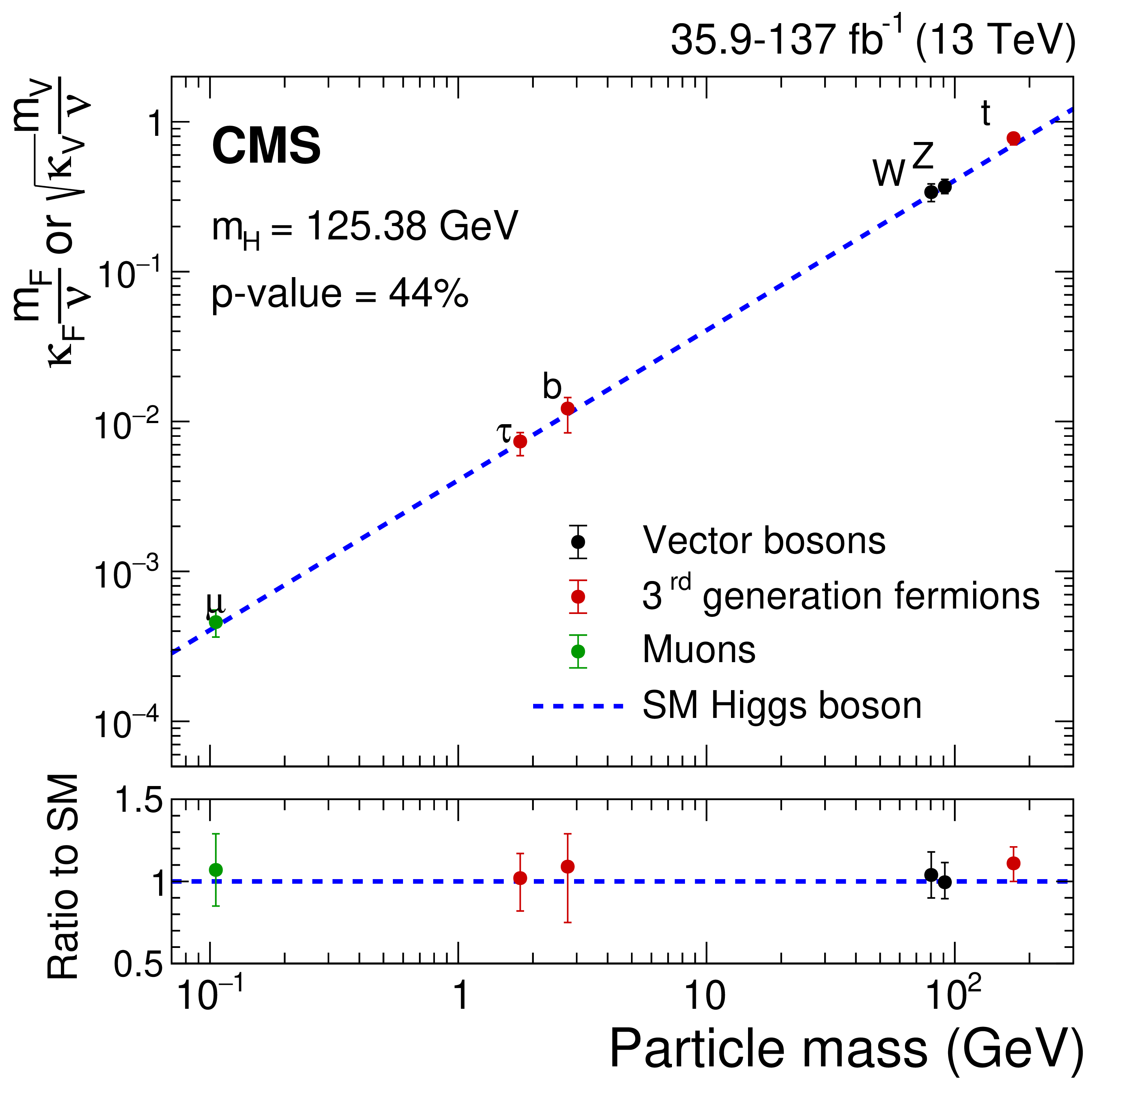
Higgs Couplings
Most solid proof that the new particle is the Higgs boson
Uncertainties not better than ~10%, room for discoveries!
Notes:
Most important plot!
Non-universal coupling
Agree with SM picture, however uncertainties still large (10-30%)

Slide 80
Intermediate summary
Higgs was discovered in 2012 based on ~5/fb at 7 TeV and ~5/fb at 8 TeV
At the end of the run II we now have ~14 times more statistics at 13 TeV
Statistical methods are used to quantify the excess and extract the key properties of the new particle: mass, spin, width, couplings from the data
The Higgs boson is now seen in multiple decay channel at the 5σ level, and an observation in the extremely challenging H → μμ channel is in reach
So far all measurement are consistent with a SM Higgs
Although with uncertainties of at best 10-20%

Slide 81
Going beyond: important unanswered questions
Data driven:
Dark matter in the universe
Neutrino masses, Dirac or Majorana neutrinos?
Why do we observe more matter than antimatter in the universe, if there is a symmetry between the two?
New in 2020: evidence for CP violation in the ν sector!
…
Theory driven:
Are quarks and leptons fundamental, or made up or more fundamental particles?
How to include gravity?
Why are there exactly three generations of quarks and leptons?
Instability of the Higgs mass (naturalness and hierarchy problems)
...

Slide 82
How to deal with these questions?
None have a clear path to answer (contrary to the case of EWSB)
DM could be from 10⁻²² GeV scalars to O(TeV) WIMPs, axions or primordial BHs
So even outside HEP
Neutrino masses could originate anywhere between the EW and GUT scales
Still in the process of acquiring basic knowledge aboiut neutrino sector: mass hierarchy, Majorana nature, sterile neutrinos, CP violations, ..
No clear hierarchy from theory side although it is likely that several questions are tied together and will find answer in a common context (eg DM and hierarchy problem)
But one question has emerged from LHC run I-II, and points to a unique and well-defined direction…

Slide 83
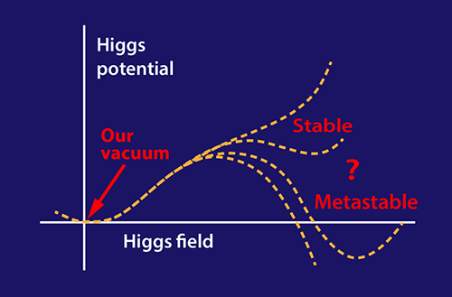
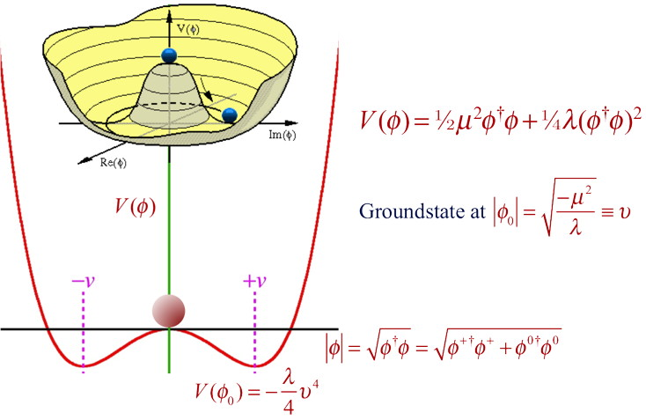
The ”immediate” next question
Where does it come from?

Slide 84
Electromagnetic vs Higgs dynamics

Slide 85
THE take away
Aside from historical moments, research is not about proving a theory is right or wrong, it is about finding how nature works
We do not measure the Higgs couplings to find deviations from the SM but to know them
Precision per se is not necessarily justified but currently we don’t really know how important is a given measurement to build the future understanding
The day a BSM signal is found, the precise coupling measurements will be crucial to establish the nature of the signal
At HL-LHC we will:
measure the H couplings to o(2-5%)
first assess the λ parameter of the Higgs potential
first assess EWSB though longitudinal VBS
A next (FCC) machine is needed:
to measure with the best possible precision the Higgs and EWSB properties
to extend the mass reach of direct search by ~an order of magnitude

Slide 86
Additional slides
Notes:
Physics at hadrons colliders

Slide 87
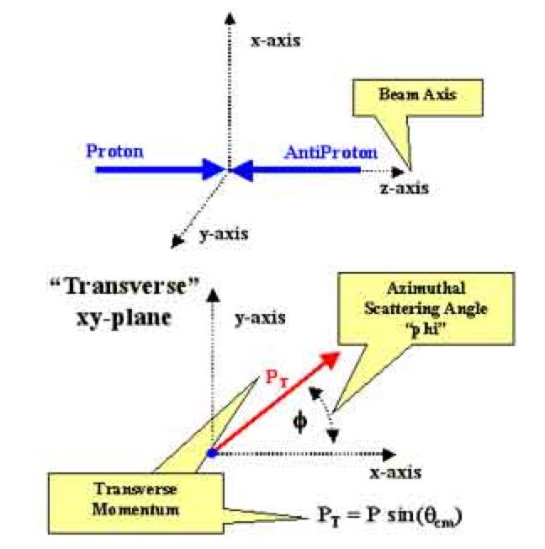
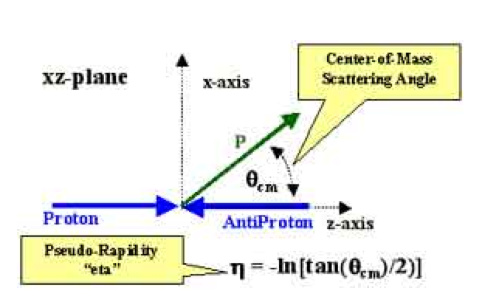
Kinematics at hadrons colliders
Particle in the final state p^{μ}=(E,p) in the lab frame
Longitudinal momentum is not known (collisions between partons) => use variables that are invariant under longitudinal boosts
Choose z-axis along the beam axis
Transverse momentum and azimutal angle:
p_{T}=sqrt(p_{x}²+p_{y}²) = p sin(θ), φ = atan(p_{y}/p_{x})
The polar angle alone is not invariant
Rapidity and pseudorapidity:
y=1/2 ln[(E+p_{z})/(E-p_{z})]
y’=y-y₀ the rapidity in a boosted frame is translated, rapidity differences are invariant
In the massless limit; y ~ η = -ln tan(θ/2)
Notes:
Enlever je pense ou mettre ailleurts!

Slide 88
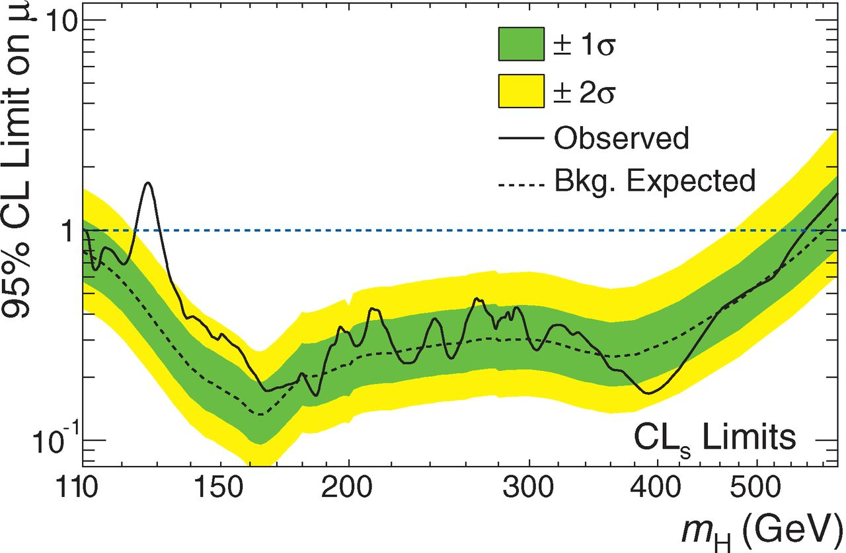
The Higgs discovery in numbers
Notes:
Yet another plot, the exclusion

Slide 89
Conférence de Moriond, 14 Mars 2012
Notes:
Started with 7 TeV beams in 2010-2011
Then 8 TeV in 2012
Discovery in July 2012 with 5.1fb at 7 TeV and 5.3fb at 8 TeV

Slide 90
September 2011

Slide 91
September 2011

Slide 92
CMS week nov.-dec. 2011
28/11
Claude are you there?
Notes:
November 2011

Slide 93
CERN december ‘11 jamboree
Notes:
November 2011

Slide 94
CERN december ‘11 jamboree
Notes:
November 2011

