Slide 1
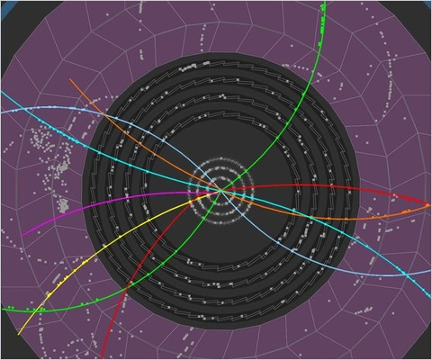
Dynamical approachES to
quarkonia SUPPRESSION
Roland Katz
QGP France – 16th of September 2014
In collaboration with P.B. Gossiaux
and TOGETHER Pays de la Loire

Slide 2
In few words ?
Go beyond the quasi-stationnary sequential suppression to explain observed kinetic dependences
a more dynamical and effective point of view :
QGP genuine time dependent scenario
quantum description of the QQ
screening, thermalisation
Roland Katz –16/09/2014

Slide 3
Summary
Background and motivations
Mean field
Quantum thermalisation ?
The Schrödinger-Langevin equation
First tests with quarkonia
Conclusion
Roland Katz –16/09/2014

Slide 4
Sequential suppression VS dynamical view assumptions
Background Mean field SL equation 1st tests on quarkonia
Sequential suppression at an early stage temperature
-> State formation only at the end of the evolution
Stationnary QGP
-> Reality is closer to a cooling QGP
Adiabatic evolution if formed; fast decorrelation if suppressed
-> Quantum description of the correlated QQ pair
Q
hadronization
Quarkonia or something else ?
QGP
Q
Roland Katz –16/09/2014

Slide 5
Ingredients ?
Background Mean field SL equation 1st tests on quarkonia
Mean field: color screened binding potential V(r,T)
+
Temperature scenarios T(t)
+
Thermalisation and diffusion
Cooling QGP
Direct interactions
with the thermal bath
Interactions due to
color charges
Roland Katz –16/09/2014

Slide 6
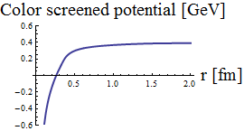
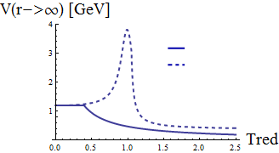
Background Mean field SL equation 1st tests on quarkonia
Mean color field: V(Tred, r) binding the QQ
Static lQCD calculations (maximum heat exchange with the medium):
F : free energy
S : entropy
U=F+TS : internal energy (no heat exchange)
T
“Weak potential” F<V<U * => some heat exchange
“Strong potential” V=U ** => adiabatic evolution
F<V<U
V=U
for Tred=1.2
Evaluated by Mócsy & Petreczky* and Kaczmarek & Zantow** from lQCD results
* Phys.Rev.D77:014501,2008 **arXiv:hep-lat/0512031v1
Roland Katz –16/09/2014

Slide 7
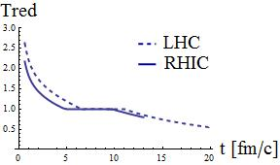
Background Mean field SL equation 1st tests on quarkonia
Cooling over time by Kolb and Heinz* (hydrodynamic evolution and entropy conservation)
At LHC ( ) and
RHIC ( ) energies
QGP homogeneous temperature scenarios
t0
medium at thermal equilibrium
Initial QQ pair radial wavefunction
Assumption: QQ pair created at t0 in the QGP core
Gaussian shape with parameters (Heisenberg principle):
Roland Katz –16/09/2014
* arXiv:nucl-th/0305084v2

Slide 8
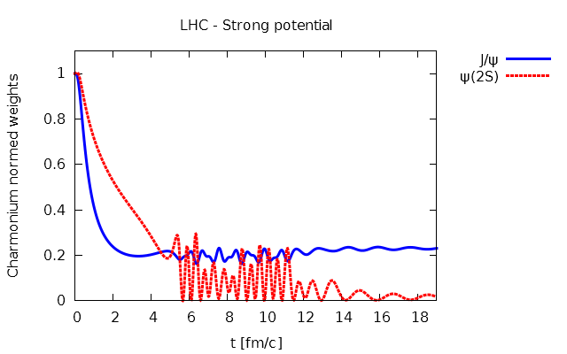
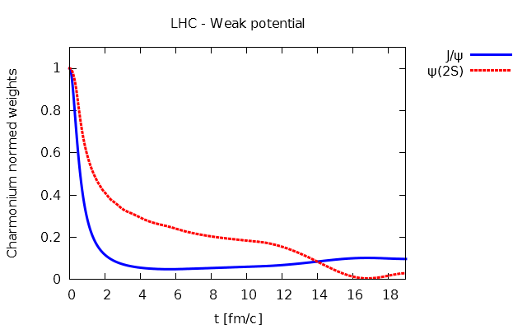
Mean field + T(t)
Background Mean field SL equation 1st tests on quarkonia
Evolution: radial non relativistic Schrödinger equation
Weight(t) = ΨQQ (t) projection onto quarkonia T=0 eigenstates
Already an actual evolution
=> the scenario can not be reduced to its very beginning
V=U at LHC
T ̴ Tc
F<V<U at LHC
Roland Katz –16/09/2014

Slide 9
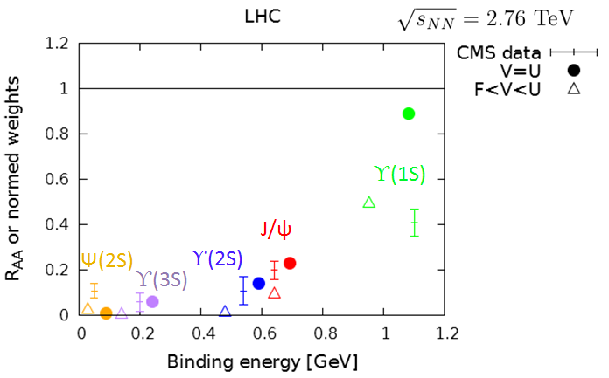
Background Mean field SL equation 1st tests on quarkonia
Mean field + T(t)
Results (at the end of the evolution) – data comparison to some extent:
LHC
CMS data: High pT and most central data => color screening relatively more important
Quite encouraging for such a simple scenario !
Feed downs from exited states and CNM effects to be implemented
Similarly to the data, less J/ψ suppression at RHIC than at LHC.
Roland Katz –16/09/2014
CMS Collaboration JHEP 05 (2012) 063 ; CMS-PAS-HIN-12-007 ; Phys. Rev. Lett. 109 (2012) 222301

Slide 10
A taste of quantum thermalisation
Background Mean field SL equation 1st tests on quarkonia
MQQ >> T => quarkonia are Brownian particles
Quantum friction/stochastic effects = long standing problem
because of their irreversible nature
Partonic approaches
Very complicated QFT problem at finite T !
NOT EFFECTIVE
The common open quantum approach
Idea: density matrix and {quarkonia + bath} => bath integrated out
non unitary evolution + decoherence effects
But defining the bath is complicated and the calculation entangled…
Akamatsu* -> complex potential
Borghini** -> a master equation
* Y. Akamatsu Phys.Rev. D87 (2013) 045016 ; ** N. Borghini et al., Eur. Phys. J. C 72 (2012) 2000

Slide 11
A taste of quantum thermalisation
Background Mean field SL equation 1st tests on quarkonia
✓
Langevin-like approaches
Idea: Effective equations to unravel/mock the open quantum approach
Knowledge of the Drag A(T) -> need for a Langevin-like eq.
(A(T) from single heavy quark observables or lQCD calculations)
Rothkopf* -> stochastic and complex potential
Semi-classical
See our SQM 2013 proceeding **
Others
Failed at low/medium temperatures
Schrödinger-Langevin equation
Effective thermalisation from fluctuation/dissipation
* Y. Akamatsu and A. Rothkopf. Phys. Rev. D 85, 105011 (2012) ; ** R. Katz and P.B. Gossaiux J.Phys.Conf.Ser. 509 (2014) 012095

Slide 12
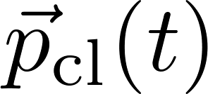
Schrödinger-Langevin (SL) equation
Background Mean field SL equation 1st tests on quarkonia
Derived from the Heisenberg-Langevin equation*, in Bohmian mechanics** …
“Dissipation”
non-linear wavefunction dependent potential
Solution for the free wavepacket:
where
Local in time friction
Brings the system to the lowest state
where and satisfy
the classical laws of motion
A is the drag coefficient (inverse relaxation time)
* Kostin The J. of Chem. Phys. 57(9):3589–3590, (1972)
** Garashchuk et al. J. of Chem. Phys. 138, 054107 (2013)
Roland Katz –16/09/2014

Slide 13
Schrödinger-Langevin (SL) equation
Background Mean field SL equation 1st tests on quarkonia
Derived from the Heisenberg-Langevin equation*, in Bohmian mechanics** …
“Fluctuation”: stochastic operator
QGP
?
Q
Brownian hierarchy:
Q
σ = quarkonia autocorrelation time with the gluonic fields
= quarkonia relaxation time
:
gaussian correlation of parameter σ and norm B
σ -> 0 : classical white noise
quantum colored noise from oscillators bath model (under investigation)
* Kostin The J. of Chem. Phys. 57(9):3589–3590, (1972)
** Garashchuk et al. J. of Chem. Phys. 138, 054107 (2013)
Roland Katz –16/09/2014

Slide 14
Properties of the SL equation
Background Mean field SL equation 1st tests on quarkonia
3 parameters: A (Drag), B (diffusion coef) and σ (correlation time)
Unitarity (no decay of the norm as with imaginary potential)
Heisenberg principle satisfied at any T
Non linear => Violation of the superposition principle
(=> decoherence)
Evolution from pure to mixed states (from statistics)
Mixed state observables:
Easy to implement numerically (especially in Monte-Carlo generator)
Roland Katz –16/09/2014

Slide 15
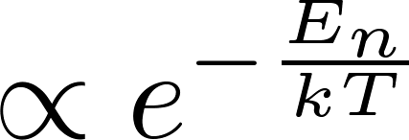
Does SL lead to thermal equilibrium ?
Background Mean field SL equation 1st tests on quarkonia
For an harmonic potential:
Asymptotic distribution of states proven to be
SL fluctuation-dissipation relation with white noise:
Other mean fields:
Asymptotic convergence shown
But thermal distribution of states ? => numerical approach !
Classical Einstein law
Roland Katz –16/09/2014

Slide 16
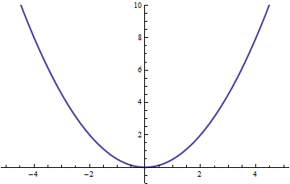
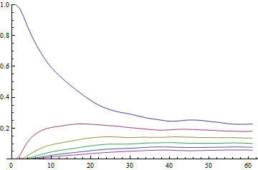
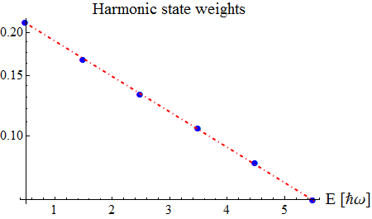
SL: numerical test of thermalisation
Background Mean field SL equation 1st tests on quarkonia
Harmonic potential
Asymptotic Boltzmann distributions ? YES for any (A,B,σ) and from any initial state
V(x)
(t >> )
Harmonic state weights (t)
Boltzmann distribution line
Roland Katz –16/09/2014

Slide 17
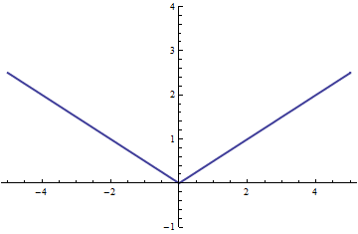
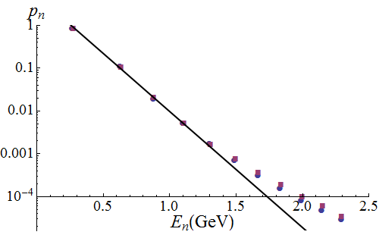
SL: numerical test of thermalisation
Background Mean field SL equation 1st tests on quarkonia
Linear potential Abs[x]
Asymptotic Boltzmann distributions ? YES but deviations for higher states when kT<<E₀
V(x)
kT/E₀=0.5
Roland Katz –16/09/2014

Slide 18
SL: numerical test of thermalisation
Background Mean field SL equation 1st tests on quarkonia
Linear potential Abs[x]
Asymptotic Boltzmann distributions ? YES but deviations for higher states when kT<<E₀
V(x)
kT/E₀=0.5
Roland Katz –16/09/2014

Slide 19
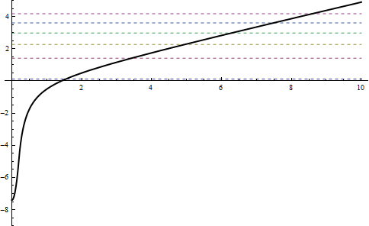
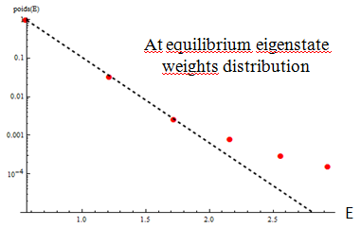
SL: numerical test of thermalisation
Background Mean field SL equation 1st tests on quarkonia
V(x)
Quarkonia approx:
Asymptotic Boltzmann distributions ?
YES but discrepancies from 3rd excited states for states at small T Tc
̴
Roland Katz –16/09/2014

Slide 20
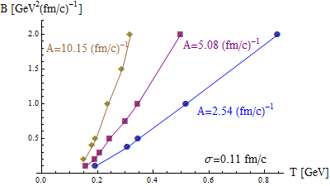
SL: some numerical tests
Background Mean field SL equation 1st tests on quarkonia
From the knowledge of (A,T) => B ?
-> Yes univoquely extracted
Roland Katz –16/09/2014
* Gossiaux P B and Aichelin J 2008 Phys. Rev. C 78 014904

Slide 21
Dynamics of QQ with SL equation
Background Mean field SL equation 1st tests on quarkonia
First tests => simplifying assumptions:
3D -> 1D
Drag coeff. for c quarks*:
σ -> 0 (white noise)
Potential:
Typically T ∈ [0.1 ; 0.43] GeV => A ∈ [0.32 ; 1.75] (fm/c)⁻¹
T=0
K|x|
- K chosen such that:
E2-E0=E(ψ’)- E(J/ψ))=600MeV
- 4 bound eigenstates at T=0
T=∞
Linear approx
Saturation (T) as Vweak
Roland Katz –16/09/2014
* Gossiaux P B and Aichelin J 2008 Phys. Rev. C 78 014904

Slide 22
Dynamics of QQ with SL equation
Background Mean field SL equation 1st tests on quarkonia
First tests => simplifying assumptions:
3D -> 1D
Drag coeff. for c quarks*:
σ -> 0 (white noise)
Potential:
Typically T ∈ [0.1 ; 0.43] GeV => A ∈ [0.32 ; 1.75] (fm/c)⁻¹
Stochastic forces =>
feed up of higher states
leakage
Linear approx
Saturation (T)
Roland Katz –16/09/2014
* Gossiaux P B and Aichelin J 2008 Phys. Rev. C 78 014904

Slide 23
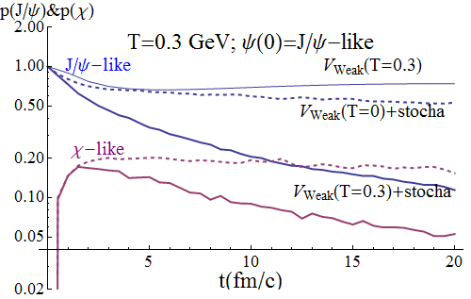
Background Mean field SL equation 1st tests on quarkonia
Dynamics of QQ with SL equation
Transient phase: reequilibration of the bound eigenstates
Naïve exp(-Γt)
Decay of the global cc system with a common half-life
Roland Katz –16/09/2014

Slide 24
Background Mean field SL equation 1st tests on quarkonia
Dynamics of QQ with SL equation
Naïve exp(-Γt)
Thermal effects lead to more suppression if
quarkonia initial states
T => Γ until saturation for large T>>Tc
Other initial states -> same long time decay

Slide 25
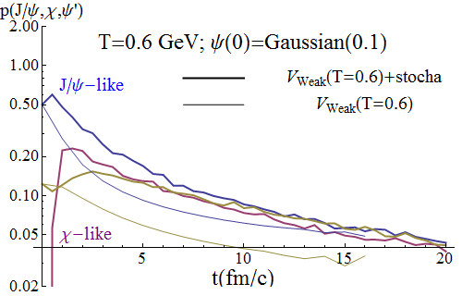
Background Mean field SL equation 1st tests on quarkonia
Dynamics of QQ with SL equation
Thermal effects -> less suppression of J/ψ, ψ‘… components at intermediate times
Roland Katz –16/09/2014

Slide 26
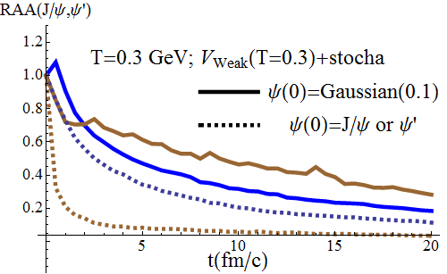
Background Mean field SL equation 1st tests on quarkonia
Dynamics of QQ with SL equation
Ψ’
J/ψ
If initial gaussian cc -> RAA (J/ψ) > RAA (ψ’) for T>0.2 GeV
Roland Katz –16/09/2014

Slide 27
Background Mean field SL equation 1st tests on quarkonia
Dynamics of QQ with SL equation
Ψ’
J/ψ
All these plots: kill the unjustified assumptions of very fast quantum decoherence
and adiabatic evolution
Roland Katz –16/09/2014

Slide 28
Conclusion
Framework satisfying all the fundamental properties of quantum evolution in contact with a heat bath,
Easy to implement numerically
First tests passed with success
Rich suppression pattern found in a stationary environment
Assumptions of early decoherence and adiabatic
evolution ruled out.
Future:
Identify the limiting cases
3D ?
Implementation with evolution scenario of the QGP
…
Roland Katz – 16/09/2014 – katz@subatech.in2p3.fr – http://rolandkatz.com/

Slide 29
BACK UP SLIDES

Slide 30
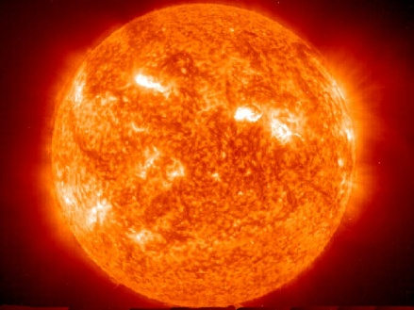
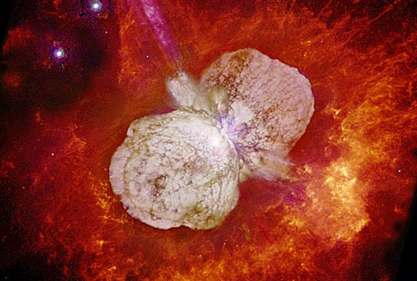
Sequential suppression assumptions …
Sequential suppression in the QGP « initial state » (formation times ?)
Then adiabatic evolution if formed; or very short time QQ decorrelation if suppressed
What a stationnary medium has to do with reality ?
Wrong !
Q
Q
?
Early QGP
States : Yes or No ?
Q
Q
Picture:
Reality:
Roland Katz –16/09/2014

Slide 31
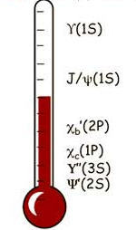
Common theoretical explanation to quarkonia suppression in QGP
Sequential suppression by Matsui and Satz …
Each state has a Tdiss
+ States formation in a stationnary medium
(with QGP early T)
= if T > Tdiss the state is dissociated for ever
=> quarkonia as QGP thermometer
… and recombination
collision energy
number of QQ in the medium
probability that a Q re-associates with another Q
Roland Katz –16/09/2014

Slide 32
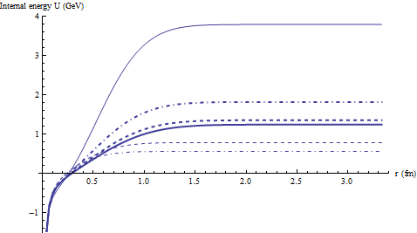
Some plots of the potentials
With weak potential F<V<U with Tred from 0.4 to 1.4
With strong potential V=U with Tred from 0.4 to 1.4

Slide 33
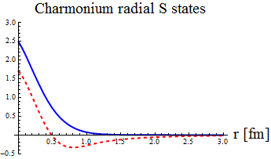
Quantum approach
Schrödinger equation for the QQ pair evolution
Where
Q
r
QGP
Initial wavefunction:
Q
where and
Projection onto the S states: the S weights
Radial eigenstates
of the hamiltonian
Roland Katz –16/09/2014

Slide 34
Semi-classical approach
The“Quantum” Wigner distribution of the cc pair:
… is evolved with the “classical”, 1st order in ħ, Wigner-Moyal equation + FP:
Finally the projection onto the J/ψ state is given by:
But in practice: N test particles (initially distributed with the same gaussian distribution in (r, p) as in the quantum case), that evolve with Newton’s laws, and give the J/ψ weight at t with:
Roland Katz –16/09/2014

