Slide 1
CMS heavy-ion overview
Raphael Granier de Cassagnac
Laboratoire Leprince-Ringuet
ERC grant “QuarkGluonPlasmaCMS”
for the CMS Collaboration
Quark Matter conference, Darmstadt
May 22nd, 2014
QGP France, Etretat
15 september 2014

Slide 2
Groupes de physique (2014)
1. Physics
B. Wyslouch,
D. d’Enterria,
O. Kodolova,
G. Roland,
R. GdC,
G. Veres,
J. Velkovska
2. Heavy ions
C. Roland,
M. Nguyen
Higgs
J. Olsen,
FSQ
J. Hollnar,
B Physics
K-F. Cheng,
…
R. GdC,
C. Silvestre,
T. Dahms,
Spectra PInG
E. Appelt
Flow PInG
W. Li
High pT PInG
Y. Yilmaz
3. Dilepton
L. Benhabib
Forward PInG
I. Katkov
Niveau 2 : Matt convener pour 2014-15, RGdC 2010-11
Niveau 3 : activité dilepton (quarkonia et bosons électrofaibles, et actuellement faible!) et highpt actuellement guidées par des « français »

Slide 3
En France, on tient encore sur une page
Early contributions from Marc Bedjidian (IPNL) ;
LLR group (2 staff + 2 postdocs + 3 PhD students as of today)
Raphaël GdC (since March 2009, approximately)
Lamia Benhabib (postdoc CNRS, 3+0.5 years, since Dec. 2009)
Sarah Porteboeuf (postdoc ReteQuarkonii, one year)
Camelia Mironov (postdoc Marie Curie, 2+2 years, since June 2010)
Bolek Wyslouch (MIT professor on 1-year sabbatical at Polytechnique)
Torsten Dahms (postdoc ERC, 3 years, since Nov. 2010)
Alice Florent (thésarde ERC, 3 years, since Sep. 2011)
Matthew Nguyen (CR2 + Marie Curie, since Oct. 2011)
Nicolas Filipovic (thésard ERC, 3 ans, since Oct. 2012)
François Arleo (théoricien associé)
Yetkin Yilmaz (postdoc ANR + Marie Curie, since May 2013)
Émilien Chapon (postdoc ERC, since Sep. 2013)
Stanislav Lisniak (thésard, since Sep. 2013)
12+ stagiaires (2 NPAC, 4 X, MIT, Ukraine, Inde, Centrale, Normale…).
( to a large extend funded by the European Community )
Début de la fin…
(de la bourse ERC)
Notes:
Encore assez peu nombreux pour tenir sur une page

Slide 4
Overview of 13 talks & 15 posters
[List of talks]
Kim, B mesons
Zsigmond, electroweak
Moon, charmonia
Appelt, jet R_{pA} & R_{AA}
Devetak, factorization breakdown
Wang, multiparticle
Xu, η-dependence of correlations in pPb
Sharma, K_{S} & Λ flow
Gulhan, jet-track
Abdulsalam, bottomonia
Barbieri, dijets & photons
Jung, b-jets
Dogra, BEC
[List of posters]
Akbiyik, γγ in pPb
Chudasama, Y in UPC
Chen, K_{S} & Λ flow
Edwards-Bruner, dE_{T}/dη
Elayavalli, jet performances
Innocenti, B mesons
Kim, shapes and FF
Krajczar, F/B
Lai, jet reconstruction
Lee, J/ψ in pPb
Lisniak, Hough transform
Siklér, BEC
Varma, φ mesons
Veres, pPb cross section
Yu, b-jet performances

Slide 5
Overview of 29 papers & 9+10 PAS
All available at:
https://twiki.cern.ch/twiki/bin/view/CMSPublic/PhysicsResultsHIN
The quark matter 2014 release:
HIN-12-007: ψ’ in PbPb
HIN-13-007: W in pPb
HIN-14-001: R_{pPb}(jet)
HIN-14-002: v_{2,3}(K_{S},Λ) in pPb
→ arxiv=1409:3392
HIN-14-003: Z in pPb
HIN-14-004: B in pPb
HIN-14-006: v_{2,3}(2…8) in pPb
HIN-14-007: R_{pPb}(b-jet)
HIN-14-008: v_{2,3}(η) in pPb
HIN-14-010: jet+track in PbPb
HIN-14-012: factorization break.
HIN-14-013: Bose-Einstein corr.

Slide 6
Overview of a plethora of probes
Already at QM’12
Jets, b-jets
W, Z, photons
5 quarkonia
Charged particles
& their correlations…
New (in pPb, also in 50-100% PbPb)
B⁺, B⁰, B_{S} mesons
K_{S}, Λ
π±, K±, p/p

Slide 7
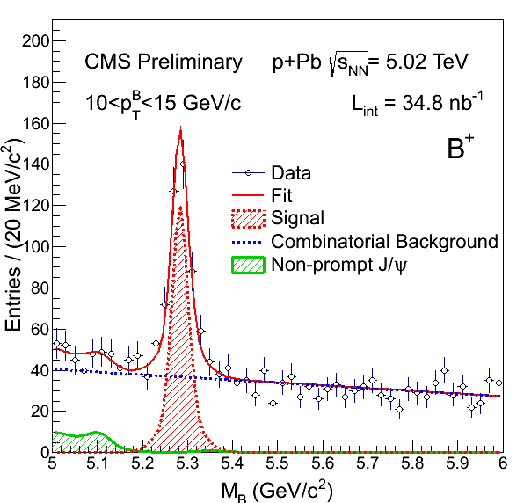
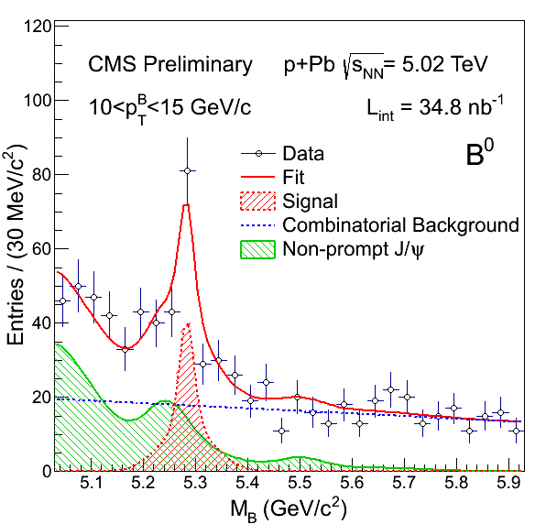
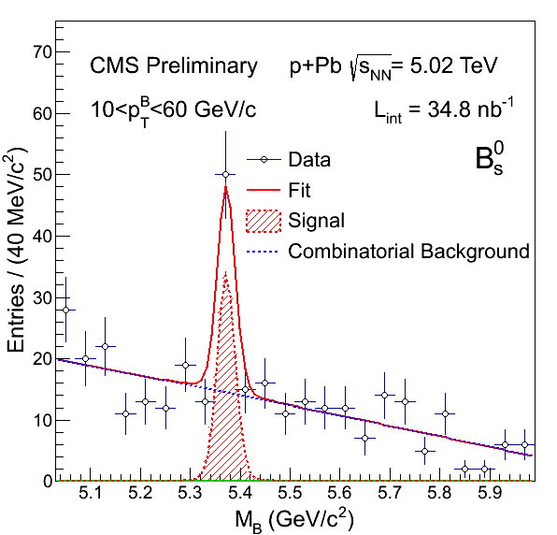
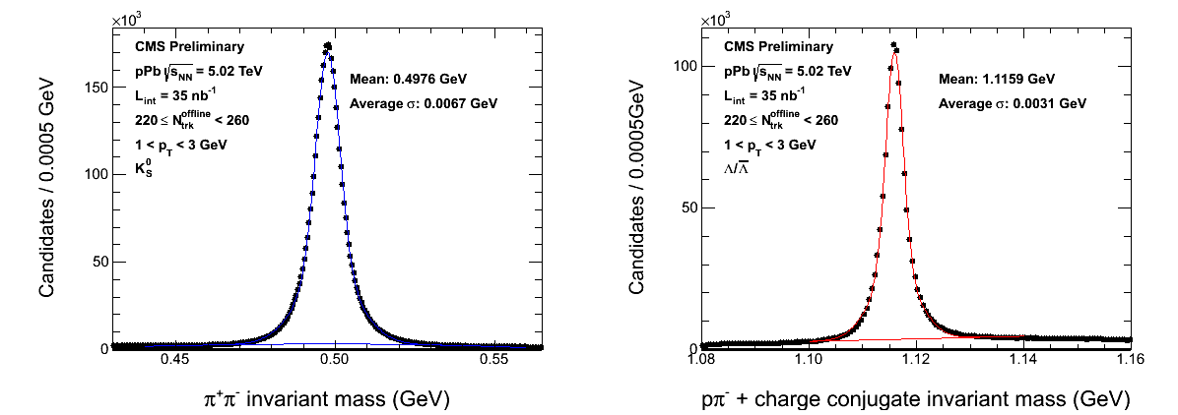
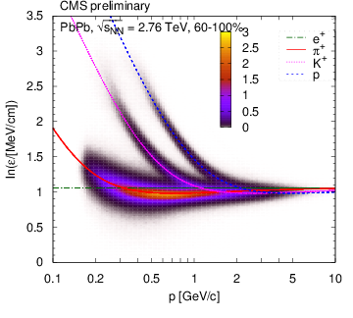
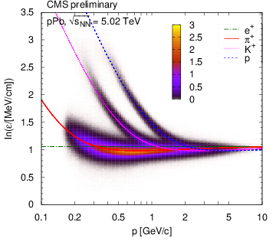
Overview of a plethora of probes
Already at QM’12
Jets, b-jets
W, Z, photons
5 quarkonia
Charged particles
& their correlations…
New (in pPb, also in 50-100% PbPb)
B⁺, B⁰, B_{S} mesons
K_{S}, Λ
π±, K±, p/p
B⁺
B⁰
B_{S}
K_{S}
Λ
p
p
K
K
π
π
PbPb
pPb

Slide 8
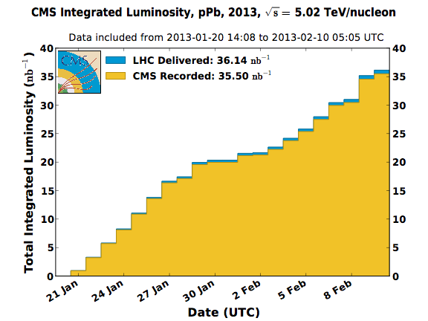
Overview of five HI-oriented runs
Same N_{coll} scaled luminosities for pp, pPb, PbPb
(as many Z’s and W’s, modulo the √s dependence)
New since QM12
PbPb results updated with 20 x more pp reference data
pPb results, awaiting 5.02 TeV pp reference data
Period | Species | Energy | Lumi
Dec. 2010 | Pb+Pb | 2.76 TeV | 7 μb^{–1}
Dec. 2011 | Pb+Pb | 2.76 TeV | 150 μb^{–1}
Mar. 2011 | p+p | 2.76 TeV | 230 nb^{–1}
Jan. 2013 | p+Pb | 5.02 TeV | 35 nb^{–1}
Fev. 2013 | p+p | 2.76 TeV | 5.4 pb^{–1}
pPb luminosity
98% DAQ eff.

Slide 9
Brief outline
Collectivity
Ridge, elliptic flow, triangular flow, HBT radii, spectra…
Energy loss
Jet fragmentation & shape, b-jets & mesons, high p_{T}…
Nuclear PDF
From jets, Z and W…
Melting
J/ψ, ψ(2S), Y(1S), Y(2S), Y(3S)
(contributions françaises majeures à ces sujets)

Slide 10
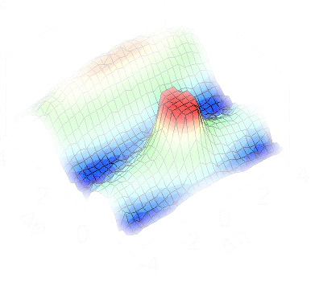
collectivity

Slide 11
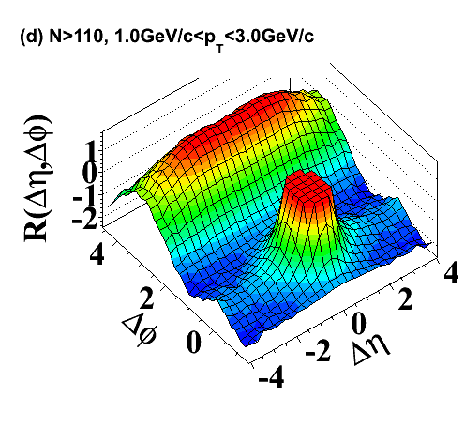
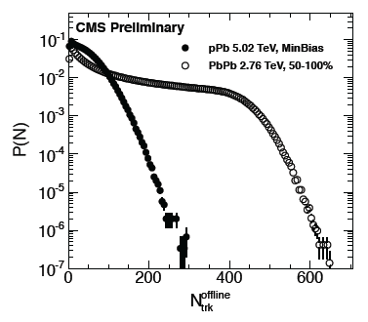
The “ridge” at LHC
Early observation in high multiplicity 7 TeV pp collisions
Origin still unclear
Then seen in PbPb collisions, reminiscent of RHIC
Believed to arise from collective flow
Now confirmed in pPb collisions
Is it collective flow? CGC?
Tool: highest pPb multiplicity (<0.0003%) ≈ 55-60% PbPb centrality
pp: JHEP 09 (2010) 091
pPb: PLB718 (2013) 795
pPb: PLB724 (2013) 213
Notes:
( plot from quan rehearsal )
More references ?
280 reco. tracks in both PbPb (55-60%) and pPb (0-0.0003%)

Slide 12
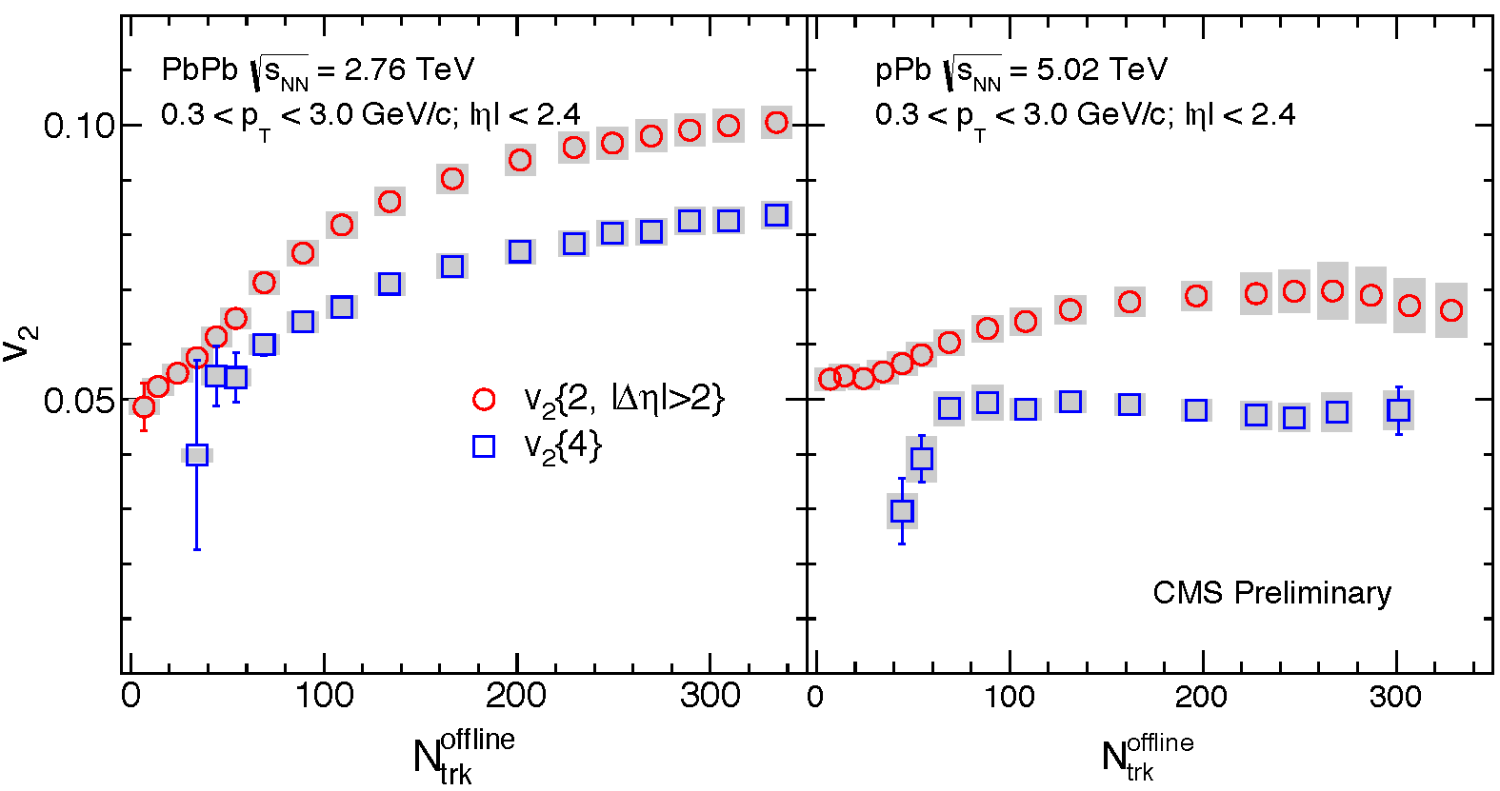
Multiparticle correlations
v₂ stays large when calculated with multi-particles
v₂(4)≠v₂(2)
(non-flow, fluctuations…)
Talk by Wang
PAS-HIN-14-006
v₂
PbPb pPb
PLB724 (2013) 213
(event multiplicity)
Notes:
Snap from HIN-14-006-v7
Animated !

Slide 13
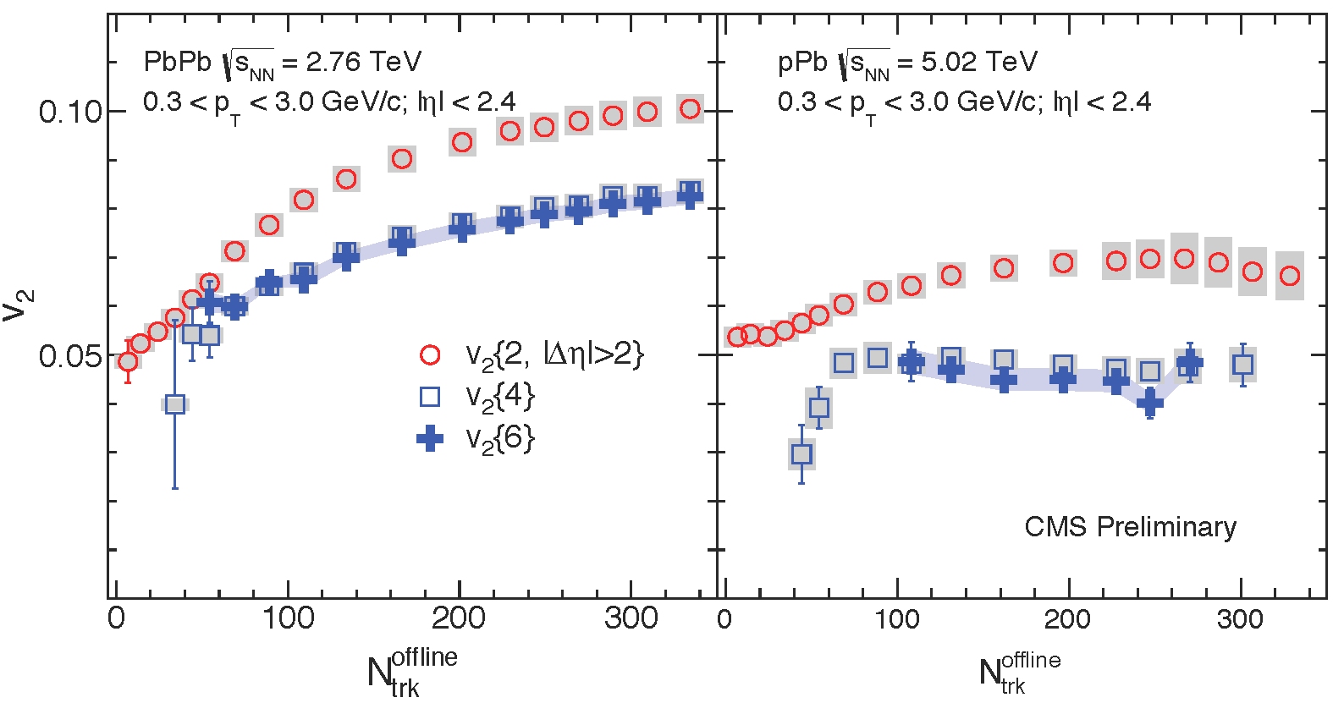
Multiparticle correlations
v₂ stays large when calculated with multi-particles
v₂(4)=v₂(6)
Talk by Wang
PAS-HIN-14-006
v₂
PbPb pPb
(event multiplicity)
Notes:
Snap from HIN-14-006-v7
Animated !

Slide 14
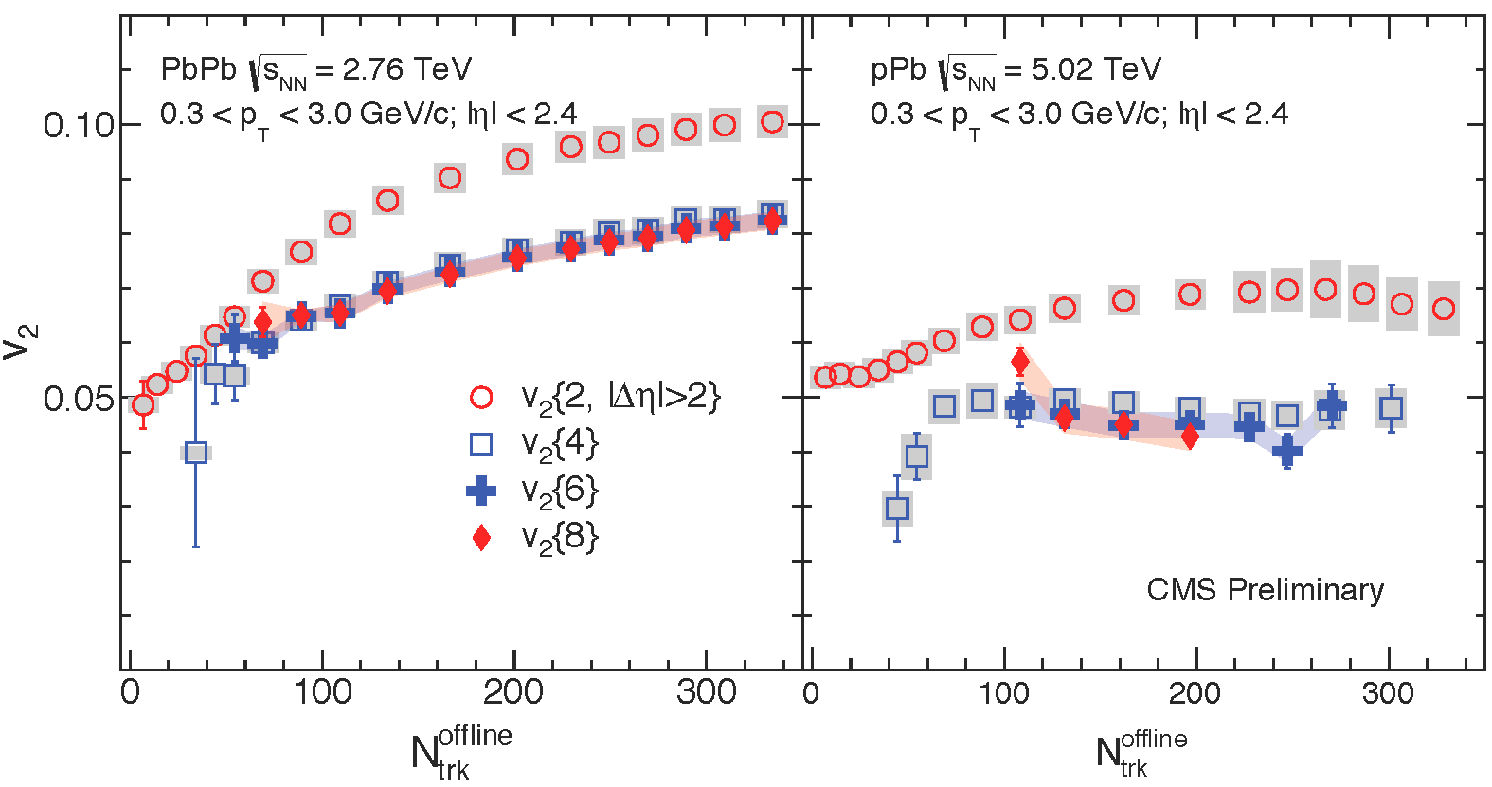
Multiparticle correlations
v₂ stays large when calculated with multi-particles
v₂(4)=v₂(6)=v₂(8)
Talk by Wang
PAS-HIN-14-006
v₂
PbPb pPb
(event multiplicity)
Notes:
Snap from HIN-14-006-v7
Animated !

Slide 15
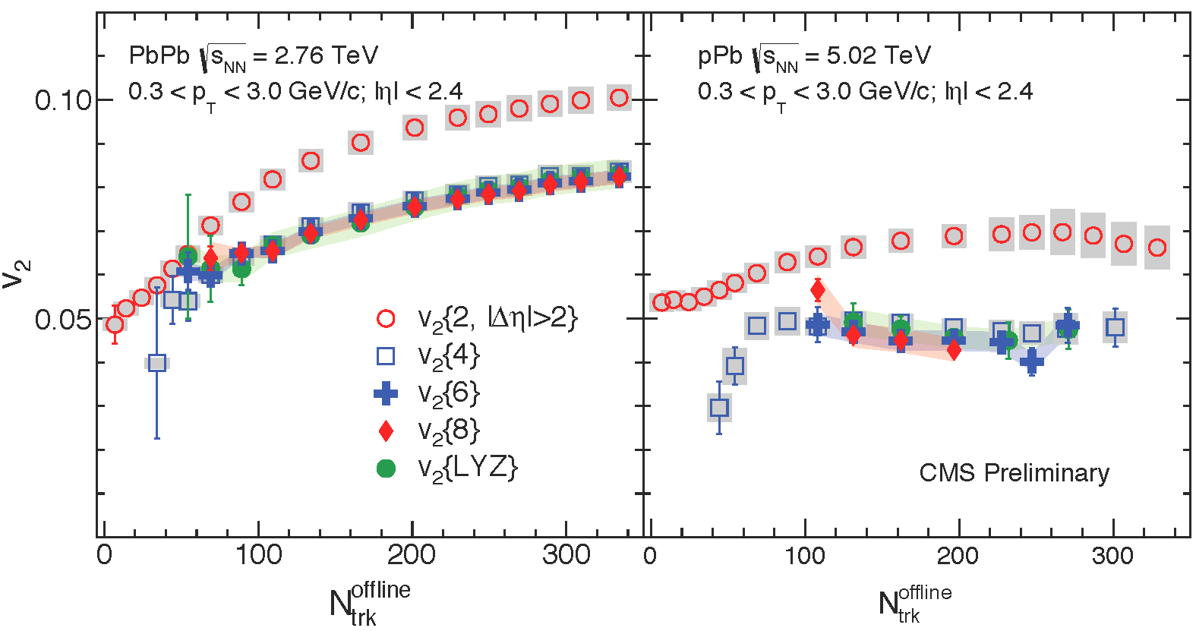
Multiparticle correlations
v₂ stays large when calculated with multi-particles
v₂(4)=v₂(6)=v₂(8)=v₂(LYZ) within 10%
True collectivity in pPb collisions!
Talk by Wang
PAS-HIN-14-006
v₂
PbPb pPb
(event multiplicity)
Notes:
Snap from HIN-14-006-v7
Animated !

Slide 16
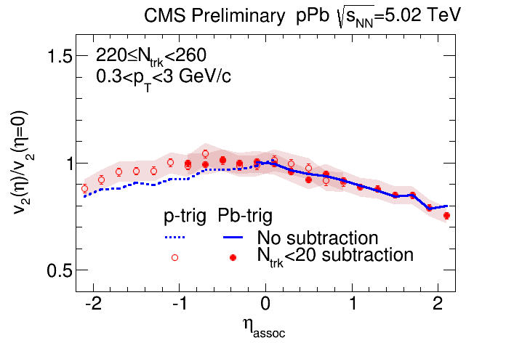
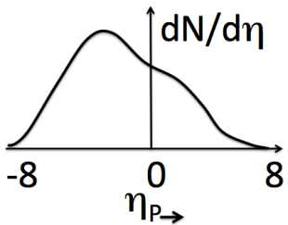
In pPb, η-dependence of v₂
In pPb collisions, v₂ depends on η
→ More v₂ with higher particle densities
Talk by Xu
PAS-HIN-14-008

Slide 17
Elliptic flow of identified particles
Identified K_{S} and Λ
& charged hadrons
v₂ (and v₃) from
2-particle correlations
show mass ordering
in pPb and PbPb
(stronger in pPb)
v₂
PbPb pPb
Talk by Sharma
PAS-HIN-14-002
Notes:
A typical feature of hydro ?
From https://twiki.cern.ch/twiki/bin/view/CMS/PhysicsResultsHIN14002

Slide 18
Elliptic flow of identified particles
Identified K_{S} and Λ
& charged hadrons
v₂ (and v₃) from
2-particle correlations
show mass ordering
In pPb and PbPb
(stronger in pPb)
and ≈ quark scaling
(better in pPb)
v₂
PbPb pPb
v₂/n_{q}
Talk by Sharma
PAS-HIN-14-002
Notes:
A typical feature of hydro ?
From https://twiki.cern.ch/twiki/bin/view/CMS/PhysicsResultsHIN14002

Slide 19
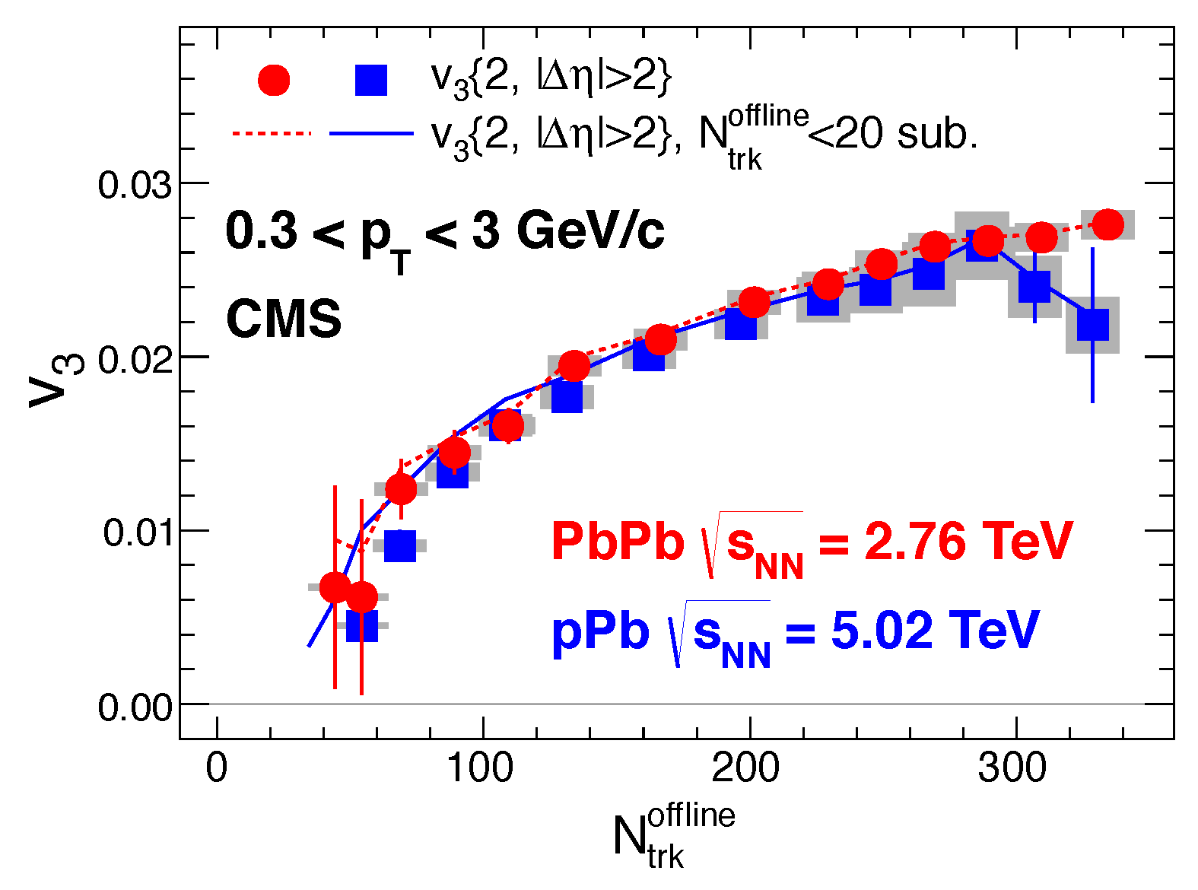
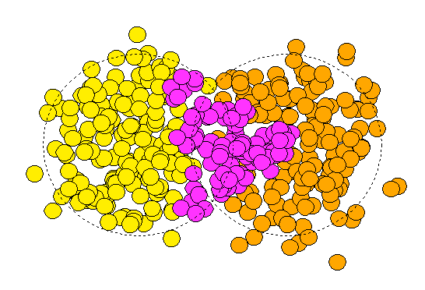
Triangular flow
Remarkable similarity in the v₃ signal as a function of multiplicity in pPb and PbPb
PLB724 (2013) 213
ψ₃
(event multiplicity)

Slide 20
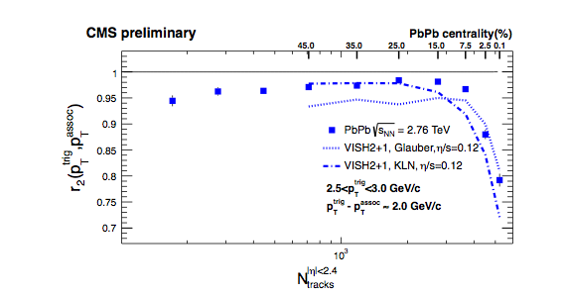
Checking factorization
From two particle correlations
V_{nΔ}(p_{T1},p_{T2}) = v_{n} (p_{T1}) x v_{n} (p_{T2}) factorization is assumed
Breaking down, in hydro, due to fluctuations
r_{n} = V_{nΔ}(p_{T1},p_{T2}) / √ V_{nΔ}(p_{T1},p_{T1}) x V_{nΔ}(p_{T2},p_{T2})
(also available in p_{T1}, p_{T2} bins)
Large breaking in very
central PbPb collisions,
qualitatively reproduced
Talk by Devetak, PAS-HIN-14-012
event multiplicity

Slide 21
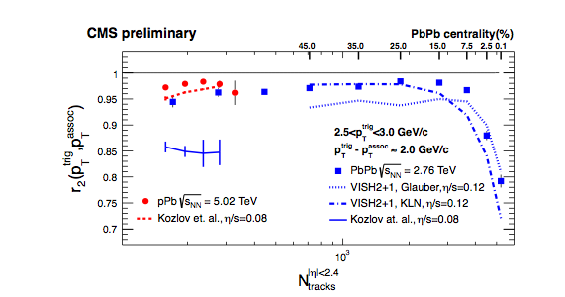
Checking factorization
From two particle correlations
V_{nΔ}(p_{T1},p_{T2}) = v_{n} (p_{T1}) x v_{n} (p_{T2}) factorization is assumed
Breaking down, in hydro, due to fluctuations
r_{n} = V_{nΔ}(p_{T1},p_{T2}) / √ V_{nΔ}(p_{T1},p_{T1}) x V_{nΔ}(p_{T2},p_{T2})
(also available in p_{T1}, p_{T2} bins)
Large breaking in very
central PbPb collisions,
qualitatively reproduced
Similar/smaller breaking
in pPb vs PbPb
Talk by Devetak, PAS-HIN-14-012
event multiplicity

Slide 22
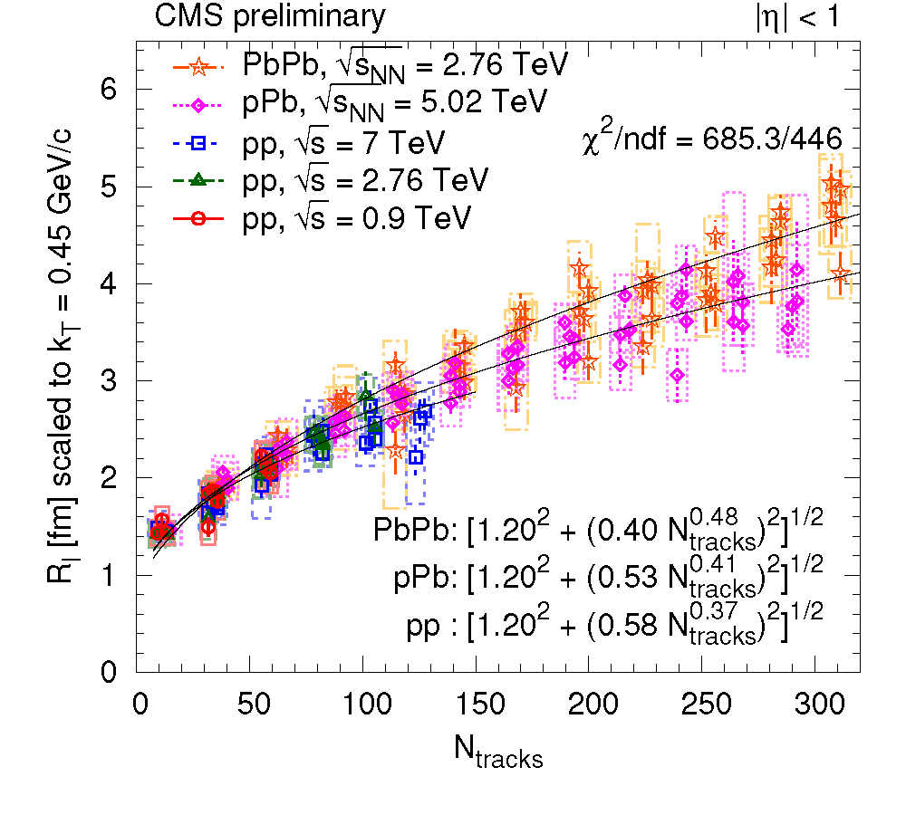
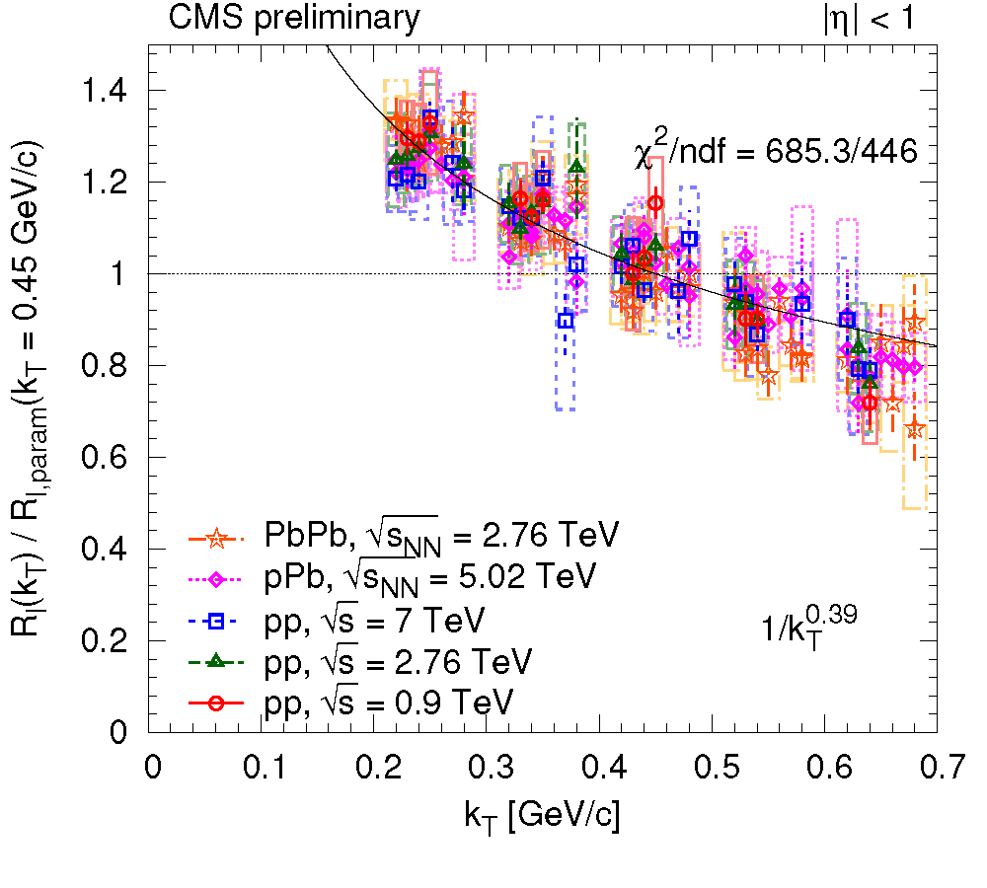
Bose-Einstein correlations
Similar large radii (R_{long} up to 5 fm) in pPb & PbPb
Thanks to π/K/p separation
Scaling with multiplicity and k_{T}
Talk by Dogra
PAS-HIN-14-013
R_{long}
(GeV)
multiplicity
k_{T} = (p_{T1} + p_{T2})/2 [GeV/c]

Slide 23
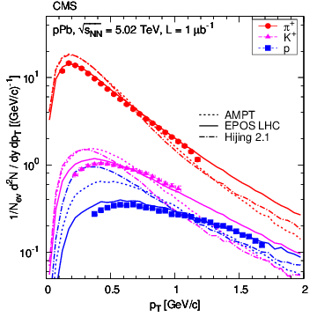
Summary (1/4) collectivity
pPb looks a lot like PbPb, and as hydro predicts!
Strong v₂ from multiparticle correlations
Similar mass ordering
v₂ depending on η in pPb
Same v₃ versus multiplicities
Same factorization breakdown
Similar HBT radii (5 fm)
and the spectra are better
reproduced by generators incl.
hydro (EPOS) →
arXiv:1307.3442, EPJC-accepted
High-multiplicity pPb collisions show collectivity!

Slide 24
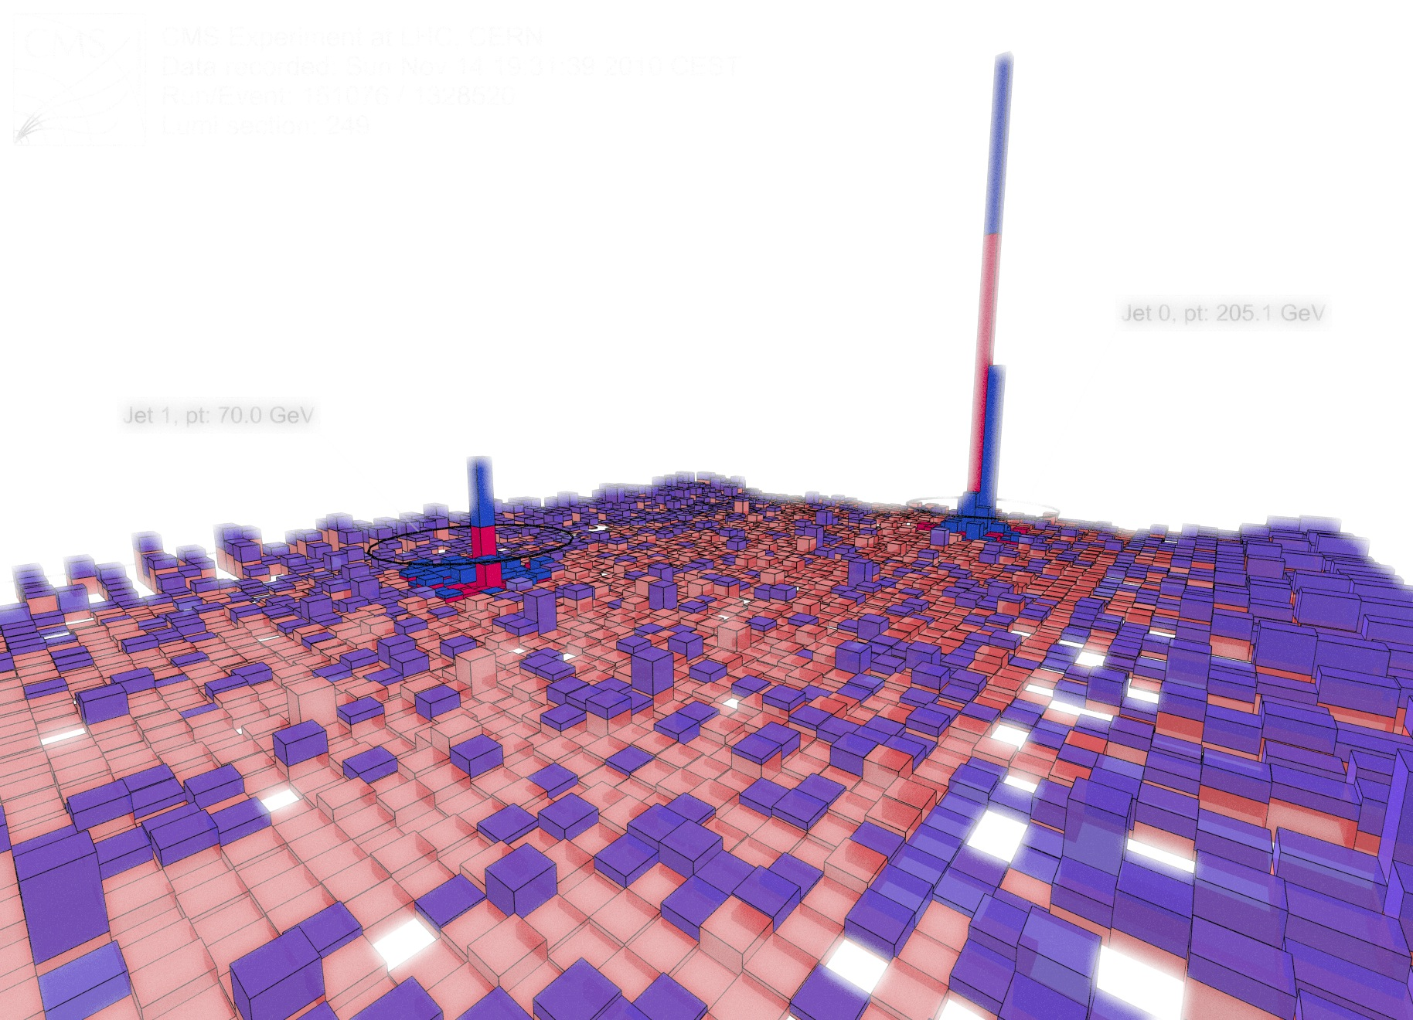
Energy loss
See Matt’s talk

Slide 25
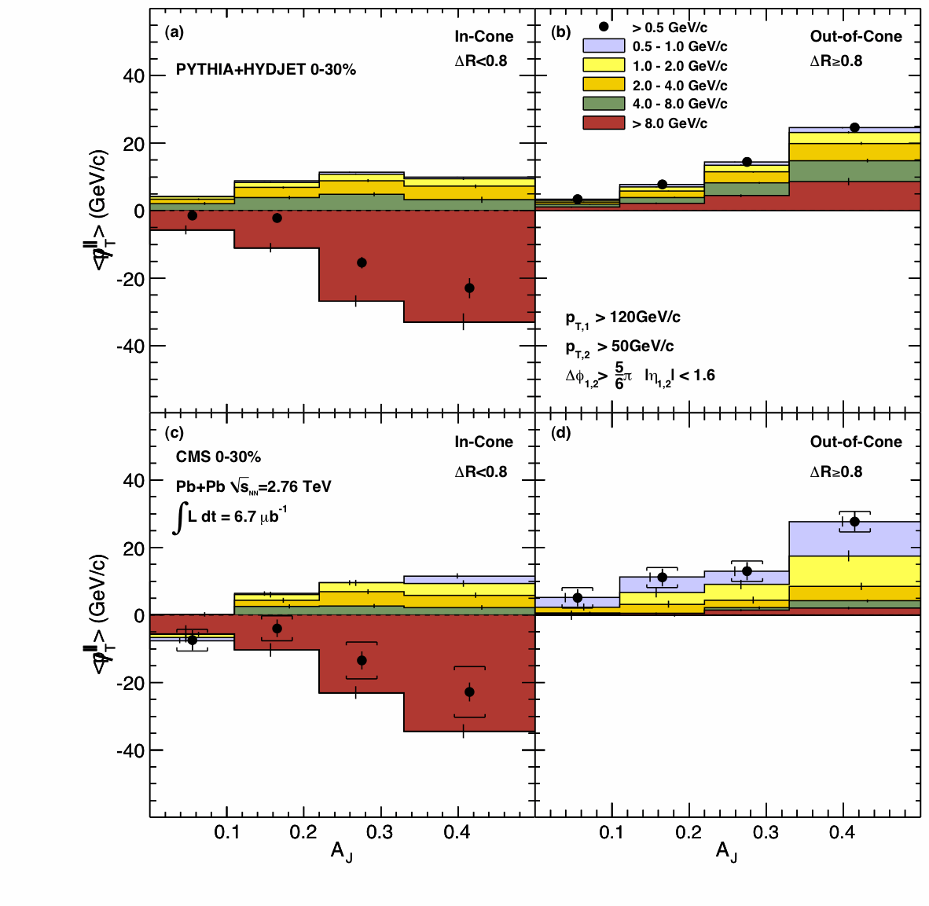
Tracing back the lost energy…
Since early 2011 we know the (subleading) jet energy is moved from high p_{T} to lower p_{T} and from small to large angles
PRC 84 (2011) 024906
ΔR<0.8
ΔR>0.8
ΔR
dijet asymmetry

Slide 26
Tracing back the lost energy…
Detailed (ΔR,p_{T}) distributions
Summing charged particles for unbalanced (A_{J}>0.22) dijets in central (0–30%) collisions…
35 GeV missing at ΔR<0.2, mmlarge p_{T} particles (>8GeV)
Talk by Gulhan, PAS-HIN-14-010
PbPb
ΔR
ΔR

Slide 27
Tracing back the lost energy…
Detailed (ΔR,p_{T}) distributions
Summing charged particles for unbalanced (A_{J}>0.22) dijets in central (0–30%) collisions…
35 GeV missing at ΔR<0.2, large p_{T} particles
Balanced by low p_{T} particle up to very large ΔR
Talk by Gulhan, PAS-HIN-14-010
PbPb

Slide 28
Tracing back the lost energy…
Detailed (ΔR,p_{T}) distributions
Summing charged particles for unbalanced (A_{J}>0.22) dijets in central (0–30%) collisions…
35 GeV missing at ΔR<0.2, large p_{T} particles
Balanced by low p_{T} particle up to very large ΔR
Subtracting the same from pp shows a different p_{T} mix
Talk by Gulhan, PAS-HIN-14-010
PbPb
PbPb–pp

Slide 29
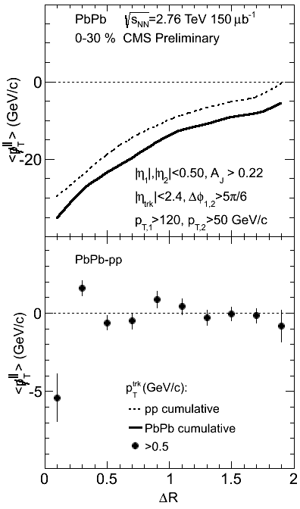
Tracing back the lost energy…
Detailed (ΔR,p_{T}) distributions
Summing charged particles for unbalanced (A_{J}>0.22) dijets in central (0–30%) collisions…
35 GeV missing at ΔR<0.2, large p_{T} particles
Balanced by low p_{T} particle up to very large ΔR
Subtracting the same from pp shows a different p_{T} mix
But a similar p_{T}-integrated ΔR distribution
Talk by Gulhan, PAS-HIN-14-010
PbPb
PbPb–pp
± 1 GeV

Slide 30
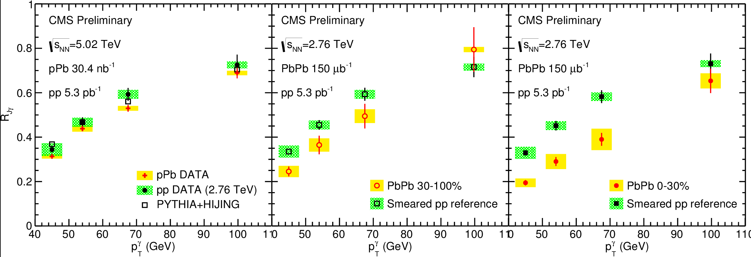
Unmodified jet energy in pPb
Jet energy is essentially unmodified in pPb
As seen for instance in gamma-jet correlations
R_{Jγ} = fraction of photons with a jet of p_{Tjet} > 30 GeV
R_{Jγ}
pPb PbPb 30-100% PbPb 0-30%
(Complementary p_{T} imbalance available)
(PbPb results updated with new pp reference)
Talk by Barbieri
PAS-HIN-13-006

Slide 31
R_{pA} & R_{AA} for jets and tracks
CMS preliminary
pPb
Central PbPb
(Jet = anti-k_{T} with R = 0.3,
BG subtracted, p_{T} unfolded)
Talk by Appelt, HIN-12-004, HIN-14-001

Slide 32
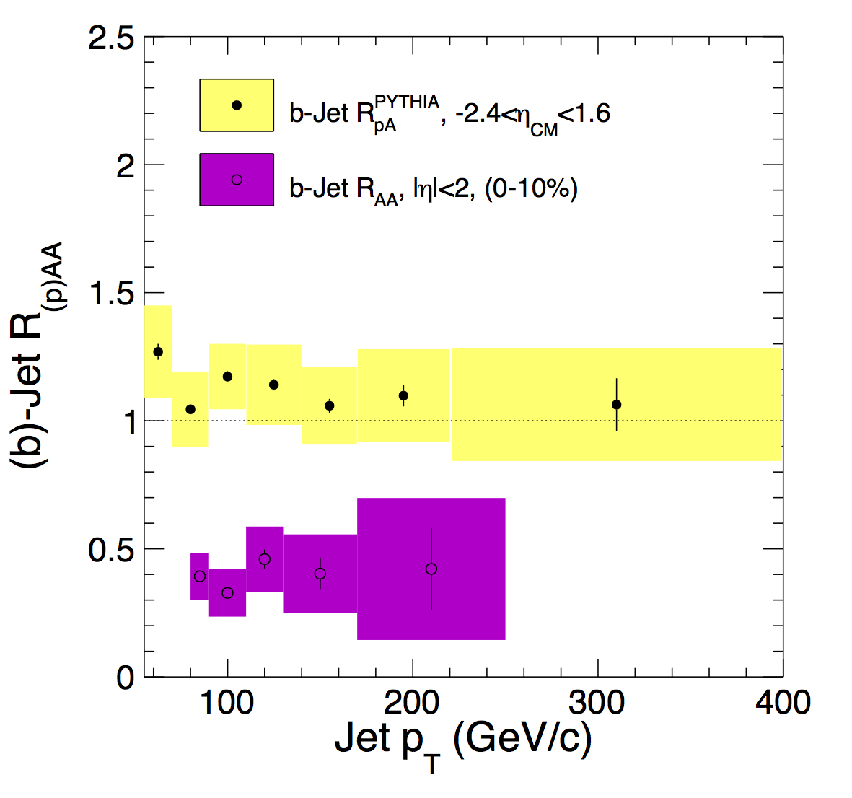
R_{pA} & R_{AA} for jets and b jets
CMS preliminary
PbPb b-jets = Matt’s analysis, soon in PRL
pPb
Central PbPb
Jets coming from b (second vertex)
as suppressed as incl. jets (R_{AA} ≈ 0.5)
not suppressed in pPb (R_{pA} ≈ 1)
Talk by Jung,
PAS-HIN-14-007,
PbPb:1312.4198

Slide 33
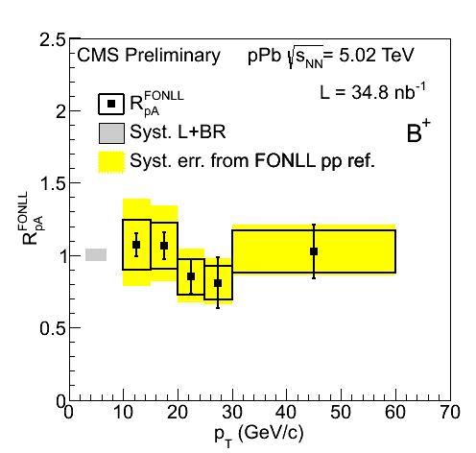
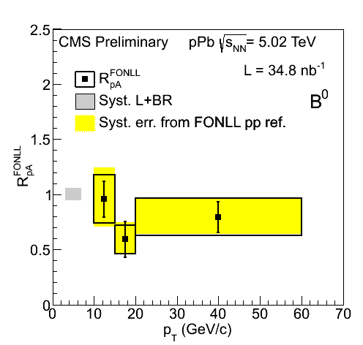
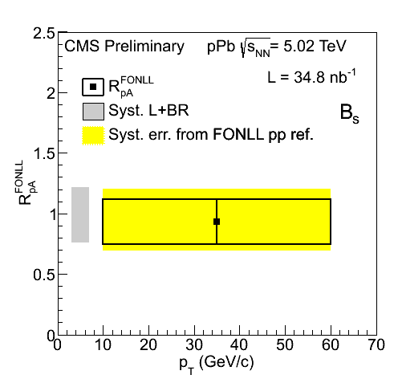
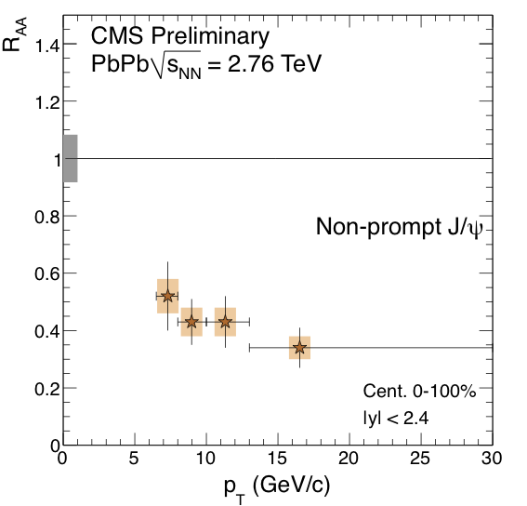
R_{pA} & R_{AA} for B mesons
B⁺ B⁰ B_{S}
pPb exclusive B decays (p_{T}(B) > 10 GeV)
(B⁺ → J/ψ K⁺, B⁰ → J/ψ K*, B_{S} → J/ψ φ)
Showing no modification
(large uncertainty, incl. the FONLL ref)
PbPb, inclusive B → J/ψ X (p_{T}(ψ) > 6.5 GeV)
Showing strong suppression
PbPb analysis from Camelia & Mihee, see her talk…
Talk by Kim, pPb: PAS-HIN-14-004, PbPb:PAS-HIN-12-014
Notes:
Dashed line at 1

Slide 34
Summary (2/4) Energy loss
Jets are heavily quenched in PbPb
Extensive studies on where the energy goes, to large angles and lower p_{T}
Jets are not strongly quenched in pPb
R_{pA} ≈ 1
No strong flavour dependence at high p_{T}
R_{AA} ≈ 0.5 for b-jet and inclusive jet

Slide 35
NUCLEAR PDF

Slide 36
R_{pA} & R_{AA} for jets and tracks
pPb
antishadowing region
Central PbPb
Enhancement observed at high p_{T}
Too large to be due to antishadowing?
Other nuclear effect?
But urgent need for pp reference
Talk by Appelt, HIN-12-004,
HIN-14-001, HIN-12-017
EPJC 72 (2012) 1945,

Slide 37
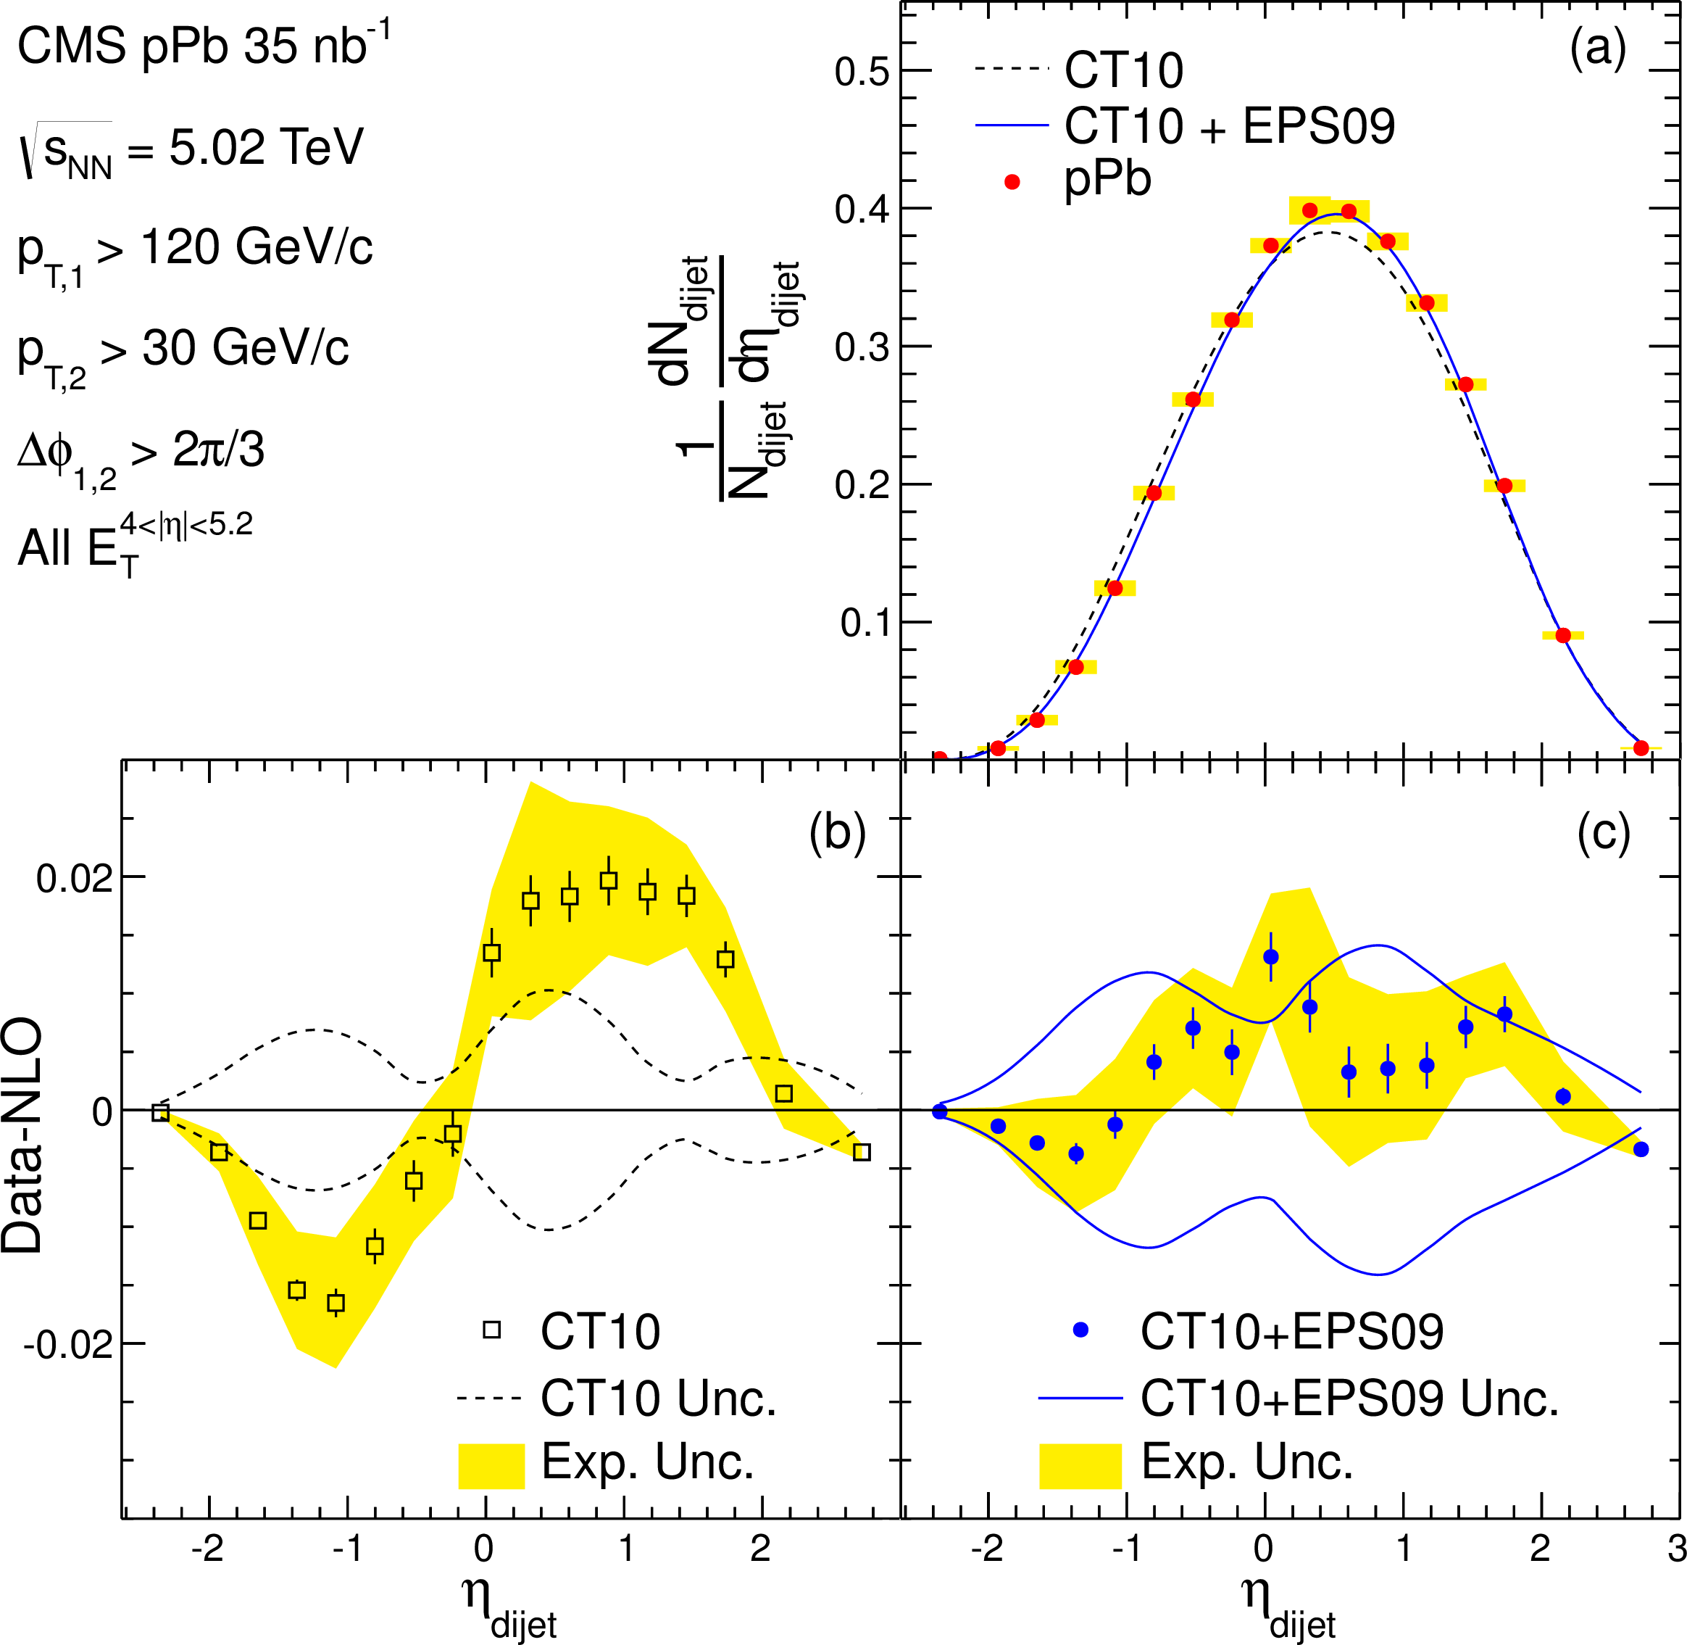
Modified dijet rapidity in pPb
η_{dijet} = (η₁+η₂)/2 has sensitivity to (gluon) PDF modifications
Shifted by an amount comparable to (EPS09) nPDF predictions
(large multiplicity dependence of the effect)
Talk by Barbieri
arXiv: 1401.4433
Notes:
Highest sensitivity

Slide 38
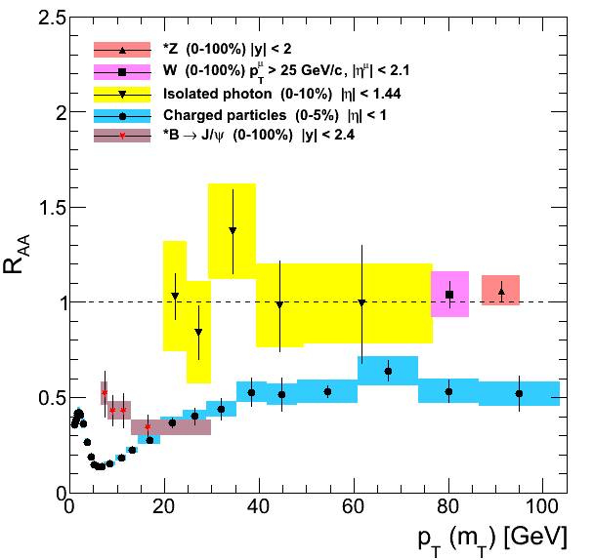
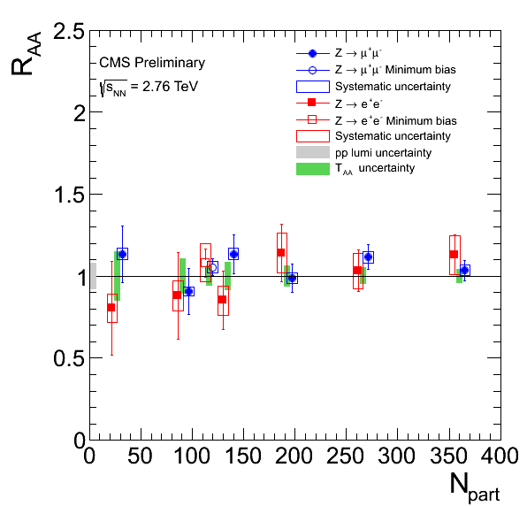
Electroweak bosons from PbPb to pPb
Standard candles: Z⁰ and W± unmodified in PbPb →
pPb providing the best opportunity to probe (valence) q and (sea) q nPDF
Higher statistics
Collision asymmetry
Well controlled pp reference
Talk by Zsigmond, PbPb:PAS-HIN-13-004
Z vs PbPb centrality

Slide 39
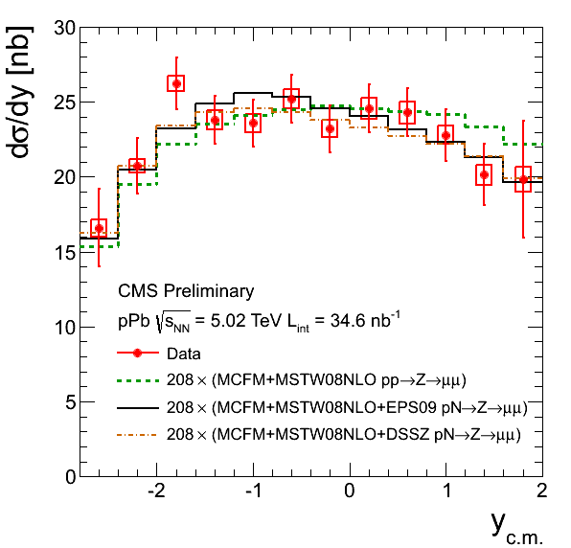
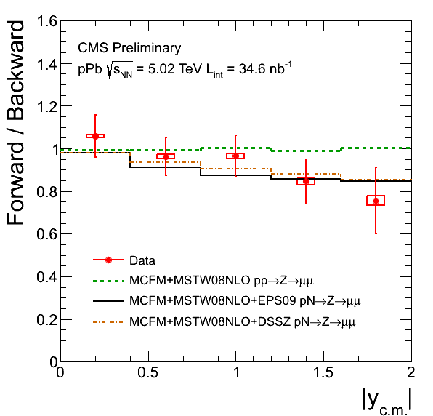
Z⁰ in pPb
≈ 2200 Z → μμ showing little nuclear effect
maybe a hint of forward/backward asymmetry
Talk by Zsigmond, PAS-HIN-14-003
Notes:
Plots from approved wiki

Slide 40
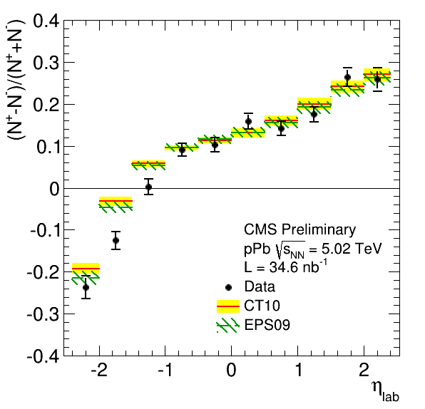
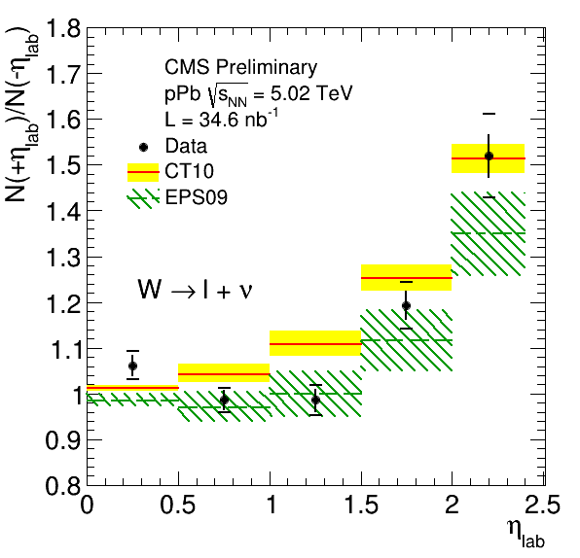
W⁺ and W– in pPb
≈ 21000 W → μ & 16000 W → e
Showing small deviations from unmodified PDFs
A hint of a different u/d modification? (not in EPS09)
Charge asymmetry
Forward/
Backward
(in lab)
Alice’s analysis &
PhD thesis, see talk
Talk by Zsigmond, PAS-HIN-13-007
Notes:
Lower the statement ! Increase the sensitivty

Slide 41
Summary (3/4) nPDF
Precision data start constraining nPDF in the high Q² regime
Dijet pseudorapidity shift → mostly gluons
Electroweak bosons → quarks / antiquarks, distinguishing ups and downs

Slide 42
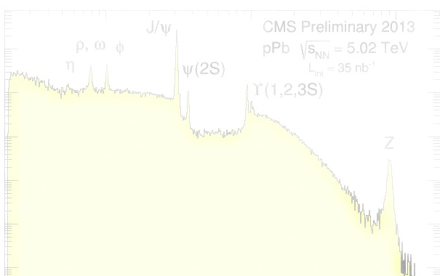
MELTING

Slide 43
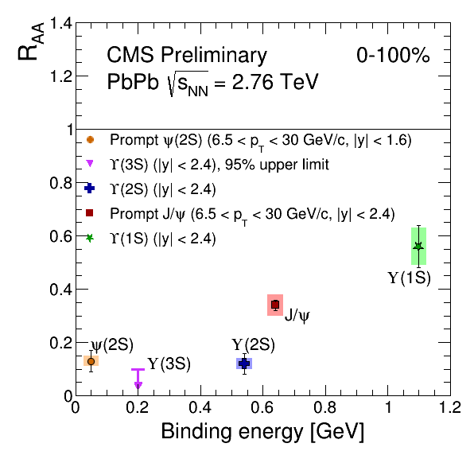
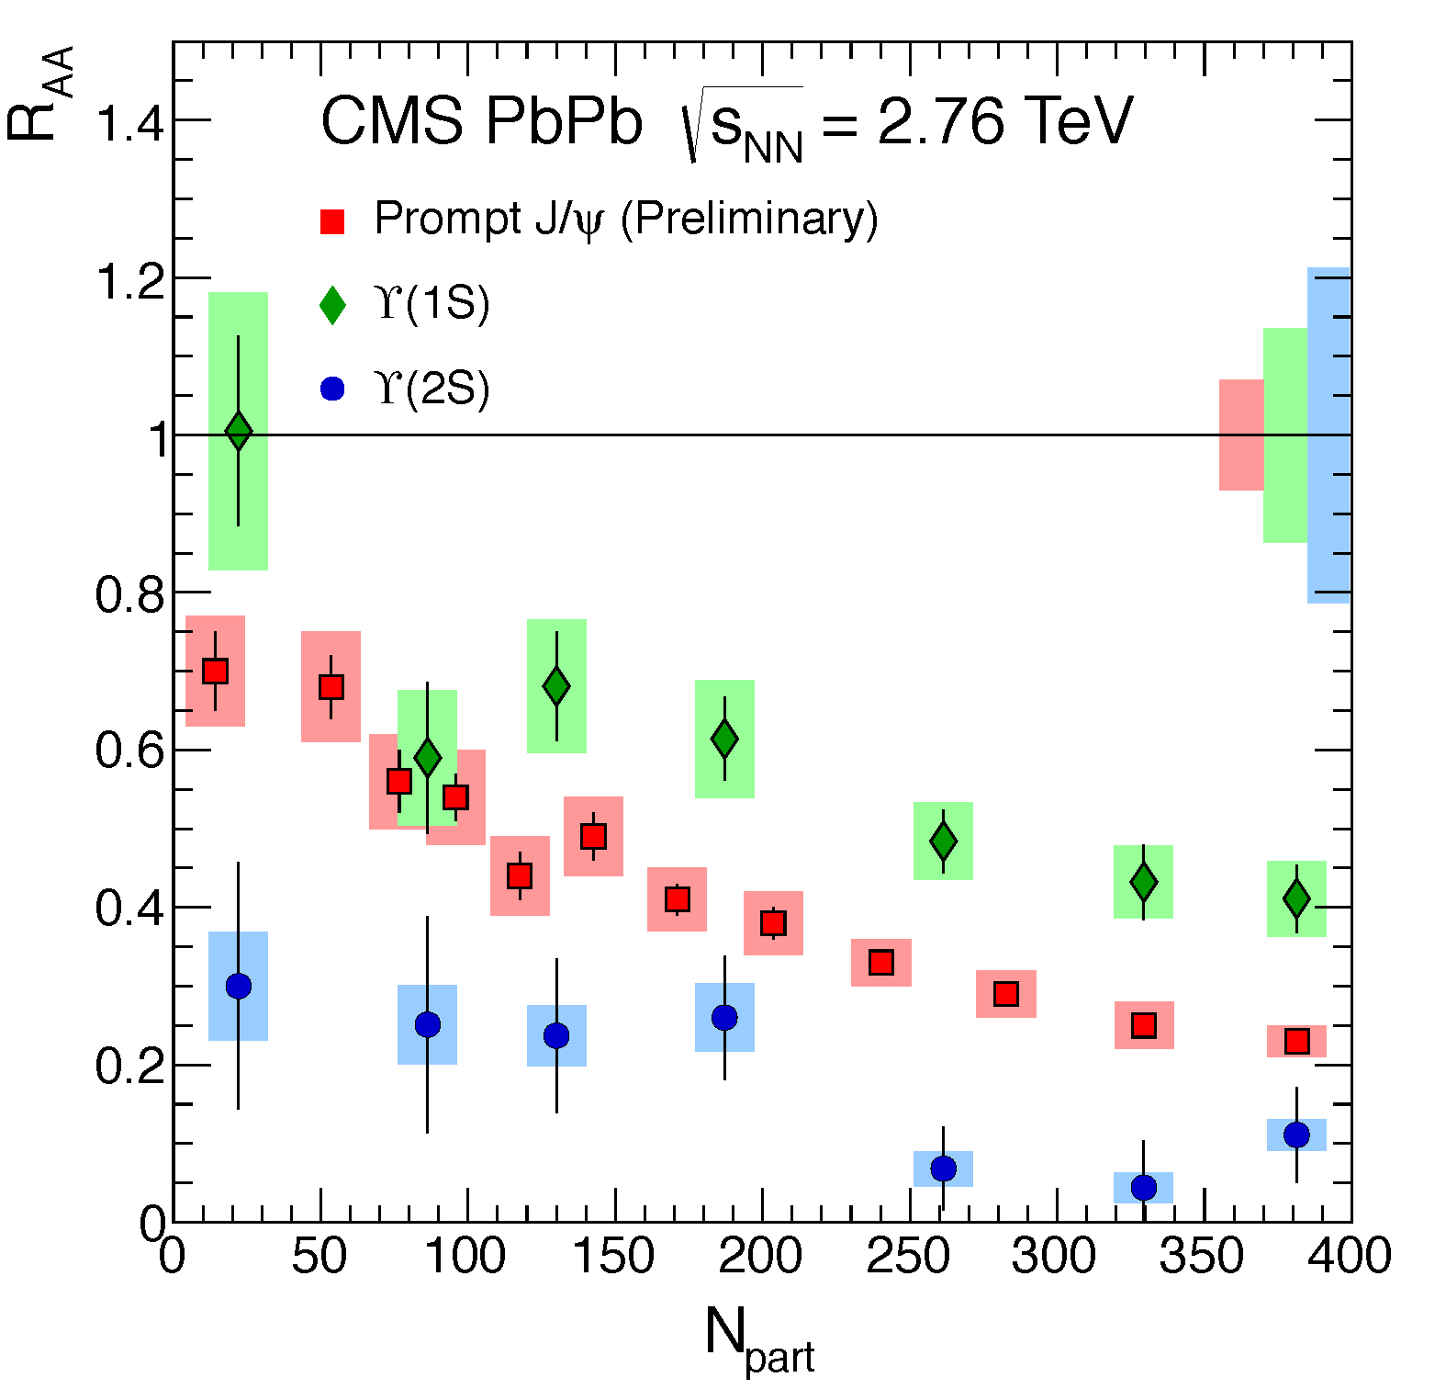
Five quarkonia
The suppression of 5 quarkonia was observed in PbPb
Well-ordered with binding energy
Inclusive bottomonia
Charmonia p_{T} > 6.5 GeV
+ p_{T}-inclusive J/ψ from ALICE less suppressed than at RHIC, calling for recombination
Quarkonia melt in quark matter
Longstanding
LLR expertise
Talks by Moon & Abdulsalam
PRL109 (2012) 2220301,
PAS-HIN-12-014, PAS-HIN-12-007
Notes:
Joke : which is not surprising given today temperature

Slide 44
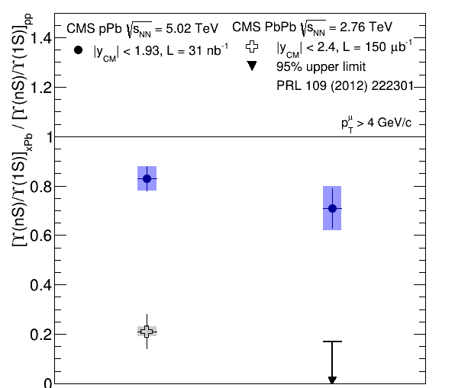
Upsilon in pPb
Excited states less suppressed than in PbPb
Excited/ground state ratio appears to vary w.r.t. the pPb and pp(!) event multiplicity (at midrapidity)
Excited states adding multiplicity?
Activity suppressing the excited states?
Talk by Abdulsalam
JHEP 04 (2014) 103
pPb
PbPb
Y(3S)
Y(1S)
Cf. Nicolas, Thesis to come on pt and y dependence in PbPb
Y(2S)
Y(1S)

Slide 45
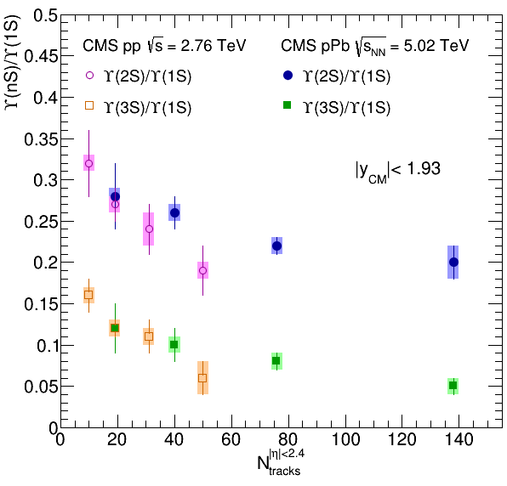
Upsilon in pPb
Excited states less suppressed than in PbPb
Excited/ground state ratio appears to vary w.r.t. the pPb and pp(!) event multiplicity (at midrapidity)
Excited states adding multiplicity?
Activity suppressing the excited states?
Talk by Abdulsalam
JHEP 04 (2014) 103
pPb
PbPb
Y(2S)
Y(1S)
Y(3S)
Y(1S)
Y(3S)
Y(1S)
pp pPb
Y(2S)
Y(1S)
Midrapidity activity

Slide 46
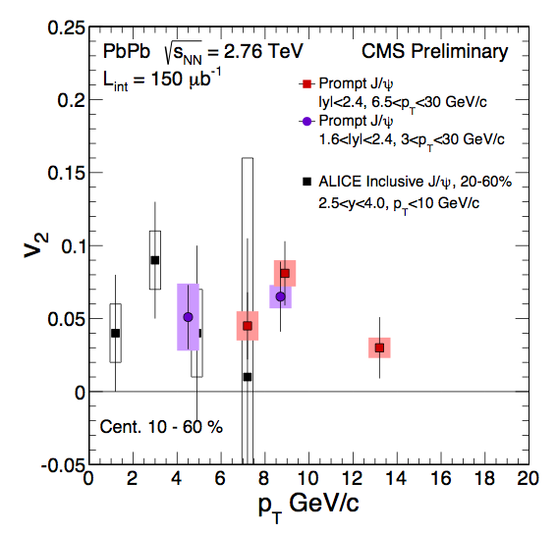
J/ψ azimuthal anisotropy
Significant v₂ at high p_{T}
Need more data to resolve the p_{T} dependence
From regeneration to path-length dependence of J/ψ suppression?
Cf. Émilien’s talk, preparing new run,
accessing lower p_{T}
Talk by Moon, PAS-HIN-12-001

Slide 47
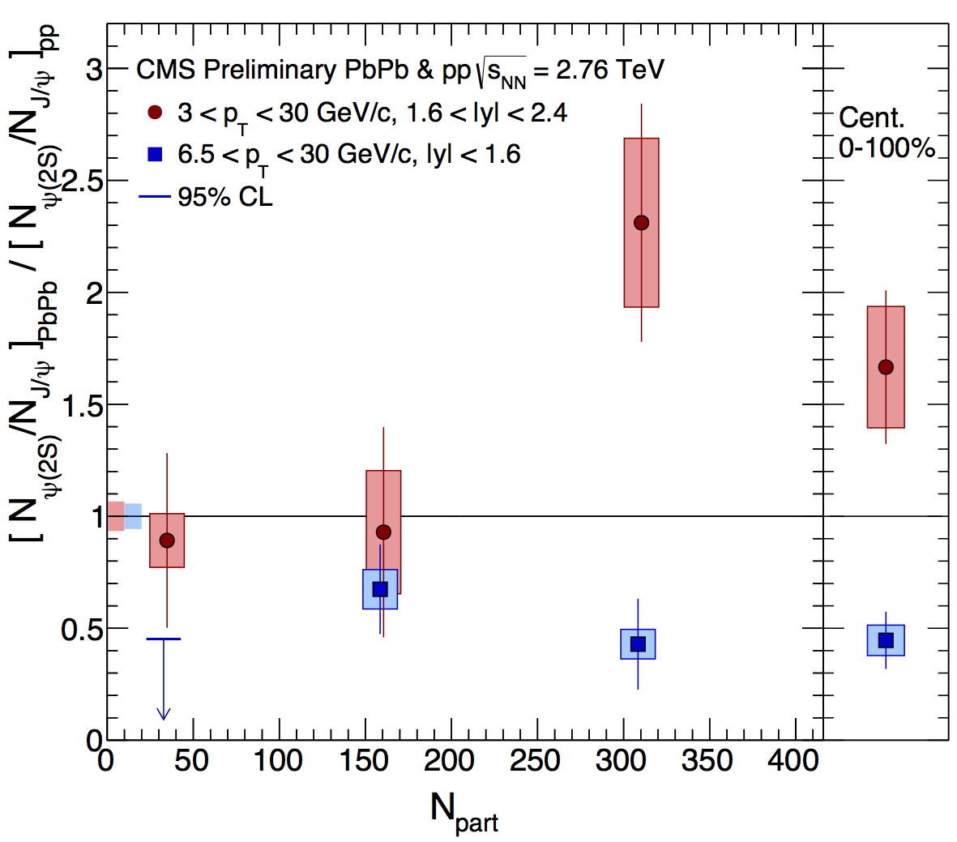
ψ’ in PbPb collisions
Surprisingly large (ψ’/ψ)_{PbPb} / (ψ’/ψ)_{pp} ratio confirmed:
new pp reference, 20 times larger, now negligible uncertainty
non-prompt component subtracted
Cf. Émilien’s talk, preparing new run,
accessing lower p_{T}
ψ’ very suppressed at high p_{T} (more than ψ)
→ R_{AA}(ψ’) = 0.13 ± 0.05
Much less at lower p_{T}
→ R_{AA}(ψ’) = 0.67 ± 0.19
40–100%
20–40%
0–20%
(Centrality-integrated R_{AA})
Talk by Moon, HIN-12-007
to be submitted soon

Slide 48
Summary (4/4) Melting
Sequential suppression from R_{AA}
Two intriguing observations
Y(nS)/Y(1S) depends on event activity (or vice versa) in both pPb & pp
Lower p_{T} ψ’ less suppressed… Could some regeneration models favour them?

Slide 49
Conclusions
Collectivity
Many observables indicating that high-multiplicity pPb collisions show collectivity
Energy loss
Detailed study of the structure of energy loss
First look at b-jets: behaving as inclusive jets
Nuclear PDF
From jets, Z and W, first constraints on high Q² nuclear PDFs, hints of nuclear effects
Melting
Apparent sequential melting of five quarkonia, with excited states showing interesting behaviours…

Slide 50
Conclusions
Collectivity
Many observables indicating that high-multiplicity pPb collisions show collectivity
Energy loss
Detailed study of the structure of energy loss
First look at b-jets: behaving as inclusive jets
Nuclear PDF
From jets, Z and W, first constraints on high Q² nuclear PDFs, hints of nuclear effects
Melting
Apparent sequential melting of five quarkonia, with excited states showing interesting behaviours…
Much more to study on tape…
Ready to take more data & increase the
statistics of the rarest QGP probes!
Notes:
Be positive

Slide 51
Back-up

Slide 52
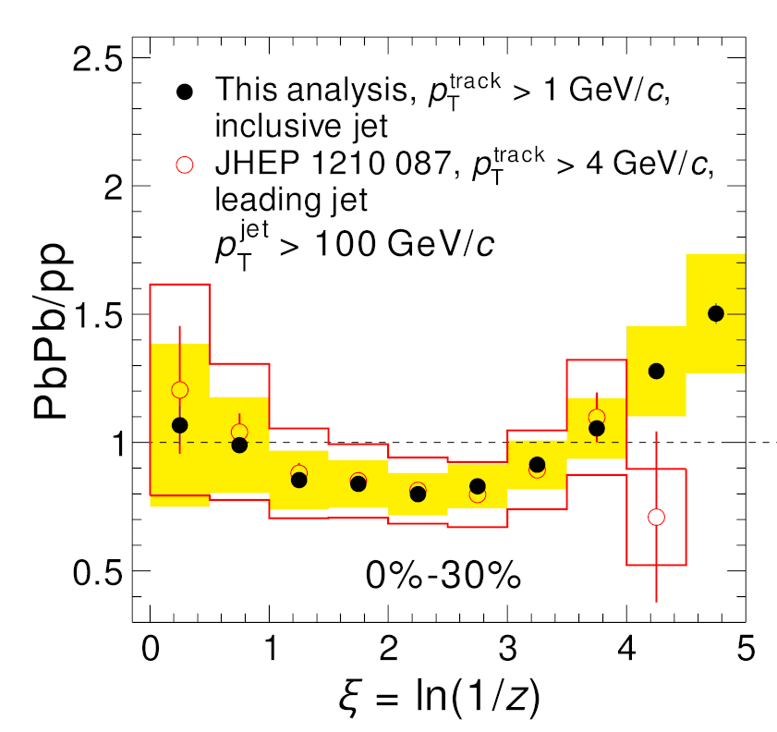
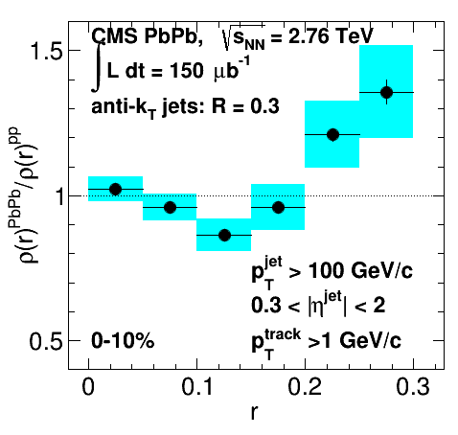
Tracing back the lost energy…
Since early 2011 we know jet energy is moved from high p_{T} to lower p_{T} and from small to large angles
e.g. for jets of ΔR = 0.3
PRC 84 (2011) 024906
PAS-HIN-12-013
PLB 730 (2014) 243
ΔR<0.3
Low p_{T} (< 3 GeV)
Large angles
Notes:
Imbalance plot
+ in-cone / out-of-cone

Slide 53
R_{pA} comparison ATLAS / CMS

Slide 54
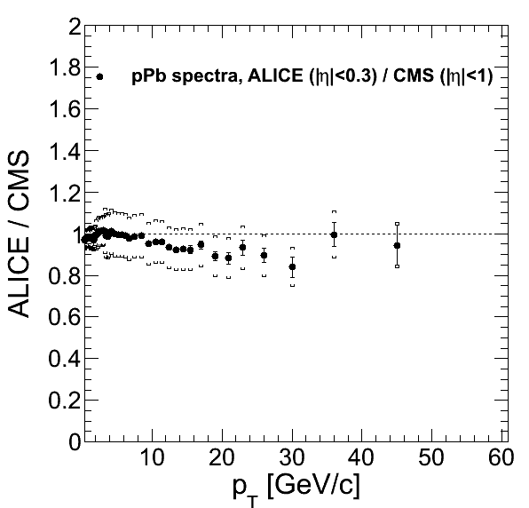
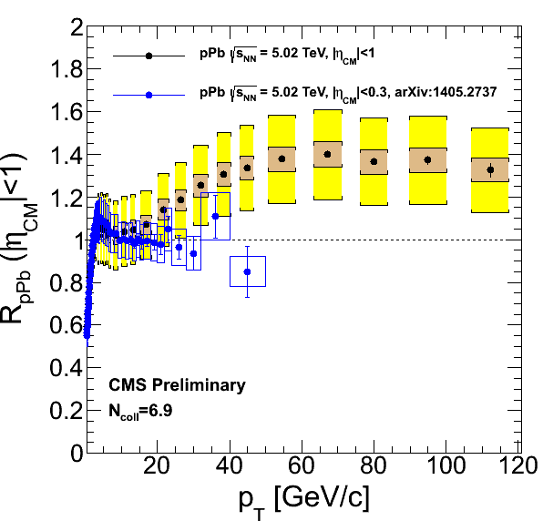
R_{pA} comparison ALICE / CMS
Small tension in pPb
data, but compatible
within systematics
Large tension in pp
reference, mostly
due to the pp data
(not to the method
of extrapolation)
→ Would be much simplier with pp data at 5 TeV

Slide 55
Modified dijet rapidity in pPb
η_{dijet} = (η₁+η₂)/2 is shifted
By an amount comparable to (EPS09) nPDF predictions
But its multiplicity dependence is very large
Talk by Barbieri
arXiv: 1401.4433

Slide 56
ψ’
ALICE / CMS
old / new

Slide 58
Y suppression
Notes:
Eur. Phys. J. A48 (2012) 72

