Slide 1
Rencontres QGP Etretat 16/9/2014
News from quarkonia
Elena G. Ferreiro
Universidad de Santiago de Compostela
Spain

Slide 2
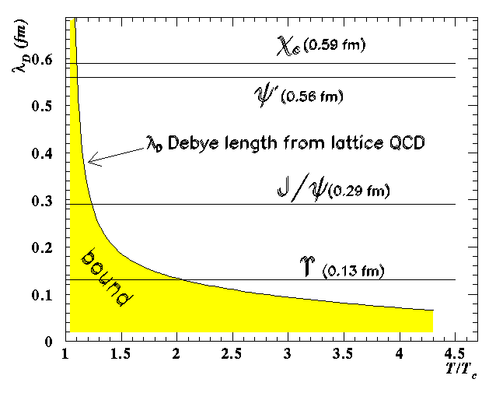
Quarkonium production: the typical introduction….
Potential between q-anti-q pair
grows linearly at large distances
V(r)
Screening of long range confining potential at high enough temperature or density.
r
What happens when the range of the binding force becomes smaller than the radius of the state?
V(r)
different states “melting” at different temperatures due to different binding energies.
Matsui and Satz:
J/ψ destruction in a QGP by Debye screening
J/Ψ suppression = QGP signature
E. G. Ferreiro Rencontres QGP Etretat 16/9/2014

Slide 3
But the story is not so simple…. Open questions
• Can the melting temperature(s) be uniquely determined ?
• Are there any other effects, not related to colour screening, that may induce
a suppression of quarkonium states ?
• Are there effects that can induce an enhancement of quarkonium?
• Is it possible to define a “reference”(i.e. unsuppressed) process in order to
properly define quarkonium suppression ?
• Do we understand charmonium production in elementary p+p collisions?
• Do experimental observations fit in a coherent picture ?
E. G. Ferreiro Rencontres QGP Etretat 16/9/2014

Slide 4
feed down?
High density, collectivity
E. G. Ferreiro Rencontres QGP Etretat 16/9/2014
Notes:
Collective n’est pas neccesariement chaud!

Slide 5
Quarkonium and the QGP - “sequential suppression”
In particular J/ψ. …
E. G. Ferreiro Rencontres QGP Etretat 16/9/2014

Slide 6

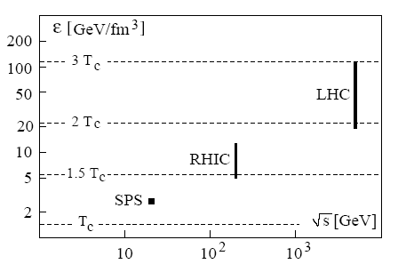
Quarkonium and the QGP - “sequential suppression”
• By determine heavy quark potential V(r,T) in
finite T QCD and solving Schrodinger eq:
Dissociation temperatures T_{diss}/T_{c}
Energy densities:
0.5-1.5 GeV/fm³ = 1.0 T_{c}
10 GeV/fm³= 1.5 T_{c}
30 GeV/fm³= 2.0 T_{c}
In particular J/ψ. …
E. G. Ferreiro Rencontres QGP Etretat 16/9/2014
Notes:
Earlier lattice studies had provided only the colour average of the in-medium
Q¯Q free energy; now it is possible to separate out the colour singlet contribution.
• Earlier potential models had used the free energy as potential in the Schr¨odinger
equation; today we can specify the colour singlet internal energy, which is
more realistic as the relevant potential and leads to a stronger binding.
• There now exist direct finite temperature lattice QCD studies of the inmedium
behaviour of charmonia, allowing ab initio conclusions not based
on any potential model, and they support a higher J/ψ dissociation temperature.

Slide 7
Quarkonium and the QGP - “sequential suppression”
At large pT the medium becomes fully transparent, because the initial dipole size is “frozen”, and the projection to the J/Ψ wave function remains the same as in pp
Satz, Kharzeev, Kopeliovich…
E. G. Ferreiro Rencontres QGP Etretat 16/9/2014

Slide 8


Similar gain and loss diferential eqs.
E. G. Ferreiro Rencontres QGP Etretat 16/9/2014

Slide 9
E. G. Ferreiro Rencontres QGP Etretat 16/9/2014

Slide 10
Recombination: proportional to
= 0.3-0.4 mb
wo shadowing
= 0.6-0.8 mb
Similar gain and loss diferential eqs.
w shadowing
E. G. Ferreiro Rencontres QGP Etretat 16/9/2014

Slide 11
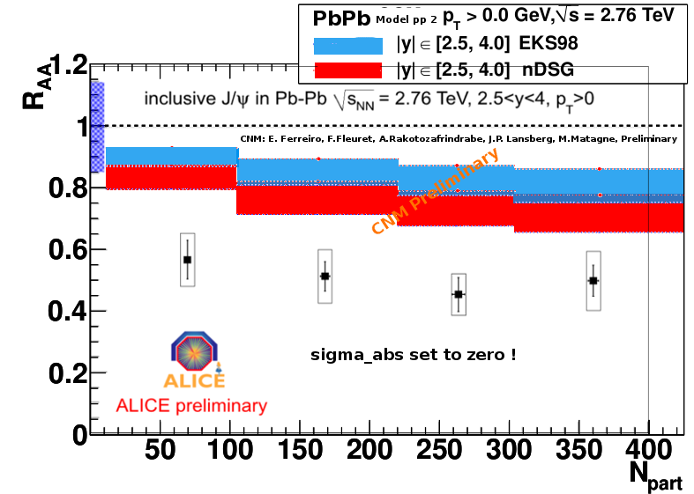
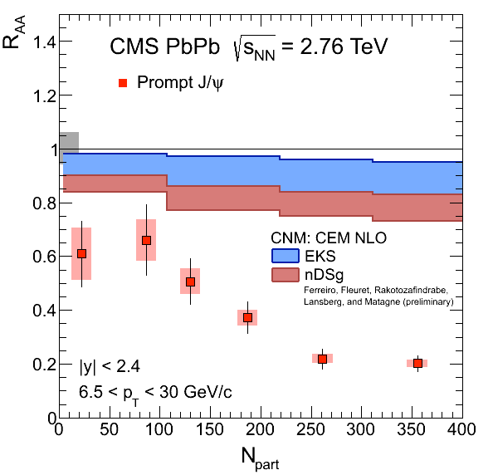
Initial shadowing effects are important: J/ψ production in PbPb
• Nuclear shadowing is an initial-state effect on the partons distributions
• Gluon distribution functions are modified by the nuclear environment
• PDFs in nuclei different from the superposition of PDFs of their nucleons
Shadowing effects increases with energy (1/x) and decrease with Q² (m_{T})
Rakotozandrabe, Ferreiro, Fleuret, Lansberg , Matagne Nucl. Phys. A855, 327 (2011)
Production mechanism affects CNM effects intimately:
• Shadowing depends on momentum fraction x of the target (and projectile in AA)
which is influenced by how the state was produced: 2 → 1 or 2 → 2 process
• Production can also affect other CNM effects,
since singlet and octet states can be absorbed differently
E. G. Ferreiro Rencontres QGP Etretat 16/9/2014

Slide 12
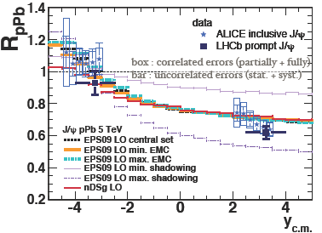
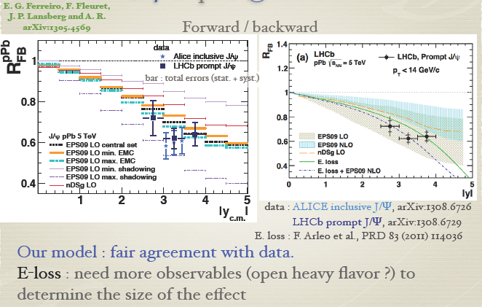
Cross check: J/ψ production in pPb
good agreement with EPS09 LO and nDSg shadowing
also consistent w energy loss models w/wo EPS09NLO shadowing
EPS09 NLO and CGC calculation disfavored
E.G.F, F. Fleuret, J.P. Lansberg,
A.Rakotozafindrabe
arXiv:1305.4569
E. G. Ferreiro Rencontres QGP Etretat 16/9/2014

Slide 13
What have we learnt from J/ψ production in pPb and PbPb?
J/ψ production seems at least qualitatively understood
Cold nuclear matter effects can be described with shadowing and/or energy loss
Production in HI collisions is described by a combination of
•suppression (either color screening, or in-medium dissociation)
•recombination (either in-medium or at phase boundary)
Challenge will be to discriminate between these possible scenarios
Hugo’s
talk
High density medium,
Not necessairly thermalized
What is the state of the art for ψ (2)?
Note that cold nuclear matter effects (shadowing and/or energy loss) are considered to be the same for than for the J/ψ
Nevertheless, in-medium effects depending on density (comovers) would be able to distinguish between them
E. G. Ferreiro Rencontres QGP Etretat 16/9/2014

Slide 14
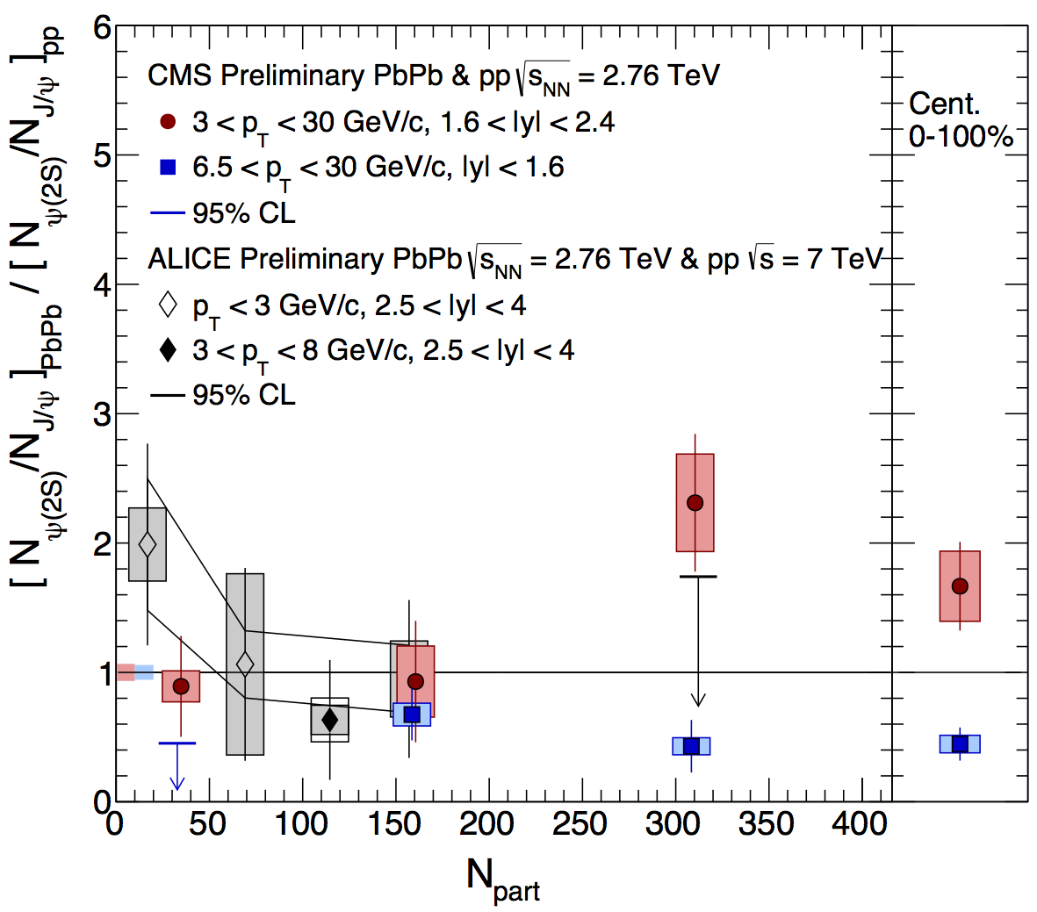
[ψ (2S)/J/ψ ]_{PbPb} / [ψ (2S)/J/ψ ]_{pp}
Surprisingly large (ψ’/ψ)_{PbPb} / (ψ’/ψ)_{pp} ratio confirmed
ψ’ very suppressed at high p_{T} (more than ψ)
Much less at lower p_{T}
But… is it really so surprising?
?
E. G. Ferreiro Rencontres QGP Etretat 16/9/2014

Slide 15
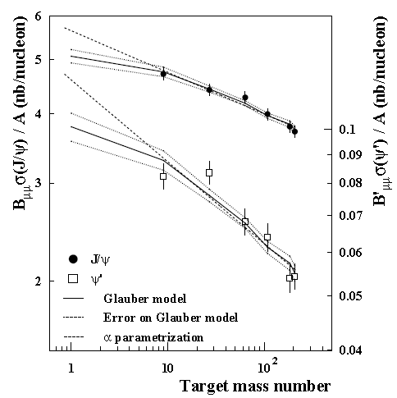
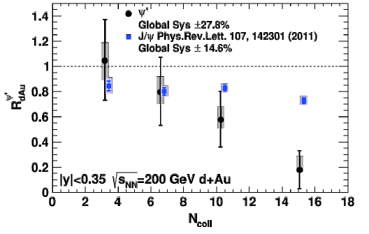
[ψ (2S)/J/ψ ]_{pPb} / [ψ (2S)/J/ψ ]_{pp}
SPS
RHIC
In pA collisions at all energies:
R_{pA}^{J/ψ} > R_{pA}^{ψ} ‘
E. G. Ferreiro Rencontres QGP Etretat 16/9/2014

Slide 16
M. Durham QM2014
E. G. Ferreiro Rencontres QGP Etretat 16/9/2014

Slide 17
[ψ (2S)/J/ψ ]_{pPb} / [ψ (2S)/J/ψ ]_{pp}
In a comover scenario, expected stronger suppression for 2S that 1S in pA,
Increasing with centrality
Capella et al, Phys.Lett. B430 (1998) 23
E. G. Ferreiro Rencontres QGP Etretat 16/9/2014

Slide 18
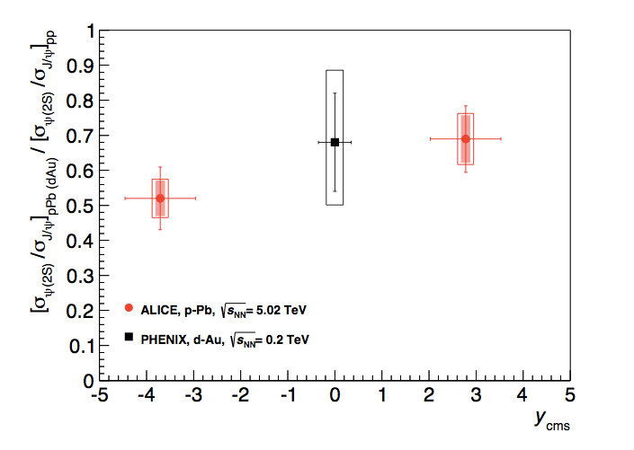
[ψ (2S)/J/ψ ]_{pPb}/[ψ (2S)/J/ψ ]_{pp VS.} ψ (2S)/J/ψ ]_{PbPb}/[ψ (2S)/J/ψ ]_{pp}
2S less supressed than 1S in PbPb or ….
Suppression + recombination at low pT?
2S more supressed than 1S in pPb
Peter Braun-Munzinger, Krzysztof Redlich EPJC16 (2000) 519
Comover dissociation + recombination in PbPb at LHC?
E. G. Ferreiro Rencontres QGP Etretat 16/9/2014

Slide 19
[ψ (2S)/J/ψ ]_{PbPb} / [ψ (2S)/J/ψ ]_{pp}
Comover results: 2 set of results
Exact numerical solution
Exact numerical solution
Feed down taken
into account:
Inclusive 1S =
0.4 direct 1S + 0.6 2S
E. G. Ferreiro Rencontres QGP Etretat 16/9/2014

Slide 20
Comover
dissociation+
recombination
?
Feed down taken into account:
Inclusive 1S = 0.4 direct 1S + 0.6 2S

Slide 21
Comover
dissociation+
recombination
?
Peter Braun-Munzinger, Krzysztof Redlich EPJC16 (2000) 519
Feed down taken into account:
Inclusive 1S = 0.4 direct 1S + 0.6 2S

Slide 22
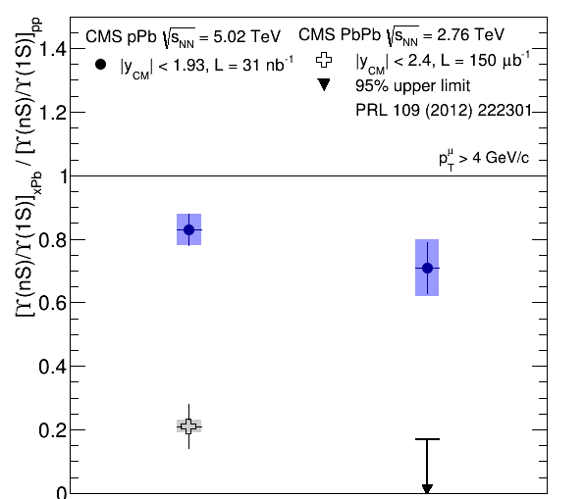
ϒ(1S), ϒ(2S), ϒ(3S) in PbPb
Sequential suppression of the three states
in order of their binding energy
Clear suppression of ϒ(2S)
ϒ(1S) suppression consistent with excited
state suppresion (≈ 50% feed down)
Comover dissociation
E. G. Ferreiro Rencontres QGP Etretat 16/9/2014

Slide 23
What have we learnt from J/ψ production in pPb and PbPb?
J/ψ production seems at least qualitatively understood
Cold nuclear matter effects can be described with shadowing and/or energy loss
Production in HI collisions is described by a combination of
•suppression (either color screening, or in-medium dissociation)
•recombination (either in-medium or at phase boundary)
Challenge will be to discriminate between these possible scenarios
Hugo’s
talk
High density medium,
Not necessairly thermalized
Crucial to distinguish among the models
What is the state of the art for ψ (2)?
Note that cold nuclear matter effects (shadowing and/or energy loss) are considered to be the same for than for the J/ψ
Nevertheless, in-medium effects depending on density (comovers) would be able to distinguish between them
ϒ(2S) and (3S) are strongly suppressed at LHC.
ϒ(1S) suppression is the same at RHIC and LHC, consistent with higher mass excited states suppression
No recombination, but some shadowing effects
E. G. Ferreiro Rencontres QGP Etretat 16/9/2014

Slide 25
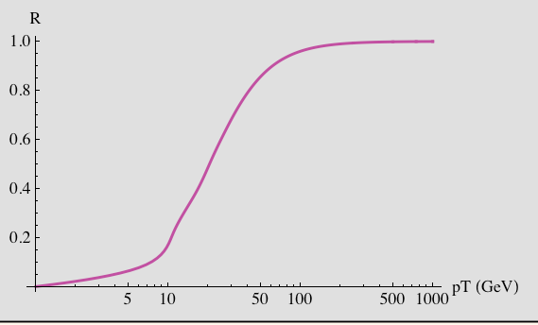
Two sources of J/Ψ suppression in a hot medium: B. Kopeliovich
QM2014
(i) Debye screening, i.e. weakening of the binding potential, which can lead to
disappearance of the bound level (melting)
(ii) Color-exchange interactions of the c-cbar dipole with the medium, leading to a
break-up of the colorless dipole (absorption).
Absoption q ≈3.6 T³ Melting
The melting scenario assumes that lacking a bound level the quarks fly away, resulting in disappearance of J/Ψ. However, the quark distribution amplitude still can be projected to the charmonium wave function.
Even in the extreme case of lacking any
potential between c and c-bar (T -> ∞),
still the J/Ψ can survive.
At large pT the medium becomes fully transparent, because
the initial dipole size is “frozen”, and the projection to the J/Ψ
wave function remains the same as in pp

