Slide 1
Heavy quarks and QGP with LHCb / SMOG
Physics case
LHCb / SMOG

Slide 2
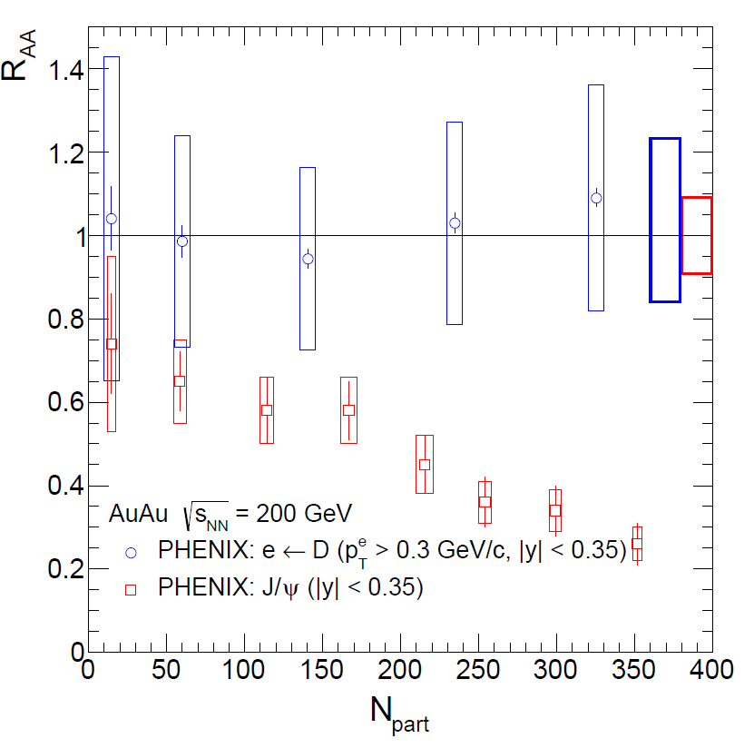
Heavy quarks
The Physics case
Heavy quarks and Quark Gluon Plasma (QGP)
Heavy quarks are ″special ″ QGP probes : m_{Q} >> QGP critical temperature T_{C} (~170 MeV),
➔ Heavy quarks should be produced in initial nucleon-nucleon collisions only, the QGP phase shouldn’t modify the overall heavy quark yields,
➔ QGP phase should modify relative heavy quark (hidden/open) bound state yields
Heavy quark hadronization ($c\overline{c}$ example):
~90% of $c\overline{c}$pairs → open charm
~10% of $c\overline{c}$pairs → hidden charm (charmonia)
Phys. Rev. C84, 044905 (2011)
Phys. Rev. C84, 054912 (2001)
Since most of the produced $c\overline{c}$pairs hadronize into open charm (~90%), open charm production reflects the original charm quark yield.
PHENIX Au+Au collisions @ $\sqrt{s_{NN}}$ = 200 GeV
Blue = open charm
Red = hidden charm
no (little) modification of open charm yield
modification of J/Ψ ($c\overline{c}$bound state) yield

Slide 3
Heavy quarks
The Physics case
Heavy quarks and Quark Gluon Plasma (QGP)
Heavy quarks are ″special ″ QGP probes : m_{Q} >> QGP critical temperature T_{C} (~170 MeV),
➔ Heavy quarks should be produced in initial nucleon-nucleon collisions only, the QGP phase shouldn’t modify the overall heavy quark yields,
➔ QGP phase should modify relative heavy quark (hidden/open) bound state yields
Modifying hidden bound state yields Possible QGP effects on quarkonium:
Color screening: $Q\overline{Q}$ bound states suppression
Color screening in a QGP decreases quarkonium binding
Color screening should lead to a suppression of quarkonium production yields
Recombination: $Q\overline{Q}$ bound states enhancement
at sufficiently high $\sqrt{s_{NN}}$, heavy quarks are abundantly produced.
After thermalisation, statistical combination can lead to an enhancement of quarkonium production yields
recombination
quarkonium production probability
screening
Energy Density

Slide 4
Charm quarks
The Physics case
Experimentally, charmonium is a priviledged probe
Charmonium production in A+A collisions studied at:
CERN-SPS (√s=17 GeV) NA38, NA50, NA60 experiments
BNL-RHIC (√s=200 GeV) PHENIX, STAR experiments
CERN-LHC (√s=2.76 TeV) ALICE, CMS experiments
Short summary for J/Ψ:
NA50 (PbPb@SPS) observed an anomalous J/Ψ suppression
PHENIX (AuAu@RHIC) observed a similar suppression (than NA50)
ALICE (PbPb@LHC) observed a smaller suppression (than PHENIX)
➔Possible Color screening starting at SPS
➔Possible recombination occuring at LHC
Within the SPS+RHIC+LHC energy range, charm seems to be the adequate probe to investigate both screening and recombination.
recombination
LHC
SPS
Charmonium production probability
screening
Energy Density

Slide 5
Charm quarks
The Physics case
What next to be done with charmonium
To confirm (and study) charmonium color screening and recombination, one must compare charmonium and open charm production in A+A collisions
Since most of the produced $c\overline{c}$pairs hadronize into open charm (~90%), open charm production reflects the original $c\overline{c}$pair production
Open charm is therefore an (the?) appropriate reference to calibrate charmonium screening/recombination studies.
TeV scale: Charmonium recombination
Both J/Ψ and open charm will be measured in PbPb at large energy densities at LHC
➔ Best place to study charmonium recombination
recombination
20-GeV Scale: Charmonium color screening
At SPS energies, in Pb+Pb collisions, J/Ψ suppression occurs in the middle of the accessible energy density range
➔ Best place to study color screening
Needs measurement of open charm yields
Needs precise measurements of several $c\overline{c}$states to test if color screening leads indeed to a sequential suppression
LHC
SPS
Charmonium production probability
screening
Energy Density

Slide 6
Sequential suppression
Color screening
Quarkonium sequential suppression
Quarkonium sequential suppression in a Quark Gluon Plasma is a prediction of lattice QCD :
Because of feed-downs and different T_{d}, sequential suppression should show up.
H. Satz, J. Phys. G 32 (2006)
$\frac{\text{quarkonium} \text{dissociation} \text{temperature}}{\text{critical} \text{QGP} \text{temperature}}$ ➔
Feed-downs contributing to J/Ψ inclusive yield
60% direct J/Ψ
+ 30% χ_{c}→J/Ψ+γ
+ 10% Ψ’ → J/Ψ + X
Inclusive J/Ψ yield
Sequential suppression - screening
1st step
2nd step
production probability
According to lattice calculations,
T_{d} (Ψ’) < T_{d} (χ_{c}) < T_{d} (J/Ψ)
➔ One should observe a step-like suppression pattern
3rd step
Ψ’
χ_{c}
J/Ψ
Temperature (Energy density)

Slide 7
Charmonia in A+A
NA50 results
Anomalous suppression at SPS
Eur.Phys.J.C49:559-567,2007
L = length of nuclear matter seen by quarkonium state
p+A
Expected = measured yields in p+A extrapolated to large L
S+U
Pb+Pb
0.9
0.9
Color screening ?
NA50 measured J/Ψ and Ψ’, but,
too small Ψ’→ J/Ψ feed-down
too fragile Ψ’
to answer the question
need of a larger feed-down fraction
Need of a stronger bound state
Need to measure χ_{c} yield !
L (fm)
ε (GeV/fm³)
4.37
1.04
4.90
1.24
6.65
2.04
7.65
2.53
8.83
3.19
9.43
3.76

Slide 8
Charmonia in A+A
Suppression patterns
Anomalous suppression at SPS
Eur.Phys.J.C49:559-567,2007
Color screening ?
p+A
60% direct J/Ψ
+ 30% χ_{c}→J/Ψ+γ
+ 10% Ψ’ → J/Ψ + X
Inclusive J/Ψ yield
S+U
Take advantage of large χ_{c} → J/Ψ feed-down fraction
Pb+Pb
QGP - χ_{c}
Measuring J/Ψ, Ψ’ and χ_{c} suppression patterns will give the answer
comovers - χ_{c}
Alternative (no QGP) scenario: suppression by comoving hadrons
Smooth suppression
Same suppression-starting point
Slopes related to binding energy : S_{Ψ ’} > S_{χ} > S_{J/Ψ}
L (fm)
ε (GeV/fm³)
4.37
1.04
4.90
1.24
6.65
2.04
7.65
2.53
8.83
3.19
9.43
3.76

Slide 9
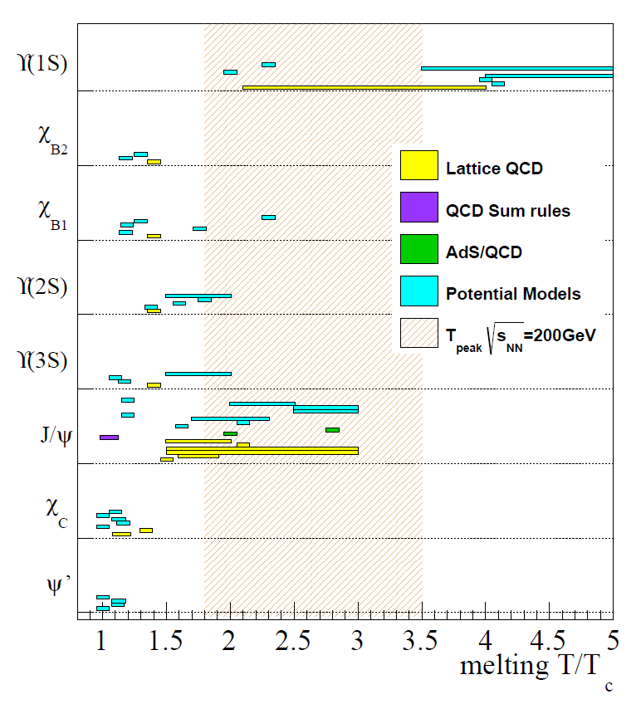
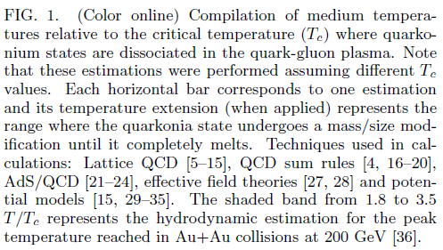
Physics case summary
Measuring χ_{c} in A+A
Hint of color screening at SPS
Anomalous suppression of J/ψ
Anomalous suppression of ψ’
But, need to be confirmed
by measuring together J/ψ, ψ’, χ_{c} and open charm
Measuring χ_{c} may also permit to
Contrain J/ψ T_{C}
test the phase transition
PHENIX
PRC91, 024913 (2015)

Slide 10
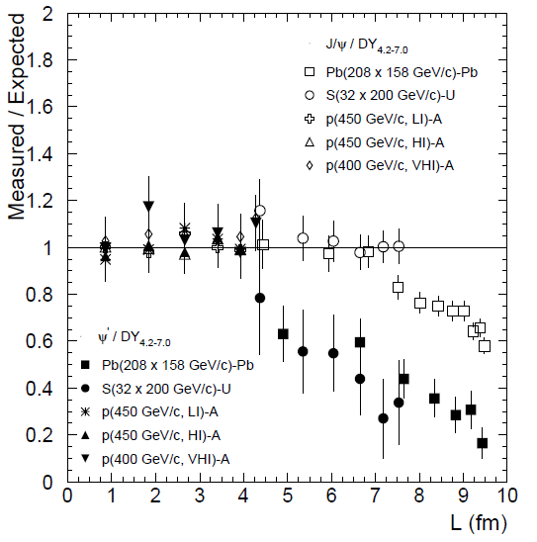
Charmonia in A+A
statistics
Typical 40-day Pb+Pb run @SPS (10⁷.s⁻¹ Pb beam → 10% λ_{I} Pb target)
~ 180 000 J/Ψ→μ⁺μ⁻ recorded by NA50
~ 1300 Ψ’ → μ⁺μ⁻ recorded by NA50
If capable of measuring χ_{c} -> J/Ψγ,
in NA50 acceptance : 3000 < χ_{c} < 7000
Possible χ_{c} suppression pattern
~180 000 J/Ψ
~ 1300 Ψ’
~ 3000 χ_{c}
But
NA50 was not instrumented to measure photons
➔ not able to measure χ_{c} production
NA50 was not instrumented to perform PID
➔ not able to measure D⁰ production
Today, these measurements are possible with LHCb / SMOG

Slide 11
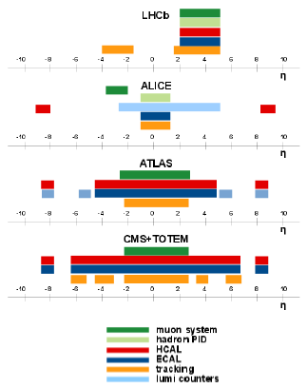
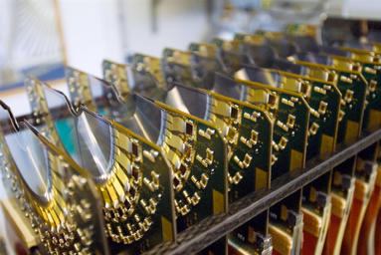
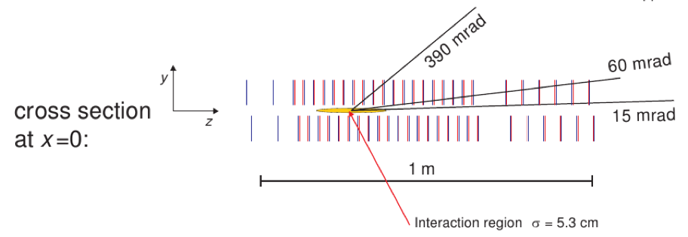
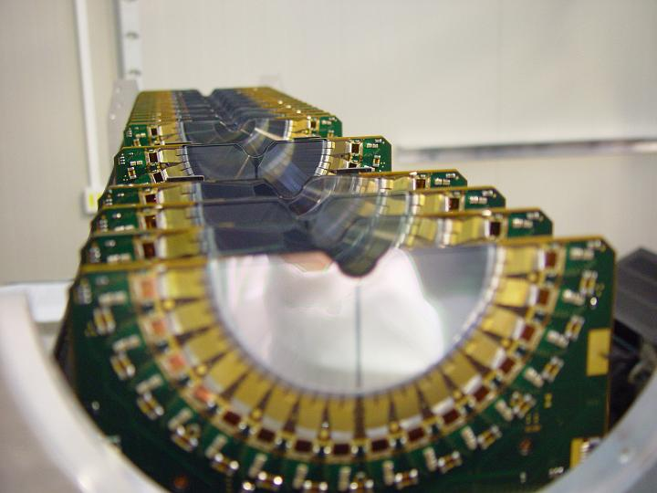
The detector
LHCb
Le VELO (Vertex LOcator)

Slide 12
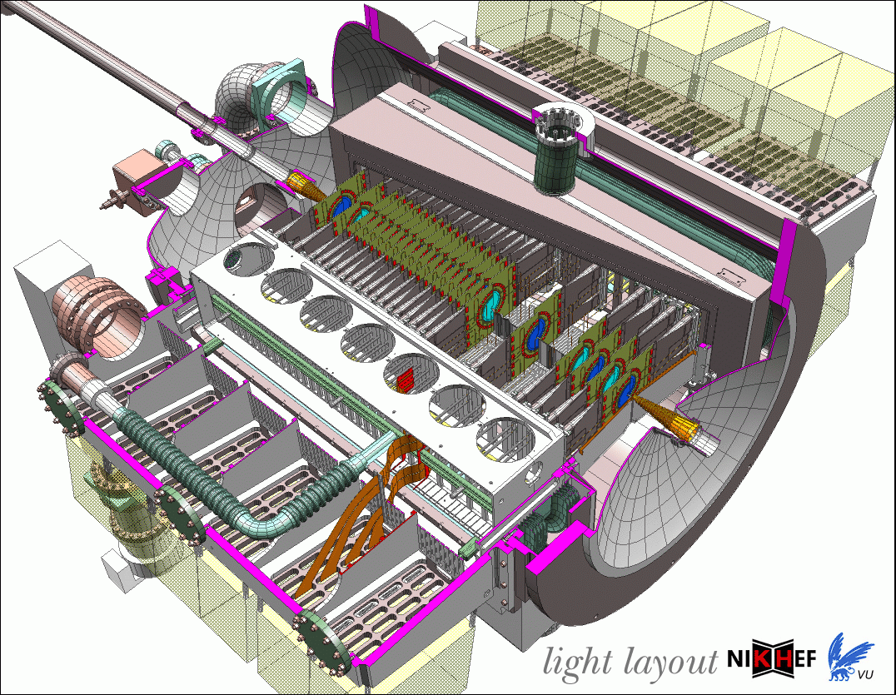
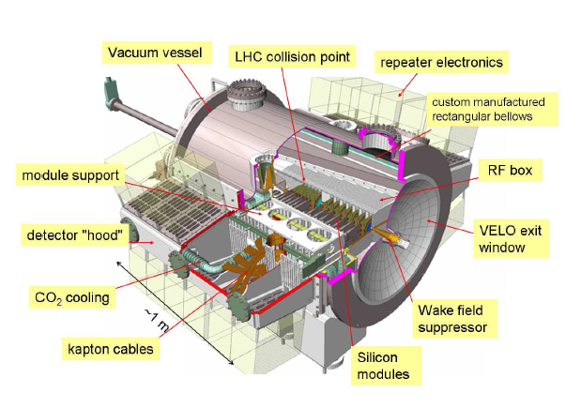
The VELO
LHCb
VErtex LOcator

Slide 13
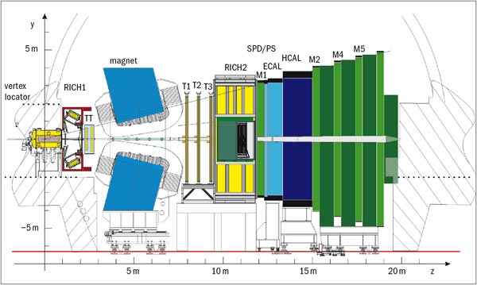
A fixed target
SMOG (System for Measuring Overlap with Gas)
Injecting gas in LHCb Vertex Locator (VELO) region
Primary role : luminosity measurement
Can be used as an internal gas target
Noble gas only : (very low chemical reactivity)
He (4), Ne (20), Ar (40), Kr (84), Xe (131)
Gaz pressure : 10⁻⁷ to 10⁻⁶ mbar
beam
target

Slide 14
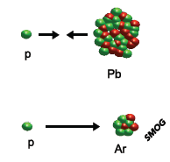
Programme ions lourds
LHCb fonctionnera en deux modes
Mode collisionneur
Mode « cible fixe »
$$\sqrt{s_{NN}}=5 TeV$$
$$\sqrt{s_{NN}}=5 à 8 TeV$$
${\sqrt{s}}_{NN}^{ SPS}$~ 20 GeV
${\sqrt{s}}_{NN}^{ RHIC}$= 200 GeV
${\sqrt{s}}_{NN}^{ LHC}$= 5 TeV
$$\sqrt{s_{NN}}=90 à 110 GeV$$
$$\sqrt{s_{NN}}=70 GeV$$
$$\text{LHCb} \text{rapidity}\text{ 2.5 < }\text{yLHCb}\text{ < 4.5}⟹\left\{\begin{aligned}\text{7 }\text{TeV} \text{beam}\text{: } −2.3<y_{LHCb}^{∗}<−0.3 \\ \text{2.75 }\text{TeV} \text{beam}\text{: }−1.8<y_{LHCb}^{∗}<0.2 \end{aligned}\right.$$

Slide 15
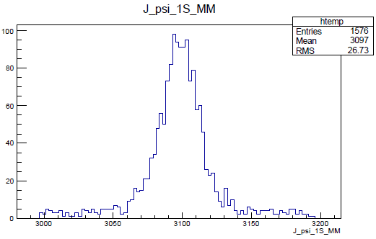
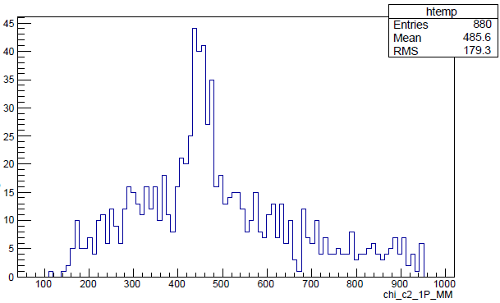
Running PbAr ?
LHCb SMOG physics
PbAr@70 GeV .vs. PbPb@17 GeV
Multiplicity is related to event centrality and center-of-mass energy
Multiplicity can be used to compare different A+B collisions at different √s_{NN}
PbAr @ 71 GeV multiplicity ≡ PbPb@17 GeV multiplicity
➔ PbAr @ 71 GeV is a good starting point to compare with NA50
System \ centrality | 60 – 100% | 50 – 60% | 40 – 50% | 30 – 40% | 20 – 30% | 10 – 20 % | 0 – 10%
PbNe – 71 GeV | 108.6 | 254.4 | 392.5 | 588.0 | 814.5 | 1086.0 | 1494.9
PbAr – 71 GeV | 123,6 | 308,8 | 496,5 | 806,6 | 1228,3 | 1711,9 | 2372,7
PbKr – 71 GeV | 196,9 | 533,6 | 919,1 | 1451,2 | 2205,5 | 2986,6 | 4084,3
PbPb – 17 GeV | 124,2 | 331,6 | 605,9 | 919,6 | 1338,7 | 2035,8 | 2980,5
(based on EPOS-LHC-v3400)
M_{J/Ψ}
M_{χc}-M_{J/Ψ}
Acceptance × efficiency
(PbAr full LHCb simulations)
J/Ψ ~ 20%, χ_{c} (J/Ψ γ) ~ 5%

Slide 16
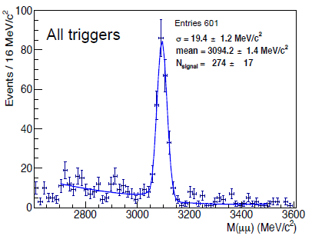
LHCb SMOG
Real data
Feb. 2013 : 27 minutes Pb+Ne @ 54 GeV
August 2015 : 12h p-Ne @ ~110 GeV
36 protons bunches

Slide 17
Conclusion
Heavy quarks and QGP
Testing color screening
Measuring together χ_{c}, J/Ψ and Ψ’ is crucial
Open charm is the appropriate reference
LHCb
Fantastic opportunity to perform this program
SMOG acts as a fixed target (He, Ne, Ar, Xe, Kr)
First full data taking in 2015
October 2015 : 3 days of pAr (~20000 J/ψ)
November-december 2015 : 21 days of PbAr (~15000 J/ψ)
Leading role of LAL/LLR team for heavy flavor: Francesco Bossu, Frédéric Fleuret, Giulia Manca, Laure Massacrié, Patrick Robbe, Yanxi Zhanj
Not discussed in this talk : a thorough pA program
Capable of reaching large x₂ (up to 0.3 for J/ψ, 0.9 for Υ)
First look at the program proposed by the AFTER team (after.in2p3.fr)

Slide 18
backup

Slide 19
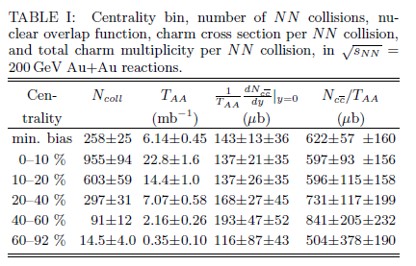
Open charm production
Phys. Rev. Lett. 94, 082301 (2005)
In central Au+Au collisions @ 200 GeV
$$N_{c\overline{c}}\sim 597∙{10}^{−3}mb×22.8 {mb}^{−1}\sim 13$$
~0.1 $c\overline{c}$ @ 20 GeV
~1 $c\overline{c}$ @ 70 GeV
~10 $c\overline{c}$ @ 200 GeV
~100 $c\overline{c}$ @ 5500 GeV
$$σ_{c\overline{c}}^{5500 GeV}\sim 10×σ_{c\overline{c}}^{200 GeV}\sim 100×σ_{c\overline{c}}^{70 GeV}\sim 1000×σ_{c\overline{c}}^{20 GeV}$$

