Slide 1
CHIC, Charme et QGP
– quarkonia suppression in A+A –
– J/Ψ experimental highlights –
– CHIC physics motivations –
– CHIC experimental aspects –

Slide 2
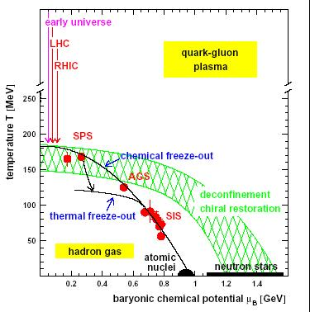
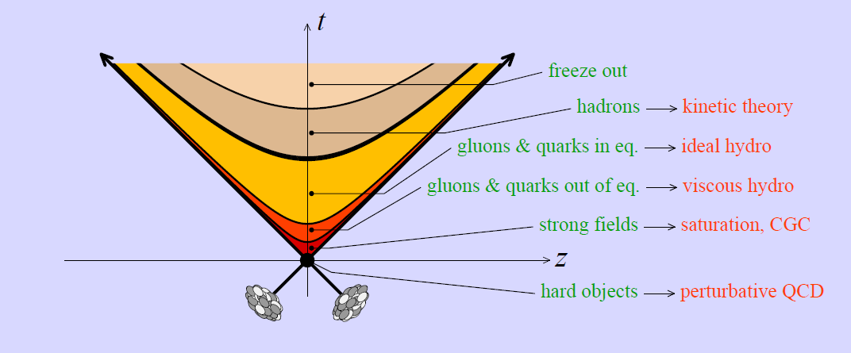
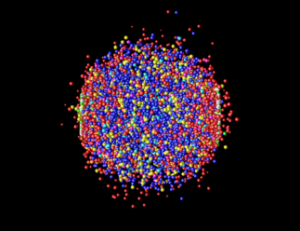
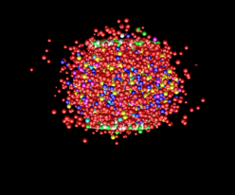
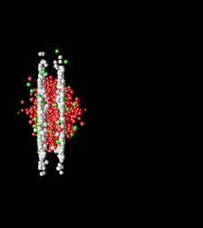
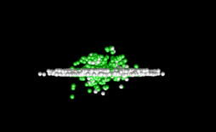
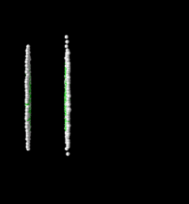
Quark Gluon Plasma
Deconfined matter
In the universe
Big bang: from plasma to confined matter
High temperature : 10¹² K
10⁻⁶ s
Neutron stars: from confined matter to plasma
Star collapse
High density of matter (5 to 10 times standard nuclear density)
In the lab: heavy ion collisions
CMS energy: √s_{SPS} < √s_{RHIC} < √s_{LHC}
Energy density: ε_{SPS} < ε_{RHIC} < ε_{LHC}
Temperature: T_{SPS} < T_{RHIC} < T_{LHC}
QGP features
Very high density : jet quenching
Collective motion : elliptic flow
High temperature : thermal photons
Color screening : quarkonia
➔ finding transition to QGP

Slide 3
quarkonia suppression in A+A collisions

Slide 4
quarkonia suppression in A+A collisions
Motivations
Quarkonia suppression is a prediction of lattice QCD calculations, for instance :
Experimental setups
SPS/CERN – NA38, NA50, NA60 (√s_{NN} = 17 – 30 GeV): fixed target experiments
Statistic :100 000’s J/ψ
Data sets : p+A w/ A=p, d, Be, Al, Cu, Ag, W, Pb; S+U, In+In, Pb+Pb
Small rapidity coverage (typically y ∈ [0,1])
RHIC/BNL Phenix experiment (√s_{NN} = 200 GeV): collider experiments
Statistic : 1000’s J/ψ (10000’s since 2007)
Data sets : p+p, d+Au, Cu+Cu, Au+Au
Large rapidity coverage (y ∈ [-0.5,0.5], y ∈ [-2.2,-1.2] and y ∈ [1.2,2.2])
LHC/CERN experiments (√s_{NN} = 5,5 TeV): collider experiments
Collider experiments
Statistic : 100000’s J/ψ
Data sets : p+p, Pb+Pb, p+Pb
Large rapidity coverage (|y|<2.5 ATLAS/CMS, |y|<0.9 and -4.0 < y < -2.5 ALICE)
H. Satz, J. Phys. G 32 (2006)

Slide 5
quarkonia suppression in A+A collisions
Sequential suppression in a QGP
inclusive J/Ψ yield ~ 60% direct J/Ψ + 30% χ_{c}→J/Ψ+γ + 10% Ψ’ → J/Ψ + X
Charmonium temperatures of dissociation
H. Satz, J. Phys. G 32 (2006)
T_{LHC-CERN} > T_{RHIC-BNL} > T_{SPS-CERN}
Sequential suppression
J/Ψ production (a.u.)
1
~0.9
~0.6
~0
Temperature
T_{Ψ’} > T_{c}
T_{χ} > T_{Ψ’} > T_{c}
T_{J/Ψ} > T_{χ} > T_{Ψ’} > T_{c}

Slide 6
quarkonia suppression in A+A collisions
Recombination in a QGP
If QGP at work ➔ c and c quarks can combine to form a J/Ψ
(require a large number of cc pairs → RHIC ? LHC ?)
T_{LHC-CERN} > T_{RHIC-BNL} > T_{SPS-CERN}
Sequential suppression
Recombination
J/Ψ production (a.u.)
1
~0.9
~0.6
~0
Temperature
T_{Ψ’} > T_{c}
T_{χ} > T_{Ψ’} > T_{c}
T_{J/Ψ} > T_{χ} > T_{Ψ’} > T_{c}

Slide 7
quarkonia suppression in A+A collisions
Suppression by comovers (Alternative scenario)
Suppression by comovers:
quarkonia can be broken by interaction with comoving hadrons
(Eur.Phys.J.C58:437-444,2008)
Two parameters
Interaction cross section σ_{co}
Hadron density N^{co}
Sequential suppression
Recombination
Suppression by comovers
J/Ψ production (a.u.)
1
~0.9
~0.6
~0
Temperature
T_{Ψ’} > T_{c}
T_{χ} > T_{Ψ’} > T_{c}
T_{J/Ψ} > T_{χ} > T_{Ψ’} > T_{c}

Slide 8
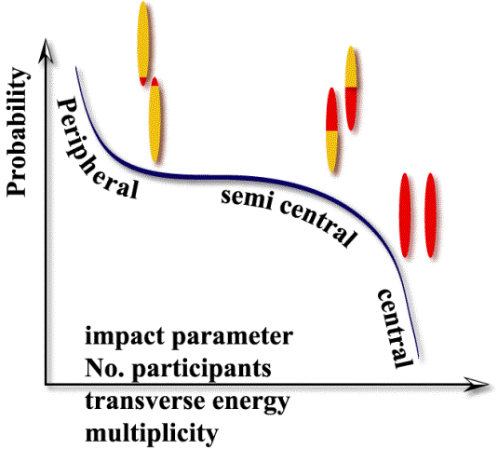
quarkonia suppression in A+A collisions
Observable : Nuclear modification factor R_{AA}
dN_{AA} = yield in A+A collisions
<N_{coll}> = average number of nucleon-nucleon collisions in A+A collisions
dN_{PP} = yield in p+p collisions ≡ yield in one nucleon-nucleon collision
Centrality of the nucleus-nucleus collision
N_{part}= number of participant nucleons ≡ interacting nucleons
N_{coll} (L)= number of binary collisions ≡ nucleon-nucleon collisions
dN_{ch}/dy= produced charged particles density ≡ energy density
If no nuclear effet,
R_{AA} = 1
Centrality | b (fm) | N_{part} | N_{coll}
0 – 5 % | 2.3 ± 0.9 | 353 ± 19 | 1091 ± 102
20 – 25 % | 7.1 ± 0.5 | 181 ± 16 | 422 ± 65
90 – 95% | 14.5 ± 0.3 | 4.1 ± 2.5 | 2.8 ±2.2
Spectators
b
Participants
Number of Collisions
Participants
Spectators

Slide 9
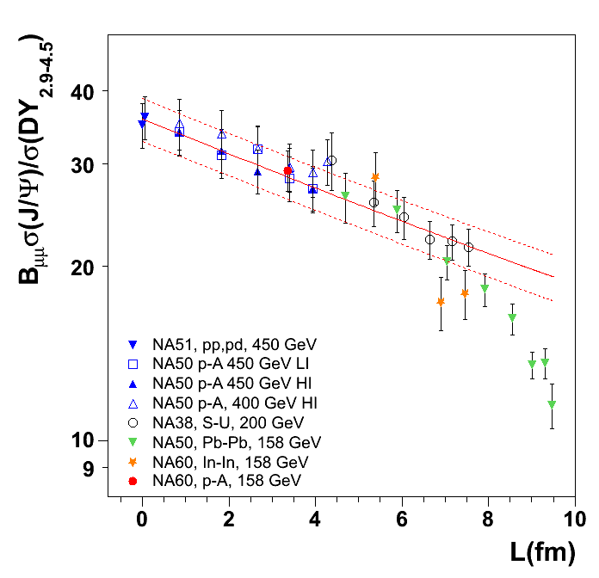
J/Ψ experimental highlights
SPS (17 GeV): NA38, NA51, NA50, NA60
peripheral
mid
central
collisions
Two major results :
Observation of Cold Nuclear Matter effects : Absorption by nuclear matter
Suppression observed from p+p to peripheral Pb+Pb
J/ψ survival probability :
Fit to data: σ_{abs}=4.18 ±0.35 mb
Observation of Anomalous suppression in Pb+Pb (NA50) central collisions when compared with Cold Nuclear Matter effects.
NA50, EPJ C39 (2005) 335
NA60, PRL99 (2007) 132302
J/ψ nuclear absorption
J/Ψ
L

Slide 10
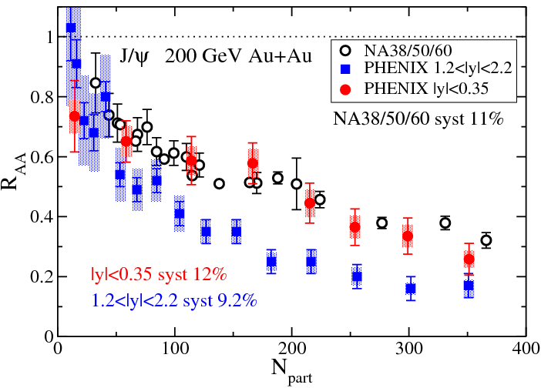
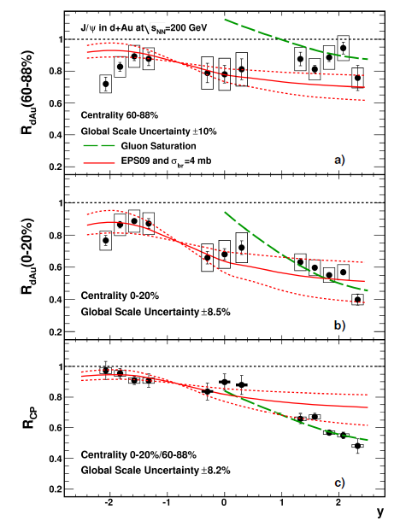
J/Ψ experimental highlights
RHIC (200 GeV) .vs. SPS (17 GeV)
Hot and dense matter effects
Measure J/Ψ in Au+Au (RHIC) Pb+Pb (SPS)
Compare at same rapidity (same y ~ same x_{F})
0<y<1 at SPS (NA50/NA60)
|y|<0.35 at RHIC (PHENIX)
Expected larger suppression at RHIC due to larger energy density
observe SIMILAR SUPPRESSION
at mid rapidity
Observe LARGER SUPPRESSION
at forward rapidity
Cold Nuclear Matter effects at RHIC
Measure J/Ψ production in d+Au collisions
Observe LARGER SUPPRESSION
at forward rapidity (small x₂)
Pattern still not fully understood
Difference forward.vs.mid rapidity may explain larger suppression observed in forward Au+Au

Slide 11
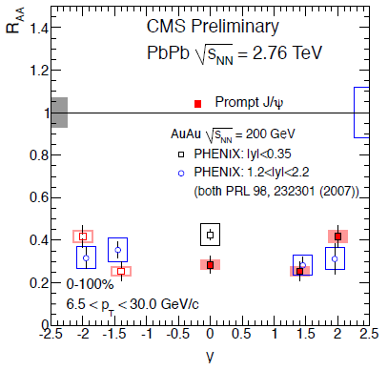
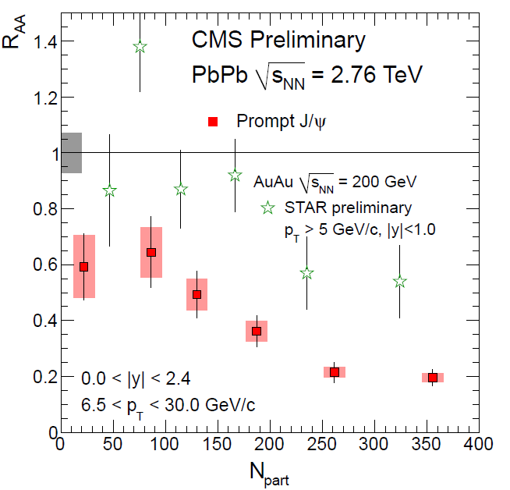
J/Ψ experimental highlights
RHIC (200 GeV) .vs. LHC (2.76 TeV) at forward rapidity
Compare PHENIX vs ALICE
1.2 < |y| < 2.2 at RHIC/PHENIX
2.5 < y < 4 at LHC/ALICE
LESS SUPPRESSION at LHC .vs. RHIC
Could be due to recombination effects
RHIC (200 GeV) .vs. LHC (2.76 TeV) at mid-rapidity
Compare PHENIX, STAR vs CMS
|y|<0.35 at RHIC/PHENIX
|y|<1 at RHIC/STAR
|y|<1 at LHC/CMS
MORE SUPPRESSION at LHC .vs. RHIC
p_{T}>6.5 GeV/c ➔ in principle no recombination applies
larger suppression due to QGP effects ?
Hint of sequential suppression ? (J/Ψ melting)
Caution : Need CNM effects comparison
PHENIX
CMS
http://cdsweb.cern.ch/record/1353586

Slide 12
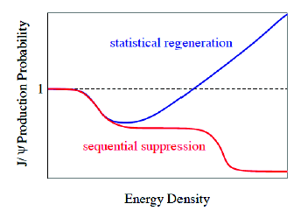
quarkonia suppression in A+A
Overall possible J/Ψ (simplified) picture
Similar suppression at SPS.vs.RHIC
Larger suppression at LHC
outside recombination regime
CMS results
Hint of sequential suppression ?
(assuming CNM effects are the same or smaller)
Smaller suppression at LHC
inside recombination regime
ALICE results
Hint of recombination?
(assuming CNM effects are the same of larger)
Next fondamental questions to answer :
Are CNM effects playing an important role at LHC ? p+Pb run
Is recombination mechanism at work ? J/Ψ at mid-rapidity at low p_{T}
Is sequential suppression at work ? measure χ_{c} in A+A→ not accessible ➔ CHIC
Recombination
LHC low p_{T} (ALICE)
SPS/RHIC
LHC high p_{T} (CMS)
Sequential suppression

Slide 13
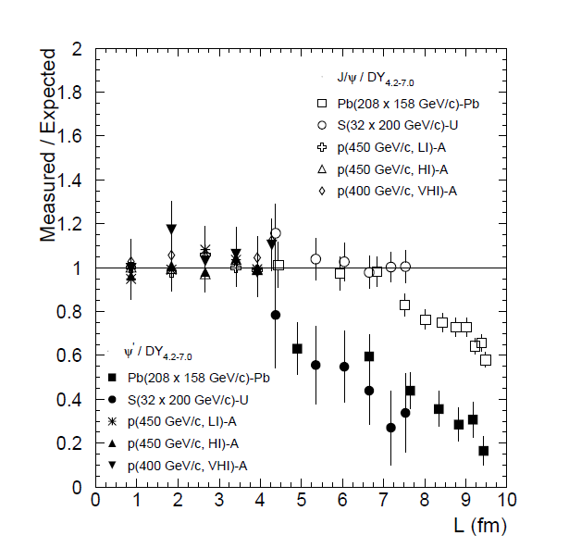
CHIC – Physics motivations
Benchmark 1: Measure χ_{c} in A+A at SPS
Physics goal : test charmonium sequential suppression scenario
How χ_{c} is suppressed relative to J/Ψ ? What is the dependence with y, p_{T}, centrality,… ?
Mandatory to draw the whole picture (SPS .vs. RHIC .vs. LHC)
Why at SPS ?
Lowest energy density where anomalous
suppression has been seen.
Appropriate range of energy density to investigate
full sequential suppression : Ψ’, χ_{c} and J/Ψ
No recombination at SPS
Why a fixed target experiment ?
Precise control of normal suppression (CNM effects)
Eur.Phys.J.C49:559-567,2007

Slide 14
CHIC – Physics motivations
Quarkonia suppression
At SPS
Eur.Phys.J.C49:559-567,2007
60% direct J/Ψ
+ 30% χ_{c}→J/Ψ+γ
+ 10% Ψ’ → J/Ψ + X
Inclusive J/Ψ yield
p+A
S+U
Two possible scenarios:
sequential suppression (QGP)
comovers (no QGP)
Pb+Pb
Temperature of dissociation
Binding energy
L (fm)
ε (GeV/fm³)
4.37
1.04
4.90
1.24
6.65
2.04
7.65
2.53
8.83
3.19
9.43
3.76

Slide 15
CHIC – Physics motivations
Two possible scenarios
QGP (sequential suppression)
Eur.Phys.J.C49:559-567,2007
p+A
Because ΔE (Ψ’) ~50 MeV
Ψ’ easily suppressed by comovers
Because ΔE(χ_{c})~200 MeV and ΔE(J/Ψ)~600 MeV
χ_{c} and J/Ψ hardly suppressed by comovers
S+U
Pb+Pb
Inclusive J/Ψ
χ_{c}
Ψ’
If χ_{c} suppressed by QGP,
χ_{c} slope strongly steeper than J/Ψ and Ψ’
Measuring
χ_{c} suppression pattern
will (in)validate this
Note that direct J/Ψ can be experimentally estimated
Yield_{incl.J/Ψ} – Yield_{χc→J/Ψ+γ} – Yield_{Ψ’} ~ Yield_{direct J/Ψ}
L (fm)
ε (GeV/fm³)
4.37
1.04
4.90
1.24
6.65
2.04
7.65
2.53
8.83
3.19
9.43
3.76

Slide 16
CHIC – Physics motivations
Two possible scenarios
No QGP (full comovers)
Eur.Phys.J.C49:559-567,2007
p+A
Because σ_{J/Ψ-co} ≤ σ_{χc-co} ≤ σ_{Ψ’-co}
Ψ’ slope slightly steeper than χ_{c}
χ_{c} slope slightly steeper than J/Ψ
S+U
Pb+Pb
direct J/Ψ
Measuring
χ_{c} suppression pattern
will (in)validate this
Ψ’
χ_{c}
Note that direct J/Ψ can be experimentally estimated
Yield_{incl.J/Ψ} – Yield_{χc→J/Ψ+γ} – Yield_{Ψ’} ~ Yield_{direct J/Ψ}
L (fm)
ε (GeV/fm³)
4.37
1.04
4.90
1.24
6.65
2.04
7.65
2.53
8.83
3.19
9.43
3.76

Slide 17
CHIC – Physics motivations
Conclusion : measure χ_{c} in A+A at SPS
Eur.Phys.J.C49:559-567,2007
p+A
measuring
Ψ’, J/Ψ and χ_{c} suppression pattern
S+U
Pb+Pb
No QGP χ_{c}
will answer the question
------ QGP
------ no QGP
QGP χ_{c}
Note that direct J/Ψ can be experimentally estimated
Yield_{incl.J/Ψ} – Yield_{χc→J/Ψ+γ} – Yield_{Ψ’} ~ Yield_{direct J/Ψ}
L (fm)
ε (GeV/fm³)
4.37
1.04
4.90
1.24
6.65
2.04
7.65
2.53
8.83
3.19
9.43
3.76

Slide 18
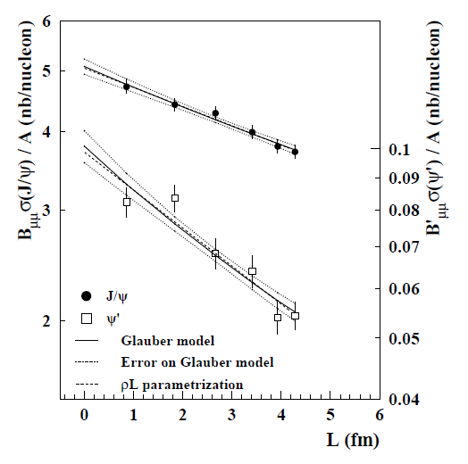
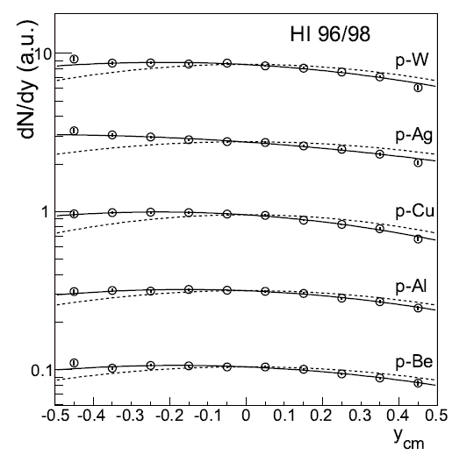
CHIC – Physics motivations
Benchmark 2: Measure charmonium in p+A at SPS
J/Ψ and Ψ’ suppression in p+A collisions as a function of L
➔ Measuring different charmonium states gives key information on Cold Nuclear Matter and production mechanism.
NA50
J/Ψ
Ψ’
Euro. Phys. J. C48 (2006) 329.
J/Ψ rapidity distribution in p+A collisions (asymetry wrt y_{cm}=0)
➔ Measuring charmonium in a wide x_{F} range is important to identify possible (anti)shadowing effects

Slide 19
CHIC – Physics motivations
Measure charmonium in p+A at SPS
➔ Measuring charmonium in a wide x_{F} range is important to estimate possible (anti)shadowing effects
E866, Phys. Rev. Lett. 84, 3256-3260 (2000)
With M=3.1 GeV/c² and √s=17.2 GeV (158 GeV)
x_{F} = 1 ➔ y_{CMS} = 1.7
With M=3.1 GeV/c² and √s=29.1 GeV (450 GeV)
x_{F} = 1 ➔ y_{CMS} = 2.2
Y_{CMS}=2 ➔ x_{F} = 0.8
Possible to access large x_{F} if measuring charmonia at rapidity up to y_{CMS}~2

Slide 20
CHIC – Physics motivations
Measure χ_{c} production in A+A
How χ_{c} is suppressed relative to J/Ψ ? What is the dependence with y, p_{T}, N_{part},… ?
Mandatory to draw the whole picture (SPS .vs. RHIC .vs. LHC)
Benchmark 1 : Measure χ_{c} production within y_{CMS} ∈ [-0.5, 0.5]
Measure charmonia production in p+A
what is the dependence of charmonia suppression with rapidity ?
Crucial to understand effects due to cold nuclear matter
Benchmark 2 : Measure charmonium states within y_{CMS} ∈ [-0.5, 2]
Other physics subjects
Open charm, low mass resonances, Drell-Yan,…

Slide 21
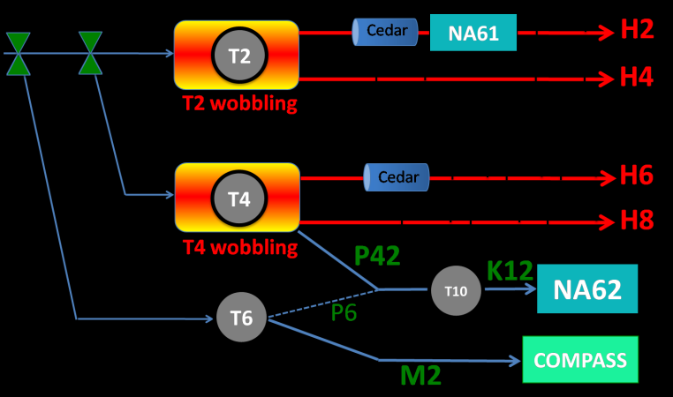
CHIC – Expected yields
Need high intensity p and Pb beams (~ 10⁷ Pb/sec)
NA50/NA60 beam line not available (NA62)
H2 beam line occupied by NA61
H4 and H8 available but need shielding for HI
NA50: European Physical Journal C39 (2005) 335
New measurement of J/ψ suppression in Pb+Pb at 158 GeV/nucleon
35 days of data taking in 2000
~1.10⁷Pb/s over 5s bursts every 20s
4 mm thick Pb target (10%λ_{I})
~ 100 000 J/Ψ→μ⁺μ⁻ within y_{CMS}∈[0,1] (on disk)
Expect fair amount of χ_{c}: N_{J/Ψ} ~ 60% direct + ~30% from χ_{c} + ~10% from Ψ’
Same conditions as NA50 setup ➔ ~20 000 χ_{c} expected within y_{CMS} ∈ [-0.5,0.5]
Expect more with thicker target (1cm for instance)
North Area Beamlines

Slide 22
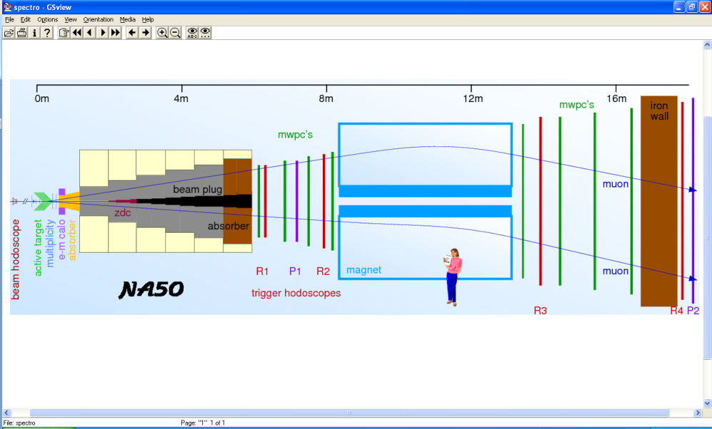
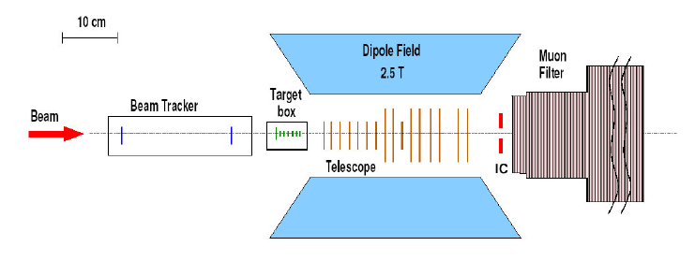
CHIC – detector design
Past experiments
1st generation: NA38,NA50,NA51
Measure dimuons
2nd generation: NA60
Measure dimuons and open charm vertex
Target → absorber → spectrometer → muID
Target → telescope

Slide 23
CHIC – detector design
3rd generation: CHIC
Measure dimuons and photons
Must place the calorimeter in front of the absorber
Must separate photon/electron ➔ tracking in front of the calorimeter.
MuID
Muon Filter
(absorber)
target
tracking
tracking
EMCal
Beam
vertex
Dipole field
Target → vertex → spectrometer → calorimeter → absorber → muID

Slide 24
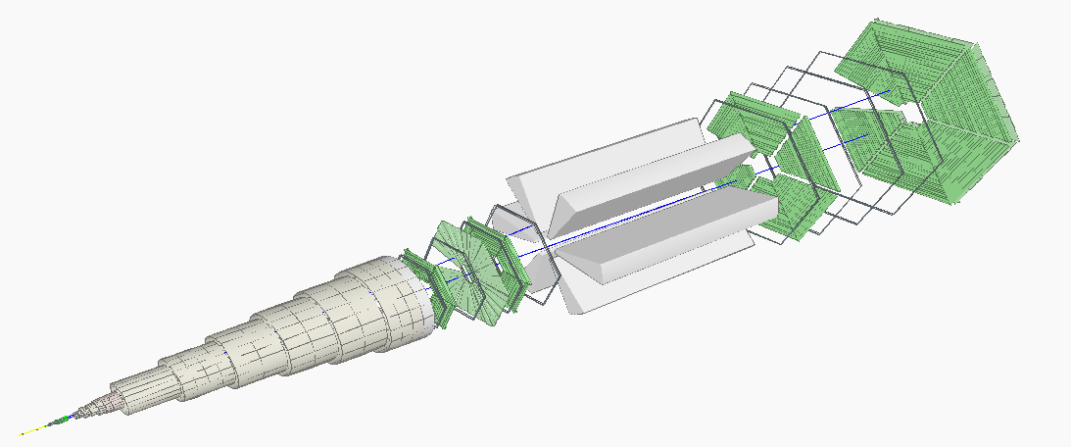
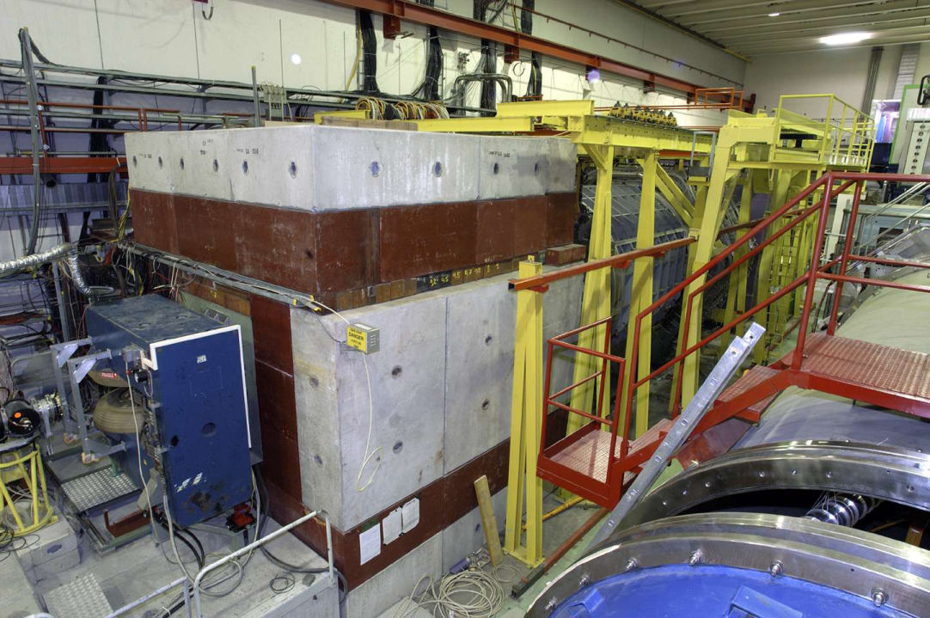
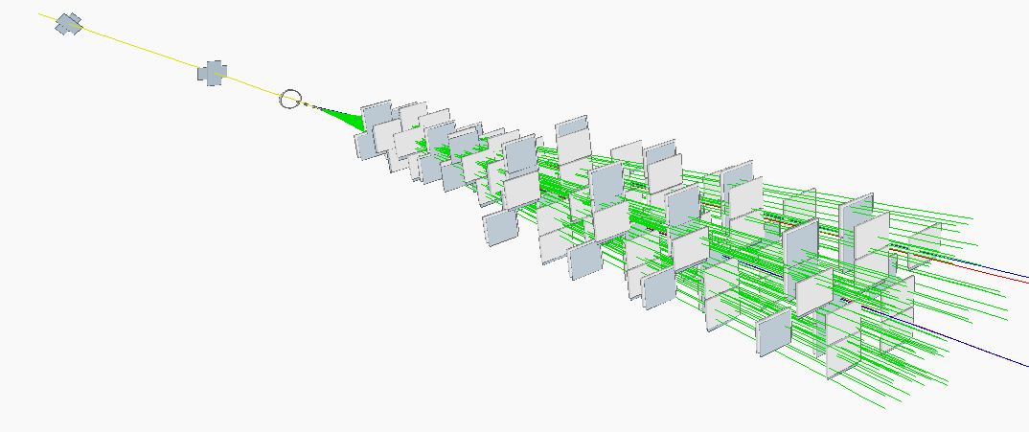
CHIC – tracking
The NA60 example
Pixel detector
16 planes – 96 chips total
32 x 256 pixels / chip
Pixel size = 425 × 50 μm²
Magnetic field = 2.5 T × 40 cm
Momentum resolution @J/Ψ mass
(typical p_{μ} ~ 15 GeV/c)
(R. S. priv. Comm.)

Slide 25
CHIC – tracking
The NA60 pixel detector
The CHIC pixel detector
~40 cm
L = 0.4 m
~100 cm
L = 1 m

Slide 26
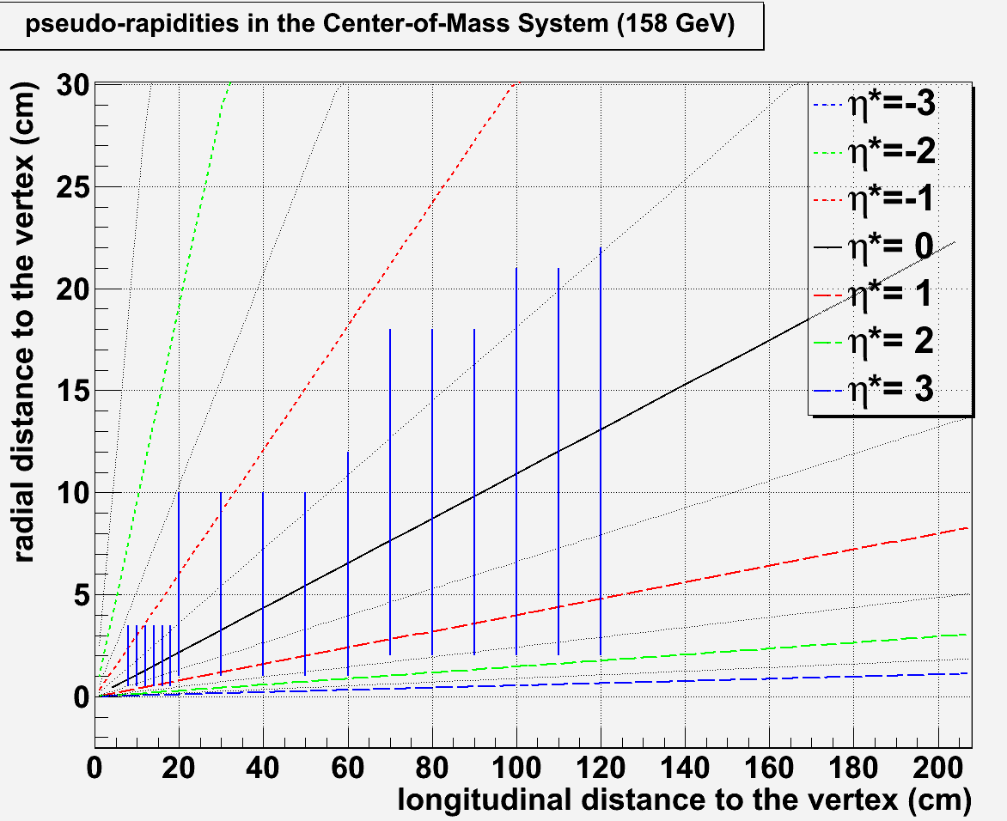
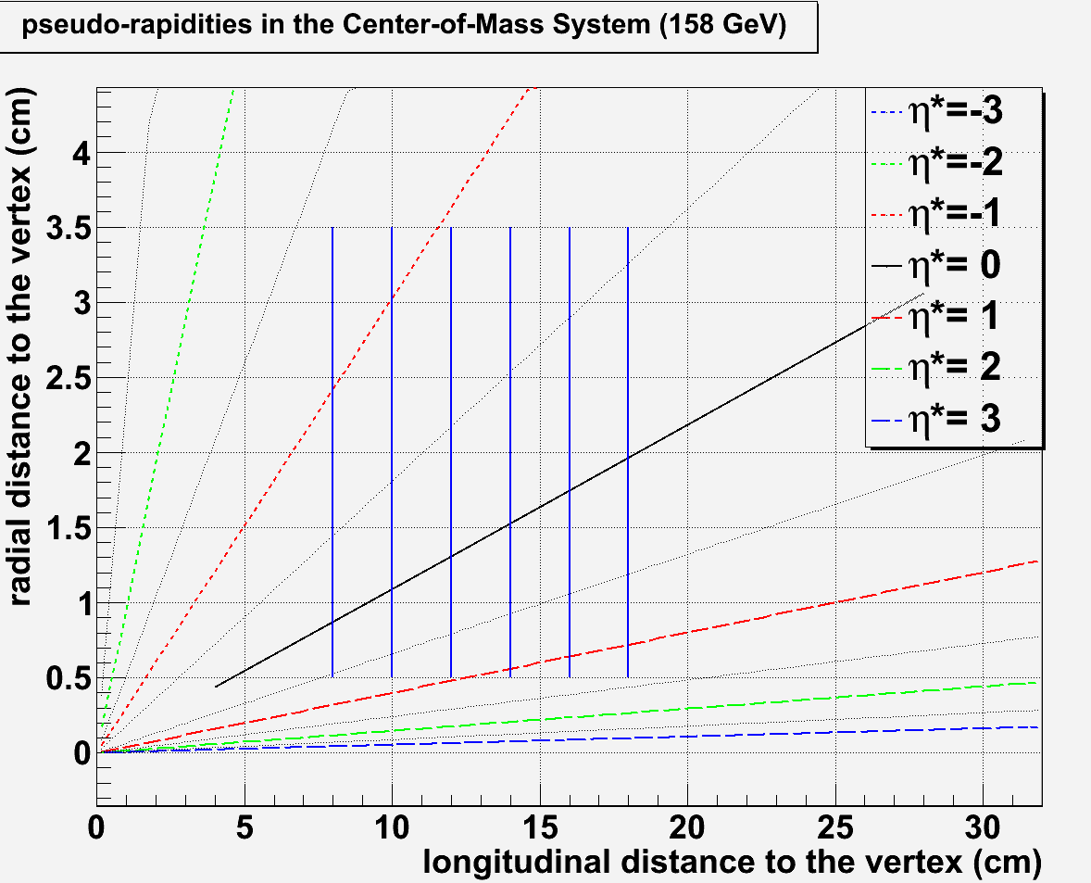
CHIC – tracking
Size, position, resolution : tentative design – toy example
B (T) | L (cm) | ΔP/P (%) | ΔM (MeV)
2.5 | 40 | ~ 6 | ~120
2.5 | 60 | ~ 2.7 | ~60
2.5 | 80 | ~ 1.5 | ~30
2.5 | 100 | ~1 | ~20
11 plane spectrometer
@ z_{max} = 120 cm ➔ r_{max}(η*=-0.5)~22 cm
11 planes from z=20 cm to z = 120 cm
← NA60
η∗=-0.5
← CHIC
22
6 plane vertex
@ r_{min} = 0.5 cm ➔ z_{min}(η*=0.5)~7.5 cm
6 planes from z=8 cm to z=18 cm
η∗=0.5
η∗=-0.5
η∗=1
η∗=0.5
Track particles within η*∈[-0.5 ; 1]
7.5

Slide 27
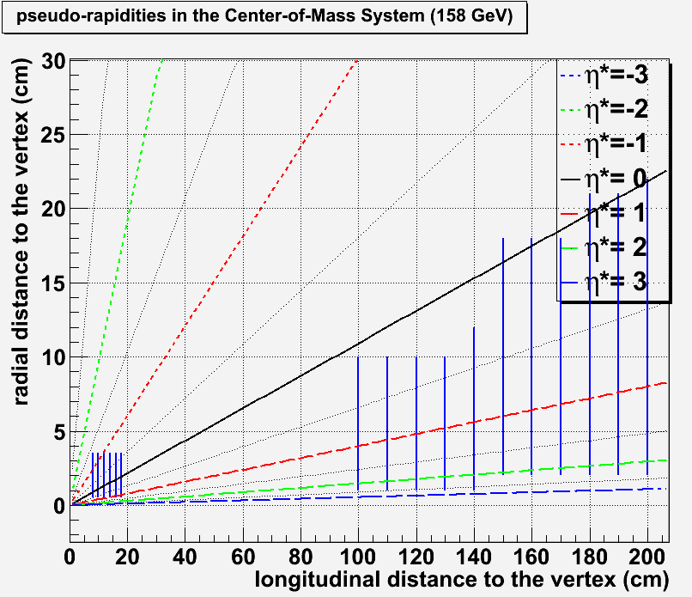
CHIC – tracking
Size, position, resolution : tentative design - toy
yexample
B (T) | L (cm) | ΔP/P (%) | ΔM (MeV)
2.5 | 40 | ~ 6 | ~120
2.5 | 60 | ~ 2.7 | ~60
2.5 | 80 | ~ 1.5 | ~30
2.5 | 100 | ~1 | ~20
11 plane spectrometer
@ z_{max} = 120 cm ➔ r_{max}(η*=-0.5)~22 cm
11 planes from z=100 cm to z = 200 cm
← NA60
← CHIC
22
6 plane vertex
@ r_{min} = 0.5 cm ➔ z_{min}(η*=0.5)~7.5 cm
6 planes from z=8 cm to z=18 cm
η∗=-0.5
η∗=0.5
η∗=2
η∗=0.5
Track particles within η*∈[0.5 ; 2]
7.5

Slide 28
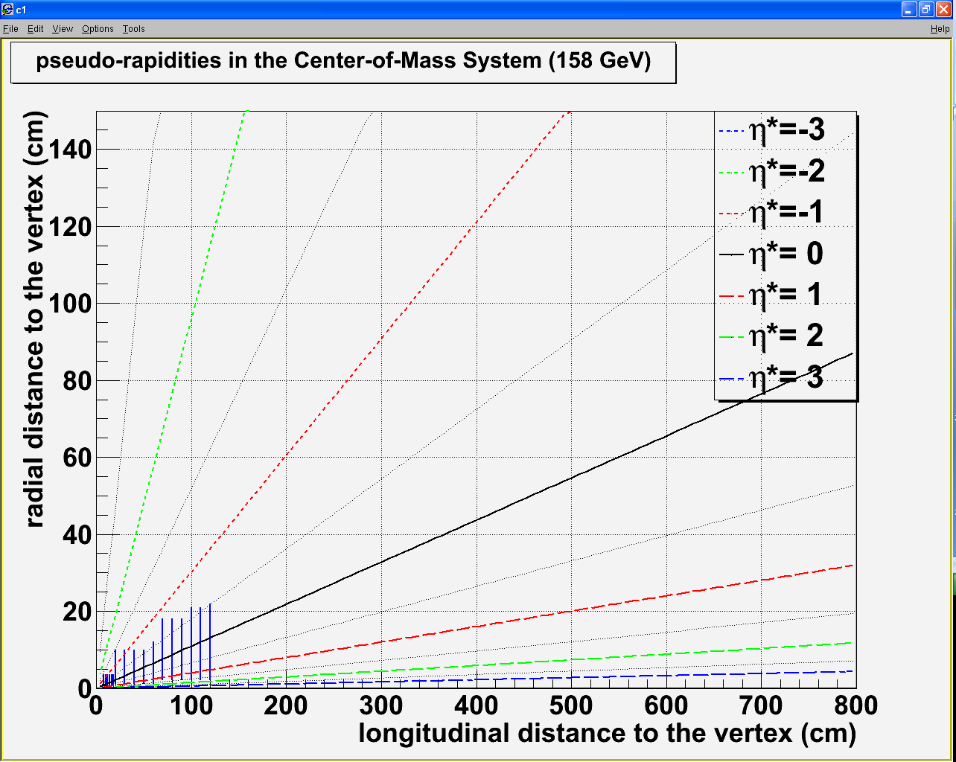
CHIC – tentative design
Vertex detector :
R_{min} = 0.5 cm Z_{min} = 7.5 cm
R_{max} = 3.5 cm Z_{max} = 18 cm
120 cm
100 cm
1 m
2 m
3 m
4 m
5 m
6 m
80 cm
Spectrometer :
R_{min} = 1 cm Z_{min} = 20 (100) cm
R_{max} = 22 cm Z_{max} = 120 (200) cm
60 cm
40 cm
20 cm

Slide 29
CHIC – calorimetry
Goal : measure χ_{c} → J/Ψ + γ
Issues
Low energy photon (similar to π⁰ → γγ)
High multiplicity of photon from π⁰ /η→ γγ
High multiplicity of charged particles (π^{+/-})
Pythia 6.421 - p+p - √s = 17.2 GeV
<p_{T}>~500 MeV
<E>~3 GeV

Slide 30
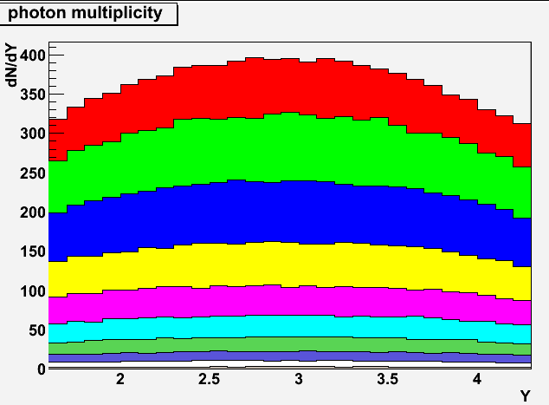
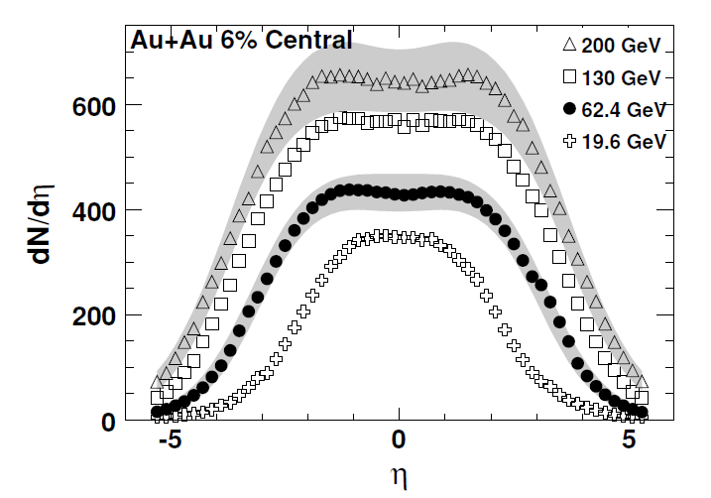
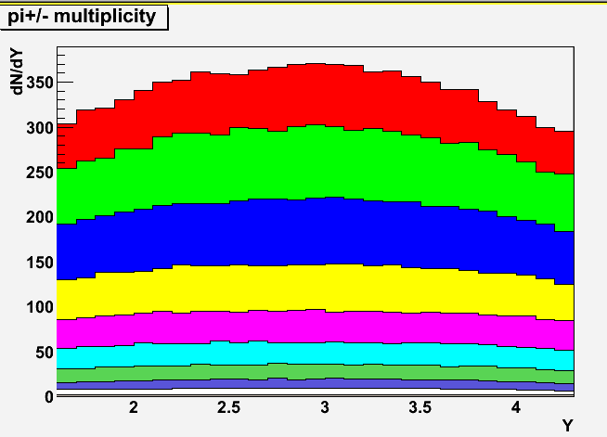
CHIC – calorimetry
Goal : measure χ_{c} → J/Ψ + γ
Issues
Low energy photon (similar to π⁰ → γγ)
High multiplicity of photon from π⁰ /η→ γγ
High multiplicity of charged particles (π^{+/-})
WA98: Phys. Lett. B458: 422-430, 1999)
~480 γ
~340 γ
~400 γ
0 – 5%
Phobos: Phys. Rev. C74, 021901, 2006
Epos 1.6 : Pb+Pb @ 17.2 GeV
~350 π^{+/-}
~370 π^{+/-}
0 – 5%
0 – 5% Pb+Pb most central ➔ ~450 γ + 350 π^{+/-}
Epos 1.6 : Pb+Pb @ 17.2 GeV

Slide 31
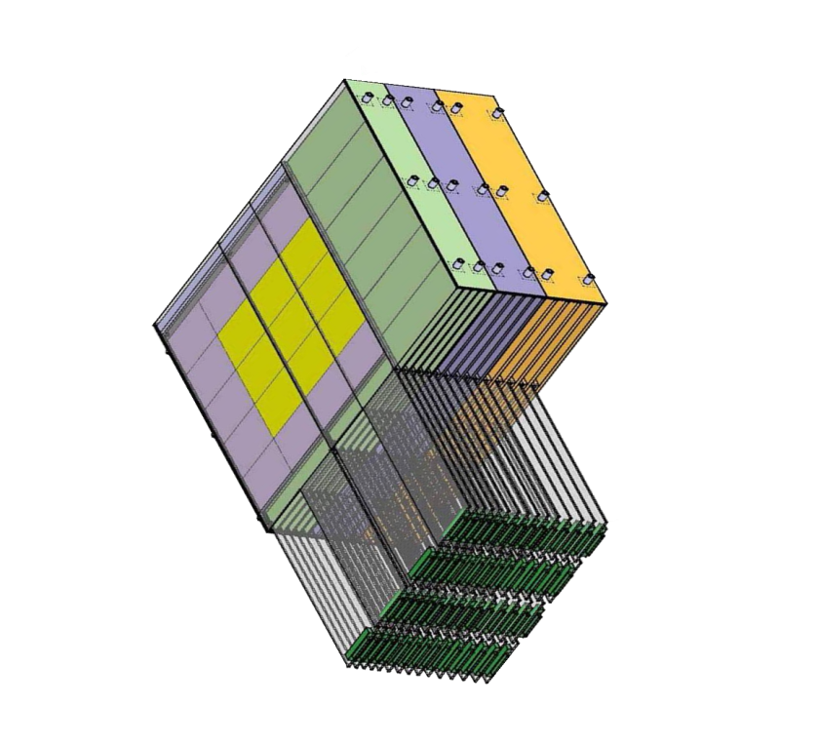
CHIC – calorimetry
Need very high segmentation
to separate two electromagnetic showers
To isolate photons from π^{+/-} contamination
W + Si calorimeter à la Calice
30 layers
0.5 x 0.5 cm² pads
24 X₀ in 20 cm
W+Si : two relevant quantities
1st relevant quantity : distance
between two incoming particles
Min. distance between 2 particles at impact
= 1 free pad = 1 cm (for 0.5×0.5 cm²)
distance between two incoming particles
must be > 1 cm
N photons ➔ N/2 neutrals (π⁰ + η)➔ N π^{+/-}
➔ N γ + N π^{+/-} = 2N particles
distance between two photons
must be > 2 cm (1cm×2N/N)
2nd relevant quantity : EM shower transverse size
Moliere Radius R_{M} : 90% of the shower energy
Distance between two photons
must be > 2 cm (2 R_{M})
bad
good
Geometrical condition: in principle
Δγ > 2cm

Slide 32
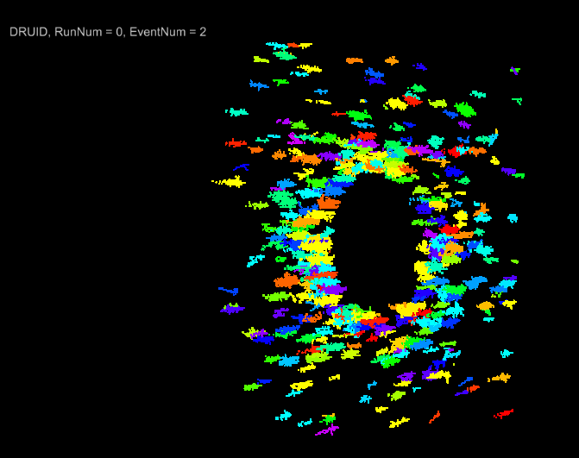
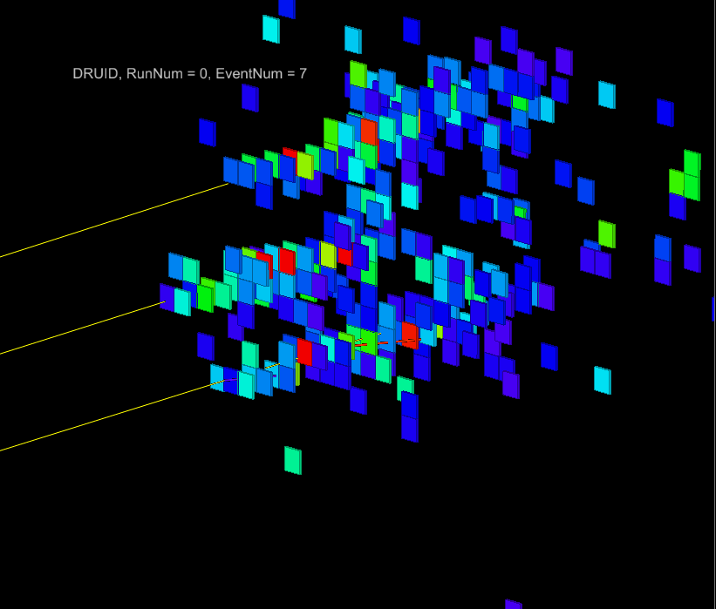
CHIC – calorimetry
Full simulation performed with the Calice Ecal proto
Pythia 6.421 - p+p - √s = 17.2 GeV
<E>~3 GeV
Pb+Pb
3 photons with E~2 GeV
distance between each photon~ 2 cm
0.5 x 0.5 cm² pads
(full simu made by D. Jeans - LLR - Calice collab.)

Slide 33
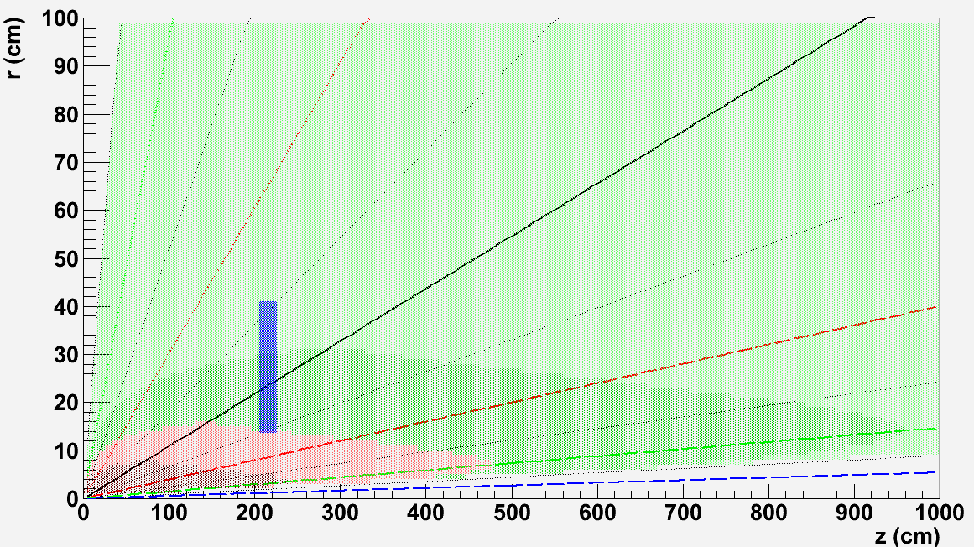
CHIC – calorimetry
Size and position : tentative design
0 – 5% most central Pb+Pb events as measured by WA98
Distance between
two photons
[-0.5:0.5]
r_{min}
Δγ>4
Z
Δγ<4
Δγ<1
Δγ<2
r_{max}
Closer position to the target w/ Δγ>2cm:
Z = 205 cm [-0.5:0.5]
R_{min} = 13.6 cm
R_{max} = 40.9 cm
Using 0.5 x 0.5 cm² pads
20 cm

Slide 34
CHIC – calorimetry
Size and position : tentative design
0 – 5% most central Pb+Pb events as measured by WA98
Distance between
two photons
[-0.5:0.5]
r_{min}
Δγ>4
Z
Δγ<4
Δγ<1
Δγ<2
r_{max}
Warning : not clear that Δγ>2 cm is large enough.
May need to investigate alternative design, for instance:
taking Δγ>4cm with z = 205 cm ➔ R_{min/max}=30/55 cm ➔ η* ∈[-0.8, -0.3]
taking Δγ>4cm with η* ∈[-0.5, 0.5] ➔ z ~400 cm
Must check with full simulation what is optimum Δγ !
20 cm

Slide 35
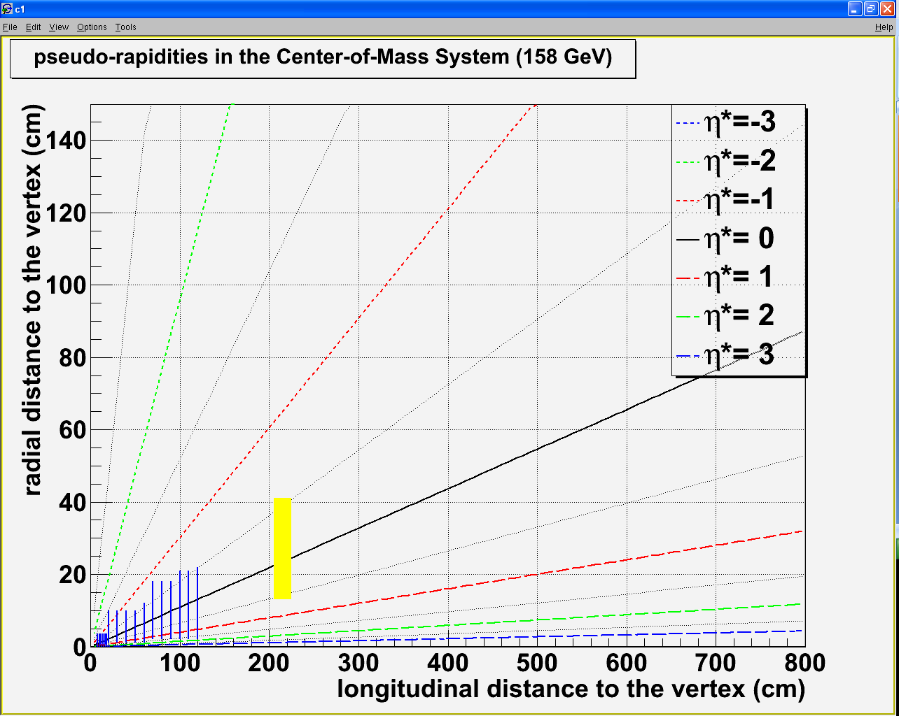
CHIC – tentative design
Vertex detector :
R_{min} = 0.5 cm Z_{min} = 7.5 cm
R_{max} = 3.5 cm Z_{max} = 18 cm
120 cm
100 cm
1 m
2 m
3 m
4 m
5 m
6 m
80 cm
Spectrometer :
R_{min} = 1 cm Z_{min} = 20 (100) cm
R_{max} = 22 cm Z_{max} = 120 (200) cm
60 cm
40 cm
20 cm
Calorimeter Δγ>2 cm:
Rmin = 14 cm Zmin = 205 cm
Rmax = 41 cm Zmax = 225 cm
Dipole field
η_{γ}* ∈[-0.5, 0.5]

Slide 36
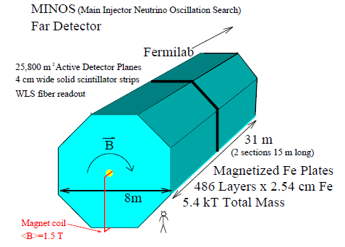
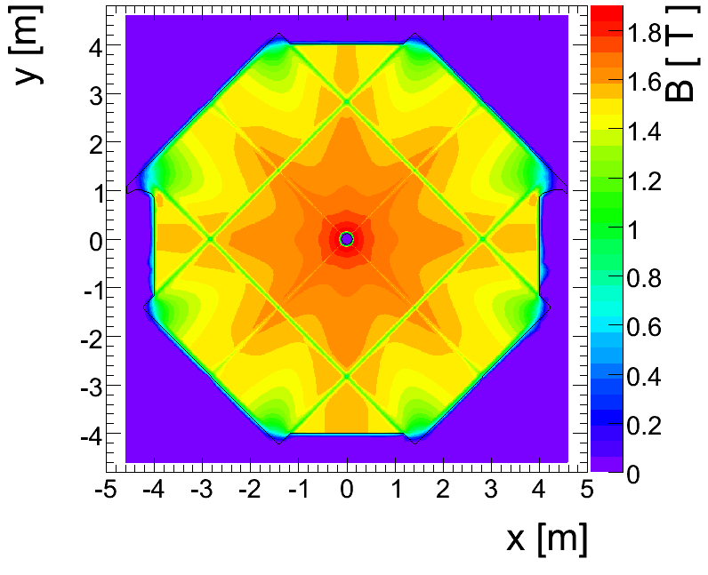
CHIC – absorber
Absorber type
NA50/NA60 : measure muon momentum after the absorber
➔ must minimize multiple scattering
Must use low Z material: best = BeO (but expensive)
NA50 : 0.6 m BeO + 4 m C + 0.6 m Fe = 5.2 m
CHIC : measure muon momentum before the absorber
➔ minimization of multiple scattering less crucial
➔ can use Fe material to absorb π^{+/-}
➔ need to match muon track position between spectrometer and trigger : Use an instrumented Fe absorber
DHCal
μ
π+
http://newsline.linearcollider.org/archive/2010/20101104.html
➔ can match muon track momentum between spectrometer and trigger : Use magnetized Fe absorber ?
Minos

Slide 37
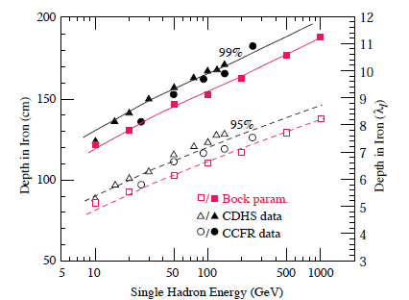
CHIC – absorber
Absorber size and hadron energy loss
At least 2 m Fe length needed
Fraction of
hadron energy
absorbed in Fe
Pythia 6.421 - p+p - √s = 17.2 GeV
0.3
50 GeV/c
π^{+/-} momentum up to ~50 GeV/c
Particle Data Group: J. Phys. G 37, 075021 (2010)
➔ all π^{+/-} stopped with a 2.0 m Fe absorber

Slide 38
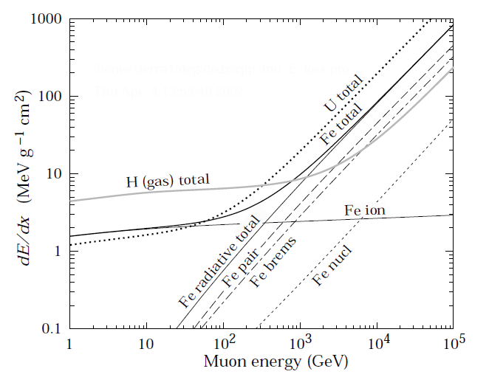
CHIC – absorber
Absorber size and muon energy loss
All π^{+/-} stopped with a 2.0 m Fe absorber
➔ but need more Fe to stop muons from pion decay
Pythia 6.421 - p+p - √s = 17.2 GeV
Particle Data Group: J. Phys. G 37, 075021 (2010)
3
5
7 GeV/c
dE/dx ~ 2 MeV g⁻¹ cm²
Fe density ~ 7.8 g cm⁻³
dE/dx ~ 15.6 MeV cm⁻¹
➔ 2.0 m Fe ➔ ΔE/Δx ~ 15.6 x 200 ~ 3 GeV ➔ A_{J/Ψ} ~ 18.4 %
3.2 m Fe ➔ ΔE/Δx ~ 15.6 x 320 ~ 5 GeV ➔ A_{J/Ψ} ~ 18.0 %
3.8 m Fe ➔ ΔE/Δx ~ 15.6 x 380 ~ 6 GeV ➔ A_{J/Ψ} ~ 17.3 %
4.5 m Fe ➔ ΔE/Δx ~ 15.6 x 450 ~ 7 GeV ➔ A_{J/Ψ} ~ 16.1 %
Muon
energy loss
in Fe

Slide 39
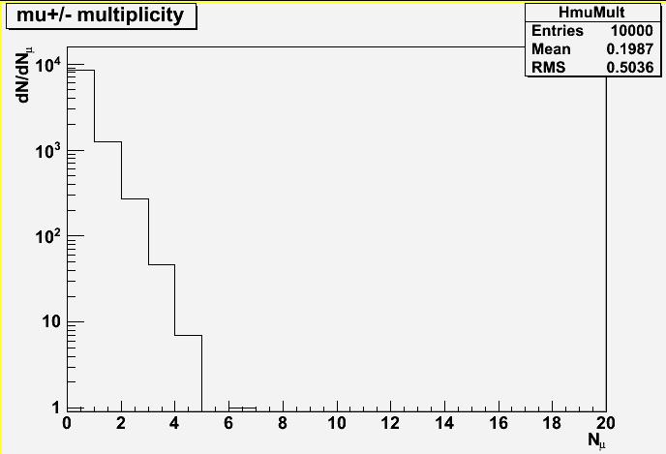
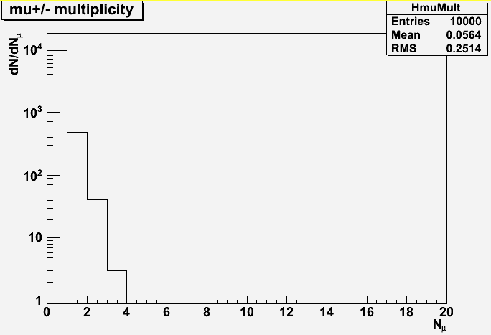
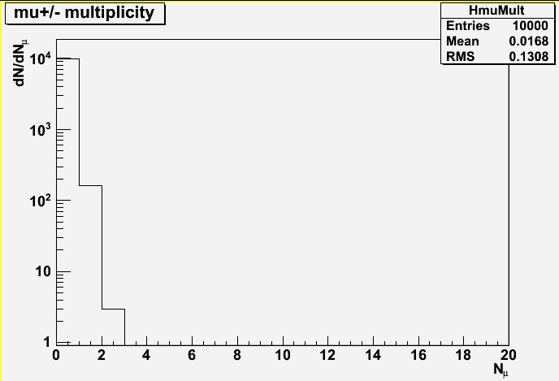
CHIC – trigger rate in Pb+Pb
Pb Beam intensity
NA50 → 5.10⁷ ions/bunch ➔ 10⁷ ions/sec (with a bunch time length ~ 5 sec)
Luminosity : L = N_{b}xN_{T} = N_{b} x (ρ x e x N_{A})/A = 10⁷x(11.35 x 0.4 x 6.02 10²³)/207.19=0.12μb⁻¹s⁻¹
Number of min bias events (for Pb+Pb)
σ_{I}=68.8 x (A^{1/3}_{proj} + B^{1/3}_{targ} – 1.32)² ➔ σ^{PbPb}_{minbias}=68.8 x (208^{1/3} + 207.19^{1/3} – 1.32)²=7.62 barn
Nevents/sec ~ 0.12 10⁶ x 7.62 ~ 0.9 MHz
Event rejection :
10 000 Pb+Pb minbias events
generated with EPOS 1.6
Absorber starts @ 205 cm
π^{+/-} stop decaying after ~1 λ_{I} in tungsten (λ_{I}~10cm)
➔ π^{+/-} stop decaying @ 2.15 m
~ 4 kHz
~ 1.1 kHz
~ 270 Hz
At least 2 μ in the
Detector (329 events)
At least 2 μ in the
Detector (44 events)
At least 2 μ in the
Detector (12 events)
At least 2 μ in the
Detector (3 events)
3.2m Fe abs.: P_{z}>5 GeV/c: Trigger accepts 44/10000 events➔ N_{events}/sec ~ 0.9 MHz x 4.4 10⁻³ ~ 4 kHz
3.8m Fe abs.: P_{z}>6 GeV/c: Trigger accepts 12/10000 events ➔ N_{events}/sec ~ 0.9 MHz x 1.2 10⁻³ ~ 1.1 kHz
4.5m Fe abs.: P_{z}>7 GeV/c: Trigger accepts 3/10000 events ➔ N_{events}/sec ~ 0.9 MHz x 3 10⁻⁴ ~ 270 Hz

Slide 40
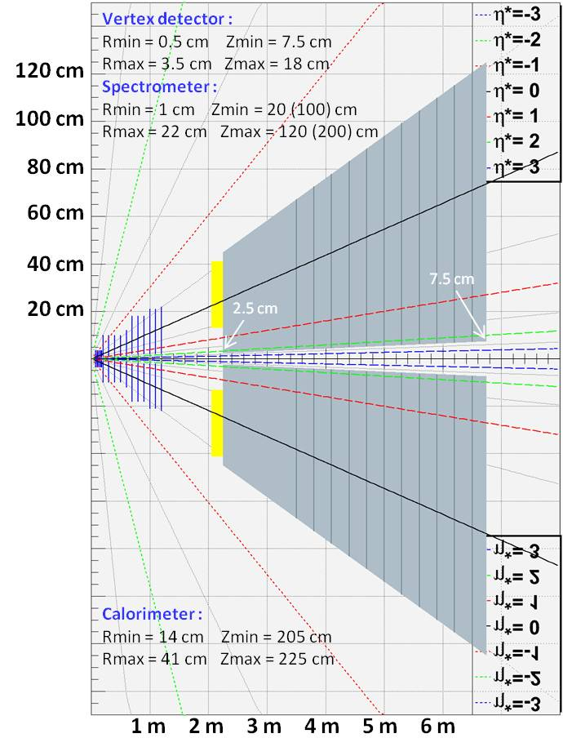
CHIC – Detector design
Primary goals :
χ_{c} → J/Ψ + γ → μ⁺ μ⁻ γ at y_{CMS} = 0
J/Ψ→μ⁺ μ⁻ in large y_{CMS} range
Detector features : very compact
Spectrometer
- Measure tracks before absorber ➔ σ_{M}~20 MeV/c²
- Covers y_{CMS} [-0.5, 2] ➔ need high segmentation
➔ Silicon technologies
Calorimeter
- Measuring γ in high π⁰ multiplicity environment
➔ ultra-granular EMCal (Calice)
Absorber/trigger
- Using 4.5 m thick Fe to absorb π/K and low P μ^{+/-}
- Can use smaller absorber if Fe magnetized
- Trigger to be defined (expected rate = 0.3 kHz)
Expected performances
tracking :
Calorimetry :
Dipole field
Dipole field

Slide 41
CHIC – Performances
χ_{c2} in p+p collisions at √s=17.8 GeV
Sample:
20 000 events with Pythia 6.421
1 χ_{c2}→J/Ψ γ →μ⁺ μ⁻ γ per event
Smearing ΔP_{μ}/P_{μ} = 1%
Smearing ΔE_{γ}/E_{γ} = 20%/√E_{γ}
Selections :
Keep muons w/ -0.5 < y_{cms} < 0.5
Keep muons w/ P_{z} > 7 GeV
Keep muons w/ z_{vertex} < 215 cm
Keep photons w/ -0.5 < y_{cms} < 0.5
Reject photons w/ M_{γγ} ∈[100, 160] MeV/c²
Results : signal/bkg = 2.8
χ_{c2} in Pb+Pb at √s=17.8 GeV
Sample:
10 000 events minbias with Epos 1.6
1 pythia χ_{c2} embedded in each event
Selections
Same selections as in p+p
Results : signal/bkg = 1.7
χ_{c2} in p+p
χ_{c2} in Pb+Pb

Slide 42
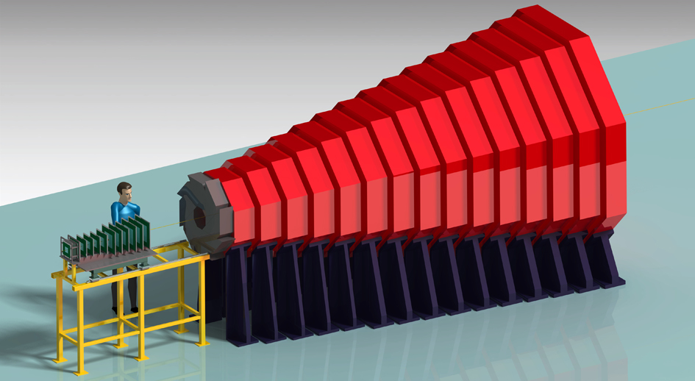
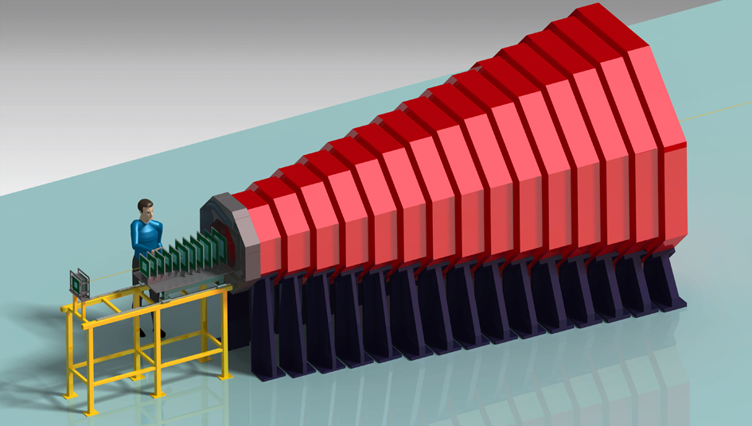
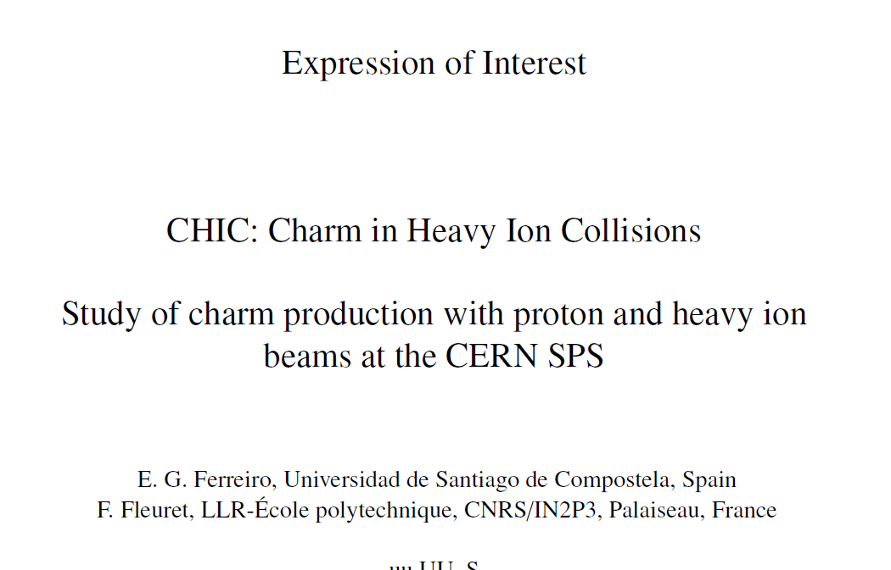
Conclusion
Already many data on J/Ψ production at different energies, more to come
Still difficult to fully understand:
Did we see sequential suppression ?
Did we see recombination ?
The measurement of χ_{c} is a crucial step
SPS is the best place to start
It is today feasible
Search for partners
Dessins produits par Oscar Ferreira – LLR

