Slide 1
Charm production with SMOG at LHCb
Running LHCb in a fixed-target mode
Heavy flavor production in Heavy Ion collisions
F. Fleuret on behalf of the LHCb collaboration

Slide 2
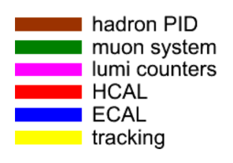
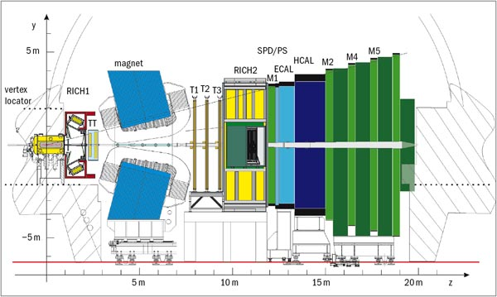
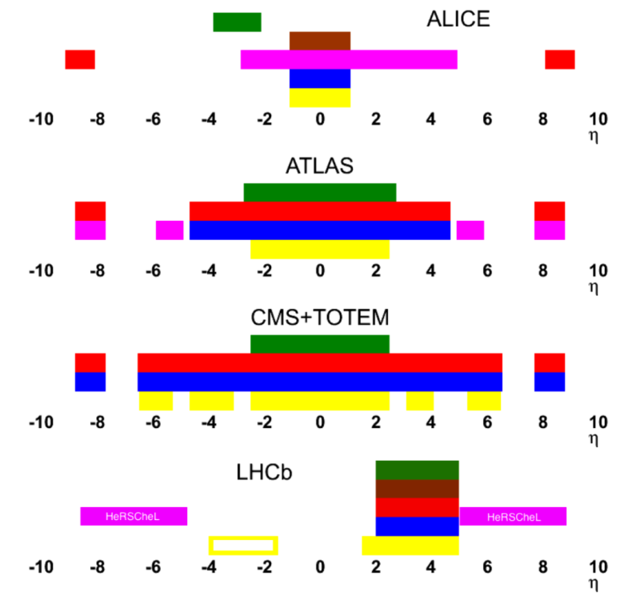
LHCb detector
Designed for heavy flavor physics
Single arm spectrometer, fully instrumented in 2 < y < 5
Excellent vertex, IP and decay time resolution
  σ(IP)≈20μm
Very good momentum resolution
  δp/p≈0.5−1% for 0<p<200 GeV/c
Particle identification
  ε_{K→K}≈95% for ε_{π→K}≈5% up to 100 GeV/c
  ε_{μ→μ}≈97% for ε_{π→μ}≈1−3%
JINST 3 (2008) S08005
IJMPA 30 (2015) 1530022

Slide 3
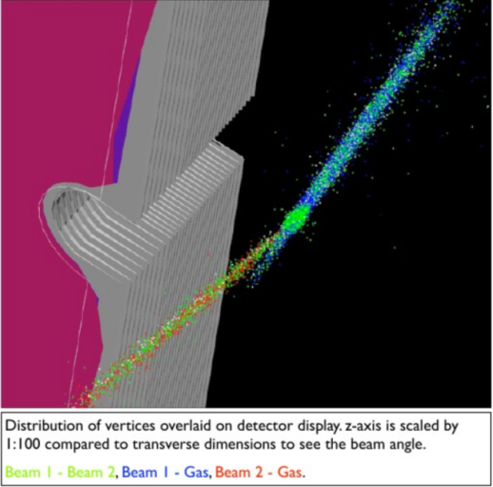

SMOG (System for Measuring Overlap with Gas)
Injecting gas in LHCb Vertex Locator (VELO) region
  Primary role : luminosity measurement
  Can be used as an internal gas target
  Allows measurement of p-gas and ion-gas interactions
beam
Noble gas only :
(very low chemical reactivity)
He, Ne, Ar, Kr, Xe
A = 4, 20, 40, 84, 131
Gaz pressure:
10⁻⁷ to 10⁻⁶ mbar
target
Gas
injection

Slide 4
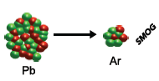
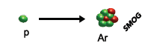
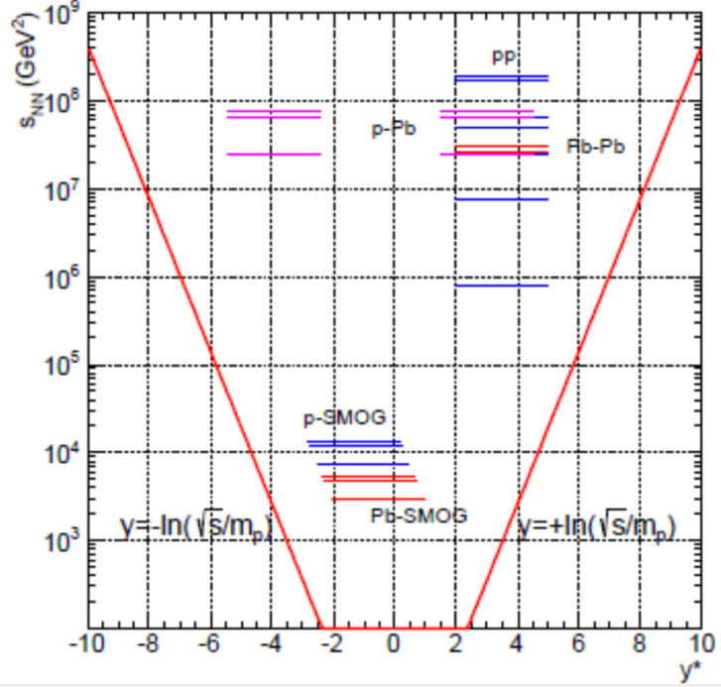
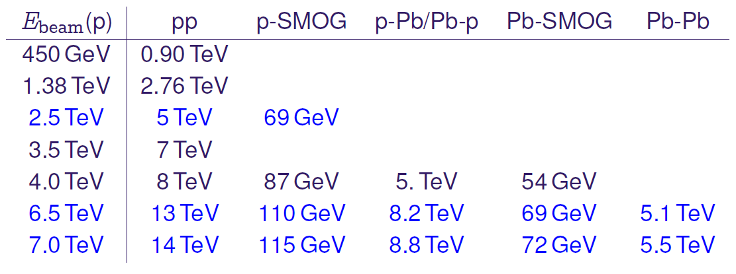
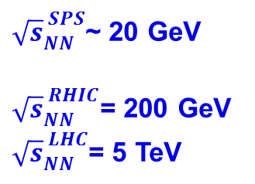



Fixed-target program
    ${\sqrt{s}}_{NN}^{ SPS}$~ 20 GeV
    ${\sqrt{s}}_{NN}^{ RHIC}$= 200 GeV
    ${\sqrt{s}}_{NN}^{ LHC}$= 5 TeV
$$\sqrt{s_{NN}}=90 à 110 GeV$$
$$\sqrt{s_{NN}}=69 GeV$$
Colliding mode (forward rapidity)
(Collision energy)²
5.02 TeV
Fixed-target mode (backward rapidity)
At $\sqrt{s_{NN}}=110 GeV$ y* = y_{lab} - 4.77
Give access to the target large Bjorken-x region
Mid-rapidity
LHCb rapidity coverage in the center-of-mass system

Slide 5
Nucleus-Nucleus collisions
Physics case
  2.75 TeV Pb beam on fixed target ➔ √s_{NN}~71 GeV (close to the 17 GeV regime reached at SPS)
    Investigate the Quark Gluon Plasma (QGP) phase transition
    Thanks to unique capabilities, LHCb offers new opportunities in the charm sector: J/ψ, ψ’, χ_{c}, D⁰, D^{+/-}, D*, Λ_{c}… (in the 90’s the NA50/SPS experiment measured only J/ψ and ψ’ in PbPb @ 17 GeV)
Accessing similar energy density regime (than SPS): operate PbAr@71 GeV
  Particle multiplicity is related to event centrality and center-of-mass energy
  Particle multiplicity can be used to compare different A+B collisions at different √s_{NN}
  PbAr @ 71 GeV multiplicity ≡ PbPb@17 GeV multiplicity
  ➔ PbAr @ 71 GeV is a good starting point to compare with NA50 (SPS)
System \ centrality | 60 – 100% | 50 – 60% | 40 – 50% | 30 – 40% | 20 – 30% | 10 – 20 % | 0 – 10%
PbNe – 71 GeV | 108.6 | 254.4 | 392.5 | 588.0 | 814.5 | 1086.0 | 1494.9
PbAr – 71 GeV | 123.6 | 308.8 | 496.5 | 806.6 | 1228.3 | 1711.9 | 2372.7
PbKr – 71 GeV | 196.9 | 533.6 | 919.1 | 1451.2 | 2205.5 | 2986.6 | 4084.3
PbPb – 17 GeV | 124.2 | 331.6 | 605.9 | 919.6 | 1338.7 | 2035.8 | 2980.5
|←LHC →|
(based on EPOS-LHC-v3400)
SPS

Slide 6
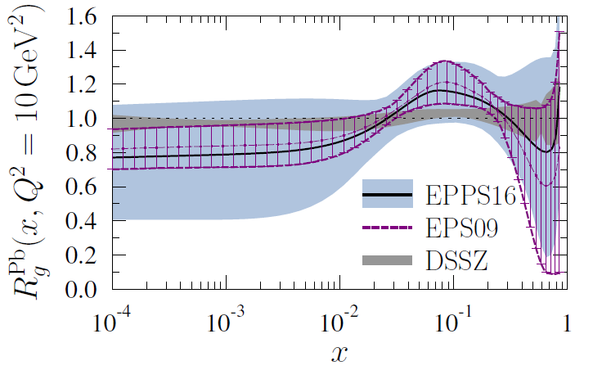
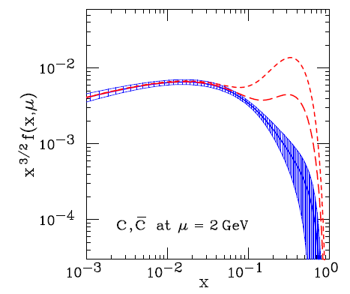
Proton-Nucleus collisions
Serve as a baseline for nucleus-nucleus collisions
Specific proton-nucleus physics program:
  Precision cross-section measurement for cosmic ray physics (see G. Graziani’s talk)
  Nuclear parton distribution function (nPDF), saturation, energy loss, nuclear absorption, …
With SMOG, LHCb offers a large rapidity coverage (~3 rapidity units) at large Bjorken-x x₂
  Give access to nPDF anti-shadowing region and intrinsic charm content in the nucleon
y=5
y=3.5
y=3.5
y=2.5
arXiv:1612.05741v1
y=5
y=2.5
With Intrinsic charm
PRD75 (2007), 054029
PDF in a Pb nucleus/PDF in a single nucleon
Charm quark distributions
With no
Intrinsic charm
BHPS with CTEQ6.5
LHCb
LHCb
Bjorken-x = fraction of the nucleon momentum carried by a parton

Slide 7

LHCb fixed-target mode
Data recorded
  Gas pressure in the VELO: ~ 1 – 2×10⁻⁷ mbar
Presented here : pAr @ 110 GeV (LHCb-CONF-2017-001)
  Preliminary results on heavy flavor production with SMOG
  Study J/ψ and D⁰ production in $\sqrt{s_{NN}}$=110 GeV proton-argon collisions
    Demonstration of feasibility of the heavy- flavor LHCb fixed-target program
System | Duration | CMS energy | Protons on target
2015
pHe | 7h | 110 GeV | 2×10²¹
pNe | 12h | 110 GeV | 1×10²¹
pAr | 17h | 110 GeV | 4×10²²
pAr | 11h | 69 GeV | 2×10²⁰
PbAr (To be analyzed) | 100h | 69 GeV | 2×10²⁰
2016
pHe (see G. Graziani‘s talk) | 18h | 110 GeV | 3×10²¹
pHe (to be analyzed) | 87h | 87 GeV | 4×10²²

Slide 8
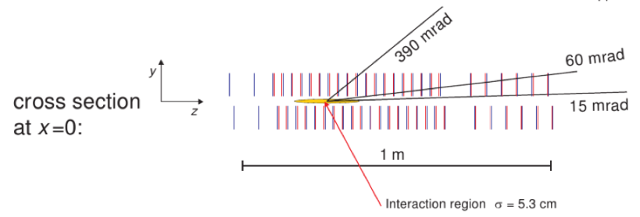

Data sample
pAr collisions @ 110 GeV
  17h of pAr collisions with 685 non-colliding bunches: ~4×10²² protons on target
  Select events with Beam 1 only at interaction point
  Apply topological cuts to remove possible residual proton-proton collisions (ghost charge)
  Select events with Z_{vertex} inside VELO Z_{vertex} ∈ [-20 cm, 20 cm]
$$R=\sqrt{X^{2}+Y^{2}}$$
Beam 1
(R,Z) position of the Primary Vertex

Slide 9
Signal extraction
(LHCb-CONF-2017-001)
J/ψ and D⁰ signal
  Overall data (17h) : ~500 J/ψ ~6500 D⁰
  Very clear signal, very small background
σ_{M} ~8 MeV/c²
σ_{M} ~14 MeV/c²

Slide 10
J/ψ and D⁰ differential production
(LHCb-CONF-2017-001)
4 p_{T} bins ∈ [0, 600] – [600, 1200] – [1200, 1800] – [1800, 8000] MeV/c
[0, 600]
[600, 1200]
[1200, 1800]
[1800, 8000]
J/ψ
J/ψ
J/ψ
J/ψ
[0, 600]
[600, 1200]
[1200, 1800]
[1800, 8000]
D⁰
D⁰
D⁰
D⁰

Slide 11
J/ψ and D⁰ differential production
(LHCb-CONF-2017-001)
4 rapidity bins : [2, 3] – [3, 3.5] – [3.5, 4] – [4, 4.6]
[2, 3]
[3, 3.5]
[3.5, 4]
[4, 4.6]
J/ψ
J/ψ
J/ψ
J/ψ
[2, 3]
[3, 3.5]
[3.5, 4]
[4, 4.6]
D⁰
D⁰
D⁰
D⁰

Slide 12

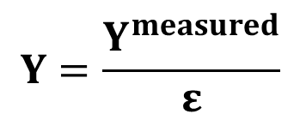
Yield corrections and uncertainties
$$Y=\frac{Y^{measured}}{ε}$$
(LHCb-CONF-2017-001)
Y^{measured} extracted from mass fits are corrected for different efficiencies:
$$ε=ε_{acc}×ε_{trig}×ε_{sel}×ε_{reco}×ε_{PID}$$
geometrical acceptance, trigger, selection, reconstruction, particle identification
Corrections are computed using pAr simulation samples and pp 13 TeV data
Source of uncertainties | J/ψ y | J/ψ p_{T} | D⁰ y | D⁰ p_{T}
Corr. between bins
Signal selection | 1.4% | 1.4% | 2.2% | 2.2%
Signal extraction | 2.3% | 2.3% | 2.3% | 2.7%
Uncorr. between bins
MC smaple | (1.2 – 2.6)% | (0.9 – 1.4)% | (1.0 – 1.9)% | (1.0 – 1.5)%
Tracking | (2.2 – 3.7)% | (2.2 – 2.9)% | (2.7 – 3.4)% | (2.8 – 3.6)%
PID | (0.2 – 2.7)% | (0.1 – 2.0)% | (4.1 – 8.8)% | (4.8 – 6.9)%
Stat. uncertainties | (7.7 – 12.5)% | (7.8 – 13.6)% | (0.7 – 3.7)% | (0.6 – 3.4)%
J/ψ uncertainties are dominated by statistical uncertainties

Slide 13
J/ψ corrected yields
(LHCb-CONF-2017-001)
J/ψ transverse momentum and rapidity distributions
  Box = quadractic sum of all uncertainties
  Red boxes = MC
    Pythia8-CT09MCS/NRQCD
    Overall MC yields normalized to overal data yields
(Pythia8 – NRQCD)
J/ψ
(Pythia8 – NRQCD)
0
8 GeV/c
2
4.5

Slide 14
J/ψ yields compared to phenomenological parametrizations
(LHCb-CONF-2017-001)
Phenomenological parametrizations based on
  Arleo, F. and Peigné, S. J. High Energ. Phys. (2013) 2013:122
  Arleo, F. et al., J. High Energ. Phys. (2013) 2013: 155
  MC and phenomenological distributions are normalized to data
Phenomenological parameters
  extracted from linear (blue plain curve) and logarithmic (green dashed curve) interpolations between 41.5 GeV and 200 GeV measurements
No strong difference observed within uncertainties
(Pythia8 – NRQCD)
(Pythia8 – NRQCD)
Rapidity in CMS: y* = y – 4.77

Slide 15
D⁰ corrected yields
(LHCb-CONF-2017-001)
D⁰ transverse momentum and rapidity distributions
  Box = quadractic sum of all uncertainties
  Red boxes = MC
    Pythia8-CT09MCS
    Overall MC yields normalized to overal data yields
D⁰
D⁰
(Pythia8 – CT09MCS)
(Pythia8 – CT09MCS)
0
8 GeV/c
2
4.5

Slide 16
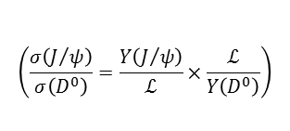
J/ψ to D⁰ ratios
(LHCb-CONF-2017-001)
J/ψ / D⁰ cross section ratio vs. p_{T} and rapidity
  Luminosity cancel out in the cross section ratio
  No significant dependence of σ(J/ψ)/σ(D⁰) with rapidity
  σ(J/ψ)/σ(D⁰) ratio increases with transverse momentum
  Need theoretical predictions !
$$\left(\frac{σ\left(J/ψ\right)}{σ\left(D^{0}\right)}=\frac{Y\left(J/ψ\right)}{ℒ}×\frac{ℒ}{Y\left(D^{0}\right)}\right)$$

Slide 17
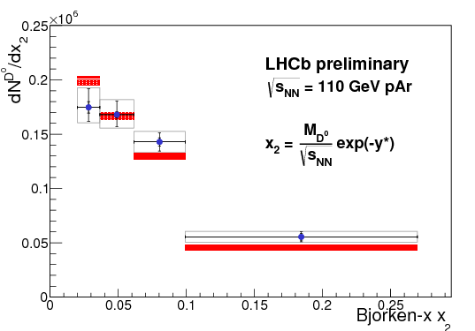
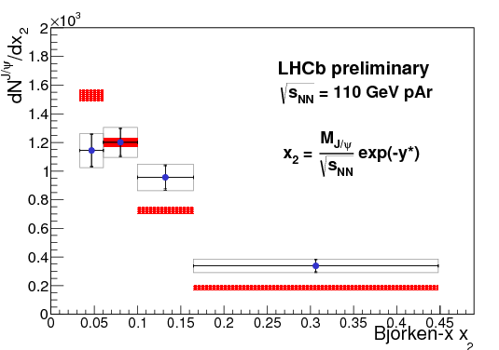

Bjorken-x distributions
(LHCb-CONF-2017-001)
Definition used in this analysis: $x_{2}=\frac{M}{\sqrt{s_{NN}}}e^{−y^{∗}}$
  Overall MC yields normalized to overal data yields
  Bjorken-x range covered by the data
    J/ψ x₂ $∈\left[0.03, 0.45\right]$
    D⁰ x₂ $∈\left[0.02, 0.27\right]$
  Access Intrinsic charm regime
  Need theoretical predictions !
(Rapidity in CMS: y* = y – 4.77)
(Pythia8 – CT09MCS)
(Pythia8 – CT09MCS/NRQCD)
D⁰ x₂
J/ψ x₂
0.02
0.27
PRD75 (2007), 054029
Charm quark distributions
With no
Intrinsic charm
BHPS with CTEQ6.5

Slide 18
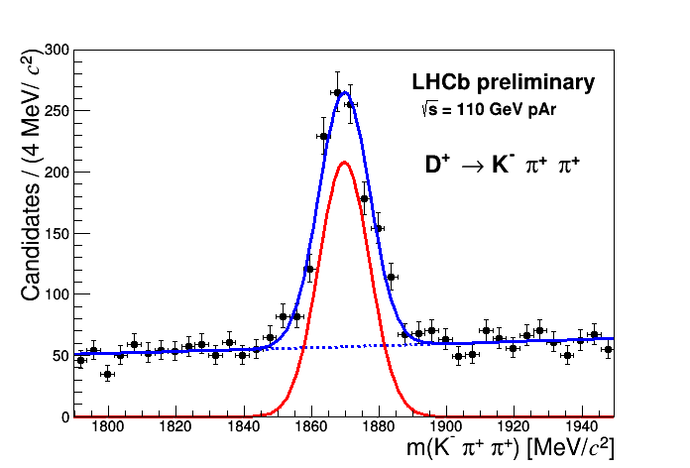




Other charmed hadrons
(LHCb-CONF-2017-001)
Other possible measurements: signals extracted from these pAr data
$$\sim 1000$$
$$\sim 130$$
$$\sim 2300$$
$$\sim 50$$

Slide 19
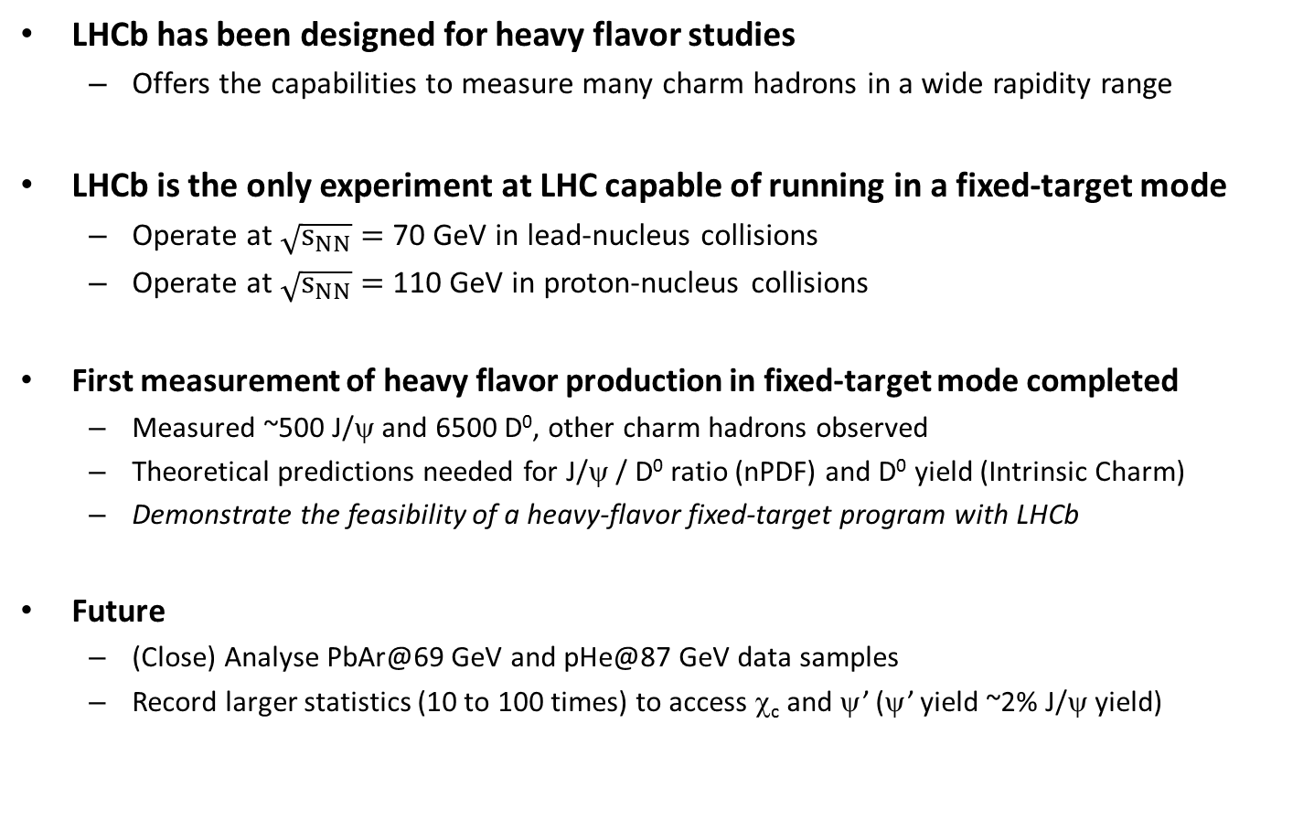
Conclusion
LHCb has been designed for heavy flavor studies
  Offers the capabilities to measure many charm hadrons in a wide rapidity range
LHCb is the only experiment at LHC capable of running in a fixed-target mode
  Operate at $\sqrt{s_{NN}}=$ 70 GeV in lead-nucleus collisions
  Operate at $\sqrt{s_{NN}}=$ 110 GeV in proton-nucleus collisions
First measurement of heavy flavor production in fixed-target mode completed
  Measured ~500 J/ψ and 6500 D⁰, other charm hadrons observed
  Theoretical predictions needed for J/ψ / D⁰ ratio (nPDF) and D⁰ yield (Intrinsic Charm)
  Demonstrate the feasibility of a heavy-flavor fixed-target program with LHCb
Future
  (Close) Analyse PbAr@69 GeV and pHe@87 GeV data samples
  Record larger statistics (10 to 100 times) to access χ_{c} and ψ’ (ψ’ yield ~2% J/ψ yield)

