Slide 1
Charmonia in Heavy Ion Collisions should we go back to SPS ?
– charmonia in A+A : the current (simplified) picture –
– back to SPS : the CHIC picture –

Slide 2
Charmonia in A+A Reminder
Motivations
Quarkonia suppression is a prediction of lattice QCD calculations, for instance :
Experimental setups
SPS/CERN – NA38, NA50, NA60 (√s_{NN} = 17 – 30 GeV): fixed target experiments
Statistic :100 000’s J/ψ
Data sets : p+A w/ A=p, d, Be, Al, Cu, Ag, W, Pb; S+U, In+In, Pb+Pb
Small rapidity coverage (typically y_{CMS} ∈ [0,1])
RHIC/BNL – Phenix experiment (√s_{NN} = 200 GeV): collider experiments
Statistic : 1000’s J/ψ (10000’s since 2007)
Data sets : p+p, d+Au, Cu+Cu, Au+Au
Large rapidity coverage (y_{CMS} ∈ [-0.5,0.5], y_{CMS} ∈ [-2.2,-1.2] and y_{CMS} ∈ [1.2,2.2])
LHC/CERN experiments (√s_{NN} = 5,5 TeV): collider experiments
Collider experiments
Statistic : 100000’s J/ψ
Data sets : p+p, Pb+Pb, p+Pb
Large rapidity coverage (|y_{CMS}|<2.5 ATLAS/CMS, |y_{CMS}|<0.9 and -4.0 < y_{CMS} < -2.5 ALICE)
H. Satz, J. Phys. G 32 (2006)

Slide 3
Charmonia in A+A Envisionned mechanisms
Sequential suppression in a QGP
inclusive J/Ψ yield ~ 60% direct J/Ψ + 30% χ_{c}→J/Ψ+γ + 10% Ψ’ → J/Ψ + X
Charmonium temperatures of dissociation
H. Satz, J. Phys. G 32 (2006)
T_{LHC-CERN} > T_{RHIC-BNL} > T_{SPS-CERN}
Sequential suppression
J/Ψ production (a.u.)
1
~0.9
~0.6
~0
Temperature
T_{Ψ’} > T_{c}
T_{χ} > T_{Ψ’} > T_{c}
T_{J/Ψ} > T_{χ} > T_{Ψ’} > T_{c}

Slide 4
Charmonia in A+A Envisionned mechanisms
Recombination in a QGP
If QGP at work ➔ c and c quarks can combine to form a J/Ψ
(require a large number of cc pairs → RHIC ? LHC ?)
T_{LHC-CERN} > T_{RHIC-BNL} > T_{SPS-CERN}
Sequential suppression
Recombination
J/Ψ production (a.u.)
1
~0.9
~0.6
~0
Temperature
T_{Ψ’} > T_{c}
T_{χ} > T_{Ψ’} > T_{c}
T_{J/Ψ} > T_{χ} > T_{Ψ’} > T_{c}

Slide 5
Charmonia in A+A Envisionned mechanisms
Suppression by comovers (Alternative scenario)
Suppression by comovers:
quarkonia can be broken by interaction with comoving hadrons
(Eur.Phys.J.C58:437-444,2008)
Two parameters
Interaction cross section σ_{co}
Hadron density N^{co}
Sequential suppression
Recombination
Suppression by comovers
J/Ψ production (a.u.)
1
~0.9
~0.6
~0
Temperature
T_{Ψ’} > T_{c}
T_{χ} > T_{Ψ’} > T_{c}
T_{J/Ψ} > T_{χ} > T_{Ψ’} > T_{c}

Slide 6
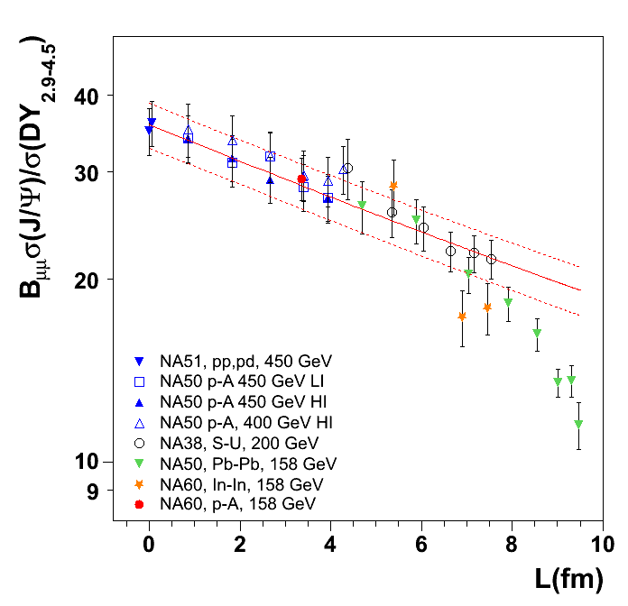
Charmonia in A+A Experimental highlights
SPS (17 GeV): NA38, NA51, NA50, NA60
Two major results :
Observation of Cold Nuclear Matter effects : Absorption by nuclear matter
Suppression observed from p+p to peripheral Pb+Pb
J/ψ survival probability :
Fit to data: σ_{abs}=4.18 ±0.35 mb
Observation of Anomalous suppression in Pb+Pb (NA50) central collisions when compared with Cold Nuclear Matter effects.
peripheral
mid
central
collisions
NA50, EPJ C39 (2005) 335
NA60, PRL99 (2007) 132302
J/ψ nuclear absorption
J/Ψ
L

Slide 7
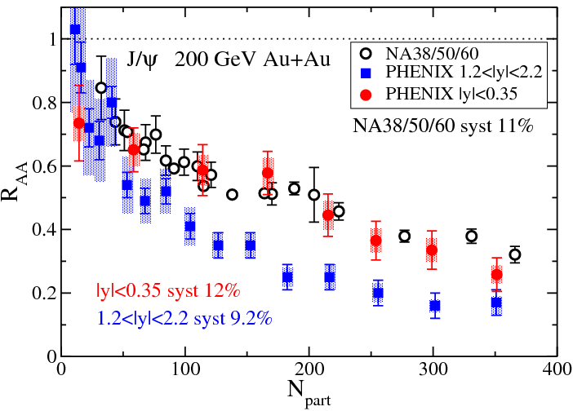
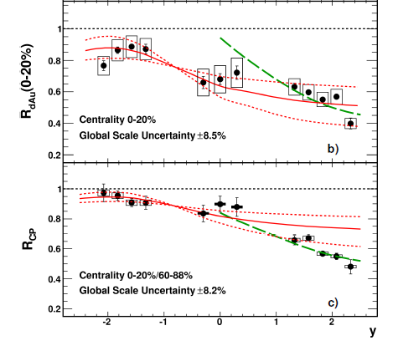
Charmonia in A+A Experimental highlights
RHIC (200 GeV) .vs. SPS (17 GeV)
Hot and dense matter effects
Measure J/Ψ in Au+Au (RHIC) Pb+Pb (SPS)
Compare at same rapidity (same y ~ same x_{F})
0<y<1 at SPS (NA50/NA60)
|y|<0.35 at RHIC (PHENIX)
Expected larger suppression at RHIC due to larger energy density
observe SIMILAR SUPPRESSION
at mid rapidity
Observe LARGER SUPPRESSION
at forward rapidity
Cold Nuclear Matter effects at RHIC
Measure J/Ψ production in d+Au collisions
Observe LARGER SUPPRESSION
at forward rapidity (small x₂)
Pattern still not fully understood
Difference forward.vs.mid rapidity may explain larger suppression observed in forward Au+Au

Slide 8
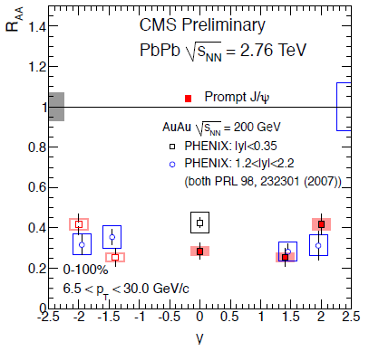
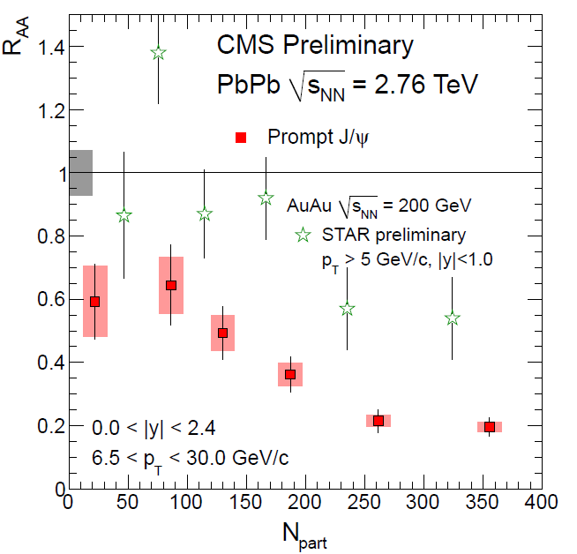
Charmonia in A+A Experimental highlights
RHIC (200 GeV) .vs. LHC (2.76 TeV) at forward rapidity
Compare PHENIX vs ALICE
1.2 < |y| < 2.2 at RHIC/PHENIX
2.5 < y < 4 at LHC/ALICE
LESS SUPPRESSION at LHC .vs. RHIC
Could be due to recombination effects
RHIC (200 GeV) .vs. LHC (2.76 TeV) at mid-rapidity
Compare PHENIX, STAR vs CMS
|y|<0.35 at RHIC/PHENIX
|y|<1 at RHIC/STAR
|y|<1 at LHC/CMS
MORE SUPPRESSION at LHC .vs. RHIC
p_{T}>6.5 GeV/c ➔ in principle no recombination applies
larger suppression due to QGP effects ?
Hint of sequential suppression ? (J/Ψ melting)
Caution : Need CNM effects comparison
PHENIX
CMS
http://cdsweb.cern.ch/record/1353586

Slide 9
Charmonia in A+A The current picture
Overall possible J/Ψ (simplified) picture
Similar suppression at SPS.vs.RHIC
Ψ’ and χ_{c} suppression only ?
CMS: Larger suppression at LHC
pT>6.5 GeV/c ➔ « outside » recombination regime ?
Hint of sequential suppression ?
(assuming CNM effects are the same or smaller)
ALICE |y|>2.5: Smaller suppression at LHC
« inside » recombination regime ?
Hint of recombination ?
(assuming CNM effects are the same of larger)
Energy density
SPS/RHIC
Sequential suppression
J/Ψ production probability
SPS/RHIC
Sequential suppression
LHC high p_{T}
recombination
LHC low p_{T}
SPS/RHIC
Sequential suppression

Slide 10
Charmonia in A+A Key questions
Answers to these questions are mandatory :
What are CNM effects at LHC ?
Shadowing should be large at forward rapidity
Shadowing should be small at high p_{T}
Resonance break-up cross section should be small
Is recombination mechanism at work ?
If smaller suppression observed at mid-rapidity and low p_{T}
Is sequential suppression at work ?
Need several (at least two) resonances
Ψ’ is not a good probe because of comovers
Should measure χ_{c}
➔ p+Pb run
➔ ALICE.vs.CMS at |y|=0
➔ unreachable

Slide 11
Back to SPS ? Sequential suppression ?
Measuring χ_{c} in A+A:
test charmonia sequential suppression
How χ_{c} is suppressed relative to J/Ψ ? Dependence with y, p_{T}, centrality?
Mandatory to draw the whole picture (SPS .vs. RHIC .vs. LHC)
Should measure χ_{c} at SPS. Why at SPS ?
If we understand SPS, we understand RHIC (same suppression)
Anomalous suppression has been seen at SPS
Appropriate range of energy density: can investigate Ψ’, χ_{c} and J/Ψ suppression
On average, 0.1 cc pair/event
No recombination at SPS
Fixed target experiment ?
Can operate many target species
Better control of CNM effects

Slide 12
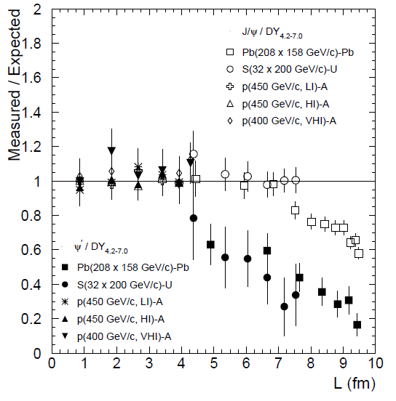
Back to SPS ? Charmonia suppression
Charmonia suppression
At SPS
Eur.Phys.J.C49:559-567,2007
60% direct J/Ψ
+ 30% χ_{c}→J/Ψ+γ
+ 10% Ψ’ → J/Ψ + X
Inclusive J/Ψ yield
p+A
S+U
Two possible scenarios:
sequential suppression (QGP)
comovers (no QGP)
Pb+Pb
Temperature of dissociation
Binding energy
L (fm)
ε (GeV/fm³)
4.37
1.04
4.90
1.24
6.65
2.04
7.65
2.53
8.83
3.19
9.43
3.76

Slide 13
Back to SPS ? Charmonia suppression
Two possible scenarios
QGP (sequential suppression)
Eur.Phys.J.C49:559-567,2007
p+A
Because ΔE (Ψ’) ~50 MeV
Ψ’ easily suppressed by comovers
Because ΔE(χ_{c})~200 MeV and ΔE(J/Ψ)~600 MeV
χ_{c} and J/Ψ hardly suppressed by comovers
S+U
Pb+Pb
Inclusive J/Ψ
χ_{c}
Ψ’
If χ_{c} suppressed by QGP,
χ_{c} slope strongly steeper than J/Ψ and Ψ’
Measuring χ_{c} suppression pattern
will (in)validate this
Note that direct J/Ψ can be experimentally estimated
Yield_{incl.J/Ψ} – Yield_{χc→J/Ψ+γ} – Yield_{Ψ’} ~ Yield_{direct J/Ψ}
L (fm)
ε (GeV/fm³)
4.37
1.04
4.90
1.24
6.65
2.04
7.65
2.53
8.83
3.19
9.43
3.76

Slide 14
Back to SPS ? Charmonia suppression
Two possible scenarios
No QGP (full comovers)
Eur.Phys.J.C49:559-567,2007
p+A
S+U
Because σ_{J/Ψ-co} ≤ σ_{χc-co} ≤ σ_{Ψ’-co}
Ψ’ slope slightly steeper than χ_{c}
χ_{c} slope slightly steeper than J/Ψ
Pb+Pb
direct J/Ψ
Measuring
χ_{c} suppression pattern
will (in)validate this
Ψ’
χ_{c}
Note that direct J/Ψ can be experimentally estimated
Yield_{incl.J/Ψ} – Yield_{χc→J/Ψ+γ} – Yield_{Ψ’} ~ Yield_{direct J/Ψ}
L (fm)
ε (GeV/fm³)
4.37
1.04
4.90
1.24
6.65
2.04
7.65
2.53
8.83
3.19
9.43
3.76

Slide 15
Back to SPS ? Measuring χ_{c}
Conclusion :
Eur.Phys.J.C49:559-567,2007
p+A
measuring
Ψ’, J/Ψ and χ_{c} suppression pattern
S+U
Pb+Pb
No QGP χ_{c}
will answer the question
------ QGP
------ no QGP
QGP χ_{c}
Note that direct J/Ψ can be experimentally estimated
Yield_{incl.J/Ψ} – Yield_{χc→J/Ψ+γ} – Yield_{Ψ’} ~ Yield_{direct J/Ψ}
L (fm)
ε (GeV/fm³)
4.37
1.04
4.90
1.24
6.65
2.04
7.65
2.53
8.83
3.19
9.43
3.76

Slide 16
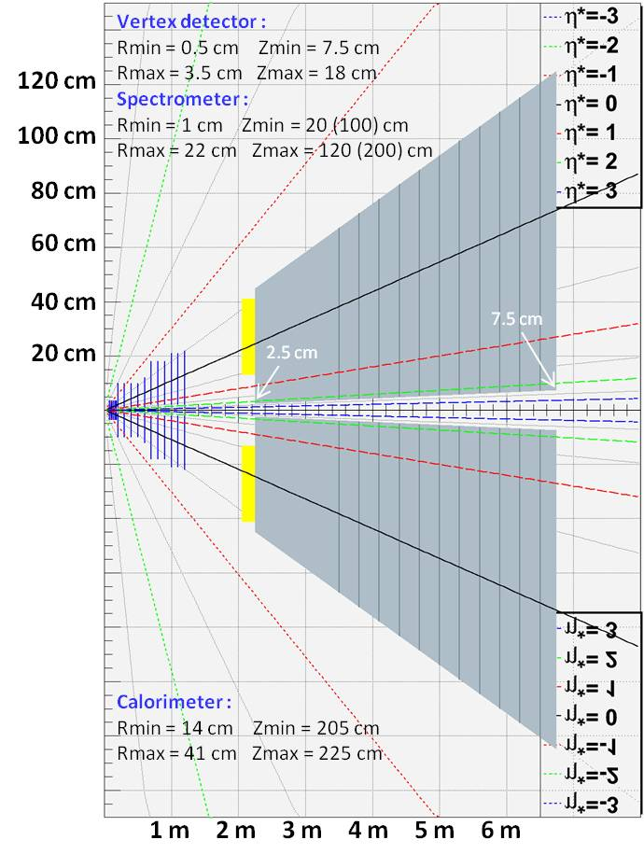
Back to SPS Charm In Heavy Ion Collisions
Primary goals :
χ_{c} → J/Ψ + γ → μ⁺ μ⁻ γ at y_{CMS} = 0
J/Ψ→μ⁺ μ⁻ in large y_{CMS} range
Detector features : very compact
Spectrometer
- Measure tracks before absorber ➔ σ_{M}~20 MeV/c²
- Covers y_{CMS} [-0.5, 2] ➔ need high segmentation
➔ Silicon technologies
Calorimeter
- Measuring γ in high π⁰ multiplicity environment
➔ ultra-granular EMCal (Calice)
Absorber/trigger
- Using 4.5 m thick Fe to absorb π/K and low P μ^{+/-}
- Can use smaller absorber if Fe magnetized
- Trigger to be defined (expected rate = 0.3 kHz)
Expected performances
tracking :
Calorimetry :
Dipole field
Dipole field

Slide 17
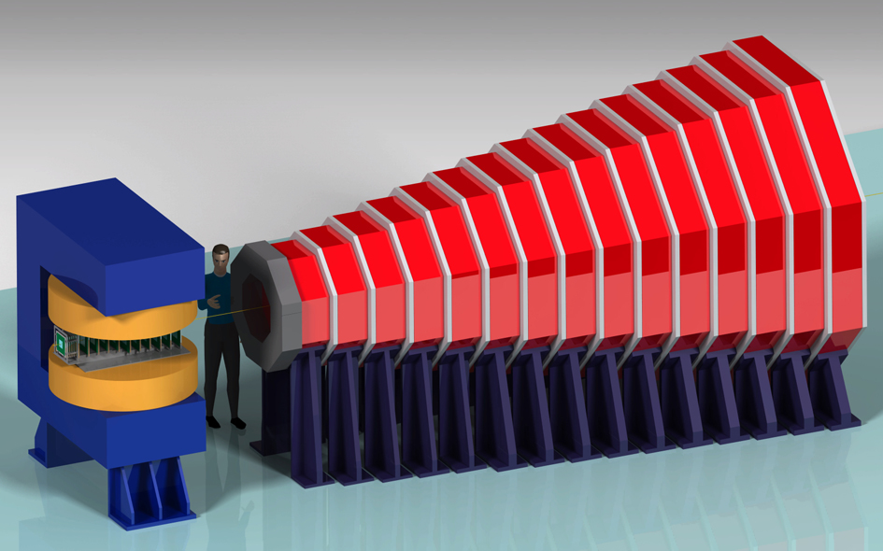
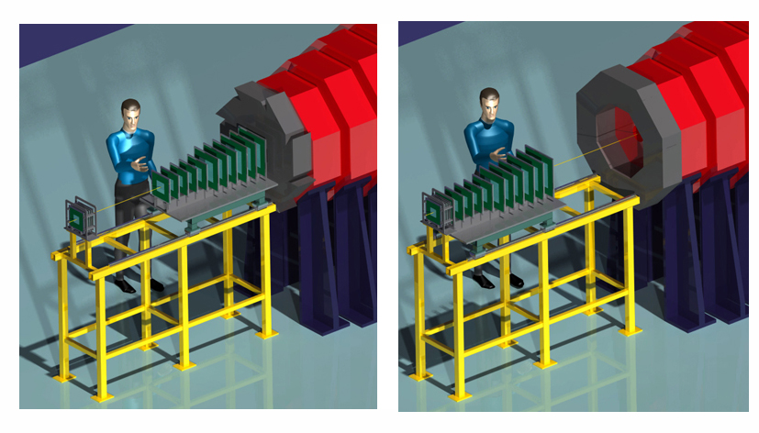
Back to SPS Charm In Heavy Ion Collisions
CHIC: Experimental setup flexibility
Very compact detector
(full detector simulation ongoing)
Forward rapidity
Mid rapidity
Large rapidity coverage
fixed target mode ➔ high flexibility
displace tracker to access large rapidity
modify calorimeter to access large rapidity

Slide 18
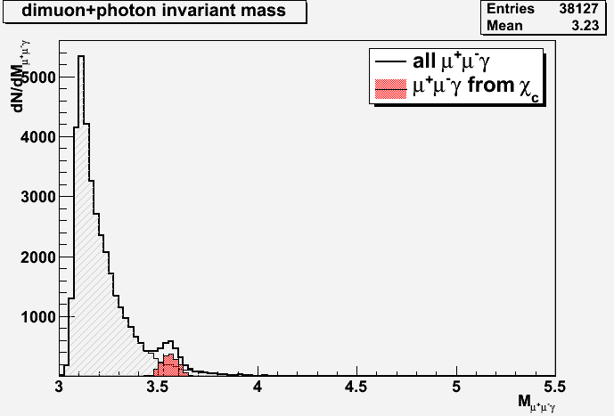
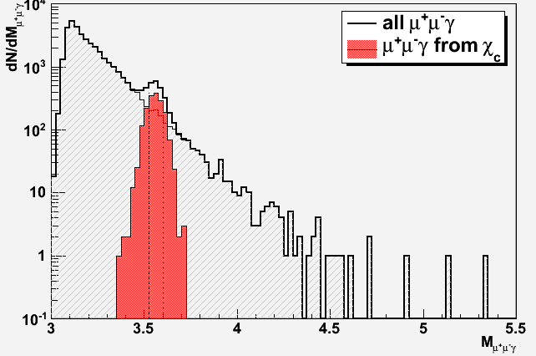
Charm in Heavy Ion Collisions Signal extraction
Typical mass plots
200 000 Pb+Pb minBias EPOS events
140 000 events with J/Ψ embedded (70%)
60 000 events with χ_{c} embedded (30%)
J/Ψ
S/B=990
χ_{c}
S/B=1.8
After acceptance and selection cuts:
35 000 J/Ψ ➔ acc x eff = 17.4%
1700 χ_{c} ➔ acc x eff = 2.8 %

Slide 19
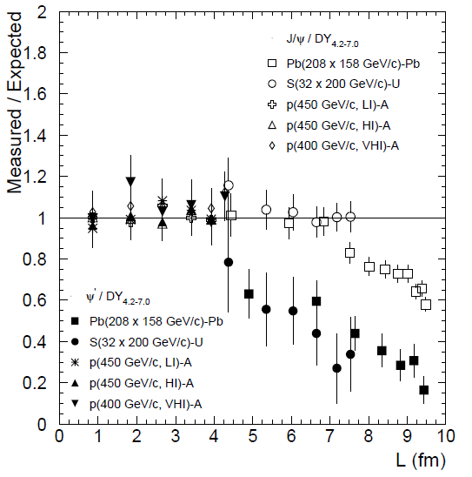
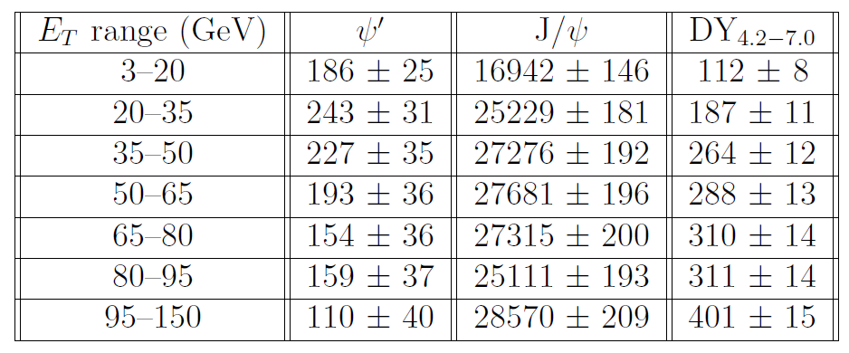
Charm in Heavy Ion Collisions Figure of Merit
Typical one month Pb+Pb run with a 4mm thick target
~ 200 000 inclusive J/Ψ→μ⁺μ⁻ expected
2 extreme scenarios:
If χ_{c} suppressed as J/Ψ
If χ_{c} suppressed as Ψ’
~180 000 J/Ψ
~ 1300 Ψ’
χ_{c as J/Ψ} | χ_{c as Ψ’}
677 | 406
1010 | 530
1091 | 495
1107 | 421
1093 | 336
1004 | 347
1143 | 240
7125 | 2775
Eur.Phys.J.C49:559-567,2007
Uncertainties
χ_{c} stat > 2 x Ψ’ stat
➔ χ_{c} error < Ψ’ error/√2

Slide 20
Back to SPS Charm In Heavy Ion Collisions
Conclusion
Core benchmark : unique test of χ_{c} in heavy ion collisions
What we didn’t discuss :
CHIC p+A program
9 months of proton beam available – to be compared to the usual one month
capability to access x_{F} = 1
physics of saturation : shadowing, CGC, energy loss (Arléo, Peigné)
charmonium hadronisation time
charmonium absorption cross section
Drell-Yan studies
Open charm studies
Charged/neutral hadrons studies
Photons studies
Low mass dileptons

Slide 21
Backup slides

Slide 22
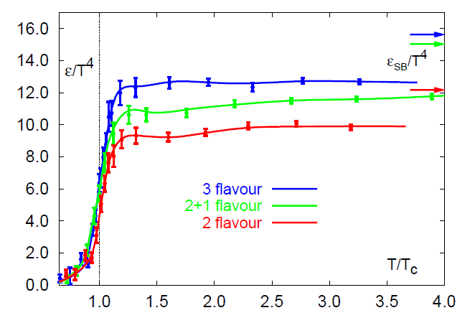
Backup Physics motivations
Sequential suppression in a QGP
No QGP
QGP
If QGP at work ➔ threshold effect
threshold
F. Karsch, Lect. Notes Phys. 583 (2002) 209
Above
threshold
Temperatures of dissociation :
H. Satz, J. Phys. G 32 (2005)

Slide 23
Backup Physics motivations
Sequential suppression in a QGP
Eur.Phys.J.C49:559-567,2007
Theoretically,
expect
p+A
data
S+U
Experimentally,
Ψ’ suppression starts at
L (fm)
ε (GeV/fm³)
4.37
1.04
Pb+Pb
Theoretically,
χ_{c} suppression should start at
L (fm)
ε (GeV/fm³)
4.9
1.2
data
Experimentally,
J/Ψ suppression starts at
L (fm)
ε (GeV/fm³)
6.65
2.04
Conclusion
either theoretical predictions are wrong,
or Ψ’ is previously suppressed by something else
L (fm)
ε (GeV/fm³)
4.37
1.04
4.90
1.24
6.65
2.04
7.65
2.53
8.83
3.19
9.43
3.76

Slide 24
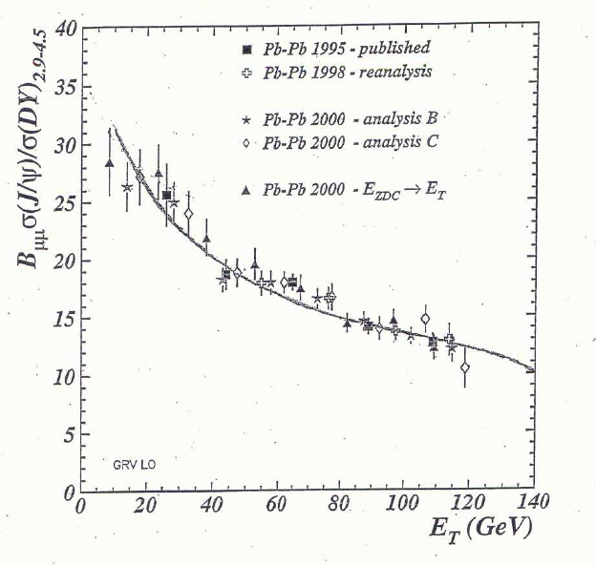
Backup Physics motivations
Sequential suppression by comovers
Suppression by comovers:
quarkonia can be broken by interaction with comoving partons/hadrons
Two parameters
Hadron density N^{co}
Interaction cross section σ_{co}
(Eur.Phys.J.C58:437-444,2008)
A. Capella, EPJ C30, 117 (2003)

Slide 25
Backup Physics motivations
Sequential suppression by comovers
Suppression by comovers:
quarkonia can be broken by interaction with comoving partons/hadrons
Two parameters
Hadron density
Interaction cross section σ_{co}
There is a hierarchy in the suppression
σ_{co} is linked to the quarkonium binding energy
The larger the binding energy, the smaller the σ_{co}
But σ_{co} is theoretically unknown (must be fitted on the data)
Sequential suppression
ΔE(J/Ψ) > ΔE(χ_{c}) > ΔE (Ψ’)
➔ σ_{J/Ψ-co} ≤ σ_{χc-co} ≤ σ_{Ψ’-co}
Quarkonium bindind energy
(ΔE = M_{quarkonium} – 2M_{D})

Slide 26
Backup Physics motivations
Sequential suppression by comovers
Eur.Phys.J.C49:559-567,2007
Eur.Phys.J.C58:437-444,2008
If comovers at work ➔ smooth suppression
p+A
(reminder: If QGP at work ➔ threshold effect)
S+U
Pb+Pb
Experimentally,
Ψ’ suppression pattern slightly steeper than J/Ψ one (theoritically σ_{J/Ψ-co} ≤ σ_{Ψ’-co})
If comovers at work, χ_{c} suppression pattern should stand within Ψ’ and J/Ψ suppression patterns
Inclusive J/Ψ
Ψ’
Conclusion
Need to measure χ_{c} pattern to test comovers scenario
L (fm)
ε (GeV/fm³)
4.37
1.04
4.90
1.24
6.65
2.04
7.65
2.53
8.83
3.19
9.43
3.76

Slide 27
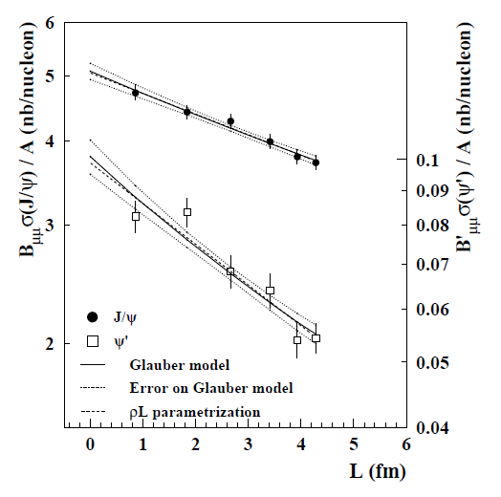
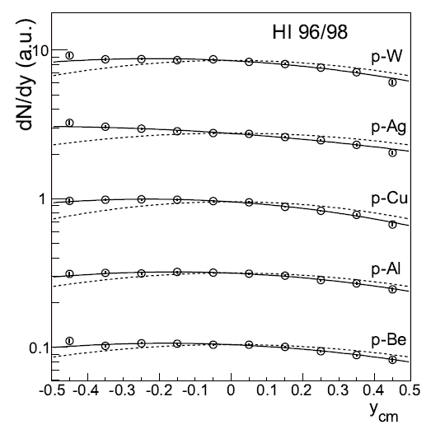
Backup Physics motivations
Benchmark 2: Measure charmonium in p+A at SPS
J/Ψ and Ψ’ suppression in p+A collisions as a function of L
➔ Measuring different charmonium states gives key information on Cold Nuclear Matter and production mechanism.
NA50
J/Ψ
Ψ’
Euro. Phys. J. C48 (2006) 329.
J/Ψ rapidity distribution in p+A collisions (asymetry wrt y_{cm}=0)
➔ Measuring charmonium in a wide x_{F} range is important to identify possible (anti)shadowing effects

Slide 28
Backup Physics motivations
Measure charmonium in p+A at SPS
➔ Measuring charmonium in a wide x_{F} range is important to estimate possible (anti)shadowing effects
E866, Phys. Rev. Lett. 84, 3256-3260 (2000)
With M=3.1 GeV/c² and √s=17.2 GeV (158 GeV)
x_{F} = 1 ➔ y_{CMS} = 1.7
With M=3.1 GeV/c² and √s=29.1 GeV (450 GeV)
x_{F} = 1 ➔ y_{CMS} = 2.2
Y_{CMS}=2 ➔ x_{F} = 0.8
Possible to access large x_{F} if measuring charmonia at rapidity up to y_{CMS}~2

Slide 29
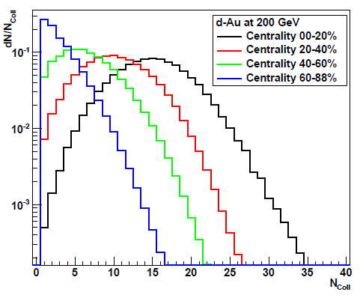
Backup fixed target.vs.collider mode
Cold Nuclear Matter studies
Must be performed in p+A collisions
The more A versatility, the better
Collider mode
Difficult to operate many A systems (for instance, since 2000, Phenix operated d+Au collisions only) ➔ studies as a function of centrality
Constraints:
Centrality bin limitation: due to the “small” number of particle produced in p+A, cannot make as many centrality bins as in A+A collisions
Glauber uncertainty :
<N_{coll}>.vs.centrality through Glauber calculation ➔ uncertainty on <N_{coll}> (~7% for Phenix)
Fixed target mode
Easy to operate many A systems
No bin limitation
No Glauber uncertainties
Phenix d+Au
centrality bins
arXiv:1204.0777
Collider mode:
centrality | <N_{coll}>
0-20% | 15.1 ± 1.0
20-40% | 10.2 ± 0.7
40-60% | 6.6 ± 0.4
60-88% | 3.2 ± 0.2
Fixed target mode:

