Slide 1
C H I C Charm in Heavy Ion Collisions @ SPS
J/Ψ – Suppression in A+A
CHIC – Physics motivations
CHIC – Experimental aspects

Slide 2
J/Ψ – Suppression in A+A
SPS (17 GeV) .vs. RHIC (200 GeV)
Compare
0<y<1 at SPS (NA50/NA60)
|y|<0.35 at RHIC (PHENIX)
➔ ~ same y (~same x_{F})
SIMILAR SUPPRESSION at SPS.vs.RHIC
Assuming CNM effects amplitude are the same (possible within large RHIC uncertainties), two hypothesis :
Due to recombination process which exactly compensates a larger suppression expected at RHIC energies
Due to χ_{c} suppression (and Ψ’) only *
➔ SEQUENTIAL SUPPRESSION
* direct J/Ψ not suppressed
PHENIX
R_{AA}(mid) > R_{AA}(forward)

Slide 3
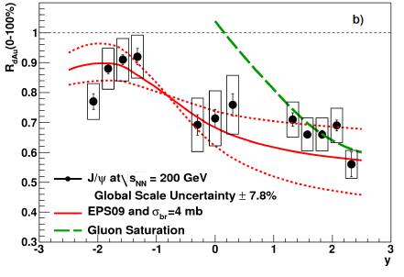
J/Ψ – Suppression in A+A
SPS (17 GeV) .vs. RHIC (200 GeV)
Compare
0<y<1 at SPS (NA50/NA60)
|y|<0.35 at RHIC (PHENIX)
1.2 < |y| < 2.2 at RHIC (PHENIX)
After CNM effects correction:
SIMILAR SUPPRESSION at SPS .vs. RHIC
If recombination at RHIC, must be small
Hint for sequential suppression ? (χ_{c} and Ψ’ melting ?)
But LARGE CNM effects uncertainties ➔ not clear yet

Slide 4
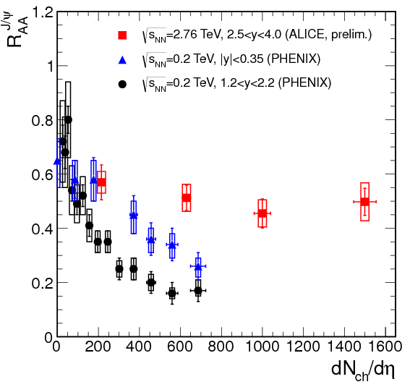
J/Ψ – Suppression in A+A
RHIC (200 GeV) .vs. LHC (2.76 TeV)
Compare
1.2 < |y| < 2.2 at RHIC (PHENIX)
2.5 < y < 4 at LHC (ALICE)
LESS SUPPRESSION at LHC .vs. RHIC
Assuming CNM effects amplitude are the same (or larger at LHC) :
Could be due to recombination effects
Caution : Needs CNM effects comparison

Slide 5
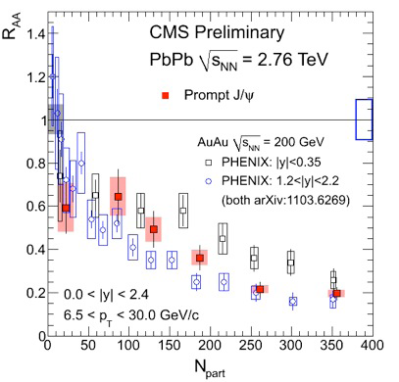
J/Ψ – Suppression in A+A
RHIC (200 GeV) .vs. LHC (2.76 TeV)
Compare
|y|<0.35 at RHIC (PHENIX)
|y|<1 at LHC (CMS)
MORE SUPPRESSION at LHC .vs. RHIC
Assuming CNM effects amplitude are the same (or smaller at LHC) :
p_{T}>6.5 GeV/c ➔ no recombination applies
larger suppression due to HDM effects ?
Hint for sequential suppression ? (J/Ψ melting)
Caution : Needs CNM effects comparison
PHENIX
CMS

Slide 6
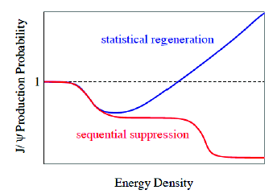
J/Ψ – Suppression in A+A
Similar suppression at SPS.vs.RHIC
After CNM effects correction
Larger suppression at LHC outside recombination regime
CMS results (assuming CNM effects are the same or smaller)
Smaller suppression at LHC inside recombination regime
ALICE results (assuming CNM effects are the same of larger)
Large uncertainties due to CNM effects
Need to measure χ_{c} to (dis)prove sequential suppression ➔ CHIC experiment

Slide 7
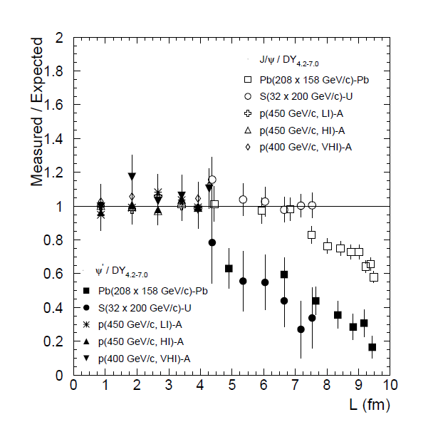
CHIC – Physics motivations
Measure χ_{c} in A+A at SPS
How χ_{c} is suppressed relative to J/Ψ ?
What is the dependence with y, p_{T}, centrality,… ?
Mandatory to draw the whole picture (SPS .vs. RHIC .vs. LHC)
Why SPS ?
SPS best place to see full
Sequential suppression
No recombination at SPS
PRL 99, 132302 (2007)
Ψ’
Need to
be measured
χ_{c} ?
χ_{c} measurement
will answer this
J/Ψ ?
1
Most central RHIC ?
LHC ?
2

Slide 8
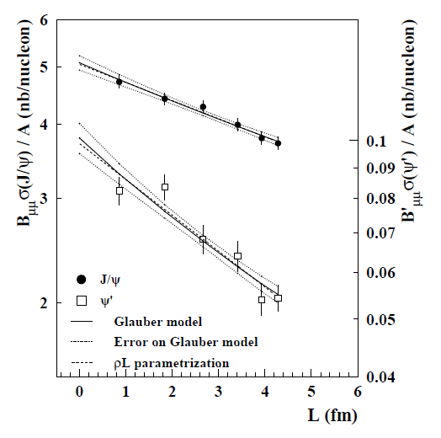
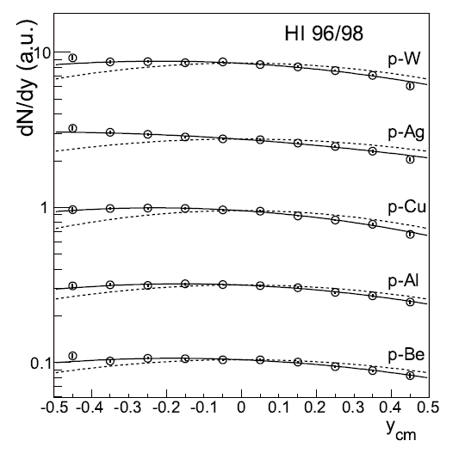
CHIC – Physics motivations
Measure charmonium in p+A at SPS
J/Ψ and Ψ’ suppression in p+A collisions as a function of L
➔ Measuring different charmonium states gives key information on nuclear « absorption » and production mechanism.
NA50
J/Ψ
Ψ’
Euro. Phys. J. C48 (2006) 329.
J/Ψ rapidity distribution in p+A collisions (asymetry wrt y_{cm}=0)
➔ Measuring charmonium in a wide x_{F} range is important to identify possible (anti)shadowing effects

Slide 9
CHIC – Physics motivations
Measure charmonium in p+A at SPS
➔ Measuring charmonium in a wide x_{F} range is important to identify possible (anti)shadowing effects
E866, Phys. Rev. Lett. 84, 3256-3260 (2000)
With M=3.1 GeV/c² and √s=17.2 GeV (158 GeV)
x_{F} = 1 ➔ y_{CMS} = 1.7
With M=3.1 GeV/c² and √s=29.1 GeV (450 GeV)
x_{F} = 1 ➔ y_{CMS} = 2.2
Y_{CMS}=2 ➔ x_{F} = 0.8
Possible to access large x_{F} if measuring charmonia at rapidity up to y_{CMS}~2

Slide 10
CHIC – Physics motivations
Measure χ_{c} production in A+A
How χ_{c} is suppressed relative to J/Ψ ? What is the dependence with y, p_{T}, N_{part},… ?
Mandatory to draw the whole picture (SPS .vs. RHIC .vs. LHC)
Benchmark 1 : Measure χ_{c} production within y_{CMS} ∈ [-0.5, 0.5]
Measure charmonia production in p+A
what is the dependence of charmonia suppression with rapidity ?
Crucial to understand effects due to cold nuclear matter
Benchmark 2 : Measure charmonium states within y_{CMS} ∈ [-0.5, 2]

Slide 11
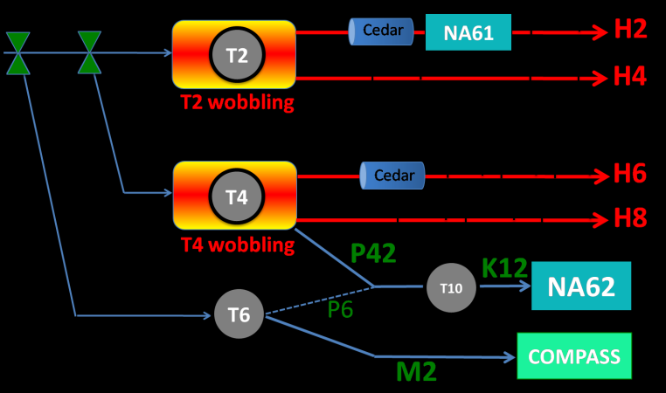
CHIC – Expected yields
Need high intensity p and Pb beams (~ 10⁷ Pb/sec)
NA50/NA60 beam line not available (NA62)
H2 beam line occupied by NA61
H4 and H8 available but need shielding for HI
NA50: European Physical Journal C39 (2005) 335
New measurement of J/ψ suppression in Pb+Pb at 158 GeV/nucleon
35 days of data taking in 2000
~1.10⁷Pb/s over 5s bursts every 20s
4 mm thick Pb target (10%λ_{I})
~ 100 000 J/Ψ→μ⁺μ⁻ within y*∈[0,1] (on tape)
Expect fair amount of χ_{c}: N_{J/Ψ} ~ 60% direct + ~30% from χ_{c} + ~10% from Ψ’
Same conditions as NA50 setup ➔ ~20 000 χ_{c} expected within y_{CMS} ∈ [-0.5,0.5]
Expect more with thicker target (1cm for instance)
North Area Beamlines

Slide 12
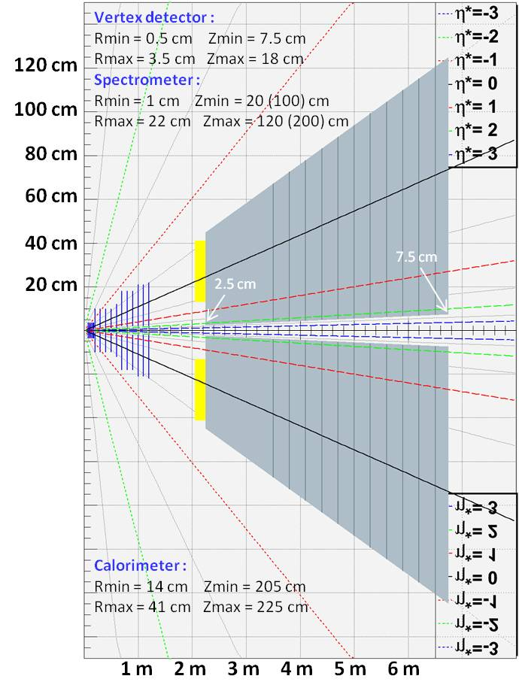
CHIC – Detector design
Primary goals :
χ_{c} → J/Ψ + γ → μ⁺ μ⁻ γ at y_{CMS} = 0
J/Ψ→μ⁺ μ⁻ in large y_{CMS} range
Detector features : very compact
Spectrometer
- Measure tracks before absorber ➔ σ_{M}~20 MeV/c²
- Covers y_{CMS} [-0.5, 2] ➔ need high segmentation
➔ Silicon technologies
Calorimeter
- Measuring γ in high π⁰ multiplicity environment
➔ ultra-granular EMCal (Calice)
Absorber/trigger
- Using 4.5 m thick Fe to absorb π/K and low P μ^{+/-}
- Can use smaller absorber if Fe magnetized
- Trigger to be defined (expected rate = 0.3 kHz)
Expected performances
tracking :
Calorimetry :
Dipole field

Slide 13
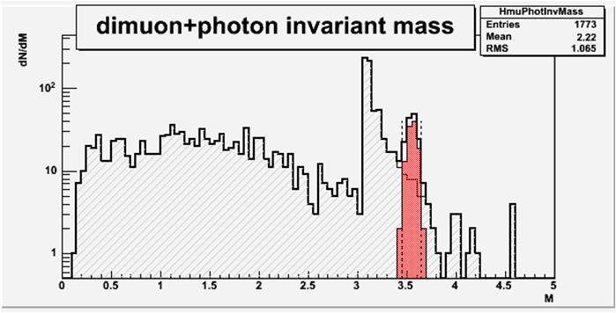
CHIC – Performances
χ_{c2} in p+p collisions at √s=17.8 GeV
Sample:
20 000 events with Pythia 6.421
1 χ_{c2}→J/Ψ γ →μ⁺ μ⁻ γ per event
Smearing ΔP_{μ}/P_{μ} = 1%
Smearing ΔE_{γ}/E_{γ} = 20%/√E_{γ}
Selections :
Keep muons w/ -0.5 < y_{cms} < 0.5
Keep muons w/ P_{z} > 7 GeV
Keep muons w/ z_{vertex} < 215 cm
Keep photons w/ -0.5 < y_{cms} < 0.5
Reject photons w/ M_{γγ} ∈[100, 160] MeV/c²
Results : signal/bkg = 2.8
χ_{c2} in Pb+Pb at √s=17.8 GeV
Sample:
10 000 events minbias with Epos 1.6
1 pythia χ_{c2} embedded in each event
Same selections as in p+p
Reject γ if not in the same emisphere as J/Ψ
Results : signal/bkg = 3.6

Slide 14
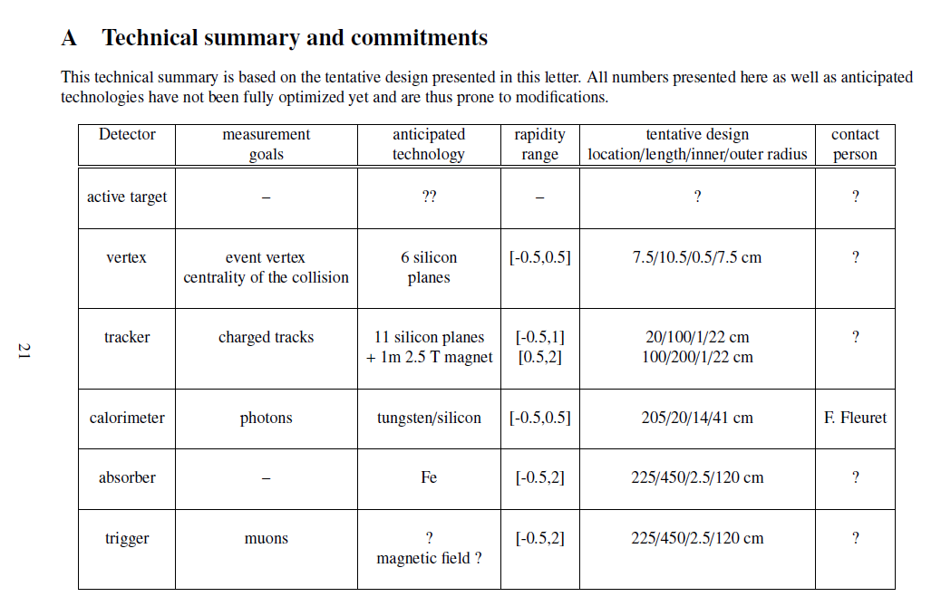
Conclusion
Many data on J/Ψ at various energies, more to come.
Still difficult to understand:
Is there sequential screening ?
When does recombination applies ?
χ_{c} is a key measurement to (dis)prove sequential screening.
Because of its energy, SPS is the best place to start with.
Thanks to new technologies (tracking, calorimetry), it is FEASIBLE.
Let’s do it !
fleuret@in2p3.fr

Slide 15
backup

Slide 16
Experimental landscape
Current landscape
Fixed target : SPS/CERN NA38/50/60 experiments – √s_{NN} = 17 – 30 GeV
Statistics :100 000’s J/ψ
Data sets : p+A w/ A=p, d, Be, Al, Cu, Ag, W, Pb; S+U, In+In, Pb+Pb
Small rapidity coverage (typically y ∈ [0,1])
Collider : RHIC/BNL Phenix, Star experiments – √s_{NN} = 200 GeV
Statistics : 1000’s J/ψ (10000’s since 2007)
Data sets : p+p, d+Au, Cu+Cu, Au+Au
Large rapidity coverage (y ∈ [-0.5,0.5], y ∈ [-2.2,-1.2] and y ∈ [1.2,2.2])
Collider : LHC/CERN Alice, CMS, Atlas experiments (√s_{NN} = 5,5 TeV)
Statistics : 100000’s J/ψ
Data sets : p+p, Pb+Pb, p+Pb
Large rapidity coverage (|y|<2.5 ATLAS/CMS, |y|<0.9 and -4.0 < y < -2.5 ALICE)
Feedback : 4 key points
High statistics→draw clear suppression pattern in Hot Nuclear Matter and Cold Nuclear Matter
Large data set → draw clear suppression pattern in Cold Nuclear Matter
Large x_{F} (rapidity) coverage → understand suppression mechanism in Cold Nuclear Matter
As large sample of quarkonium states as possible → understand suppression mechanism in Hot Nuclear Matter and Cold Nuclear Matter

