Slide 1
Cold Nuclear Matter effects at RHIC
Latest results (run 2008)

Slide 2
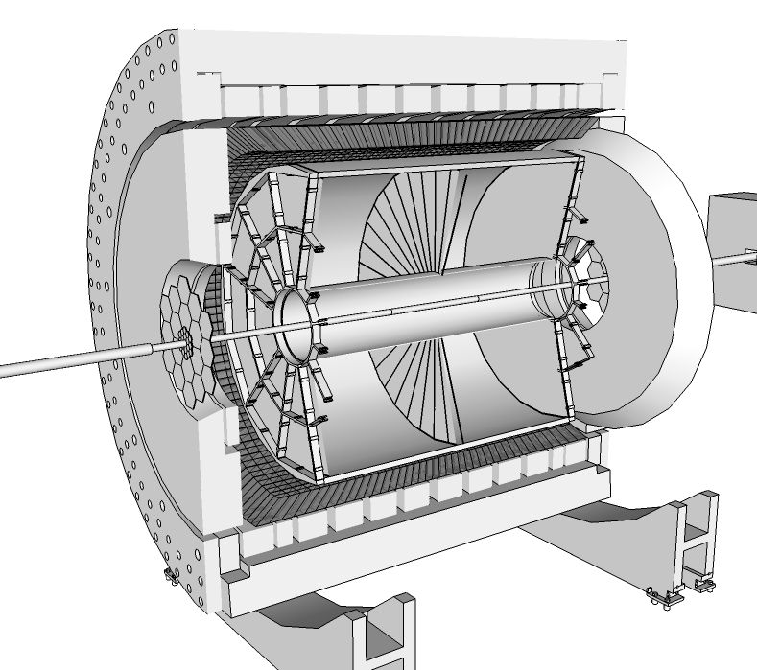
STAR & PHENIX
BEMC
|η| < 1
0 < φ < 2π
E/p → electron ID
High-energy tower trigger (p_{T}>3GeV)
TPC
|η| < 1
0 < φ < 2π
Tracking → momentum
ionization energy loss → electron ID

Slide 3
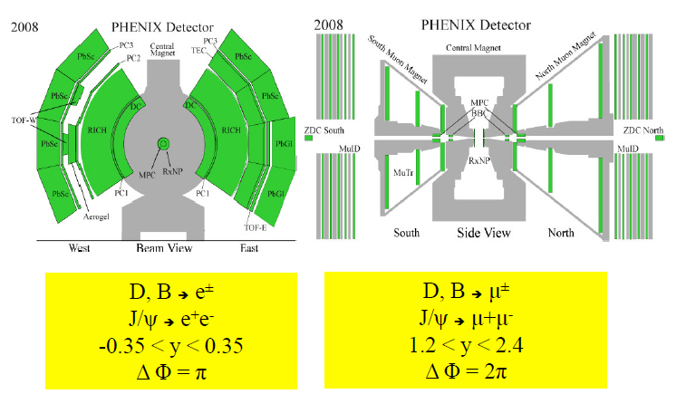
STAR & PHENIX
1.2<|y|<2.2

Slide 4
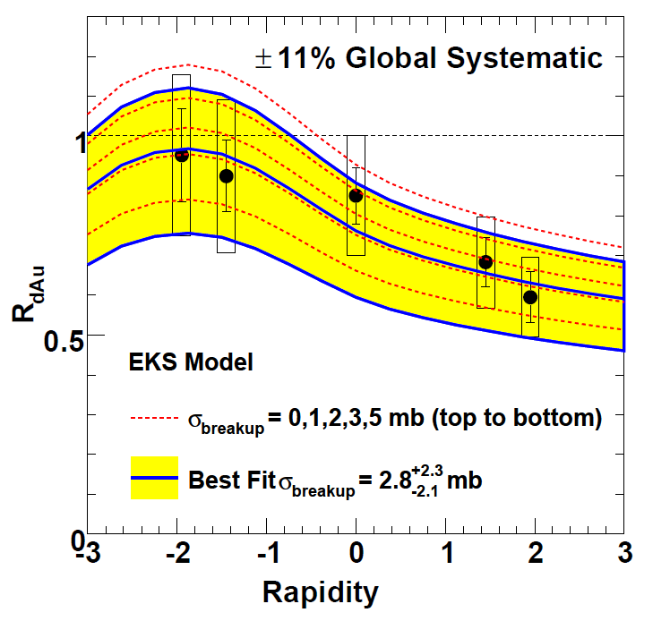
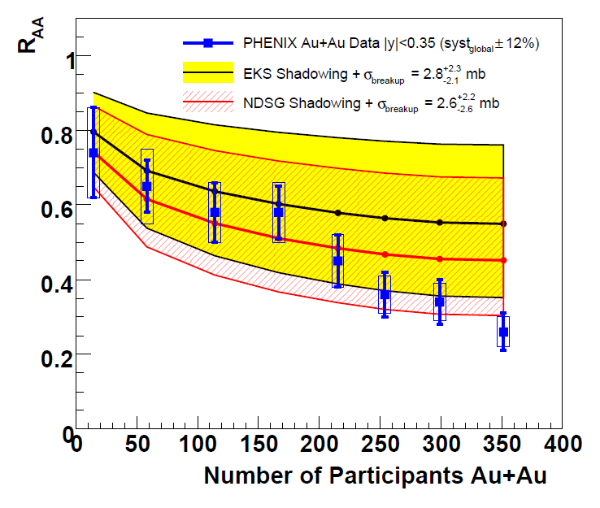
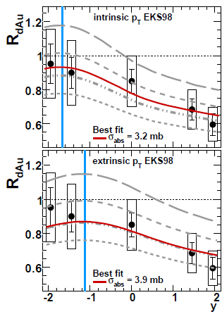
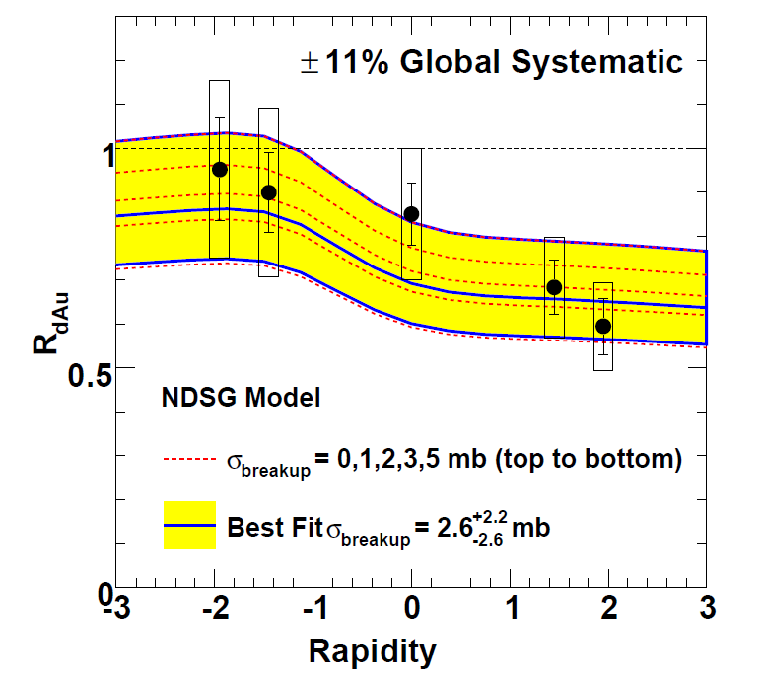
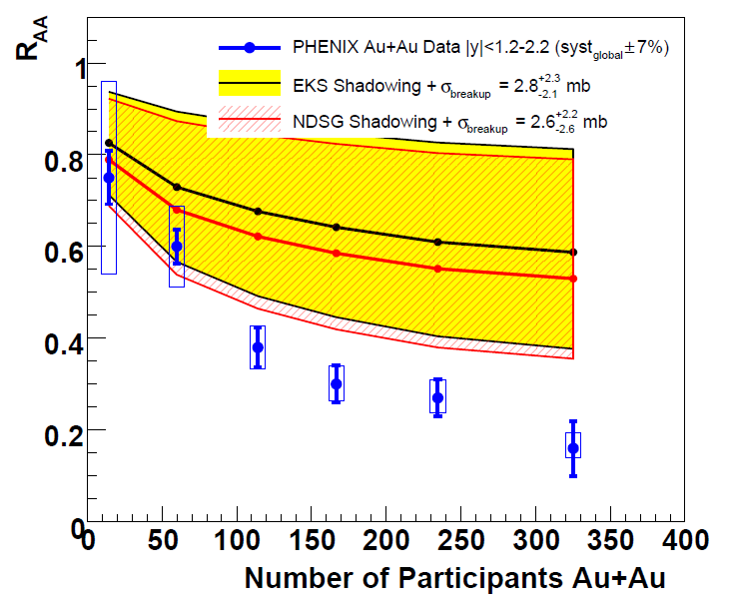
Data : 1st d+Au run in 2003
Extrapolation from d+Au to Au+Au for J/Ψ
mandatory to measure HDM effects
Effect of the J/Ψ production mecanism
Extrinsic pT (2→2) .vs. Intrinsic (2→1)
Phys. Rev. C 77, 024912
Phys. Rev. C 81, 064911
EKS 98
nDSg
➔ Need better precision on d+Au
➔ Need better precision on d+Au

Slide 5
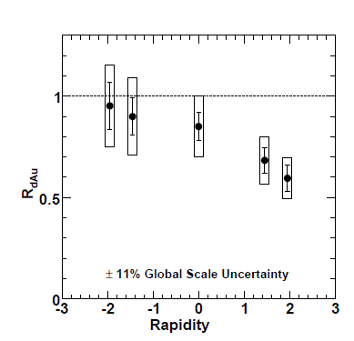
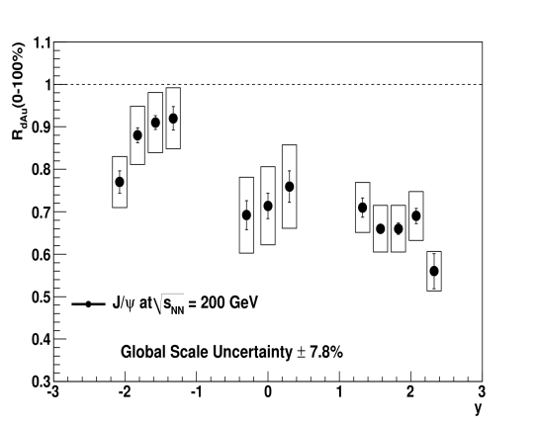
Data : New d+Au run in 2008
PHENIX example
Campagne | Espèces | Énergie (GeV) | Luminosité intégrée (Phenix)
2000/2001 | Au+Au | 130 | 1,0 μb⁻¹
2001/2002 | Au+Au p+p | 200 200 | 24,0 μb⁻¹ 0,15 pb⁻¹
2002/2003 | d+Au p+p | 200 200 | 2,74 nb⁻¹ 0,35 pb⁻¹
2003/2004 | Au+Au Au+Au | 200 62 | 241 μb⁻¹ 9 μb⁻¹
2004/2005 | Cu+Cu Cu+Cu Cu+Cu p+p | 200 62 22.5 200 | 3 nb⁻¹ 0,19 nb⁻¹ 2,70 μb⁻¹ 3,80 pb⁻¹
2005/2006 | p+p p+p | 200 62 | 10,7 pb⁻¹ 0,1 pb⁻¹
2006/2007 | Au+Au | 200 | 810 μb⁻¹
2007/2008 | d+Au p+p | 200 200 | 80 nb⁻¹ 5,2 pb⁻¹
2008/2009 | p+p p+p | 200 500 | 8,6 pb⁻¹ 13 pb⁻¹
2009/2010 | Au+Au Au+Au Au+Au Au+Au | 200 62 39 7,7 | 1,3 nb⁻¹ 0,11 nb⁻¹ 40 μb⁻¹ 0,26 μb⁻¹
~30 times larger statistic in 2008 .vs. 2003
PHENIX run 3
better precision for J/Ψ
first measurement of Υ
PHENIX run 8

Slide 6
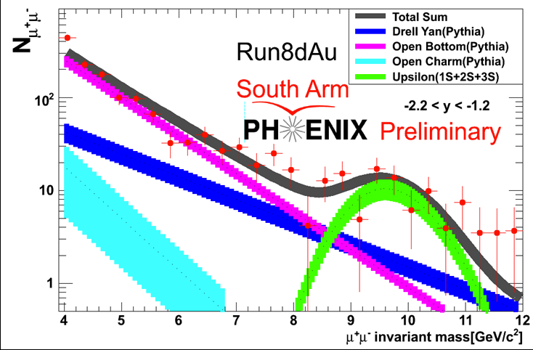
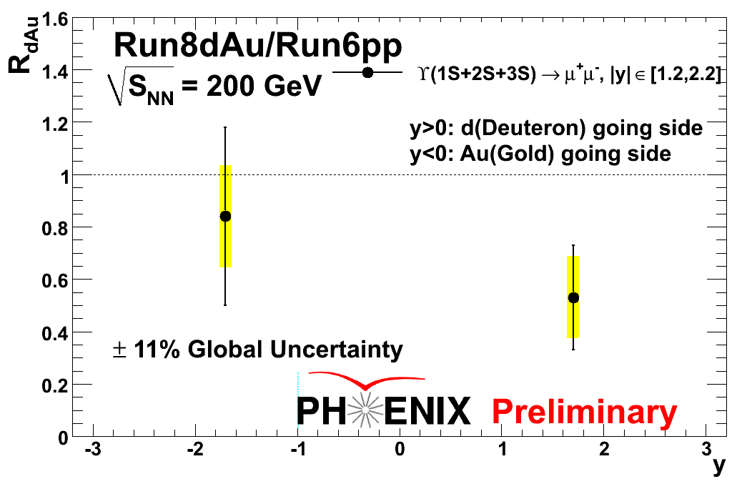
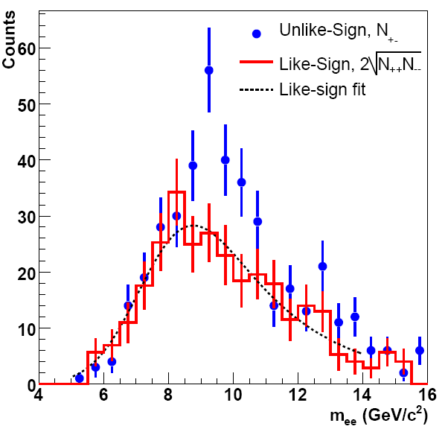
Υ : first measurement in d+Au
Made by both STAR and PHENIX (run 2008)
See Nicolas’s talk for CNM effect discussion

Slide 7
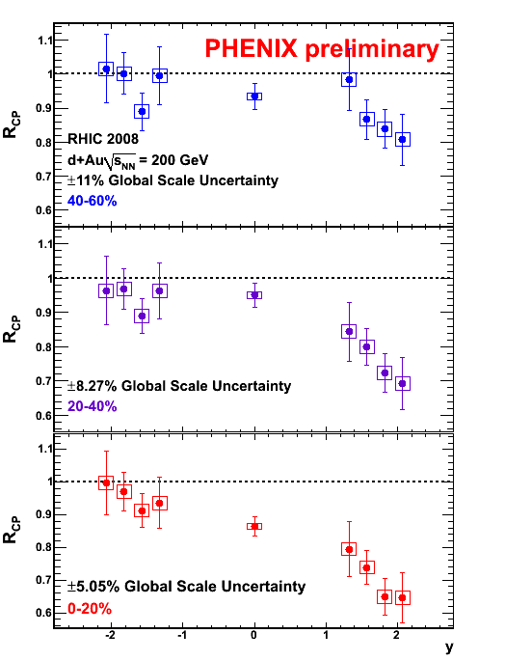
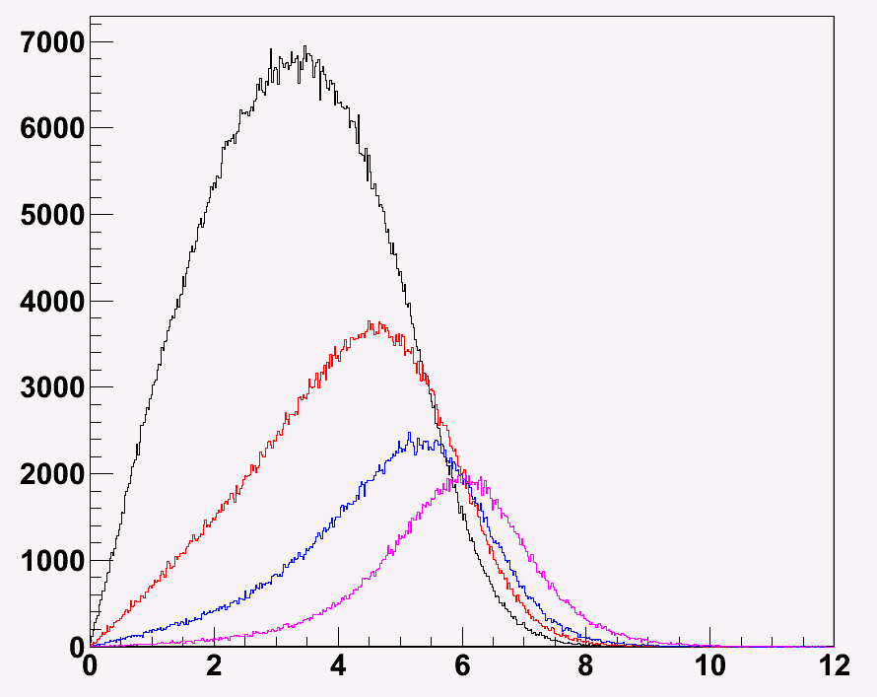
J/Ψ measurement in dAu 2008
PHENIX : R_{dAu} and R_{CP}
R_{dAu}
Most peripheral
0-20% Central
→ the most central
Caution !
wide distributions
20-40%
Most central
40-60%
60-88%
→ The most peripheral
r_{T} = transverse radius of the NN collisions wrt the center of the Au nucleus
r_{T} (fm)

Slide 8
CNM measurement
PHENIX : R_{dAu}
2008 data
2003 data
arXiv:1010.1246
Production mecanism = intrinsic p_{T} : R. Vogt, Phys. Rev. C71, 054902 (2005)
Gluon saturation : D. Kharzeev and K. Tuchin, Nucl. Phys. A735, 248 (2004)
arXiv : 1010.1246
« find a reasonable agreement within uncertainties with the unbiased R_{dAu} data »
Intrinsic p_{T} → reasonable agreement
Gluon saturation miss mid y

Slide 9
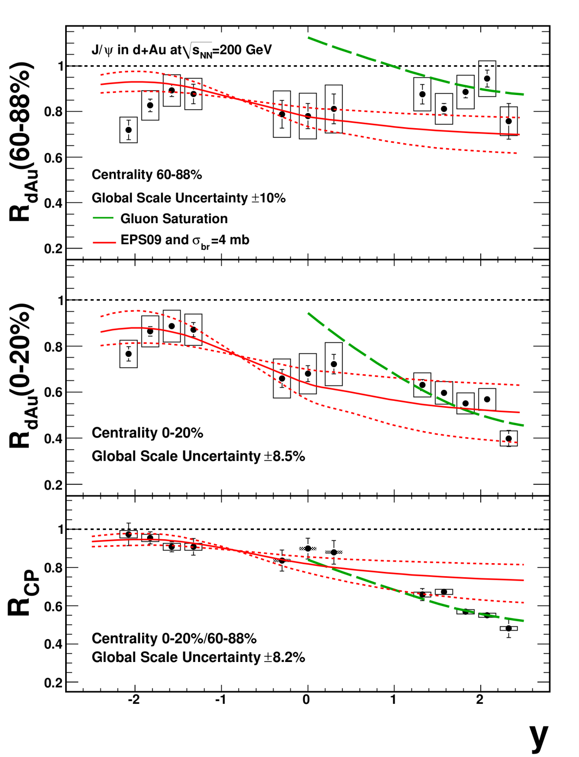
CNM measurement
2003 data
2008 data
PHENIX : R_{CP}
arXiv:1010.1246
R_{CP} has the advantage of cancelling most of the systematic uncertainties.
Intrinsic p_{T} + EPS09
R_{dAu} ➔ « reasonable agreement »
R_{CP} ➔ miss forward rapidity
Gluon saturation :
R_{dAu} ➔ miss mid rapidity
R_{CP} ➔ « reasonable agreement »

Slide 10
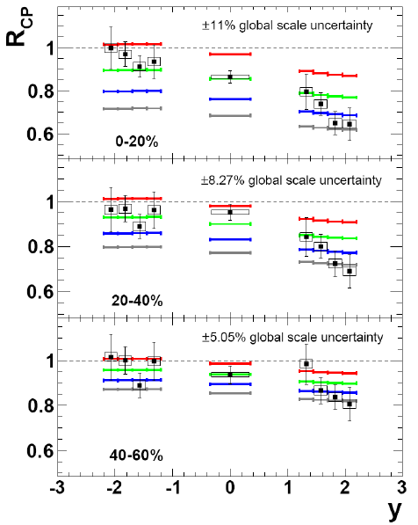
CNM measurement
About Extrinsic p_{T} ?
σ_{abs} = 0, 2, 4, 6 mb
Intrinsic p_{T} : (2→1) + EPS09
R_{dAu} ➔ « reasonable agreement »
R_{CP} ➔ miss forward rapidity
Gluon saturation :
R_{dAu} ➔ miss mid rapidity
R_{CP} ➔ « reasonable agreement »
Extrinsic p_{T} : (2→2) + EKS98
R_{CP} ➔ better agreement than
intrinsic (and saturation)
➔ still missing very forward y
PHENIX preliminary

Slide 11
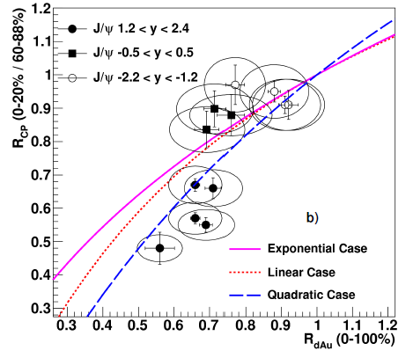
Phenix Empirical approach
Phenix ArXiv:1010.1246
goal : explore the centrality and rapidity dependence of the nuclear effects
As a function of centrality in d+Au : given r_{T} = transverse radius of the NN collisions wrt the center of Au nucleus
0-20% Central
→ the most central
Empirical parametrization of CNM: R_{dAu} (r_{T}) = M(r_{T})
linear → inhomogenous shadowing
exponential → absorption
Quadratic → energy loss
20-40%
40-60%
60-88%
→ The most peripheral
How it works : inhomogenous shadowing →
r_{T} (fm)

Slide 12
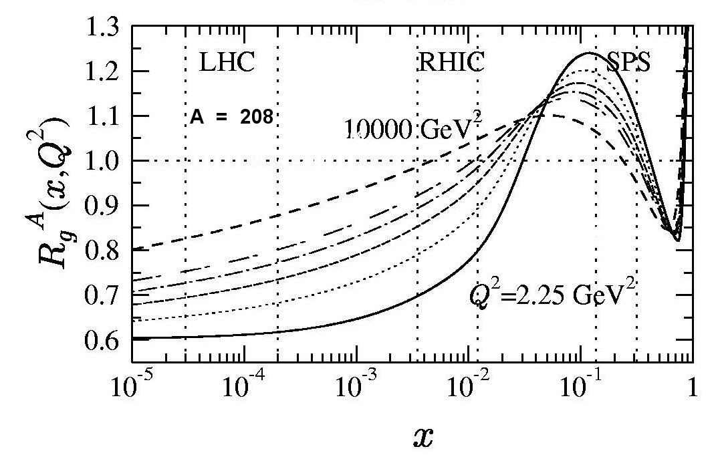
Shadowing
Homogenous shadowing
The shadowing part
Starting point
Shadowing parametrizations are given as a function of x, Q² and A
All integrated in b (impact parameter)
no spatial dependence available
not possible to study shadowing as a function of centrality
Idea
Proposed by R. Vogt and S.R. Klein (2003)
See Phys. Rev. Lett. 91 142301 (2003)
« we discuss how the shadowing and its spatial dependence may be measured … We find that inhomogenous shadowing has a significant effect on central dA collisions »
Eskola, Kolhinen, Vogt Nucl. Phys. A696 (2001)
gluons in Pb / gluons in p

Slide 13
Inhomogenous shadowing
Inhomogenous shadowing : (on MC basis)
The shadowing part
9 overlapping nucleons
PRL91:« the incident parton interacts coherently with all the target partons along its path length »
Where the J/Ψ is created

Slide 14
Inhomogenous shadowing
Back to PHENIX arXiv:1010.1246
The density weighted longitudinal thickness
-a
Shadowing ➔ Linear dependence with longitudinal thickness

Slide 15
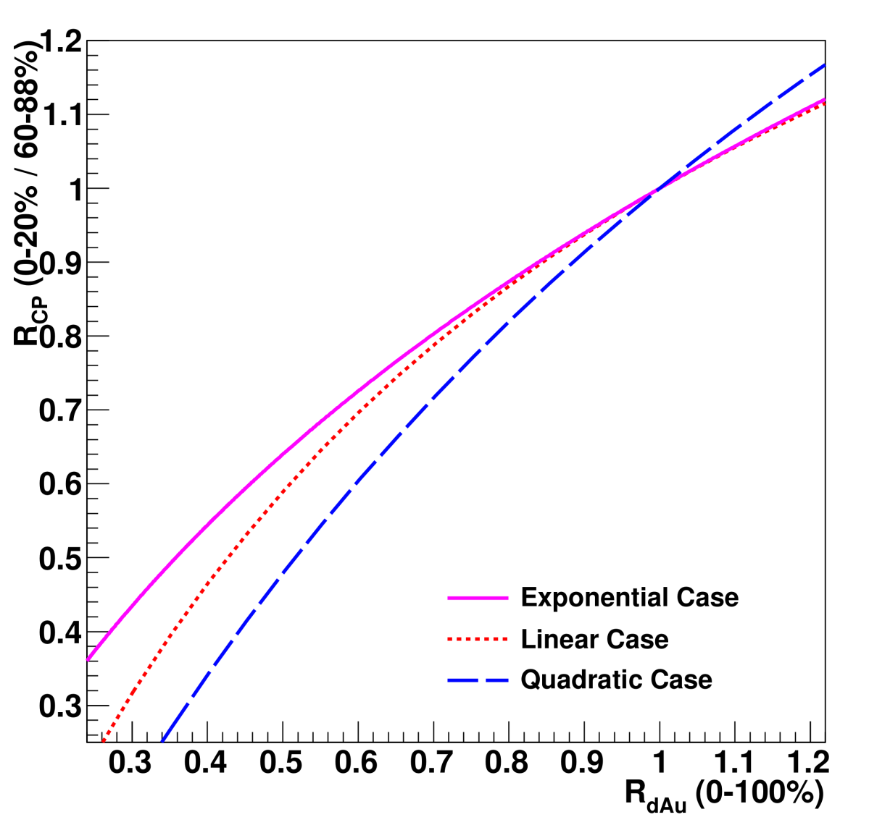
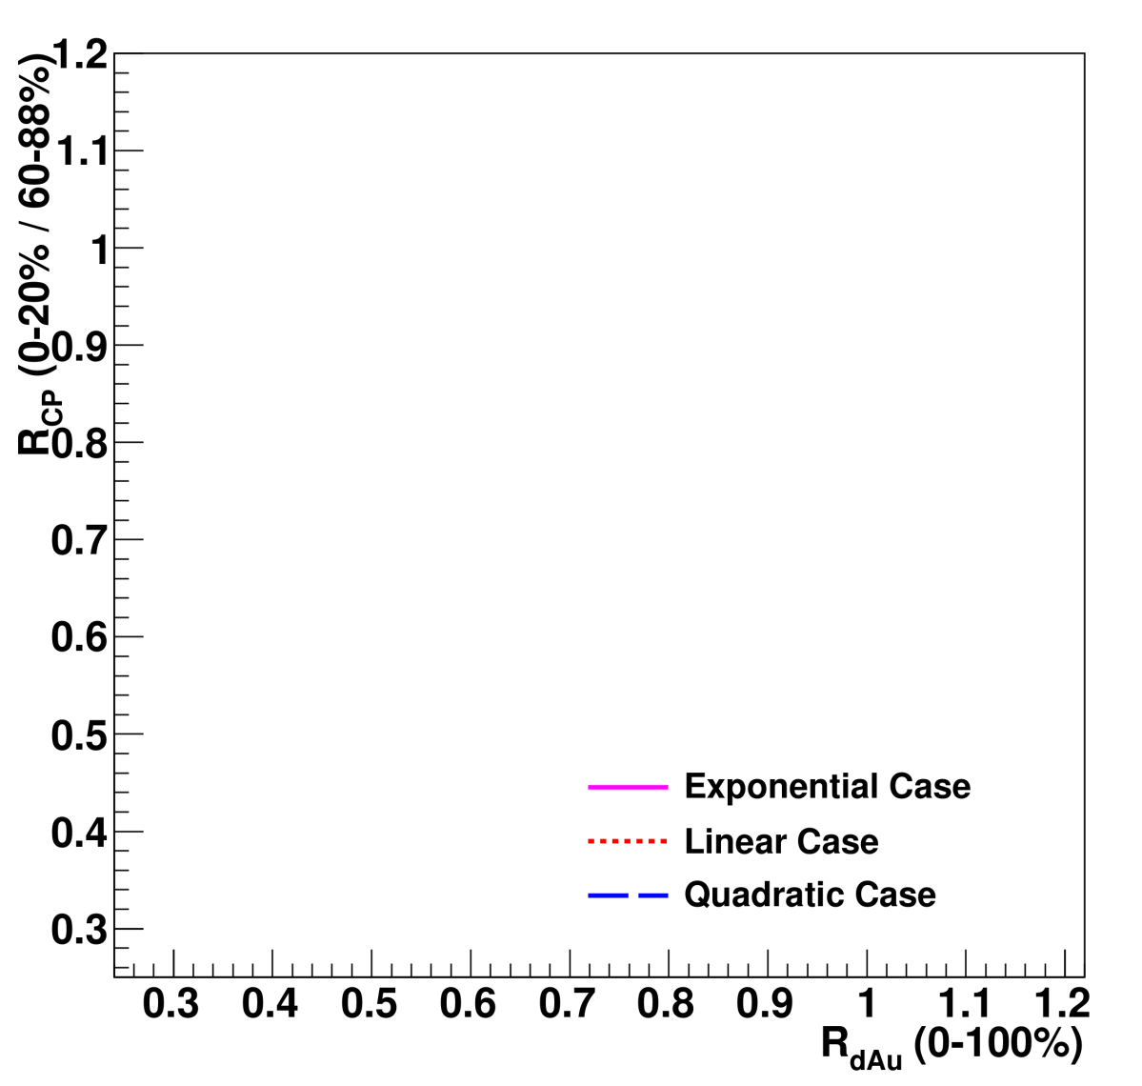
Phenix empirical approach
Parametrizations
a=0
linear
a=a₁ > 0
exponential
a=a₂ > a₁
Region with « standard » σ_{abs}
quadratic
Note :
nuclear absorption is usually quoted
as e^{-ρlσ}
ρ = 0.17 nucleon/fm³
σ ~ 4 mb = 0.4 fm²
l = length of nuclear matter ~ few fm
➔ ρlσ is small

Slide 16
Phenix empirical approach
Parametrizations against data
Backward and mid-rapidity points agree within uncertainties for the three cases presented here.
Forward rapidity points require the suppression to be stronger than exponential or linear with the thickness.
Cautious, this picture can be misleading
backward rapidity → anti shadowing
➔ a_{shadowing} < 0
need nuclear absorption to fit the data
➔ a_{abs} > 0
Some quadratic dependence in forward region ➔ energy loss ?
(in real life, effects should be added together)

Slide 17
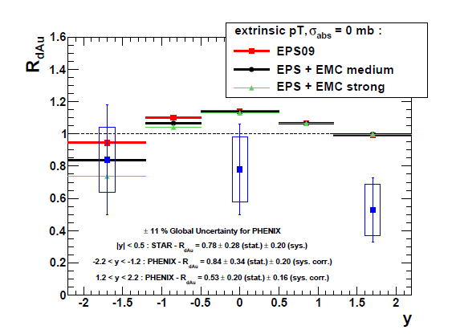
Summary
Extrinsic p_{T}
does fit the data well
still missing very
forward data
J/Ψ R_{CP} .vs. R_{dAu} :
Quadratic dependence
For forward data
Υ R_{dAu} : extrinsic p_{T}
Missing very forward data
May want to add energy loss for both J/Ψ and Υ

Slide 18
Conclusion
New data available
30 times more statistic in run 2008 .vs. 2003
First R_{dAu} for Υ
High statistical sample for J/Ψ
Results
Data may indicate some energy loss in forward rapidity region
Should come in the future :
J/Ψ R_{dAu}.vs.p_{T}
J/Ψ R_{dAu}.vs.N_{coll}

