Slide 1
Know How at LLR
Ultra-granular calorimetry
AFTER vs CHIC

Slide 2
AFTER vs CHIC
AFTER project
LHC fixed target experiment
Multi-purpose detector
Test negative x_{F} region (x_{F} ∈ [-1,0])
Must be designed to run in p+p, p+A, A+A ➔ high occupancy
Long term
CHIC project
SPS fixed target experiment
Dedicated to charmonium physics
Test positive x_{F} region (x_{F} ∈ [0,1])
Must be designed to run in p+p, p+A, A+A ➔ high occupancy
middle term
could be used as a demonstrator for after

Slide 3
Charmonia in Heavy Ion Collisions
What is CHIC ?
CHIC is a project of a fixed target experiment to be operated in Pb+Pb collisions at SPS energies (√s~20 GeV)
Benchmark 1: χ_{c} production in Pb+Pb at √s=17 GeV
Measure χ_{c} production within y_{cms}∈[-0.5,0.5]
Test charmonium sequential suppression in a QGP
Complementary with J/Ψ and Υ measurements at RHIC/LHC
χ_{c} production in A+A is currently unreachable at any facility
Benchmark 2: charmonia production in p+A within y_{cms} ∈[-0.5, 2]
Precise measurement of Cold Nuclear matter effects at SPS
Test a wide rapidity range (up to y=2 ≡ x_{F}~1)
Gluon shadowing at SPS energies
Energy loss, hadronisation time
Other physics subjects: Drell-Yan, open charm, photons, hadrons

Slide 4
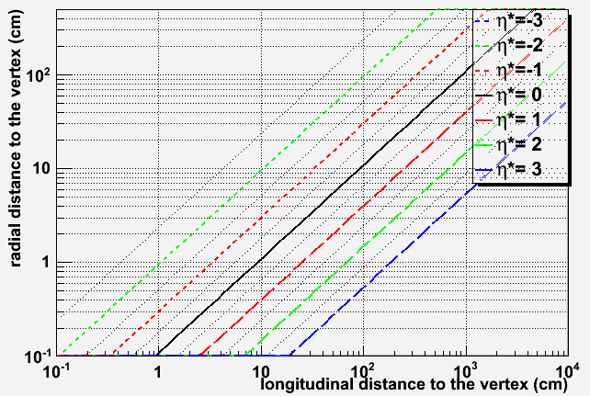
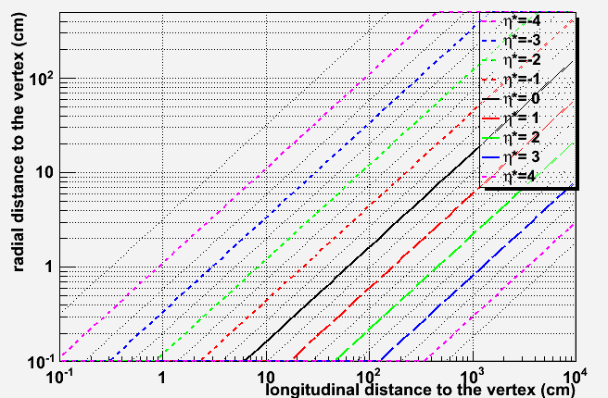
CHIC and AFTER
Experimental constraints
kinematics
CHIC: Access y_{cms} ∈[-0.5, 2]
AFTER: access y_{cms} ∈[-3.5, 0]
Beams
p+p, p+A, A+A
Detector
CHIC: vertexing, tracking, calorimetry, muon ID
AFTER: vertexing, tracking, calorimetry, muon ID, PID
CHIC
y_{cms} ∈[-0.5, 2]
AFTER
y_{cms} ∈[-3.5, 0]
CHIC ≡ demonstrator for AFTER

Slide 5
Detector design generalities
design generalities (Common to CHIC/AFTER)
Adopt particle physics strategy
Measure dimuons and photons
Must place the calorimeter in front of the absorber
Must separate photon/electron ➔ tracking in front of the calorimeter.
MuID
Muon Filter
(absorber)
target
tracking
tracking
EMCal
Beam
vertex
Dipole field
Target → vertex → spectrometer → calorimeter → absorber → muID

Slide 6
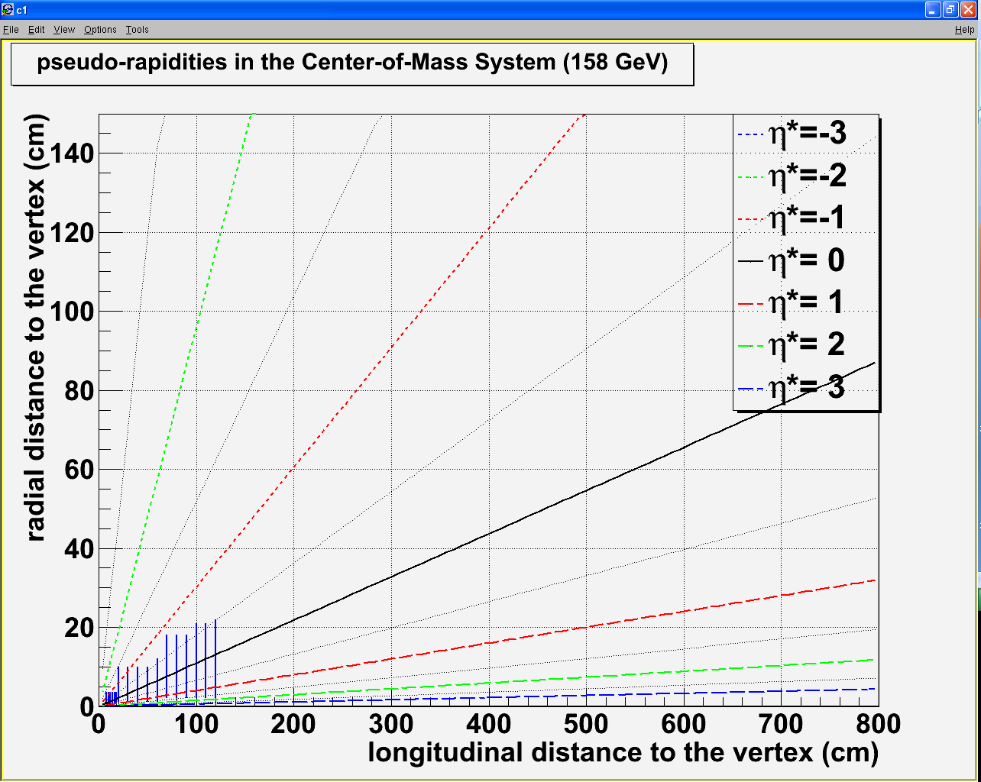
Detector design tracking
Vertex detector :
R_{min} = 0.5 cm Z_{min} = 7.5 cm
R_{max} = 3.5 cm Z_{max} = 18 cm
120 cm
100 cm
1 m
2 m
3 m
4 m
5 m
6 m
80 cm
Spectrometer :
R_{min} = 1 cm Z_{min} = 20 (100) cm
R_{max} = 22 cm Z_{max} = 120 (200) cm
60 cm
40 cm
20 cm
Magnet:
Typical J/Ψ P_{μ} ~ 15 GeV
➔ With a 1 m long 2.5 T dipole:
Dipole field

Slide 7
Detector design calorimetry
Goal : measure χ_{c} → J/Ψ + γ
Issues
Low energy photon (similar to π⁰ → γγ)
High multiplicity of photon from π⁰ /η→ γγ
High multiplicity of charged particles (π^{+/-})
Pythia 6.421 - p+p - √s = 17.2 GeV
<p_{T}>~500 MeV
<E>~3 GeV

Slide 8
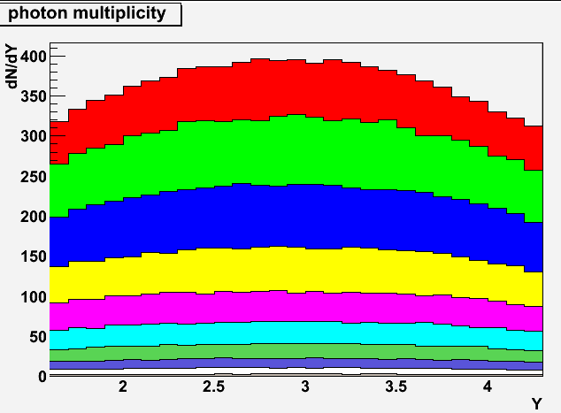
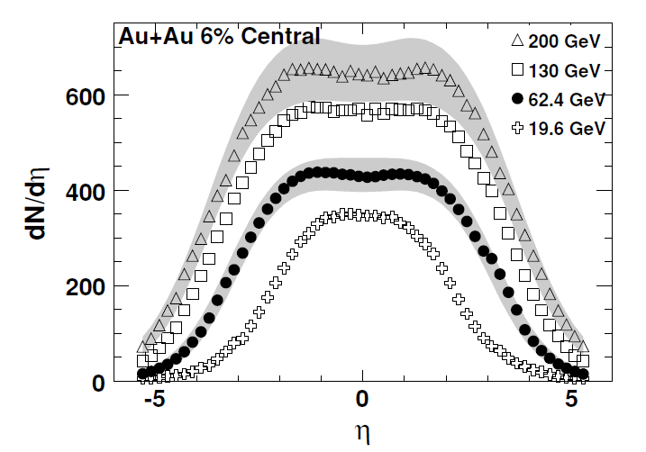
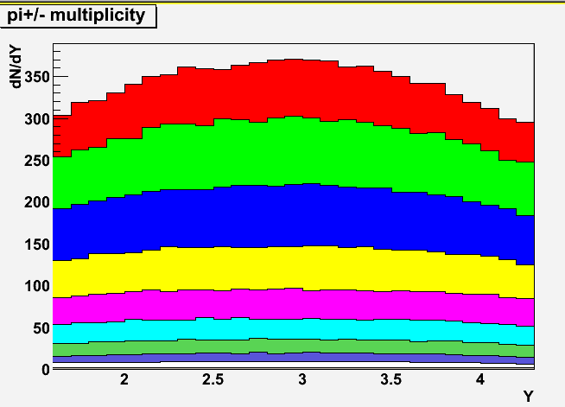
Detector design calorimetry
Goal : measure χ_{c} → J/Ψ + γ
Issues
Low energy photon (similar to π⁰ → γγ)
High multiplicity of photon from π⁰ /η→ γγ
High multiplicity of charged particles (π^{+/-})
WA98: Phys. Lett. B458: 422-430, 1999)
~480 γ
~340 γ
~400 γ
0 – 5%
Phobos: Phys. Rev. C74, 021901, 2006
Epos 1.6 : Pb+Pb @ 17.2 GeV
~350 π^{+/-}
~370 π^{+/-}
0 – 5%
0 – 5% Pb+Pb most central ➔ ~450 γ + 350 π^{+/-}
(we don’t need to go that central for χ_{c})
Epos 1.6 : Pb+Pb @ 17.2 GeV

Slide 9
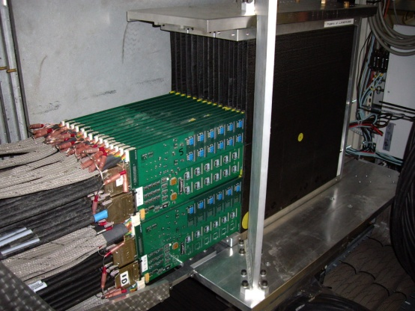
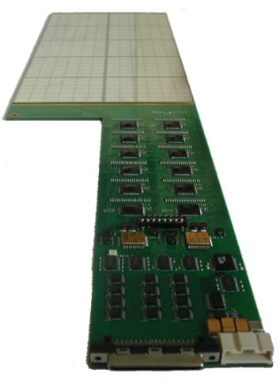
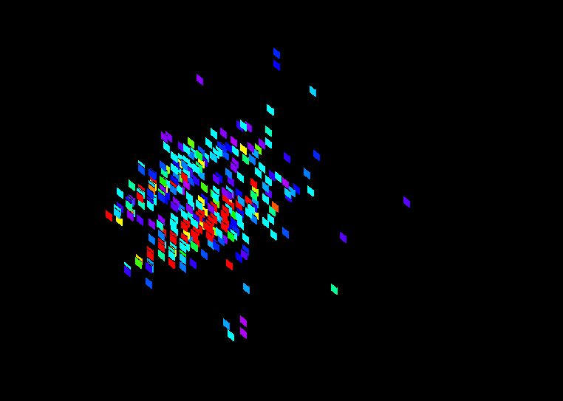
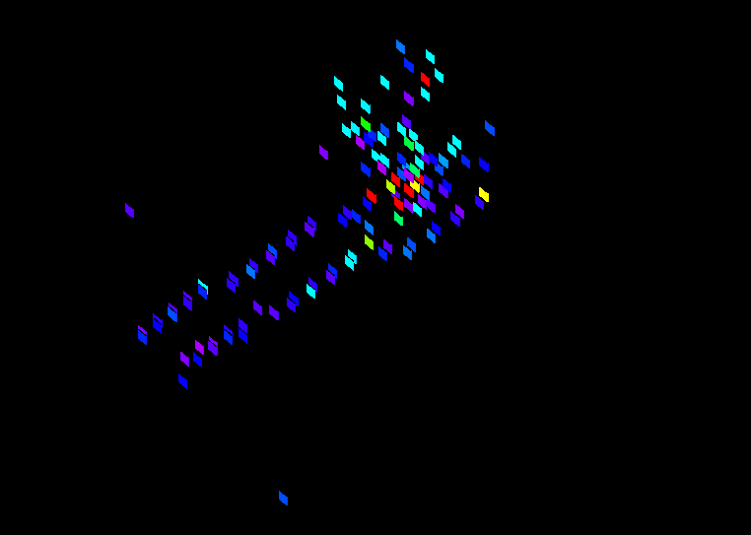
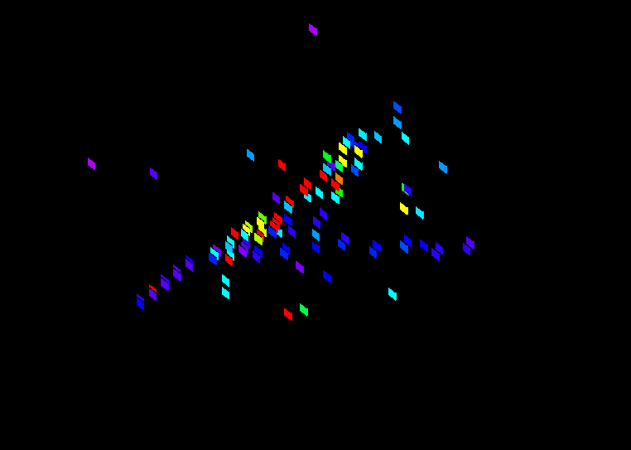
Detector design calorimetry
Need very high segmentation
to separate two electromagnetic showers
To isolate photons from π^{+/-} contamination
W + Si calorimeter à la Calice
30 layers
0.5 x 0.5 cm² pads
24 X₀ in 20 cm
LLR – Contributions
Mechanics
Sensors
DAQ
Reconstruction (GARLIC)
Simulation (MOKKA)
events taken at FNAL

Slide 10
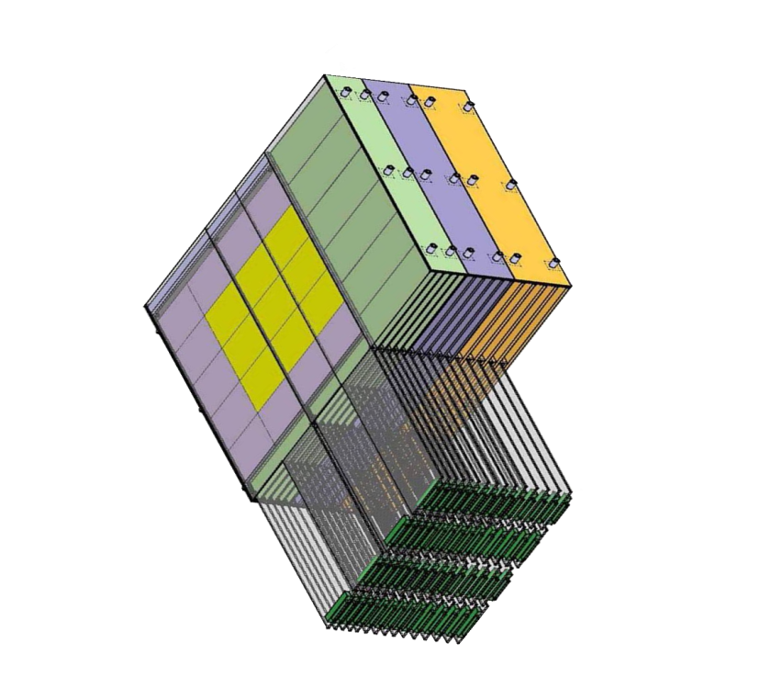
Detector design calorimetry
Need very high segmentation
to separate two electromagnetic showers
To isolate photons from π^{+/-} contamination
W + Si calorimeter à la Calice
30 layers
0.5 x 0.5 cm² pads
24 X₀ in 20 cm
W+Si : two relevant quantities
1st relevant quantity : distance
between two incoming particles
Min. distance between 2 particles at impact
= 1 free pad = 1 cm (for 0.5×0.5 cm²)
distance between two incoming particles
must be > 1 cm
N photons ➔ N/2 neutrals (π⁰ + η)➔ N π^{+/-}
➔ N γ + N π^{+/-} = 2N particles
distance between two photons
must be > 2 cm (1cm×2N/N)
2nd relevant quantity : EM shower transverse size
Moliere Radius R_{M} : 90% of the shower energy
Distance between two photons
must be > 2 cm (2 R_{M})
bad
good
Geometrical condition: in principle
Δγ > 2cm

Slide 11
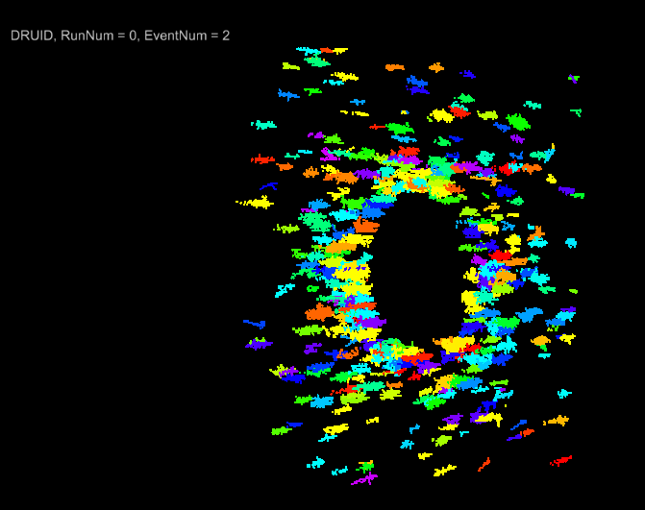
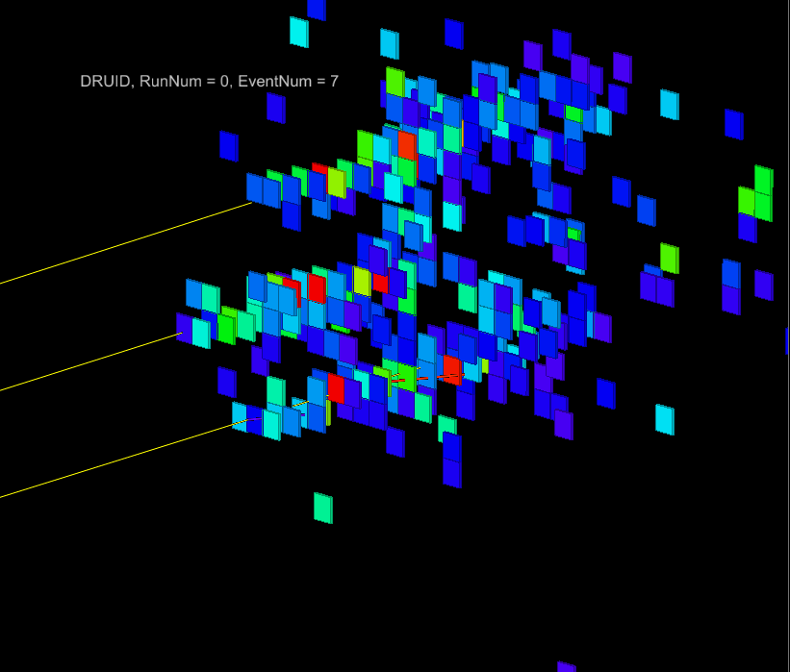
Detector design calorimetry
Full simulation performed with the Calice Ecal proto
<E>~3 GeV
Pb+Pb
3 photons with E~2 GeV
distance between each photon~ 2 cm
0.5 x 0.5 cm² pads
(full simu made by D. Jeans - Calice collab.)

Slide 12
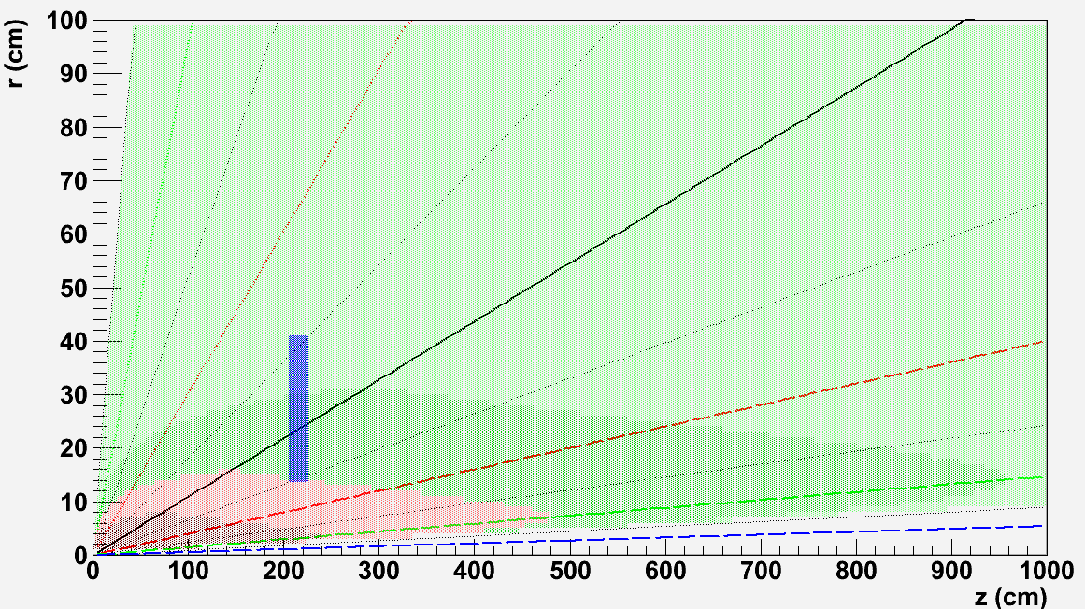
Detector design calorimetry
Size and position : tentative design
0 – 5% most central Pb+Pb events as measured by WA98
Distance between
two photons
[-0.5:0.5]
r_{min}
Δγ>4
Z
Δγ>2
Δγ<1
Δγ<2
r_{max}
Closer position to the target w/ Δγ>2cm:
Z = 205 cm [-0.5:0.5]
R_{min} = 13.6 cm
R_{max} = 40.9 cm
Using 0.5 x 0.5 cm² pads
20 cm

Slide 13
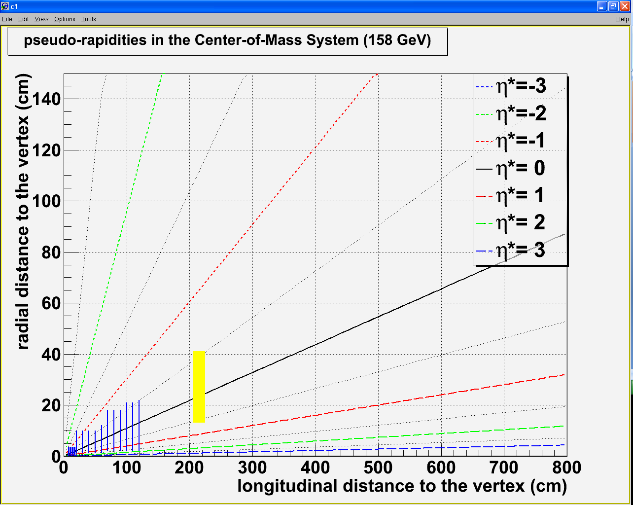
Detector design Overview
Vertex detector :
R_{min} = 0.5 cm Z_{min} = 7.5 cm
R_{max} = 3.5 cm Z_{max} = 18 cm
120 cm
100 cm
80 cm
Spectrometer :
R_{min} = 1 cm Z_{min} = 20 (100) cm
R_{max} = 22 cm Z_{max} = 120 (200) cm
60 cm
40 cm
20 cm
Calorimeter Δγ>2 cm:
Rmin = 14 cm Zmin = 205 cm
Rmax = 41 cm Zmax = 225 cm
Dipole field
η_{γ}* ∈[-0.5, 0.5]
1 m
2 m
3 m
4 m
5 m
6 m

Slide 14
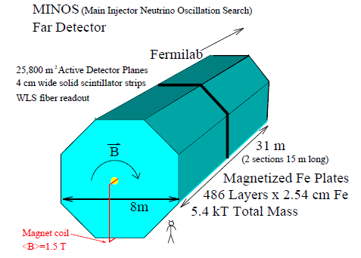
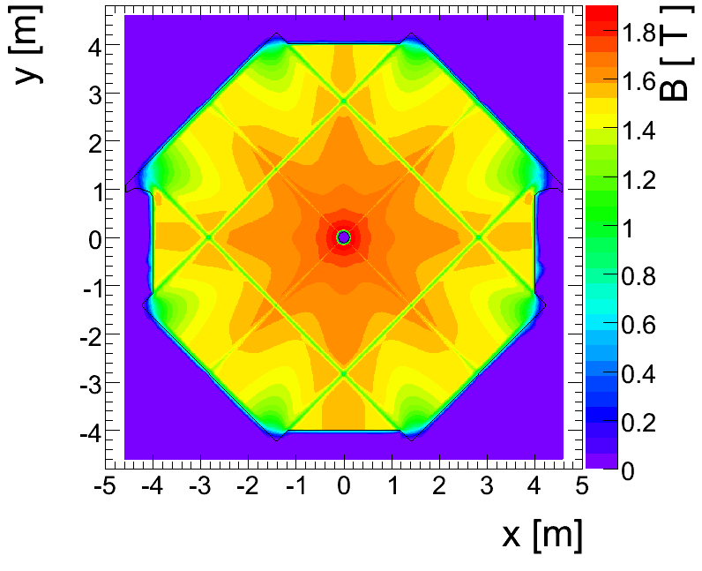
Detector design Absorber
Absorber type
NA50/NA60 : measure muon momentum after the absorber
➔ must minimize multiple scattering
Must use low Z material: best = BeO (but expensive)
NA50 : 0.6 m BeO + 4 m C + 0.6 m Fe = 5.2 m
CHIC : measure muon momentum before the absorber
➔ minimization of multiple scattering not crucial
➔ can use Fe material To absorb π^{+/-}
Need to match muon track position between spectrometer and trigger : Use an instrumented Fe absorber
DHCal
μ
π+
http://newsline.linearcollider.org/archive/2010/20101104.html
Can match muon track momentum between spectrometer and trigger : Use magnetized Fe absorber ?
Minos

Slide 15
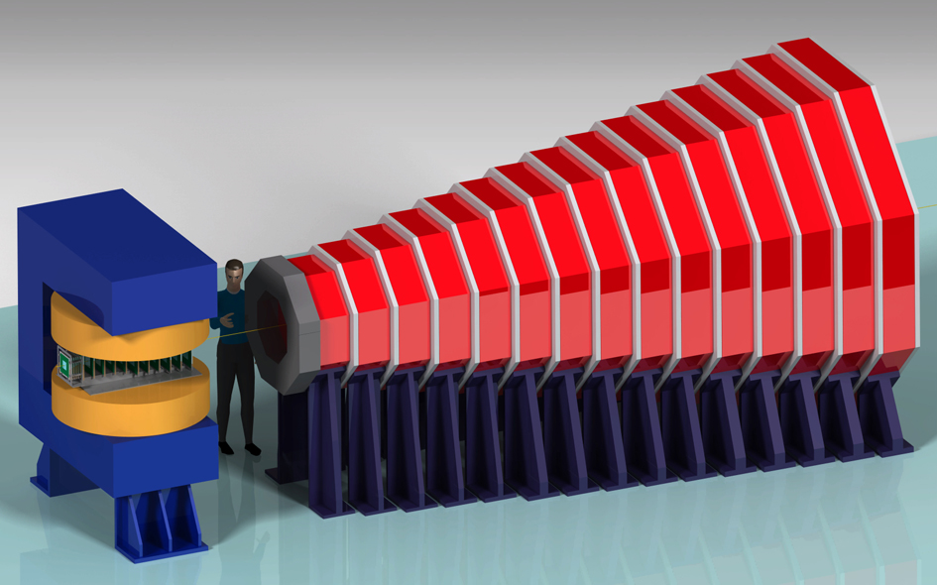
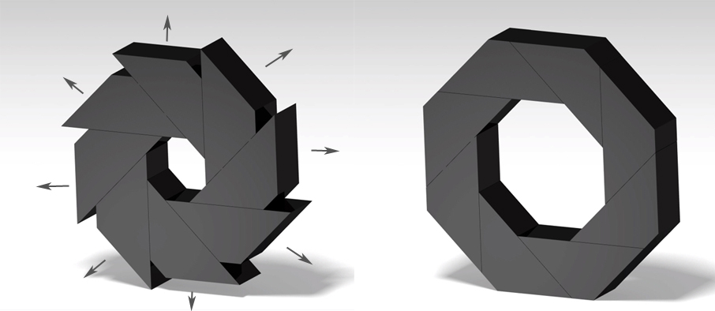
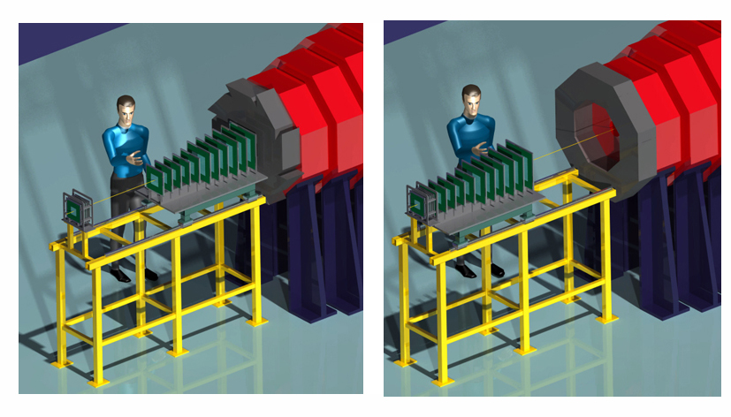
Detector design Overview
CHIC: Experimental setup flexibility
Very compact detector
(full detector simulation ongoing)
Forward rapidity
Mid rapidity
Large rapidity coverage
fixed target mode ➔ high flexibility
displace tracker to access large rapidity
modify calorimeter to access large rapidity

Slide 16
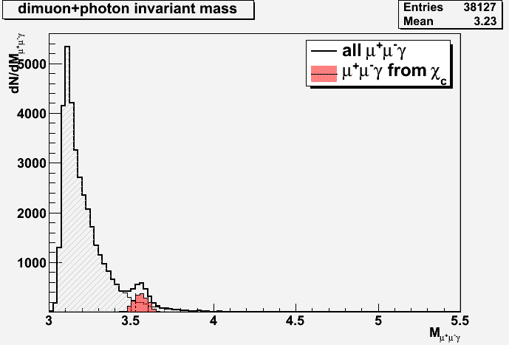
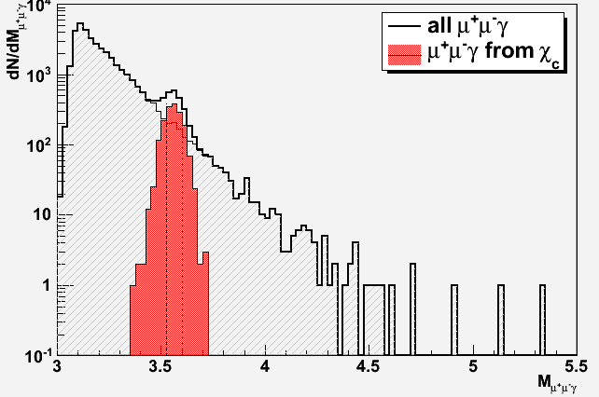
Charm in Heavy Ion Collisions Signal extraction
Typical mass plots
200 000 Pb+Pb minBias EPOS events
140 000 events with J/Ψ embedded (70%)
60 000 events with χ_{c} embedded (30%)
J/Ψ
S/B=990
χ_{c}
S/B=1.8
After acceptance and selection cuts:
35 000 J/Ψ ➔ acc x eff = 17.4%
1700 χ_{c} ➔ acc x eff = 2.8 %

Slide 17
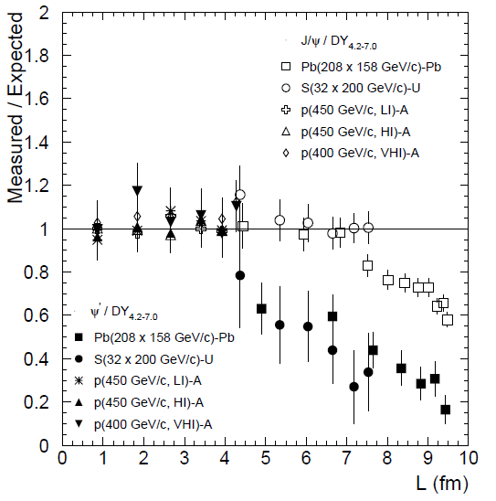
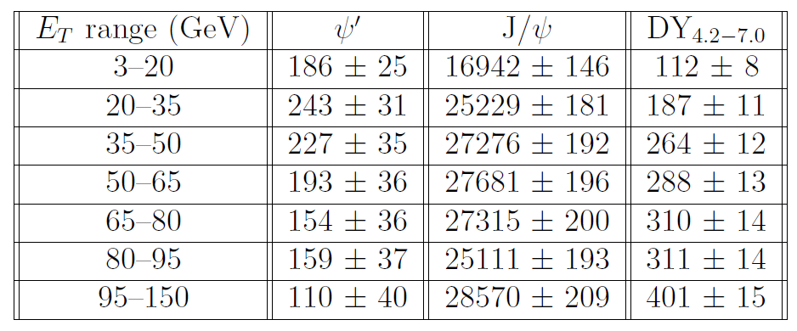
Charm in Heavy Ion Collisions Figure of Merit
Typical one month Pb+Pb run with a 4mm thick target
~ 200 000 inclusive J/Ψ→μ⁺μ⁻ expected
2 extreme scenarios:
If χ_{c} suppressed as J/Ψ
If χ_{c} suppressed as Ψ’
~180 000 J/Ψ
~ 1300 Ψ’
χ_{c as J/Ψ} | χ_{c as Ψ’}
677 | 406
1010 | 530
1091 | 495
1107 | 421
1093 | 336
1004 | 347
1143 | 240
7125 | 2775
Eur.Phys.J.C49:559-567,2007
Uncertainties
χ_{c} stat > 2 x Ψ’ stat
➔ χ_{c} error < Ψ’ error/√2

Slide 18
Conclusion
CHIC at SPS : current status
No show stopper for measurement of χ_{c} in Pb+Pb at SPS
Towards writing a Letter (contributions are very welcome)
Activities : currently starting a simulation with Geant4 ; support of 1 computer engineer and 1 Calice postdoc at LLR
From CHIC to AFTER
After will be a large/expensive detector using detector technologies which have been developed for other physics subjects ; a demonstrator would be very welcome
CHIC
It is a smaller scale than AFTER
Beam is available
CHIC could be a perfect demonstrator for AFTER

