Slide 1
An experiment to measure χ_{c} suppression at the CERN SPS
CHIC: Charm in Heavy Ion Collisions
F. Fleuret ¹, F. Arleo ², E. G. Ferreiro ³, P.-B. Gossiaux ⁴, S. Peigné ⁴
¹ LLR, École polytechnique – IN2P3/CNRS, Palaiseau, France
² LAPTh, Université de Savoie – CNRS, Annecy-le-Vieux, France
³ Universidad de Santiago de Compostela, Santiago de Compostela, Spain
⁴ SUBATECH, université de Nantes – IN2P3/CNRS, Nantes, France

Slide 2
Charmonia in A+A
The Physics case
QGP color screening through quarkonium measurements
Quarkonium color screening in a Quark Gluon Plasma is a prediction of lattice QCD, for instance :
Because of feed-downs and different T_{d}, sequential suppression should show up.
H. Satz, J. Phys. G 32 (2006)
$\frac{\text{quarkonium} \text{dissociation} \text{temperature}}{\text{critical} \text{QGP} \text{temperature}}$ ➔
Sequential suppression - screening
60% direct J/Ψ
+ 30% χ_{c}→J/Ψ+γ
+ 10% Ψ’ → J/Ψ + X
Inclusive J/Ψ yield
1st step
Feed-downs contributing to J/Ψ inclusive yield
2nd step
production probability
3rd step
Ψ’
χ_{c}
J/Ψ
Energy density

Slide 3
Charmonia in A+A
The Physics case
Other possible QGP effect: $c\overline{c}$recombination
In a QGP, $c$ and $\overline{c}$ quarks can combine to form a J/Ψ.
Requires a large number of $c\overline{c}$ pairs ➔ RHIC energies? LHC energies?
T_{LHC-CERN} > T_{RHIC-BNL} > T_{SPS-CERN}
Sequential suppression
Recombination
J/Ψ production (a.u.)
1
~0.9
~0.6
~0
Temperature
T_{Ψ’} > T_{c}
T_{χ} > T_{Ψ’} > T_{c}
T_{J/Ψ} > T_{χ} > T_{Ψ’} > T_{c}

Slide 4
Charmonia in A+A
Experimentally
Charmonium production in A+A collisions studied at:
SPS (√s~17 GeV) : NA38, NA50, NA60 experiments
RHIC (√s~200 GeV) : PHENIX, STAR experiments
LHC (√s~2.76 TeV) : ALICE, CMS experiments
Short summary for J/Ψ:
NA50 (PbPb@SPS) observed an anomalous suppression
PHENIX (AuAu@RHIC) observed a similar suppression (than NA50)
ALICE (PbPb@LHC) observed a smaller suppression for low p_{T} J/Ψ
CMS (PbPb@LHC) observed a larger suppression for high p_{T} J/Ψ
Unclear picture :
Observed Hot and Dense Matter effects. For quarkonia, are they due to
color screening ? Apply in principle at SPS, RHIC and LHC
Recombination ? Apply at RHIC? LHC?
Both ?
To understand Hot and Dense Matter effects on charmonium,
need to (dis)prove color screening first.
Study of recombination is a second step (at higher energies).

Slide 5
Charmonia in A+A
Color screening
How to Test sequential suppression with charmonia ?
must be in a regime where recombination is negligible ➔ SPS energies
must measure the suppression pattern of J/Ψ, Ψ’, χ_{c} :
~30% (resp. ~10%) of the inclusive J/Ψ yield comes from χ_{c} (resp. Ψ’) decay.
According to lattice calculations, T_{d} (Ψ’) < T_{d} (χ_{c}) < T_{d} (J/Ψ)
If screening, one should observe a step-like suppression patterns
Alternative scenario: suppression by comoving hadrons
Smooth suppression
Same suppression-starting point
Slopes related to binding energy : S_{Ψ ’} > S_{χ} > S_{J/Ψ}
suppression by comovers
Sequential suppression - screening
production probability
production probability
direct J/Ψ
χ_{c}
J/Ψ
χ_{c}
Ψ’
Ψ’
J/Ψ
Energy density
Energy density

Slide 6
Charmonia in A+A
NA50 results
Anomalous suppression at SPS
Eur.Phys.J.C49:559-567,2007
sequential suppression (QGP) ?
or
comovers (no QGP) ?
p+A
S+U
60% direct J/Ψ
+ 30% χ_{c}→J/Ψ+γ
+ 10% Ψ’ → J/Ψ + X
Inclusive J/Ψ yield
Pb+Pb
use J/Ψ feed-downs to discriminate
0.9
NA50 measured J/Ψ and Ψ’, but,
Measuring J/Ψ and Ψ’ only is not the answer : too small Ψ’→ J/Ψ feed-down
need of a larger feed-down fraction
Measure χ_{c} !
L (fm)
ε (GeV/fm³)
4.37
1.04
4.90
1.24
6.65
2.04
7.65
2.53
8.83
3.19
9.43
3.76

Slide 7
Charmonia in A+A
Comovers
Anomalous suppression at SPS
Eur.Phys.J.C49:559-567,2007
Expectations in comovers scenario
Binding energy
p+A
S+U
Pb+Pb
comovers - direct J/Ψ
Taking breakup cross-sections:
comovers-direct J/Ψ = 0.2 mb
comovers – χ_{c} = 1.0 mb
comovers – Ψ’ = 2.0 mb
comovers – Ψ’
comovers - inclusive J/Ψ
comovers - χ_{c}
60% direct J/Ψ
+ 30% χ_{c}→J/Ψ+γ
+ 10% Ψ’ → J/Ψ + X
Inclusive J/Ψ yield
and considering feed-downs
L (fm)
ε (GeV/fm³)
4.37
1.04
4.90
1.24
6.65
2.04
7.65
2.53
8.83
3.19
9.43
3.76

Slide 8
Charmonia in A+A
Suppression patterns
Anomalous suppression at SPS
Eur.Phys.J.C49:559-567,2007
sequential suppression (QGP) ?
or
comovers (no QGP) ?
p+A
S+U
60% direct J/Ψ
+ 30% χ_{c}→J/Ψ+γ
+ 10% Ψ’ → J/Ψ + X
Inclusive J/Ψ yield
Pb+Pb
Take advantage of large χ_{c} → J/Ψ feed-down fraction
QGP - χ_{c}
comovers - χ_{c}
Measuring J/Ψ, Ψ’ and χ_{c} suppression patterns will give the answer
L (fm)
ε (GeV/fm³)
4.37
1.04
4.90
1.24
6.65
2.04
7.65
2.53
8.83
3.19
9.43
3.76

Slide 9
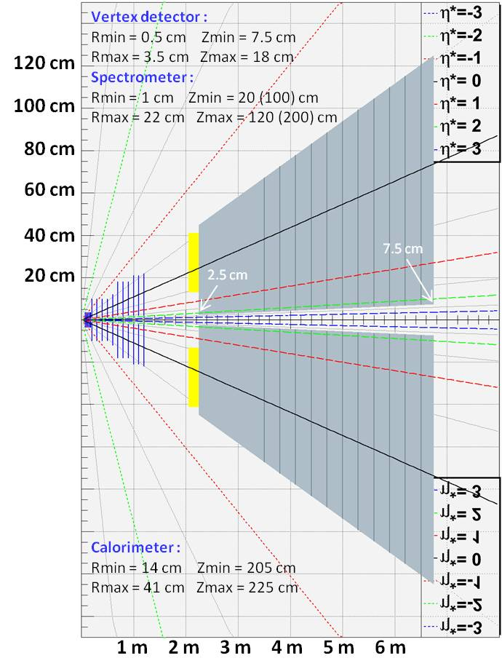
Charmonia in A+A
Measuring χ_{c} at SPS
Operate a new experiment
Primary goal:
χ_{c} → J/Ψ + γ → μ⁺ μ⁻ γ
Beam:
high-intensity 158 GeV/c Pb beam
high-intensity 158/450 GeV/c p beam
Detector features :
Vertex detector + Spectrometer
Measures tracks before absorber
for very good mass resolution
Ultra-granular calorimeter
Measures low energy γ
in high π⁰ multiplicity environment
Absorber/trigger
Absorbs π/K
Minimize fake triggers from π/K decays
Dipole field
Dipole field

Slide 10
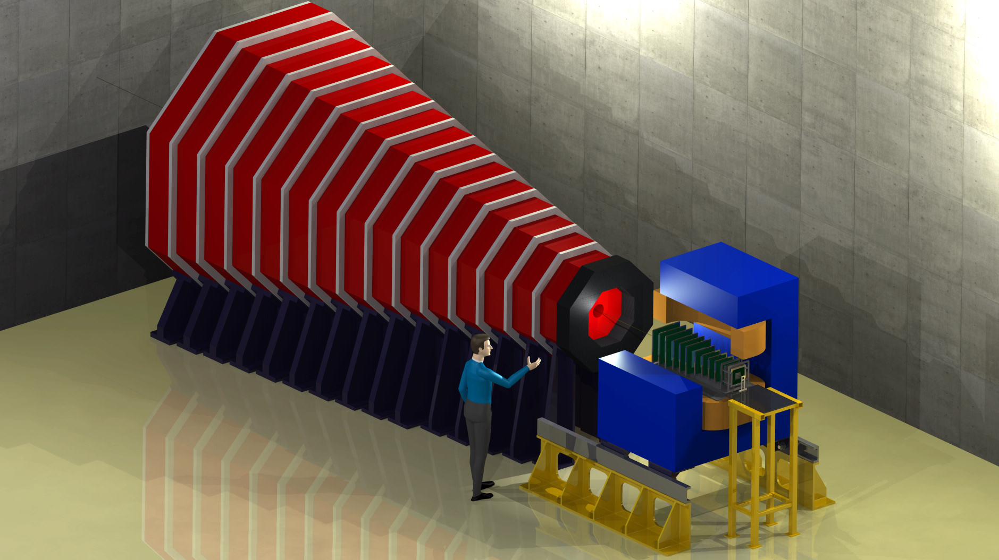
Apparatus artist view
Main purpose : measure χ_{c}→J/Ψ+γ
in Pb+Pb collisions at √s = 17.2 GeV
Calorimeter:
Measuring γ ‘s
in high π⁰ multiplicity environment
➔ ultra-granular EMCal
➔ W + Si calorimeter à la CALICE
- 30 layers
- 0.5 x 0.5 cm² pads
- 24 X₀ in 20 cm
- ΔE/E ~ 15% /√E
Absorber/dimuon trigger :
4.5 m thick instrumented Fe absorber
➔ trigger rate ~ 0.3 kHz
Could be magnetized to measure muon momentum
Silicon Spectrometer :
Measures tracks before absorber
covers 1.5 rapidity unit
Δp/p = 1% ➔ J/Ψ mass resolution ~20 MeV/c²
Estimations based on NA60 telescope performances
Magnet :
1m long 2.5 T dipole

Slide 11
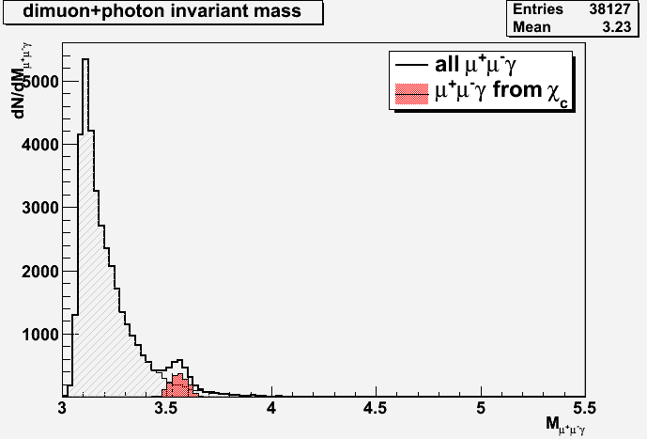
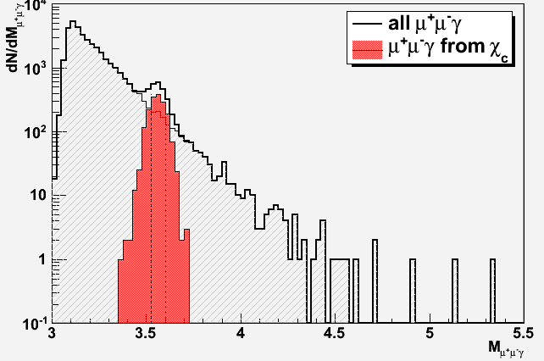
Expected performances
Signal extraction
Typical mass plots (~1 week data taking w/ a 10% λ_{I} Pb target)
140 000 J/Ψ produced in Pb+Pb (70%)
60 000 χ_{c} produced in Pb+Pb (30%)
(embedded in Pb+Pb Minbias events produced w/ EPOS)
J/Ψ
S/B=990
χ_{c}
S/B=1.8
After acceptance and selection cuts:
35 000 J/Ψ ➔ acc x eff = 17.4%
mass resolution ~ 20 MeV/c²
1700 χ_{c} ➔ acc x eff = 2.8 %
mass resolution ~ 45 MeV/c²

Slide 12
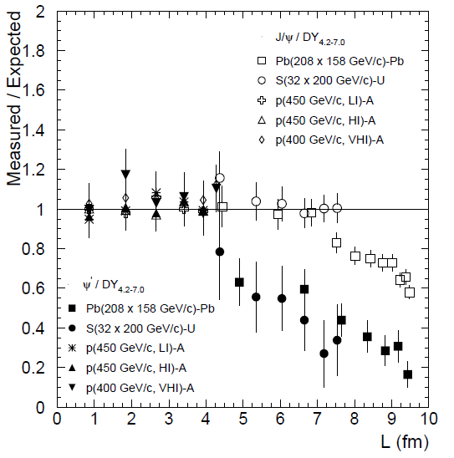
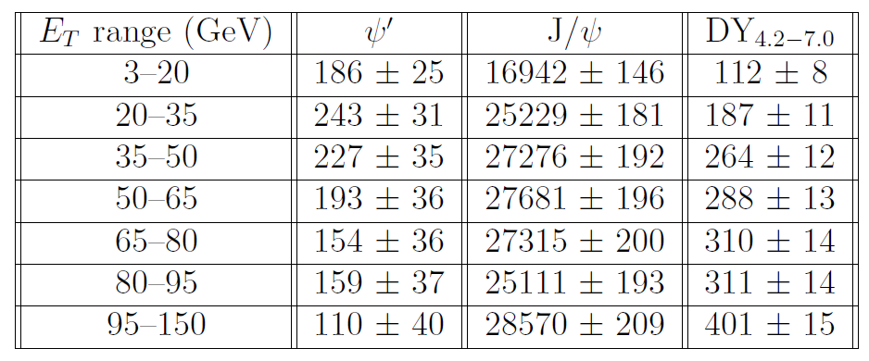
Expected performances
Statistics
Typical 40-day Pb+Pb run
~ 180 000 J/Ψ→μ⁺μ⁻ expected
2 extreme numerical scenarios:
If χ_{c} suppressed as J/Ψ
If χ_{c} suppressed as Ψ’
~180 000 J/Ψ
~ 1300 Ψ’
~ 3000 χ_{c}
χ_{c} as Ψ’ | χ_{c} as J/Ψ
406 | 677
530 | 1010
495 | 1091
421 | 1107
336 | 1093
647 | 1004
240 | 1143
3075 | 7125
Eur.Phys.J.C49:559-567,2007
Expect 3000 < ${\text{N}}_{χ_{c}}$ < 7000

Slide 13
p+A program
Cold Nuclear Matter
A thorough p+A program
mandatory as reference for hot nuclear matter effects
Must control (understand) :
charmonium absorption by cold nuclear matter ➔ A dependence
Shadowing/anti-shadowing (x₂ scaling)
Energy loss (saturation)… (x_{F} scaling)
Two detector configurations to cover y_{CMS} ∈ [-0.5 ; 2]
➔ Need large y_{CMS} range
Mid-rapidity : y_{CMS} ∈ [-0.5 ; 1]
Forward-rapidity : y_{CMS} ∈ [0.5 ; 2]
13

Slide 14
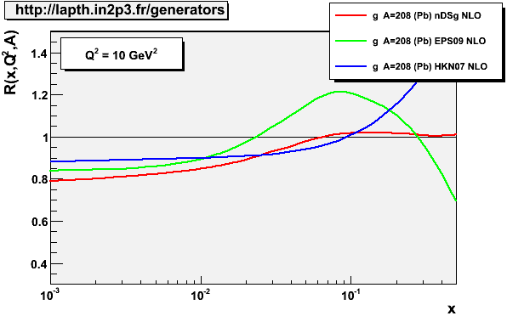
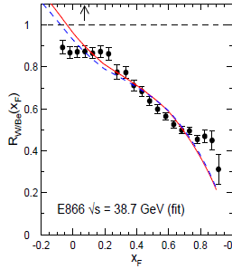
p+A program
Large rapidity coverage
A thorough p+A program
E_{beam} (√s) | Exp. | y_{CMS} | x₂ | x_{F}
158 GeV (17 GeV) | NA50 | [0;1] | [0.07;0.18] | [0;0.42]
 | CHIC | [-0.5;2] | [0.02;0.30] | [-0.19;1]
450 GeV (29 GeV) | NA50 | [-0.4;0.6] | [0.06;0.16] | [-0.09;0.14]
 | CHIC | [-0.9;1.6] | [0.02;0.26] | [-0.22;0.51]
J/Ψ, Ψ’, χ_{c} in a large y_{CMS} range
Large coverage in x₂
Large coverage in x_{F}
NA50
(29.1 GeV)
E866
CHIC (29 GeV)
F. Arleo and S. Peigné, arXiv:1204.4609
NA50
(17.2 GeV)
NA50
CHIC
CHIC (17.2 GeV)
x₂

Slide 15
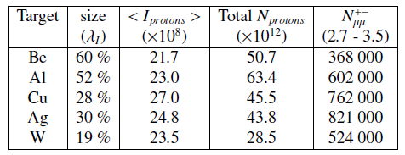
p+A program
High statistics
A thorough p+A program
J/Ψ, Ψ’, χ_{c} with several targets
NA50: p+Be, p+Al, p+Cu, p+Ag, p+W, p+Pb
Large statistics required
Typical 1week/target NA50 data taking (EPJ C33 (2004) 31-40)
Current SPS operation:
Delivering proton beam to the LHC several months per year
Length (cm)
13.0
12.0
7.5
7.5
4.5
Significantly larger (than NA50) amount of data available for CHIC

Slide 16
other physics opportunities
Low mass dileptons
Energy scan capabilities
Open charm measurement

Slide 17
Low mass dileptons
Mass resolution
CHIC expected performances for low mass dileptons
Tracking performed upstream to the absorber
➔ no multiple scattering due to absorber
➔ momentum resolution affected by magnetic field only: $\frac{ΔP}{P}∝\frac{1}{BL²}P$
Momentum resolution
With a 1m long 2.5T dipolar magnetic field
$\frac{∆P_{μ}}{P_{μ}}$ = 1% for typical muon from J/Ψ (<P_{μ}> ~10 GeV/c)
$\frac{∆P_{μ}}{P_{μ}}$ = 0.7% for typical muon from ω (<P_{μ}> ~7 GeV/c)
Expected mass resolution:
J/Ψ: $\frac{∆P_{μ}}{P_{μ}}=$1% ➔$\frac{∆P_{μ}}{√2P_{μ}}=$ $\frac{∆M_{μμ}}{M_{μμ}}=0.7\%$
ω: $\frac{∆P_{μ}}{P_{μ}}=0.7$% ➔$\frac{∆P_{μ}}{√2P_{μ}}=$ $\frac{∆M_{μμ}}{M_{μμ}}=0.5\%$
$$∆M_{μμ}^{J/Ψ}\sim 3.097 GeV/c² ×0,7\% \sim 20 \text{MeV}/c²$$
NA50: $∆M_{μμ}^{J/Ψ}\sim 90 \text{MeV}/c²$
$$∆M_{μμ}^{ω}\sim 782.7 MeV/c² ×0,5\% \sim 4 \text{MeV}/c²$$
NA60: $∆M_{μμ}^{ω}\sim 20 \text{MeV}/c²$

Slide 18
Energy scan
Rapidity coverage
Spectrometer acceptance: two detector configurations
Mid-rapidity
y_{CMS} ∈ [-0.5 ; 1]
for P_{beam} = 158 GeV/c
Forward-rapidity
y_{CMS} ∈ [0.5 ; 2]
for P_{beam} = 158 GeV/c
Depending on the beam energy, different rapidity ranges accessible
P_{beam} (GeV/c) | √s (GeV) | Rapidity of Center-of-mass | Mid-rapidity |  | Forward-rapidity
 |  |  | y_{CMS} min | y_{CMS} max | y_{CMS} min | y_{CMS} max
158 | 17.2 | 2.91 | -0.5 | 1 | 0.5 | 2
120 | 15.1 | 2.77 | -0.36 | 1.14 | 0.65 | 2.14
80 | 12.3 | 2.57 | -0.16 | 1.34 | 0.84 | 2.34
60 | 10.7 | 2.43 | -0.02 | 1.48 | 0.98 | 2.48
Common coverage: y_{CMS} ∈ [0;2]
(NA50/NA60 coverage = [0;1])

Slide 19
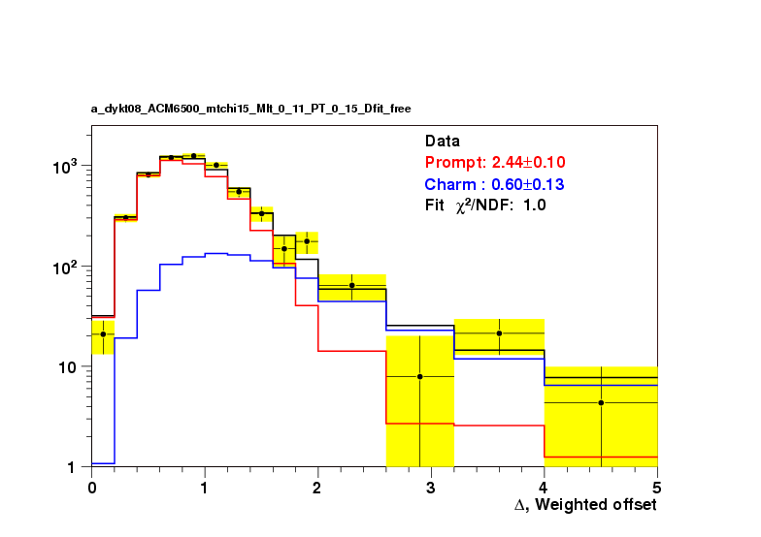
Open charm
Measuring muon offset
Use same Strategy as NA60: measure muon vertex
Open charm decay length: $\left\{\begin{matrix}D^{+/−}:cτ=311.8 μ\text{m} \\ D^{0}:cτ=122.9 μ\text{m}\end{matrix}\right.$
P_{lab} = 158 GeV/c ➔ γ=9.2 ➔ $\left\{\begin{matrix}D^{+/−}:γcτ=2.86 \text{mm} \\ D^{0}:γcτ=1.13 \text{mm}\end{matrix}\right.$
(simulation studies ongoing to estimate CHIC performances)
CHIC: Vertex detector located 7.5 cm downstream from the target
(7 cm for NA60)
NA60 vertex detector: muon offset resolution ~ 40 μm (in transverse plane)
target
In principle, CHIC can measure open charm.
Simulations on-going…
NA60 capable to separate prompt (red) from charm (blue) contribution

Slide 20
Conclusion
Measuring together J/Ψ, Ψ’ and χ_{c} in p+A collisions with several targets will give a thorough control of Cold Nuclear Matter effects
Measuring together J/Ψ, Ψ’ and χ_{c} in A+A collisions at SPS energies will (dis)prove sequential suppression scenario.
The apparatus is well suited to explore other important physics subjects such as open charm or low mass lepton pairs production in heavy ion collisions.
Testing sequential suppression scenario at SPS is crucial to fully understand RHIC and LHC results.

Slide 21
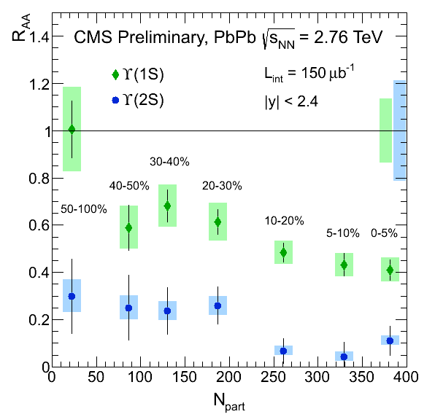
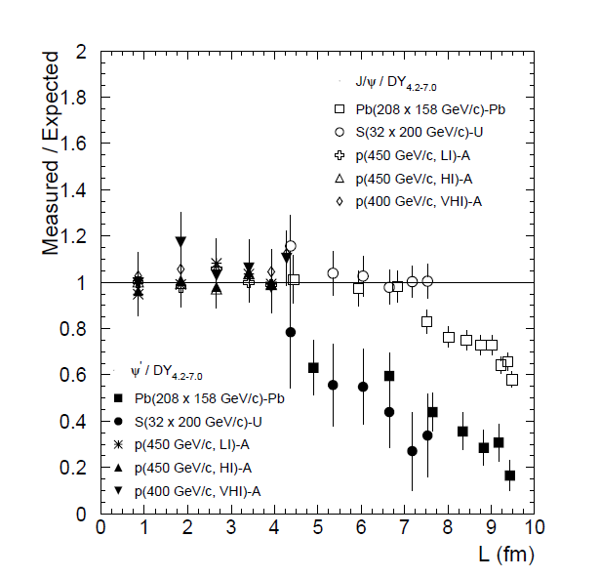
CMS@LHC New upsilon results
Results from CMS
’’Observation of Sequential $Υ$ Suppression in PbPb collisions’’
(at LHC)
PRL109, 222301 (2012)
Charmonia @ SPS bottomonia @ LHC

Slide 22
J/Ψ@SPS .vs. $Υ$@LHC color screening ?
NA50, PbPb √s_{NN}=17.2 GeV
Ψ(1S)
Ψ(2S)
Charmonia @ SPS bottomonia @ LHC
Testing sequential suppression scenario at SPS is crucial to fully understand RHIC and LHC results.

Slide 23
CERN strategy
Conclusions of the CERN Town meeting on “Relativistic Heavy-Ion Collisions”
CERN - june 29, 2012
“…The town meeting also observed that the CERN SPS would be well-positioned to contribute decisively and at a competitive time scale to central open physics issues at large baryon density. In particular, the CERN SPS will remain also in the future the only machine capable of delivering, heavy ion beams with energies exceeding 30 GeV/nucleon, and the potential of investigating rare penetrating probes at this machine is attractive.”
➔ October 2012: Submission of an Expression of Interest to the SPSC

Slide 24
Expression of interest
Submitted to SPSC (october 2012)
CERN-SPSC-2012-031

Slide 25
Feedback from SPSC referees
The SPSC has received an expression of interest to study charm production with proton and heavy ion beams. The SPSC recognizes the strong physics motivation of a study that addresses central open questions about the color screening of charmonium in heavy ion collisions and about cold nuclear matter effects. For a comprehensive investigation, an extension including open charm production would be desirable.
For further review, the SPSC would require a letter of intent with information about the experimental implementation and the collaboration pursuing it.
January 2013

Slide 26
Close and open issues
People involved
1 experimentalist : F. Fleuret
4 theoricists : F. Arleo, E.G. Ferreiro, P.-B. Gossiaux, S. Peigné
apparatus
Tracking
In the current design, tracking is performed upstream to the absorber.
Keeping low occupancy ➔ silicon technology : CMOS ?
Lab currently involved : none
Calorimetry
Around 400 γ per rapidity unit in central PbPb collisions
Need ultragranular calorimetry à la CALICE
Lab currently involved : LLR
Trigger
Absorber can be made of Fe (since tracking is performed upstream)
Absorber can be magnetized and, since instrumented, can provide momentum information to be matched with the tracker (RPCs?, micromegas?)
Lab currently involved : none
Timeline
From T₀ (3 labs involved): ~ 5 Years for full simulation and final design (2 years), construction and installation (2 years), commisionning (1 year)

Slide 27
backup

Slide 28
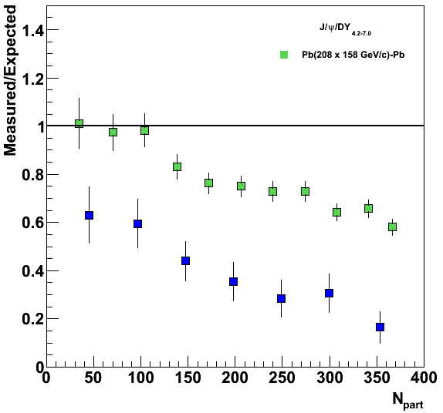
J/Ψ@SPS .vs. Υ@LHC color screening ?
NA50, PbPb √s_{NN}=17.2 GeV
Ψ(1S)
Ψ(2S)
0<y<1
Charmonia @ SPS bottomonia @ LHC
On the same axis

