Slide 1
Color screening in Quark Gluon Plasma (QGP): A new experiment to measure charm production in PbPb collisions at the CERN SPS
CHIC: Charm in Heavy Ion Collisions
F. Fleuret ¹, F. Arleo ², E. G. Ferreiro ³, P.-B. Gossiaux ⁴, S. Peigné ⁴
¹ LLR, École polytechnique – IN2P3/CNRS, Palaiseau, France
² LAPTh, Université de Savoie – CNRS, Annecy-le-Vieux, France
³ Universidad de Santiago de Compostela, Santiago de Compostela, Spain
⁴ SUBATECH, université de Nantes – IN2P3/CNRS, Nantes, France

Slide 2
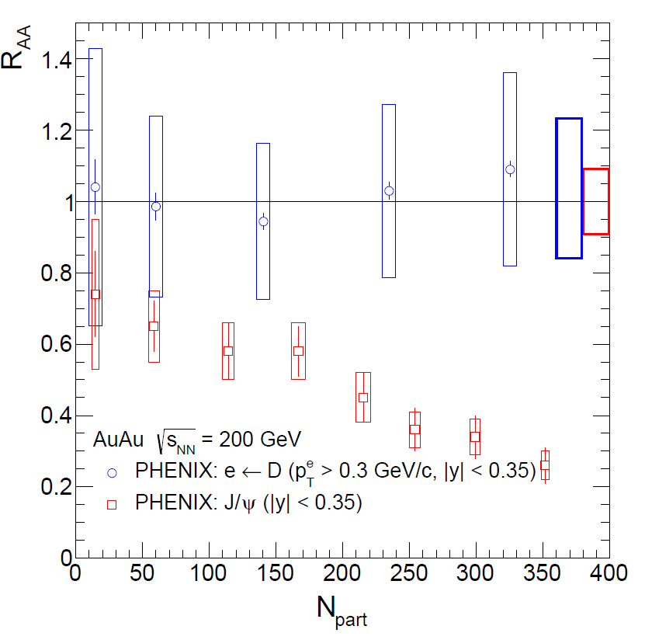
Heavy quarks
The Physics case
Heavy quarks and Quark Gluon Plasma (QGP)
Heavy quarks are ″special ″ QGP probes : m_{Q} >> QGP critical temperature T_{C} (~170 MeV),
➔ Heavy quarks should be produced in initial hard nucleon-nucleon collisions only, the QGP phase shouldn’t modify the overall heavy quark yields,
➔ QGP phase should modify relative heavy quark (open/hidden) bound state yields
Heavy quark hadronization ($c\overline{c}$ example):
~90% of $c\overline{c}$pairs → open charm
~10% of $c\overline{c}$pairs → hidden charm (charmonia)
Since most of the produced $c\overline{c}$pairs hadronize into open charm (~90%), open charm production reflects the original charm quark yield.
PHENIX Au+Au collisions @ $\sqrt{s_{NN}}$ = 200 GeV
Blue = open charm
Red = hidden charm
no (little) modification of open charm yield
modification of J/Ψ ($c\overline{c}$bound state) yield

Slide 3
Heavy quarks
The Physics case
Heavy quarks and Quark Gluon Plasma
Heavy quarks are ″special ″ QGP probes : m_{Q} >> QGP critical temperature T_{C} (~170 MeV),
➔ Heavy quarks should be produced in initial hard nucleon-nucleon collisions only, the QGP phase shouldn’t modify the overall heavy quark yields,
➔ QGP phase should modify relative heavy quark (open/hidden) bound state yields
Possible QGP effects on quarkonium:
Color screening: $Q\overline{Q}$ bound states suppression
Color screening in a QGP decreases quarkonium binding
Color screening should lead to a suppression of quarkonium production yields
Recombination: $Q\overline{Q}$ bound states enhancement
at sufficiently high $\sqrt{s_{NN}}$, heavy quarks are abondantly produced.
After thermalisation, statistical combination can lead to an enhancement of quarkonium production yields
recombination
quarkonium production probability
screening
Energy Density

Slide 4
Charm quarks
The Physics case
Experimentally, charmonium is a priviledged probe
Charmonium production in A+A collisions studied at:
CERN-SPS (√s=17 GeV) NA38, NA50, NA60 experiments
BNL-RHIC (√s=200 GeV) PHENIX, STAR experiments
CERN-LHC (√s=2.76 TeV) ALICE, CMS experiments
Short summary for J/Ψ:
NA50 (PbPb@SPS) observed an anomalous J/Ψ suppression
PHENIX (AuAu@RHIC) observed a similar suppression (than NA50)
ALICE (PbPb@LHC) observed a smaller suppression (than PHENIX)
➔Possible Color screening starting at SPS
➔Possible recombination occuring at LHC
Within the SPS+RHIC+LHC energy range, charm seems to be the adequate probe to investigate both screening and recombination.
recombination
LHC
SPS
Charmonium production probability
screening
Energy Density

Slide 5
Charm quarks
The Physics case
What next to be done with charmonium
To confirm (and study) charmonium color screening and enhancement, one must compare charmonium and open charm production in A+A collisions
Since most of the produced $c\overline{c}$pairs hadronize into open charm (~90%), open charm production reflects the original $c\overline{c}$pair production
Open charm is therefore an (the?) appropriate reference to calibrate charmonium screening/recombination studies.
Study charmonium recombination
Both J/Ψ and open charm will be measured in PbPb at large energy densities at LHC
➔ LHC is the best place to study charmonium recombination
recombination
Study charmonium color screening
At SPS energies, in Pb+Pb collisions, J/Ψ suppression occurs in the middle of the accessible energy density range
➔ SPS is the best place to study color screening
Need measurement of open charm yields
Need precise measurements of several $c\overline{c}$ states to test if color screening leads indeed to a sequential suppression
LHC
SPS
Charmonium production probability
screening
Energy Density

Slide 6
Sequential suppression
Color screening
Quarkonium sequential suppression
Quarkonium sequential suppression in a Quark Gluon Plasma is a prediction of lattice QCD, for instance :
Because of feed-downs and different T_{d}, sequential suppression should show up.
H. Satz, J. Phys. G 32 (2006)
$\frac{\text{quarkonium} \text{dissociation} \text{temperature}}{\text{critical} \text{QGP} \text{temperature}}$ ➔
Feed-downs contributing to J/Ψ inclusive yield
60% direct J/Ψ
+ 30% χ_{c}→J/Ψ+γ
+ 10% Ψ’ → J/Ψ + X
Inclusive J/Ψ yield
Sequential suppression - screening
1st step
2nd step
production probability
According to lattice calculations,
T_{d} (Ψ’) < T_{d} (χ_{c}) < T_{d} (J/Ψ)
➔ One should observe a step-like suppression pattern
3rd step
Ψ’
χ_{c}
J/Ψ
Temperature (Energy density)

Slide 7
Charmonia in A+A
NA50 results
Anomalous suppression at SPS
Eur.Phys.J.C49:559-567,2007
L = length of nuclear matter seen by quarkonium state
p+A
Expected = measured yields in p+A extrapolated to large L
S+U
Pb+Pb
0.9
0.9
Color screening ?
NA50 measured J/Ψ and Ψ’, but,
too small Ψ’→ J/Ψ feed-down
too fragile Ψ’
to answer the question
need of a larger feed-down fraction
Need of a stronger bound state
Need to measure χ_{c} yield !
L (fm)
ε (GeV/fm³)
4.37
1.04
4.90
1.24
6.65
2.04
7.65
2.53
8.83
3.19
9.43
3.76

Slide 8
Charmonia in A+A
Suppression patterns
Anomalous suppression at SPS
Eur.Phys.J.C49:559-567,2007
Color screening ?
60% direct J/Ψ
+ 30% χ_{c}→J/Ψ+γ
+ 10% Ψ’ → J/Ψ + X
Inclusive J/Ψ yield
p+A
Take advantage of large χ_{c} → J/Ψ feed-down fraction
S+U
Pb+Pb
Measuring J/Ψ, Ψ’ and χ_{c} suppression patterns will give the answer
QGP - χ_{c}
comovers - χ_{c}
Alternative (no QGP) scenario: suppression by comoving hadrons
Smooth suppression
Same suppression-starting point
Slopes related to binding energy : S_{Ψ ’} > S_{χ} > S_{J/Ψ}
L (fm)
ε (GeV/fm³)
4.37
1.04
4.90
1.24
6.65
2.04
7.65
2.53
8.83
3.19
9.43
3.76

Slide 9
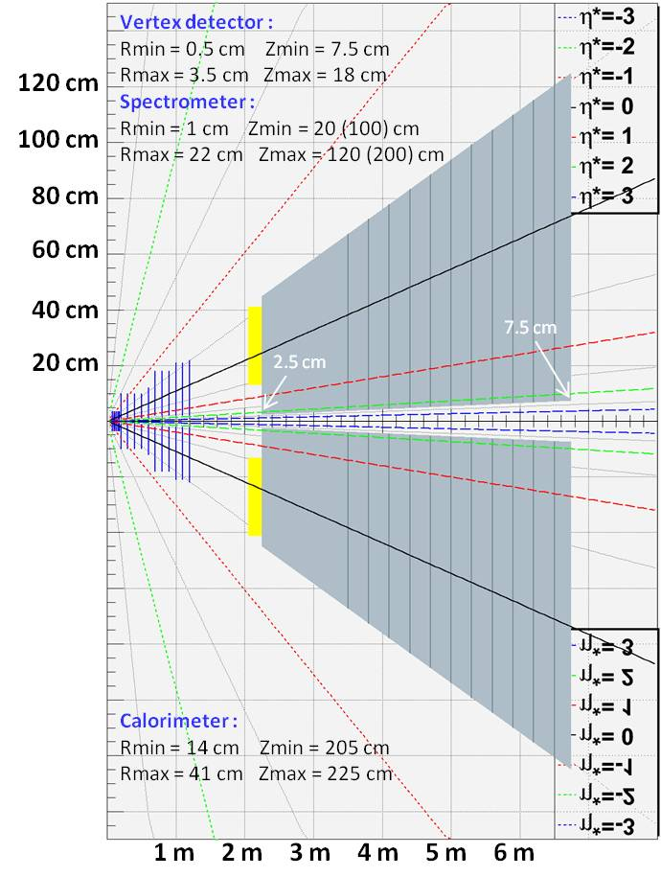
Experimental design
A new experiment @ SPS
Must measure :
Charmonia : J/Ψ, Ψ’, χ_{c}
open charm (for reference)
Beam:fixed-target experiment
high-intensity 158 GeV/c Pb beam
high-intensity 158/450 GeV/c p beam
Experimental constraints
Measure muons from charmonia and open charm decays
Measure photon from χ_{c} decay (χ_{c} →J/Ψ+γ)
Detector main components :
Vertex detector + Spectrometer
Measures tracks before absorber ➔ very good mass resolution
Measure muon vertex offset ➔ open charm
Ultra-granular calorimeter
Measure γ in high π⁰ multiplicity environment
Absorber/ muon trigger
Absorb π/K
Minimize fake triggers from π/K decays
Dipole field

Slide 10
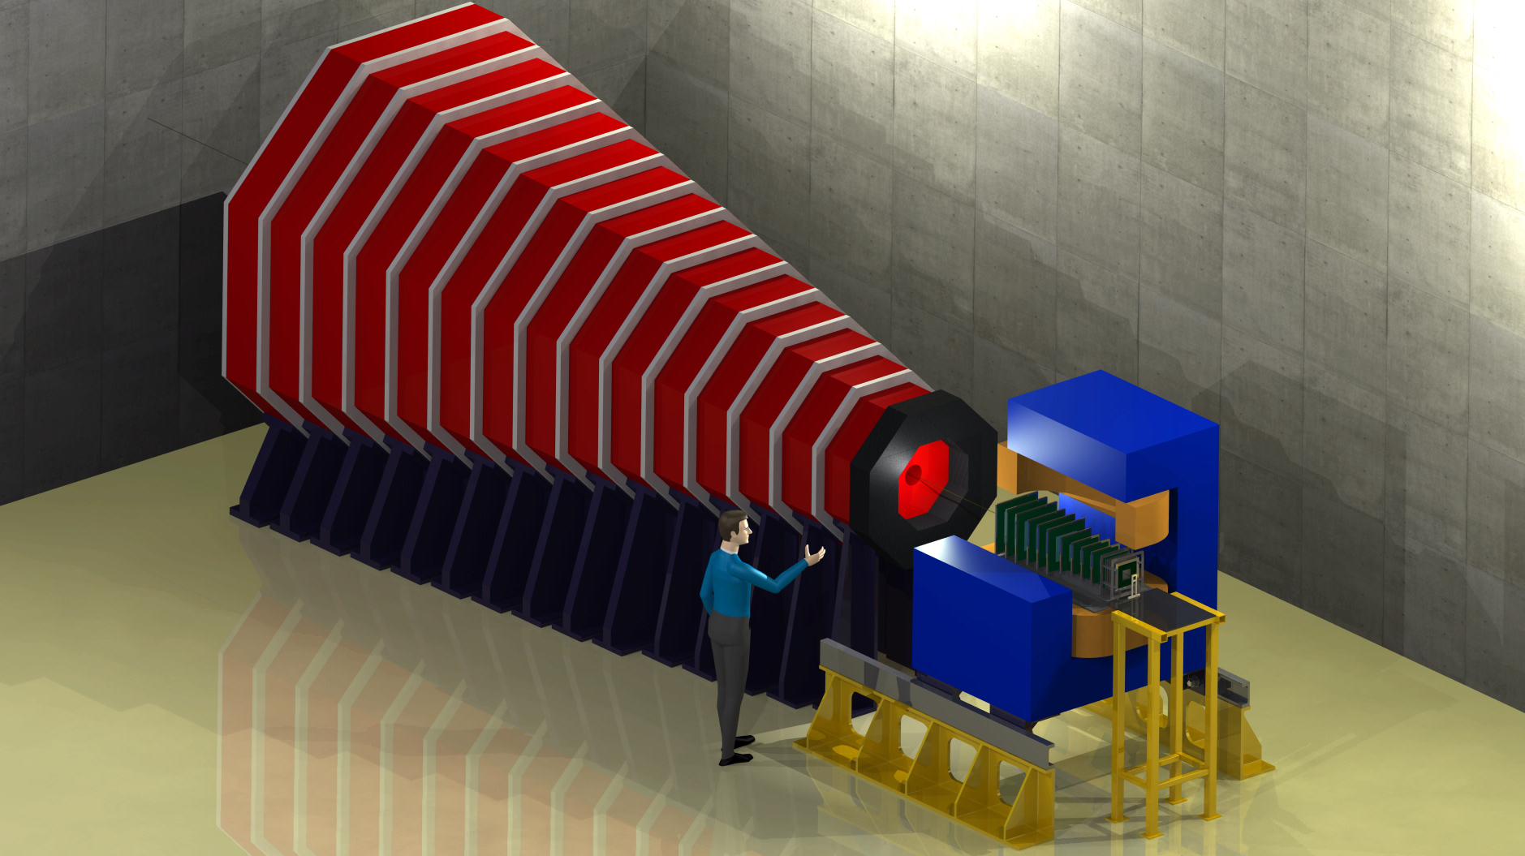
Apparatus artist view
A new experiment @ SPS
Calorimeter:
➔ ultra-granular EMCal
➔ W + Si layers à la CALICE
- 30 layers
- 0.5 x 0.5 cm² pads
- 24 X₀ in 20 cm
- ΔE/E ~ 15% /√E
Magnet :
1m long 2.5 T dipole
Estimations based on NA60/CERN telescope performances
Instrumented Absorber :
4.5 m thick Fe absorber
➔ dimuon trigger rate ~ 0.3 kHz
Could be magnetized to measure muon momentum
Silicon Spectrometer
covers 1.5 rapidity unit
Δp/p = 1% ➔ J/Ψ mass resolution ~20 MeV/c²

Slide 11
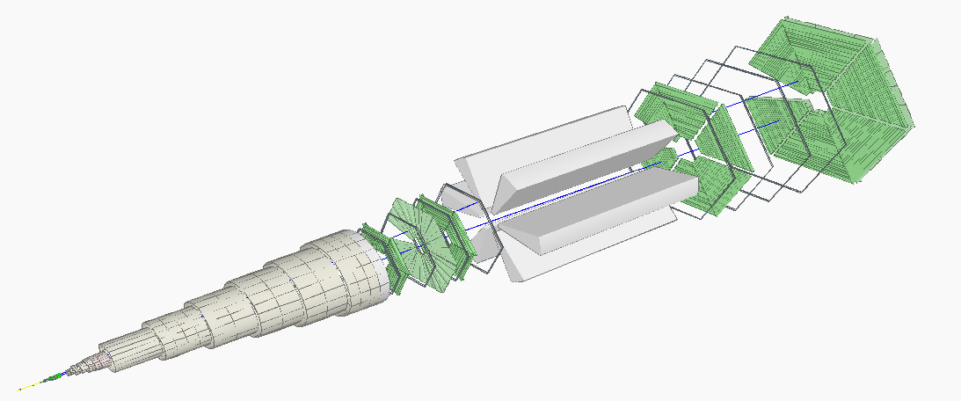
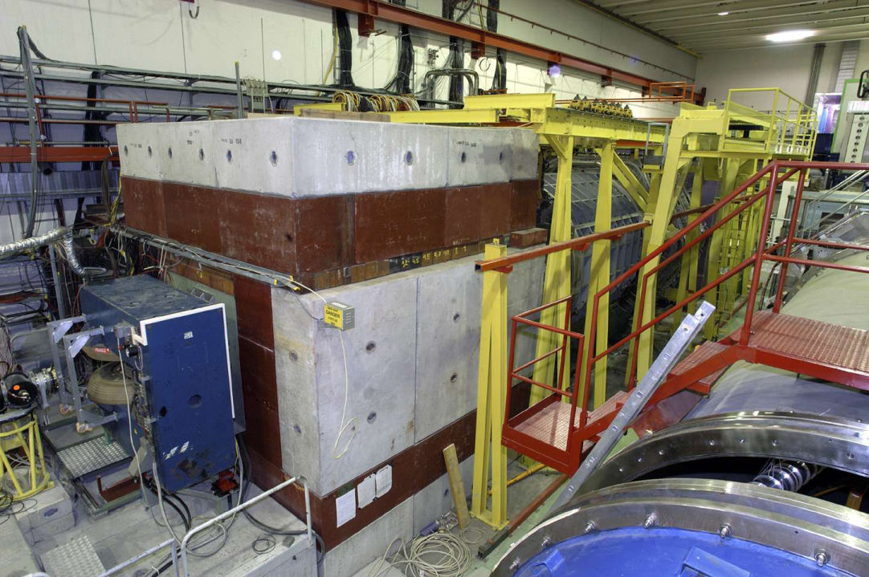
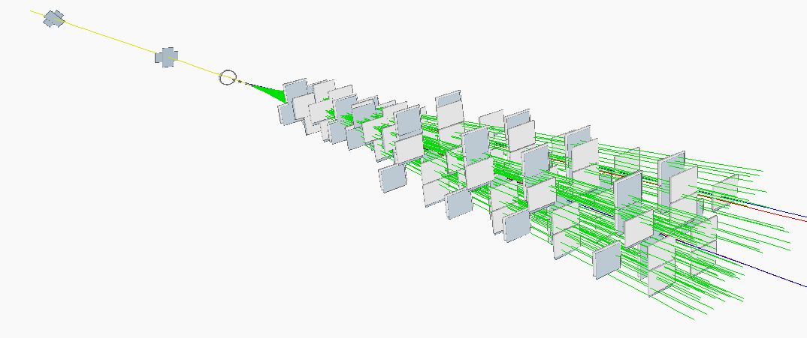
Apparatus
Silicon spectrometer
The NA60 example
Pixel detector
16 planes – 96 chips total
32 x 256 pixels / chip
Pixel size = 425 × 50 μm²
Magnetic field = 2.5 T × 40 cm
Momentum resolution @J/Ψ mass
(typical p_{μ} ~ 15 GeV/c)
(R. S. priv. Comm.)

Slide 12
Apparatus
Magnetic field
The NA60 pixel detector
The CHIC pixel detector
~40 cm
L = 0.4 m
~100 cm
L = 1 m

Slide 13
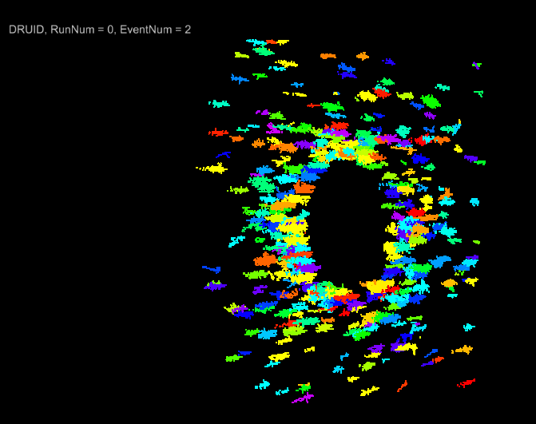
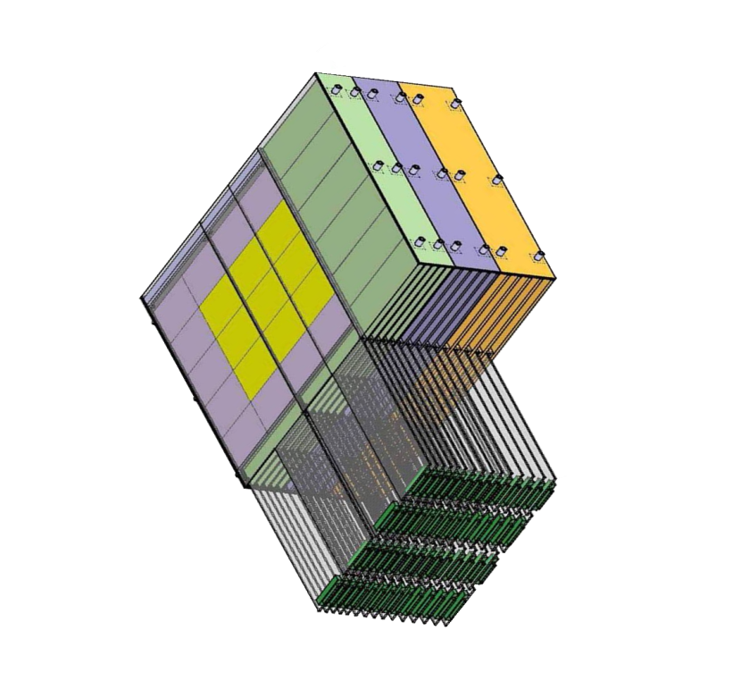
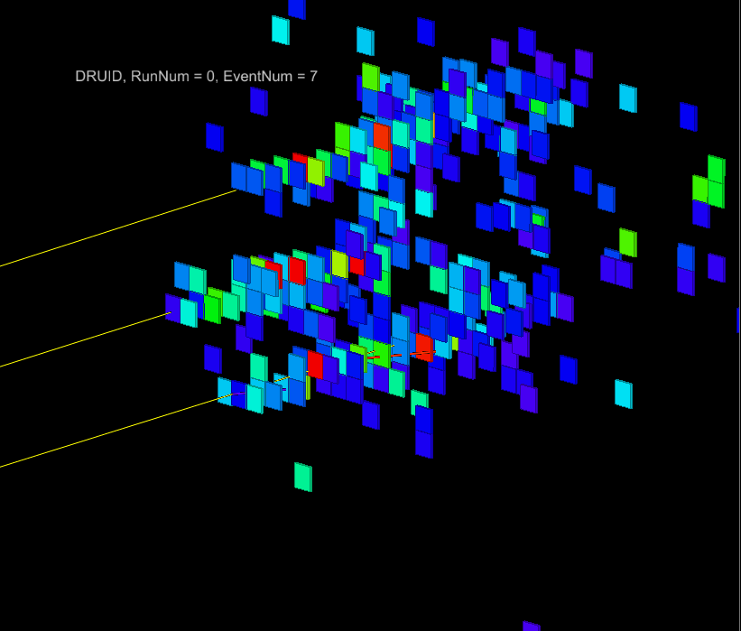
Apparatus
Calorimetry
Need to measure low energy photon (~3 GeV in lab) in high π⁰ multiplicity environment → need very high segmentation
To separate electromagnetic showers
To isolate photons from π^{+/-} contamination
W + Si calorimeter à la Calice
30 layers
0.5 x 0.5 cm² pads
24 X₀ in 20 cm
Pb+Pb
3 photons with E~2 GeV
distance between photons~ 2 cm
(full simu made by D. Jeans - LLR - Calice collab.)

Slide 14
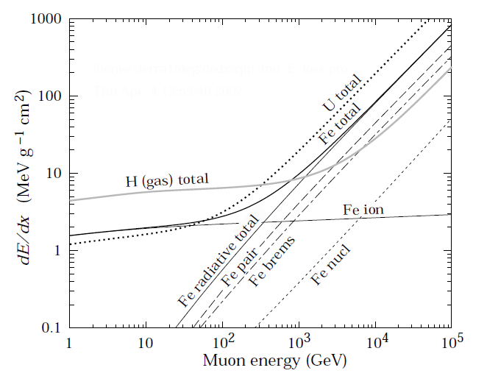
Apparatus
Absorber
Absorber size and muon energy loss
All π^{+/-} stopped with a 2.0 m Fe absorber
➔ but need more Fe to stop muons from pion decay
Pythia 6.421 - p+p - √s = 17.2 GeV
Particle Data Group: J. Phys. G 37, 075021 (2010)
3
5
7 GeV/c
dE/dx ~ 2 MeV g⁻¹ cm²
Fe density ~ 7.8 g cm⁻³
dE/dx ~ 15.6 MeV cm⁻¹
2.0 m Fe ➔ ΔE/Δx ~ 15.6 x 200 ~ 3 GeV
3.2 m Fe ➔ ΔE/Δx ~ 15.6 x 320 ~ 5 GeV
3.8 m Fe ➔ ΔE/Δx ~ 15.6 x 380 ~ 6 GeV
4.5 m Fe ➔ ΔE/Δx ~ 15.6 x 450 ~ 7 GeV
Muon
energy loss
in Fe

Slide 15
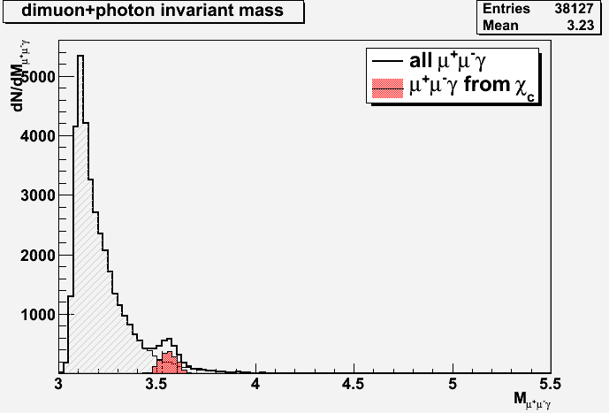
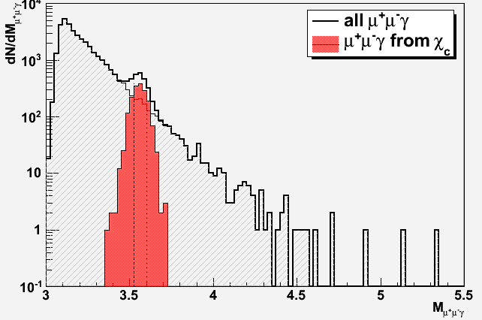
Expected performances
Signal extraction
Typical mass plots (~1 week data taking w/ a 10% λ_{I} Pb target)
200 000 J/Ψ embedded in Pb+Pb Minbias events produced w/ EPOS
140 000 direct J/Ψ◊ μ⁺μ⁻ (70%)
60 000 χ_{c} → J/Ψ γ → μ⁺μ⁻ γ (30%)
J/Ψ
$${\text{σ}}_{\text{M}}\text{\sim 20 }\text{MeV}\text{/}\text{c}\text{²}$$
χ_{c}
$${\text{σ}}_{\text{M}}\text{\sim 45 }\text{MeV}\text{/}\text{c}\text{²}$$
After acceptance/selection cuts within y_{CMS}∈[-0.5;0.5]
35 000 J/Ψ◊μ⁺μ⁻
➔ acc x eff = 17.4%
Including
1700 χ_{c} → J/Ψ γ → μ⁺μ⁻ γ ➔ acc x eff = 2.8 %

Slide 16
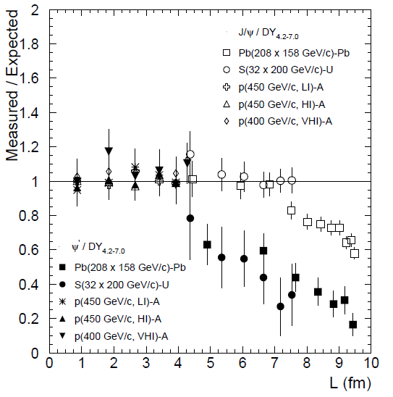
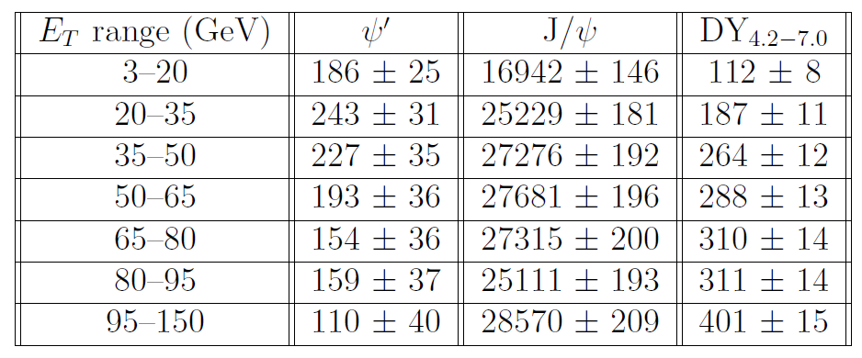
Expected number of events
Statistics
Typical 40-day Pb+Pb run (10⁷.s⁻¹ Pb beam → 10% λ_{I} Pb target)
~ 180 000 J/Ψ→μ⁺μ⁻ recorded
2 extreme numerical scenarios:
If χ_{c} suppressed as J/Ψ
If χ_{c} suppressed as Ψ’
Possible χ_{c} suppression pattern
~180 000 J/Ψ
~ 1300 Ψ’
~ 3000 χ_{c}
χ_{c} as Ψ’ | χ_{c} as J/Ψ
406 | 677
530 | 1010
495 | 1091
421 | 1107
336 | 1093
647 | 1004
240 | 1143
3075 | 7125
Eur.Phys.J.C49:559-567,2007
Expect 3000 < ${\text{N}}_{χ_{c}}$ < 7000
NA50 data

Slide 17
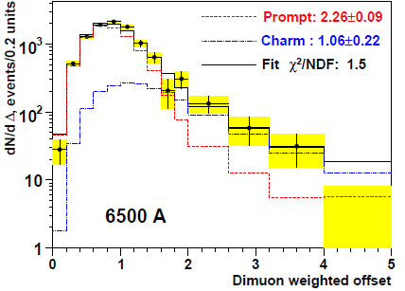
Open charm
Measuring muon offset
Use same Strategy as NA60: measure muon vertex
Open charm decay length: $\left\{\begin{matrix}D^{+/−}:cτ=311.8 μ\text{m} \\ D^{0}:cτ=122.9 μ\text{m}\end{matrix}\right.$
Eur.Phys.J.C59:607-623,2009
In+In
NA60 vertex detector: muon offset resolution ~ 40 μm (in transverse plane)
target
CHIC: Vertex detector located 7.5 cm downstream of the target (7 cm for NA60)
CHIC is able to measure open charm yields.
Detailed simulations needed to estimate performances
NA60 has separated prompt (red) from charm (blue) contribution in In+In
NA60 has found an excess of prompt dimuons in Intermediate Mass Region
NA60 has measured open charm cross-section: compatible with p+A results

Slide 18
p+A program
Cold Nuclear Matter
A thorough p+A program is mandatory to study Cold Nuclear Matter effects as a reference to study Hot Nuclear Matter effects
Must control (understand) :
charmonium absorption by cold nuclear matter ➔ A dependence
Shadowing/anti-shadowing (x₂ scaling)
Energy loss, formation time (x_{F} scaling)
➔ Need large y_{CMS} range
Mid-rapidity : y_{CMS} ∈ [-0.5 ; 1]
Forward-rapidity : y_{CMS} ∈ [0.5 ; 2]

Slide 19
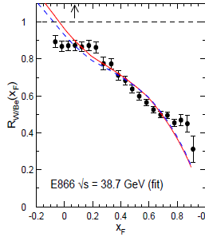
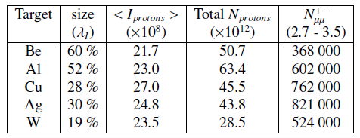
A thorough p+A program
Detector capabilities
Large rapidity range
Significantly Larger rapidity range for CHIC (y_{CMS}∈[-0.5;2]).vs. NA50 (y_{CMS}∈[0;1])
Precise A dependence (thanks to fixed-target mode)
NA50 samples : p+Be, p+Al, p+Cu, p+Ag, p+W, p+Pb
Large amount of data (thanks to fixed-target mode)
NA50
(29 GeV)
E866
CHIC (29 GeV)
F. Arleo and S. Peigné, arXiv:1204.4609
NA50
(17.2 GeV)
CHIC (17.2 GeV)
Typical 1week/target NA50 data taking
(EPJ C33 (2004) 31-40)
Large statistics required to study J/Ψ, Ψ’, χ_{c} and open charm differential yields as a function of y, p_{T}.
Current SPS operation: Delivering proton beam to the LHC several months per year
Significantly larger (than NA50) amount of data available for CHIC.

Slide 20
Project status
EoI submitted to the SPS Committee (oct. 2012)
Expression of Interest
Submitted to SPSC – oct.2012
CERN-SPSC-2012-031
MINUTES of the 108th Meeting of the SPSC
15-16 January 2013
CERN-SPSC-2013-008
The SPSC has received an expression of interest to study charm production with proton and heavy ion beams. The SPSC recognizes the strong physics motivation of a study that addresses central open questions about the color screening of charmonium in heavy ion collisions and about cold nuclear matter effects. For a comprehensive investigation, an extension including open charm production would be desirable.
For further review, the SPSC would require a letter of intent with information about the experimental implementation and the collaboration pursuing it.

Slide 21
Towards a Letter of Intent
Green light from CERN SPSC
EoI submitted to SPSC in oct. 2012 : CERN-SPSC-2012-031
Positive feed-back from SPSC in jan. 2013 : CERN-SPSC-2013-008
Current think tank
F. Arleo, E.G. Ferreiro, F. Fleuret, P.-B. Gossiaux, S. Peigné
Many opportunities for experimentalists
apparatus
Tracking
Needs low detector occupancy ➔ silicon technology
Welcomes group with expertise !
Calorimetry
Need ultragranular calorimetry à la CALICE
Expertise at LLR - Ecole polytechnique (France)
Trigger
Instrumented (magnetized) Fe Absorber
Welcomes group with expertise !
Expected timeline
From T₀ (3 labs involved): ~ 5 Years for full simulation and final design (2 years), construction and installation (2 years), commisionning (1 year)

Slide 22
Conclusion
Measuring J/Ψ, Ψ’, χ_{c} and open charm in A+A collisions at SPS will (dis)prove sequential suppression scenario.
Measuring J/Ψ, Ψ’, χ_{c} and open charm in p+A collisions with several targets will give a thorough control of Cold Nuclear Matter effects
The apparatus is well suited to explore other important physics subjects such as low mass lepton pairs production in heavy ion collisions.
Many opportunities to contribute to the project
Testing sequential suppression scenario at SPS is crucial to fully understand RHIC and LHC results.

Slide 23
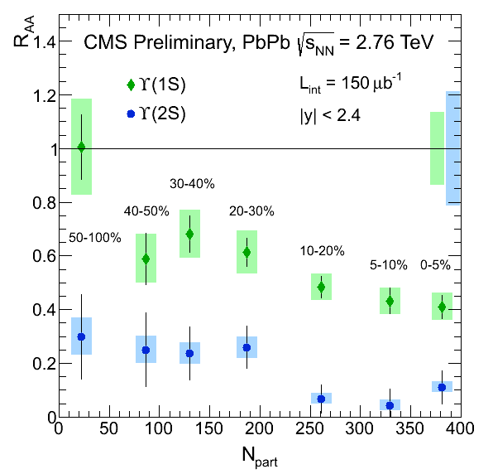
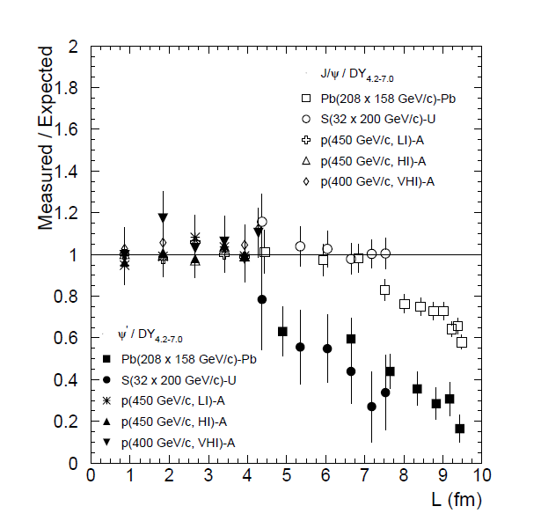
CMS@LHC New upsilon results
Results from CMS
’’Observation of Sequential $Υ$ Suppression in PbPb collisions’’
(at LHC)
PRL109, 222301 (2012)
Charmonia @ SPS bottomonia @ LHC
Testing sequential suppression scenario at SPS is crucial to fully understand RHIC and LHC results.

Slide 24
J/Ψ@SPS .vs. $Υ$@LHC color screening ?
NA50, PbPb √s_{NN}=17.2 GeV
Ψ(1S)
Ψ(2S)
Charmonia @ SPS bottomonia @ LHC
Testing sequential suppression scenario at SPS is crucial to fully understand RHIC and LHC results.

Slide 25
backup

Slide 26
Color screening
How to Test sequential suppression with charmonia ?
must measure J/Ψ, Ψ’, χ_{c}
~30% (resp. ~10%) of inclusive J/Ψ comes from χ_{c} (resp. Ψ’) decay.
According to lattice calculations, T_{d} (Ψ’) < T_{d} (χ_{c}) < T_{d} (J/Ψ)
If screening, one should observe a step-like suppression patterns
Sequential suppression - screening
J/Ψ production (a.u.)
Ψ’
χ_{c}
J/Ψ
Temperature
Alternative (no QGP) scenario: suppression by comoving hadrons
Smooth suppression
Same suppression-starting point
Slopes related to binding energy : S_{Ψ ’} > S_{χ} > S_{J/Ψ}
suppression by comovers
J/Ψ production (a.u.)
direct J/Ψ
Ψ’
χ_{c}
J/Ψ
Energy density

Slide 27
Comovers
Comovers
Anomalous suppression at SPS
Eur.Phys.J.C49:559-567,2007
Expectations in comovers scenario
Binding energy
p+A
S+U
Pb+Pb
comovers - direct J/Ψ
Taking breakup cross-sections:
comovers-direct J/Ψ = 0.2 mb
comovers – χ_{c} = 1.0 mb
comovers – Ψ’ = 2.0 mb
comovers – Ψ’
comovers - inclusive J/Ψ
comovers - χ_{c}
60% direct J/Ψ
+ 30% χ_{c}→J/Ψ+γ
+ 10% Ψ’ → J/Ψ + X
Inclusive J/Ψ yield
and considering feed-downs
L (fm)
ε (GeV/fm³)
4.37
1.04
4.90
1.24
6.65
2.04
7.65
2.53
8.83
3.19
9.43
3.76

Slide 28
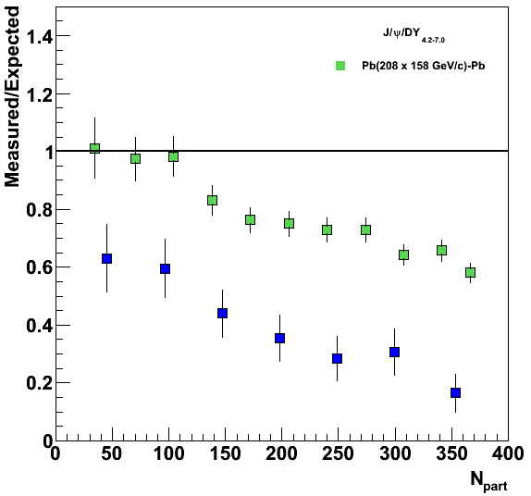
J/Ψ@SPS .vs. Υ@LHC
NA50, PbPb √s_{NN}=17.2 GeV
Ψ(1S)
Ψ(2S)
0<y<1
Charmonia @ SPS bottomonia @ LHC
Testing sequential suppression scenario at SPS is crucial to fully understand RHIC and LHC results.

Slide 29
Energy scan
Spectrometer acceptance: two detector configurations
Mid-rapidity
y_{CMS} ∈ [-0.5 ; 1]
for P_{beam} = 158 GeV/c
Forward-rapidity
y_{CMS} ∈ [0.5 ; 2]
for P_{beam} = 158 GeV/c
Depending on the beam energy, different rapidity ranges accessible
P_{beam} (GeV/c) | √s (GeV) | Rapidity of Center-of-mass | Mid-rapidity |  | Forward-rapidity
 |  |  | y_{CMS} min | y_{CMS} max | y_{CMS} min | y_{CMS} max
158 | 17.2 | 2.91 | -0.5 | 1 | 0.5 | 2
120 | 15.1 | 2.77 | -0.36 | 1.14 | 0.65 | 2.14
80 | 12.3 | 2.57 | -0.16 | 1.34 | 0.84 | 2.34
60 | 10.7 | 2.43 | -0.02 | 1.48 | 0.98 | 2.48
Common coverage: y_{CMS} ∈ [0;2]
(NA50/NA60 coverage = [0;1])

Slide 30
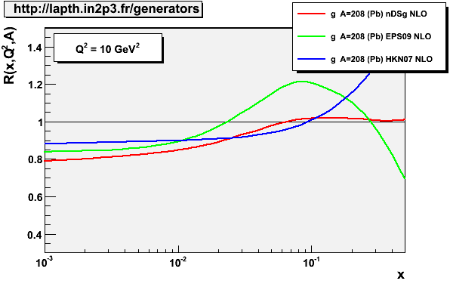
Rapidity coverage
A thorough p+A program
mandatory as reference for hot nuclear matter effects
J/Ψ, Ψ’, χ_{c} in a large y_{CMS} range
Large coverage in x₂
Large coverage in x_{F}
E_{beam} (√s) | Exp. | y_{CMS} | x₂ | x_{F}
158 GeV (~17 GeV) | NA50 | [0;1] | [0.07;0.18] | [0;0.42]
 | CHIC | [-0.5;2] | [0.02;0.30] | [-0.19;1]
450 GeV (~29 GeV) | NA50 | [-0.4;0.6] | [0.06;0.16] | [-0.09;0.14]
 | CHIC | [-0.9;1.6] | [0.02;0.26] | [-0.22;0.51]
NA50
(29 GeV)
E866
CHIC (29 GeV)
F. Arleo and S. Peigné, arXiv:1204.4609
NA50
NA50
(17.2 GeV)
CHIC
CHIC (17.2 GeV)
x₂

Slide 31
Mass resolution
CHIC expected performances for low mass dileptons
Tracking performed upstream to the absorber
➔ no multiple scattering due to absorber
➔ momentum resolution affected by magnetic field only: $\frac{ΔP}{P}∝\frac{1}{BL²}P$
Momentum resolution
With a 1m long 2.5T dipolar magnetic field
$\frac{∆P_{μ}}{P_{μ}}$ = 1% for typical muon from J/Ψ (<P_{μ}> ~10 GeV/c)
$\frac{∆P_{μ}}{P_{μ}}$ = 0.7% for typical muon from ω (<P_{μ}> ~7 GeV/c)
Expected mass resolution:
J/Ψ: $\frac{∆P_{μ}}{P_{μ}}=$1% ➔$\frac{∆P_{μ}}{√2P_{μ}}=$ $\frac{∆M_{μμ}}{M_{μμ}}=0.7\%$
ω: $\frac{∆P_{μ}}{P_{μ}}=0.7$% ➔$\frac{∆P_{μ}}{√2P_{μ}}=$ $\frac{∆M_{μμ}}{M_{μμ}}=0.5\%$
$$∆M_{μμ}^{J/Ψ}\sim 3.097 GeV/c² ×0,7\% \sim 20 \text{MeV}/c²$$
NA50: $∆M_{μμ}^{J/Ψ}\sim 90 \text{MeV}/c²$
$$∆M_{μμ}^{ω}\sim 782.7 MeV/c² ×0,5\% \sim 4 \text{MeV}/c²$$
NA60: $∆M_{μμ}^{ω}\sim 20 \text{MeV}/c²$

Slide 32
CERN strategy
Conclusions of the CERN Town meeting on “Relativistic Heavy-Ion Collisions”
CERN - june 29, 2012
“…The town meeting also observed that the CERN SPS would be well-positioned to contribute decisively and at a competitive time scale to central open physics issues at large baryon density. In particular, the CERN SPS will remain also in the future the only machine capable of delivering, heavy ion beams with energies exceeding 30 GeV/nucleon, and the potential of investigating rare penetrating probes at this machine is attractive.”

Slide 33
J/Ψ@SPS .vs. Υ@LHC color screening ?
NA50, PbPb √s_{NN}=17.2 GeV
Ψ(1S)
Ψ(2S)
0<y<1
Charmonia @ SPS bottomonia @ LHC
On the same axis

