Slide 1
An experiment to measure χ_{c} suppression at the CERN SPS
CHIC: Charm in Heavy Ion Collisions
F. Fleuret ¹, F. Arleo ², E. G. Ferreiro ³, P.-B. Gossiaux ⁴, S. Peigné ⁴
¹ LLR, École polytechnique – IN2P3/CNRS, Palaiseau, France
² LAPTh, Université de Savoie – CNRS, Annecy-le-Vieux, France
³ Universidad de Santiago de Compostela, Santiago de Compostela, Spain
⁴ SUBATECH, université de Nantes – IN2P3/CNRS, Nantes, France

Slide 2
Charmonia in A+A The Physics case
Test QGP color screening through quarkonium measurements
Quarkonium color screening in a Quark Gluon Plasma is a prediction of lattice QCD, for instance :
Because of feed-downs and different T_{d}, sequential suppression should show up.
Experimentally
J/Ψ production in A+A collisions is (has been) studied at :
SPS (√s~17 GeV) : NA38, NA50, NA60 experiments
RHIC (√s~200 GeV) : PHENIX, STAR experiments
LHC (√s~2.76 TeV) : ALICE, CMS experiments
Unclear overall picture :
Hot and Dense Matter effects due to color screening ? Recombination ? Both ?
Moreover, Cold Nuclear Matter effects must be better controlled (understood)
To understand Hot and Dense Matter effects, need to answer color screening question first. (Recombination occurs at high energies)
H. Satz, J. Phys. G 32 (2006)

Slide 3
Charmonia in A+A Testing color screening
Testing sequential suppression with charmonia :
must be in a regime where recombination is negligible ➔ SPS energies
must measure the suppression pattern of several related states, for instance:
~30% of the inclusive J/Ψ yield comes from χ_{c} decay.
According to lattice calculations, T_{d} (χ_{c}) < T_{d} (J/Ψ)
If screening, one should observe a gap in suppression patterns
Alternative scenario: suppression by comoving hadrons
Smooth suppression
Same starting point
Slopes related to binding energy : S_{Ψ ’} > S_{χ} > S_{J/Ψ}
suppression by comovers
Sequential suppression - screening
production probability
production probability
Suppression
gap
direct J/Ψ
Suppression gap
χ_{c}
J/Ψ
χ_{c}
Ψ’
Ψ’
J/Ψ
Energy density
Energy density

Slide 4
Charmonia in A+A Sequential suppression
Anomalous suppression at SPS
Eur.Phys.J.C49:559-567,2007
sequential suppression (QGP) ?
or
comovers (no QGP) ?
p+A
S+U
60% direct J/Ψ
+ 30% χ_{c}→J/Ψ+γ
+ 10% Ψ’ → J/Ψ + X
Inclusive J/Ψ yield
Pb+Pb
Measuring Ψ’ only is not the answer :
too small feed-down
➔ need of a larger feed-down fraction
L (fm)
ε (GeV/fm³)
4.37
1.04
4.90
1.24
6.65
2.04
7.65
2.53
8.83
3.19
9.43
3.76

Slide 5
Charmonia in A+A Sequential suppression
Anomalous suppression at SPS
Eur.Phys.J.C49:559-567,2007
sequential suppression (QGP) ?
or
comovers (no QGP) ?
p+A
S+U
60% direct J/Ψ
+ 30% χ_{c}→J/Ψ+γ
+ 10% Ψ’ → J/Ψ + X
Inclusive J/Ψ yield
Pb+Pb
comovers
QGP χ_{c}
Measuring Ψ’ only is not the answer :
too small feed-down
➔ need of a larger feed-down fraction
Measuring J/Ψ, Ψ’ and χ_{c} suppression patterns will give the answer
L (fm)
ε (GeV/fm³)
4.37
1.04
4.90
1.24
6.65
2.04
7.65
2.53
8.83
3.19
9.43
3.76

Slide 6
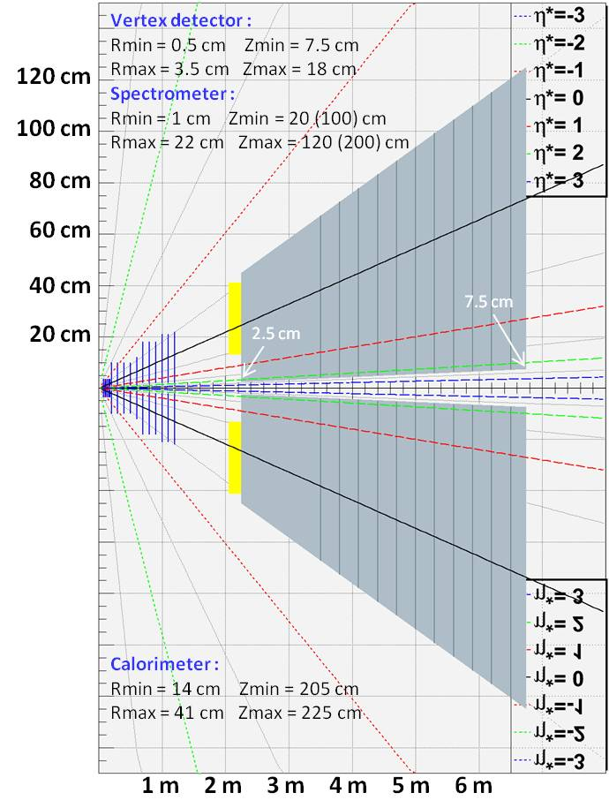
Charmonia in A+A Measuring χ_{c} at SPS
Operate a new experiment at SPS
Primary goal : χ_{c} → J/Ψ + γ → μ⁺ μ⁻ γ
With high intensity 158 GeV/c Pb beam
With high intensity 158/450 GeV/c proton beam
Detector features :
Vertex + Spectrometer
Measure tracks before absorber for very good mass resolution
Calorimeter
Measure low energy γ in high π⁰ multiplicity environment
Absorber/trigger
Absorb π/K
Minimize fake triggers from π/K decays
Dipole field
Dipole field

Slide 7
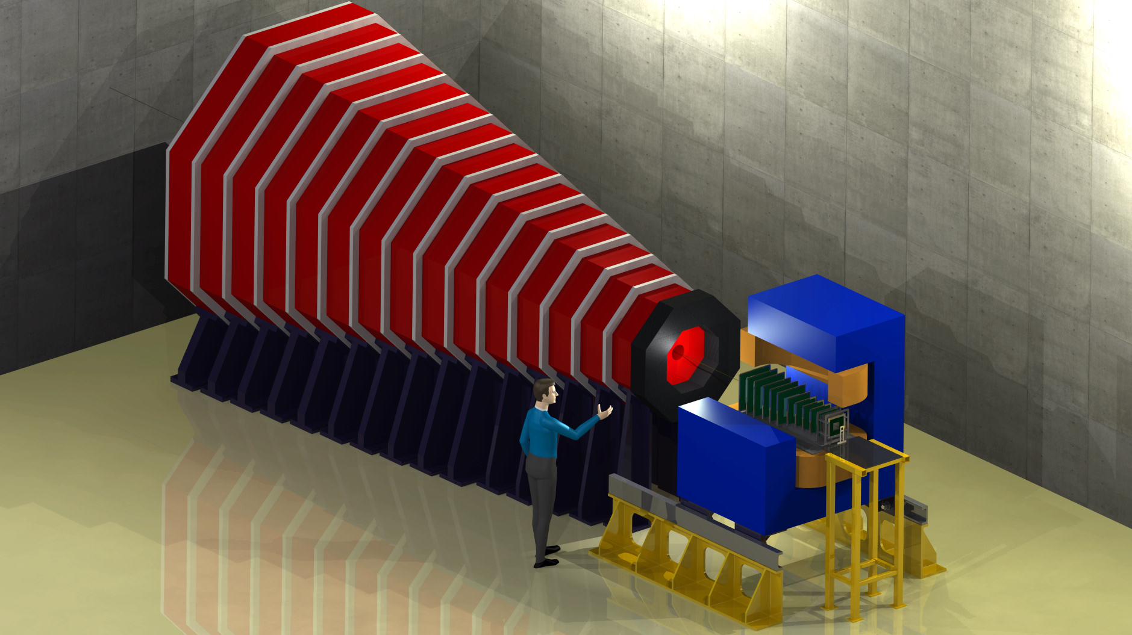
Apparatus Charm In Heavy Ion Collisions
Main purpose : measure χ_{c}→J/Ψ+γ
in Pb+Pb collisions at √s = 17.2 GeV
Calorimeter:
Measuring γ ‘s
in high π⁰ multiplicity environment
➔ ultra-granular EMCal
➔ W + Si calorimeter à la CALICE
- 30 layers
- 0.5 x 0.5 cm² pads
- 24 X₀ in 20 cm
- ΔE/E ~ 15% /√E
Absorber/dimuon trigger :
4.5 m thick instrumented Fe absorber
➔ trigger rate ~ 0.3 kHz
Silicon Spectrometer :
Measure tracks before absorber
covers 1.5 rapidity unit
Δp/p = 1% ➔ J/Ψ mass resolution ~20 MeV/c²
Estimations based on NA60 telescope performances
Magnet :
1m long 2.5 T dipole

Slide 8
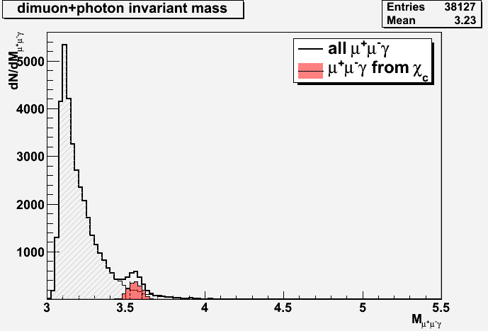
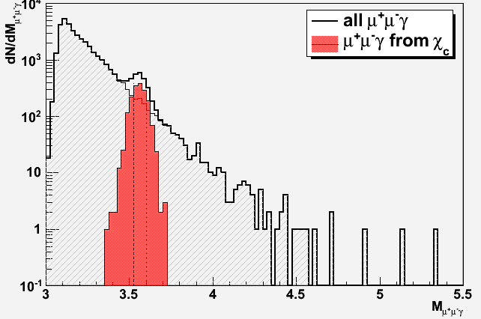
Expected performances Signal extraction
Typical mass plots (5 days data taking w/ a 10% λ_{I} Pb target)
200 000 Pb+Pb minBias EPOS events
140 000 events with J/Ψ embedded (70%)
60 000 events with χ_{c} embedded (30%)
J/Ψ
S/B=990
χ_{c}
S/B=1.8
After acceptance and selection cuts:
35 000 J/Ψ ➔ acc x eff = 17.4%
mass resolution ~ 20 MeV/c²
1700 χ_{c} ➔ acc x eff = 2.8 %
mass resolution ~ 45 MeV/c²

Slide 9
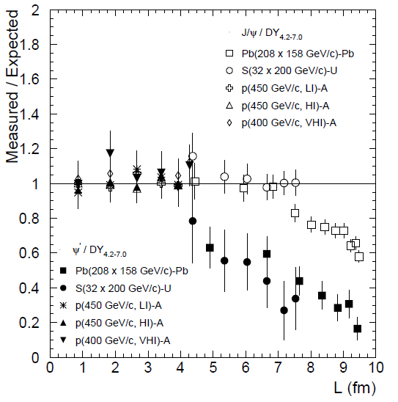
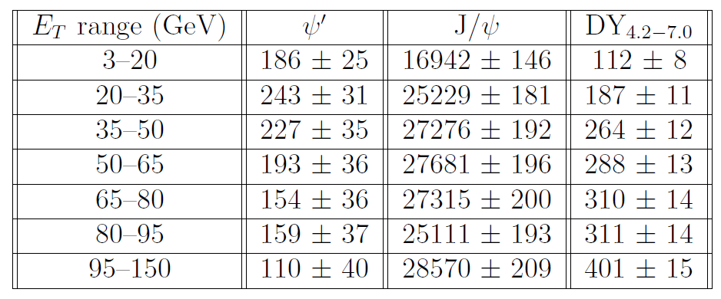
Expected performances Statistics
Typical one month Pb+Pb run
~ 200 000 inclusive J/Ψ→μ⁺μ⁻ expected
2 extreme scenarios:
If χ_{c} suppressed as J/Ψ
If χ_{c} suppressed as Ψ’
~180 000 J/Ψ
~ 1300 Ψ’
~ 3000 χc
χ_{c} as Ψ’ | χ_{c} as J/Ψ
406 | 677
530 | 1010
495 | 1091
421 | 1107
336 | 1093
647 | 1004
240 | 1143
3075 | 7125
Eur.Phys.J.C49:559-567,2007

Slide 10
p+A program investigate Cold Nuclear Matter
A thorough p+A program is mandatory as reference for hot nuclear matter effects
Must control (understand) :
charmonium absorption by cold nuclear matter ➔ A dependence
Shadowing/anti-shadowing (x₂ scaling)
Energy loss (saturation)… (x_{F} scaling)
Two detector configurations to cover y_{CMS} ∈ [-0.5 ; 2]
➔ Need large y_{CMS} range
Mid-rapidity : y_{CMS} ∈ [-0.5 ; 1]
Forward-rapidity : y_{CMS} ∈ [0.5 ; 2]
F. Fleuret - LLR Ecole polytechnique, France
10

Slide 11
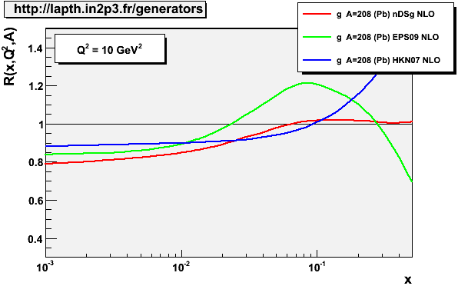
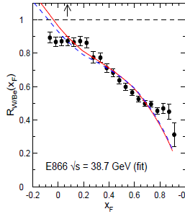
p+A program investigate Cold Nuclear Matter
A thorough p+A program requires
E_{beam} (√s) | Exp. | y_{CMS} | x₂ | x_{F}
158 GeV (17 GeV) | NA50 | [0;1] | [0.07;0.18] | [0;0.42]
 | CHIC | [-0.5;2] | [0.02;0.30] | [-0.19;1]
450 GeV (29 GeV) | NA50 | [-0.4;0.6] | [0.06;0.16] | [-0.09;0.14]
 | CHIC | [-0.9;1.6] | [0.02;0.26] | [-0.22;0.51]
J/Ψ, Ψ’, χ_{c} with several targets (NA50: p+Be, p+Al, p+Cu, p+Ag, p+W, p+Pb)
J/Ψ, Ψ’, χ_{c} in a large y_{CMS} range
Large statistics (in principle, can run with proton beam several months per year)
NA50
(29.1 GeV)
E866
CHIC (29 GeV)
F. Arleo and S. Peigné, arXiv:1204.4609
NA50
(17.2 GeV)
NA50
CHIC
CHIC (17.2 GeV)
x₂

Slide 12
Conclusion
Measuring together J/Ψ, Ψ’ and χ_{c} in p+A collisions with several targets will give a thorough control of Cold Nuclear Matter effects
Measuring together J/Ψ, Ψ’ and χ_{c} in A+A collisions at SPS energies will (dis)prove sequential suppression scenario.
The apparatus is well suited to explore other important physics subjects such as open charm or low mass lepton pairs production in heavy ion collisions.
Understanding sequential suppression at SPS is crucial to fully understand RHIC and LHC results.

Slide 13
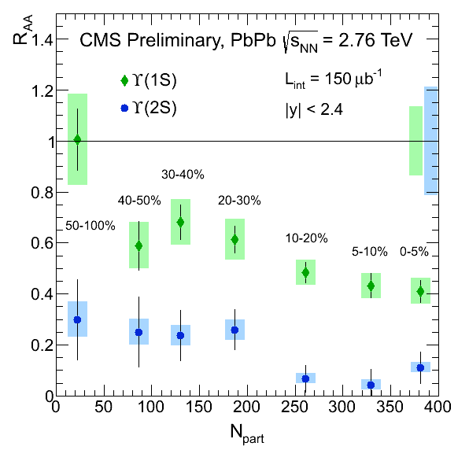
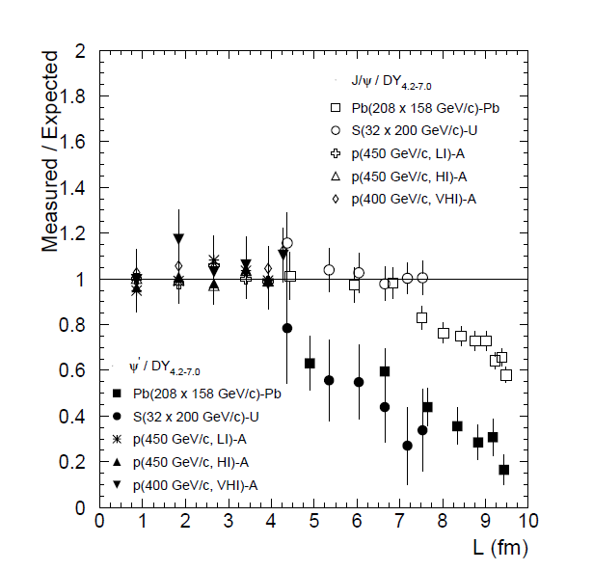
CMS@LHC New upsilon results
Results from CMS
Observation of Sequential Υ Suppression in PbPb collisions
(at LHC)
PRL109, 222301 (2012)
Charmonia @ SPS bottomonia @ LHC

Slide 14
J/Ψ@SPS .vs. Υ@LHC color screening ?
NA50, PbPb √s_{NN}=17.2 GeV
Ψ(1S)
Ψ(2S)
Charmonia @ SPS bottomonia @ LHC

Slide 15
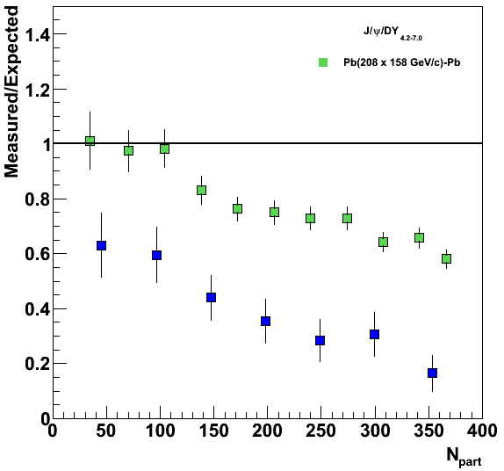
J/Ψ@SPS .vs. Υ@LHC color screening ?
NA50, PbPb √s_{NN}=17.2 GeV
Ψ(1S)
Ψ(2S)
0<y<1
Charmonia @ SPS bottomonia @ LHC
On the same axis

Slide 16
J/Ψ@SPS .vs. Υ@LHC color screening ?
NA50, PbPb √s_{NN}=17.2 GeV
Ψ(1S)
Ψ(2S)
χ_{c}?
χ_{b}?
Charmonia @ SPS bottomonia @ LHC
Let’s measure χ_{c} at SPS !

Slide 17
CERN strategy
Conclusions of the CERN Town meeting on “Relativistic Heavy-Ion Collisions”
CERN - june 29, 2012
“…The town meeting also observed that the CERN SPS would be well-positioned to contribute decisively and at a competitive time scale to central open physics issues at large baryon density. In particular, the CERN SPS will remain also in the future the only machine capable of delivering, heavy ion beams with energies exceeding 30 GeV/nucleon, and the potential of investigating rare penetrating probes at this machine is attractive.”

Slide 18
Expression of interest
Submitted to SPSC (october 2012) – under review
CERN-SPSC-2012-031

