Slide 1
Chic @ SPS (Charm in Heavy Ion Collisions)
Detector design
A 3rd generation experiment to study charm with proton and ion beams on fixed target at SPS

Slide 2
Physics motivations – 2 key questions
Measure χ_{c} in A+A
Similar J/Ψ suppression at SPS and RHIC:
Either more suppression at RHIC compensated by recombination
Or J/Ψ suppression due to χ_{c} only → sequential suppression
How χ_{c} is suppressed relative to J/Ψ ?
Mandatory to draw the whole picture (SPS .vs. RHIC .vs. LHC)
Measure charmonia production in p+A
what is the depence of charmonia suppression with rapidity ?
Crucial to understand effects due to cold nuclear matter
We need to correctly calibrate our QGP thermometer.

Slide 3
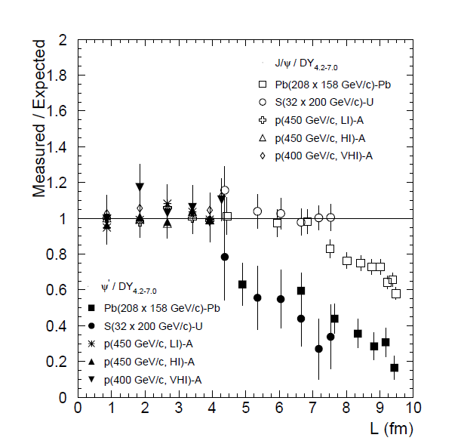
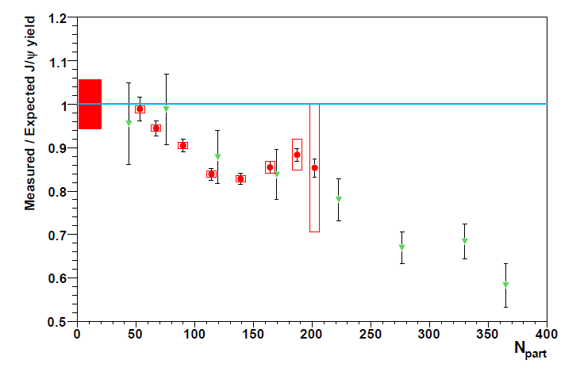
1. Measure χ_{c} in A+A
Eur. Phys. J. C49 (2007) 559
Phys. Rev. Lett. 99, 132302 (2007)
NA50
NA60
Ψ’
χ_{c}
J/Ψ
χ_{c}
Suppression
?
Direct J/Ψ
Suppression
?
Benchmark: measure χ_{c} in PbPb
at mid-rapidity
N_{J/Ψ} ~ 60% direct + ~30% from χ_{c} + ~10% from Ψ’

Slide 4
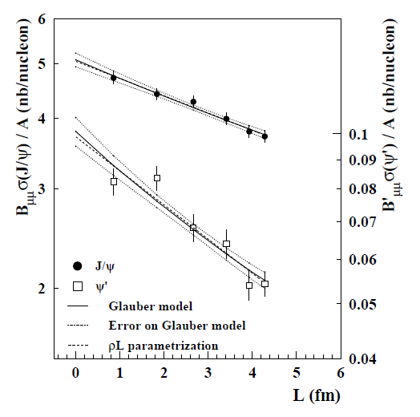
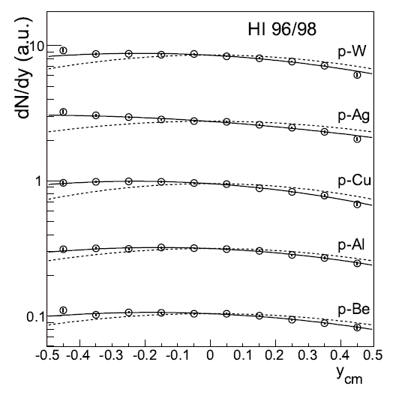
2. Measure charmonia in p+A
J/Ψ and Ψ’ suppression in p+A collisions as a function of L
➔ Measuring different charmonium states gives key information on nuclear « absorption » and production mechanism.
NA50
J/Ψ
Ψ’
Euro. Phys. J. C48 (2006) 329.
J/Ψ rapidity distribution in p+A collisions
➔ Measuring charmonium in a wide rapidity range is mandatory to identify possible (anti)shadowing effects

Slide 5
Experimental landscape
Current landscape
Fixed target : SPS/CERN NA38/50/60 experiments – √s_{NN} = 17 – 30 GeV
Statistic :100 000’s J/ψ
Data sets : p+A w/ A=p, d, Be, Al, Cu, Ag, W, Pb; S+U, In+In, Pb+Pb
Small rapidity coverage (typically y ∈ [0,1])
Collider : RHIC/BNL Phenix, Star experiments – √s_{NN} = 200 GeV
Statistic : 1000’s J/ψ (10000’s since 2007)
Data sets : p+p, d+Au, Cu+Cu, Au+Au
Large rapidity coverage (y ∈ [-0.5,0.5], y ∈ [-2.2,-1.2] and y ∈ [1.2,2.2])
Collider : LHC/CERN Alice, CMS, Atlas experiments (√s_{NN} = 5,5 TeV)
Statistic : 100000’s J/ψ
Data sets : p+p, Pb+Pb, p+Pb
Large rapidity coverage (|y|<2.5 ATLAS/CMS, |y|<0.9 and -4.0 < y < -2.5 ALICE)
Feedback
High statistic→draw clear suppression pattern in Hot Nuclear Matter and Cold Nuclear Matter
Large data set → draw clear suppression pattern in Cold Nuclear Matter
Large rapidity coverage → understand suppression mechanism in Cold Nuclear Matter
The most quarkonium states → understand suppression mechanism in Hot Nuclear Matter and Cold Nuclear Matter

Slide 6
Experimental challenges
goals
High statistic
Need to use high intensity Pb beam (~ 10⁷ Pb/sec)
Need to use high intensity p beam (~ 109 p/sec)
Large data set
Large rapidity coverage in p+A : Plan to measure cc, J/Y, Y’, open charm within y* [-0.5, 2]
The most quarkonium states
Plan to measure cc, J/Y, Y’ and open charm in Pb+Pb
Rapidity window : y [-0.5, 0.5]
Statistic expected :
In Pb+Pb (per year)
In p+A (per year)

Slide 7
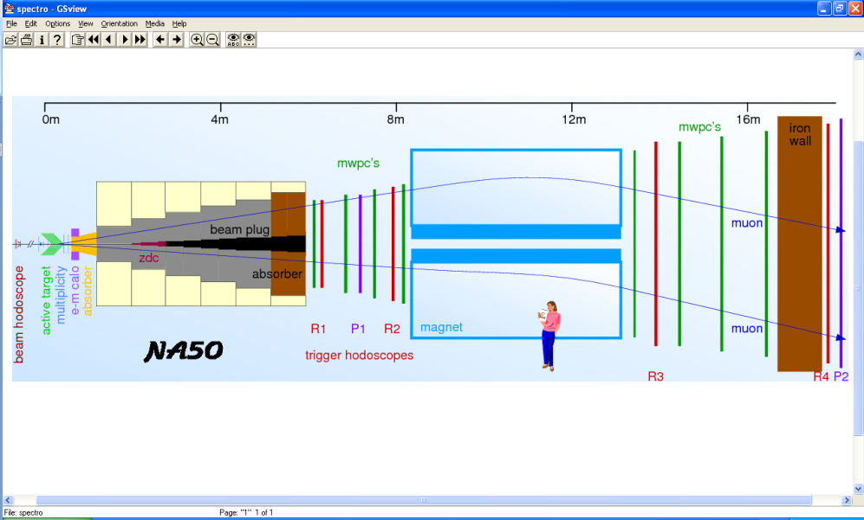
Fixed target experiments
NA38, NA50, NA51: 1st generation
Active Target → absorber → spectrometer → muID
Active target, but no vertex for open charm and not very good mass resolution

Slide 8
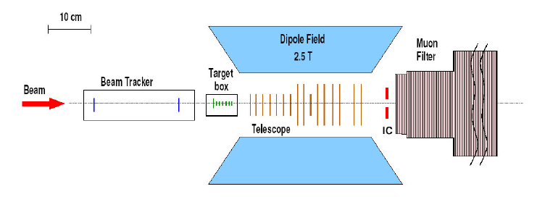
Fixed target experiments
NA60: 2nd generation
+ NA50
See NA50
Active Target → telescope → absorber → spectrometer → muID
Active target, vertex for open charm and not very good mass resolution

Slide 9
Fixed target experiments
CHIC: 3rd generation
Active target → vertex → spectrometer → calorimeter → absorber → muID
MuID
Muon Filter
(absorber)
target
tracking
tracking
EMCal
Beam
vertex
Dipole field
Active target, vertex for open charm, calorimeter for χ_{c} and very good mass resolution

Slide 10
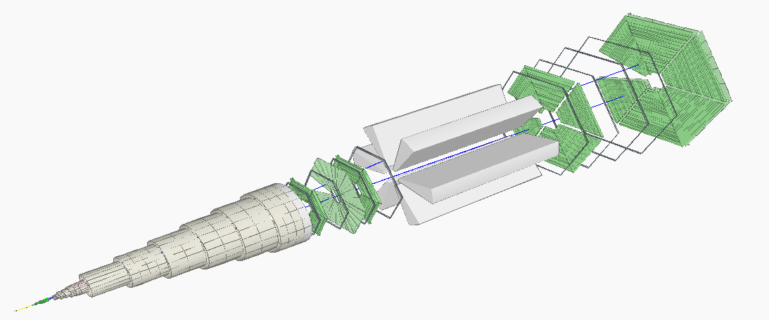
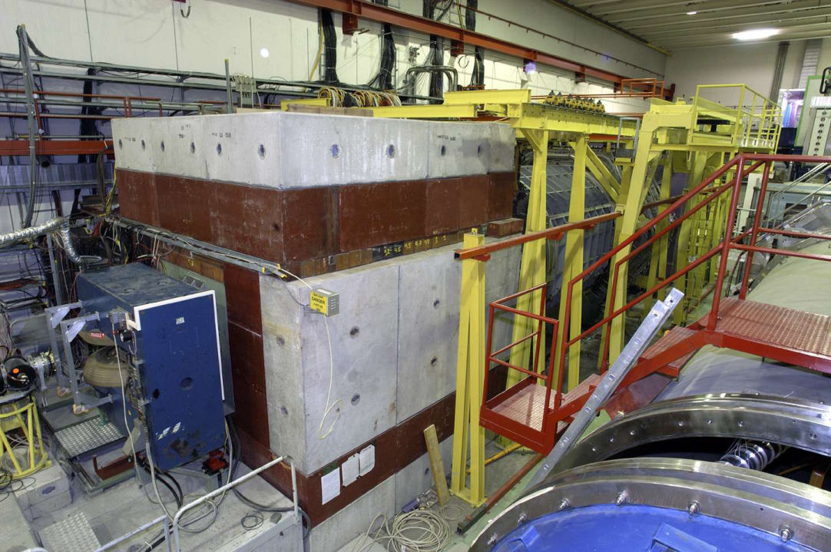
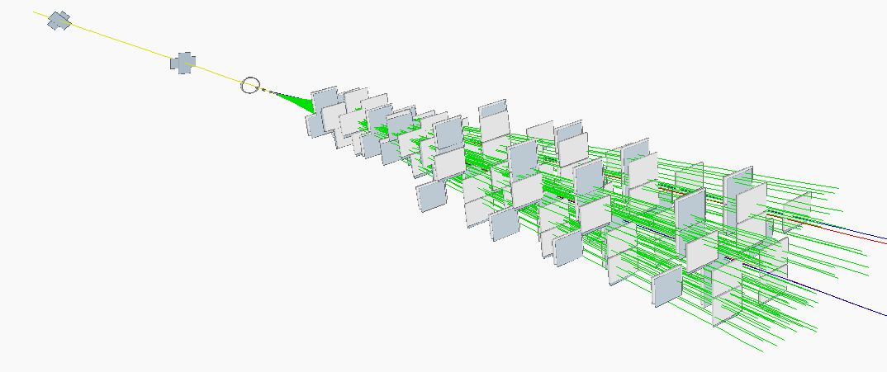
Detector – tracking
The NA60 example
Pixel detector
16 planes – 96 chips total
32 x 256 pixels / chip
Pixel size = 425 × 50 μm²
Magnetic field = 2.5 T × 40 cm
Momentum resolution @J/Ψ mass
(typical p_{μ} ~ 15 GeV/c)
(R. S. priv. Comm.)

Slide 11
Detector – tracking
~40 cm
NA60 pixel momentum resolution (R.S. priv. Comm.)
Major parameters for improvement :
Magnetic field and measurement error (linearly)
Length into magnetic field (quadratically)
B (T) | L (cm) | ε (imp.) | ΔP/P (%) | ΔM (MeV)
2.5 | 40 | ×1 | ~ 6 | ~130
2.5 | 60 | ×1 | ~ 2.7 | ~60
2.5 | 80 | ×1 | ~ 1.5 | ~30
2.5 | 100 | ×1 | ~1 | ~20
ρ = curvature
B = magnetic field
ε = measurement error
N = number of points measured
L = projected length of the track
onto the bending plane
NA60 →
L_{B}=40 cm → L_{B}=100 cm
➔ ΔP/P ~1%
➔ ΔM_{J/Ψ} ~ 20 MeV
Magnetic
field
(Particle Data Group, NIMA 410, 284-292 (1998))
Magnet
length

Slide 12
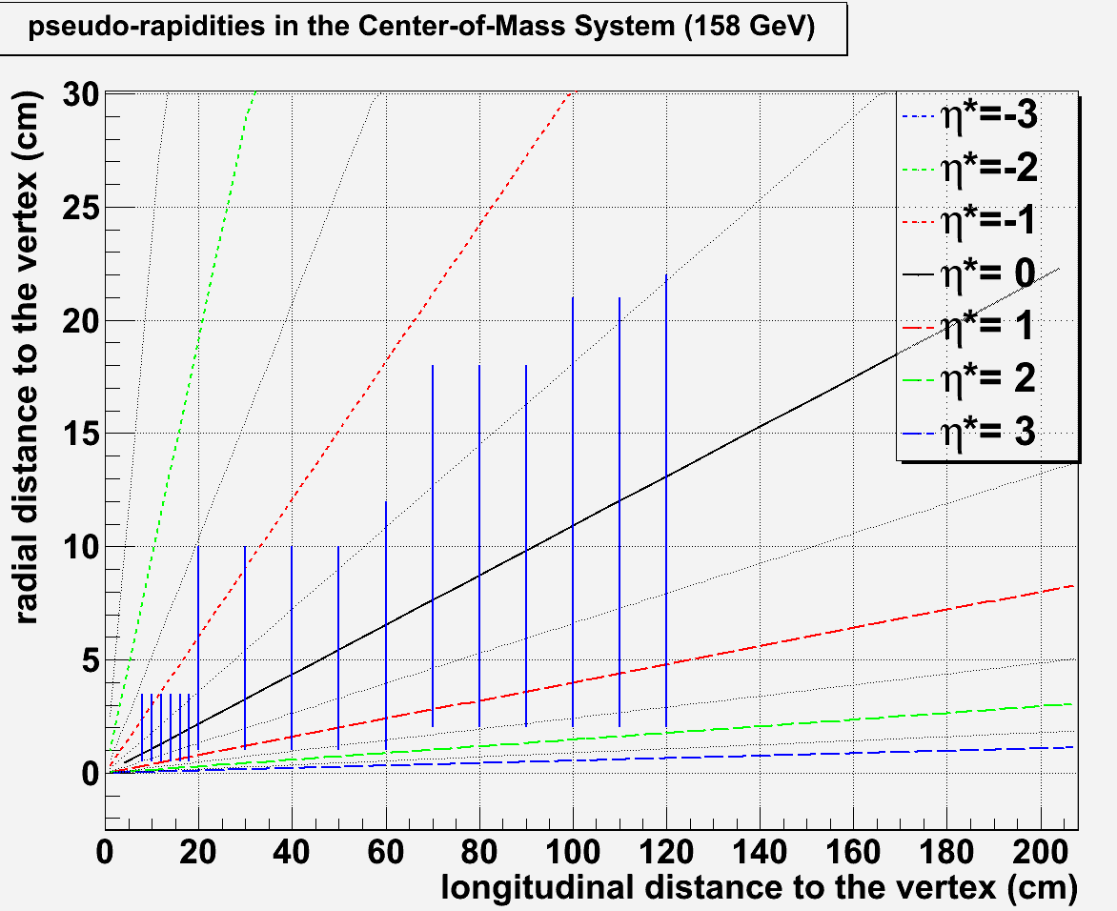
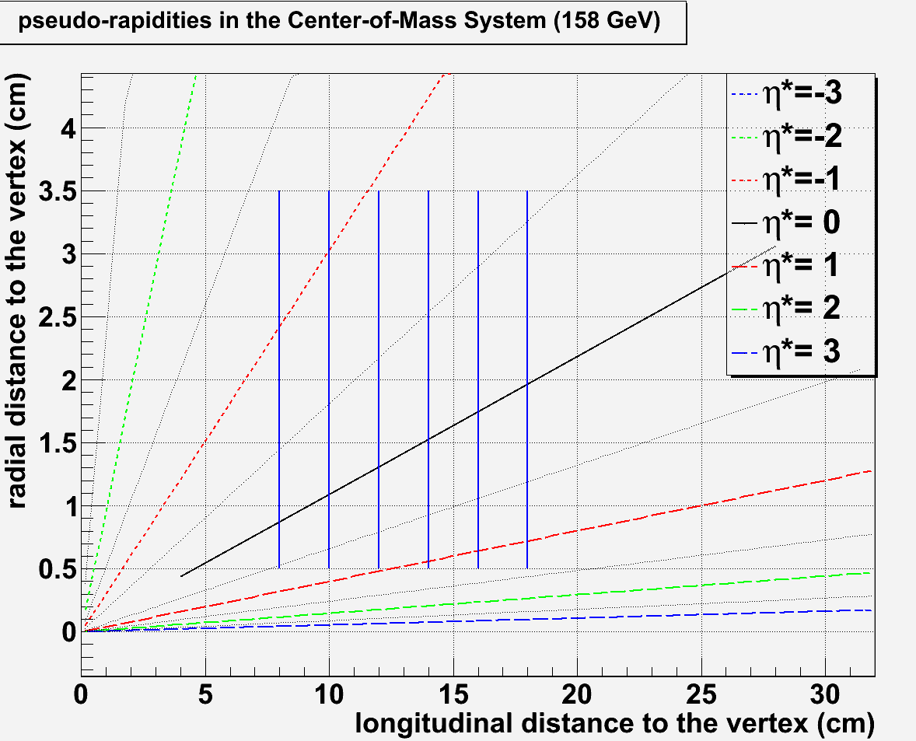
Detector – tracking
Size, position, resolution : tentative design – toy example
B (T) | L (cm) | ΔP/P (%) | ΔM (MeV)
2.5 | 40 | ~ 6 | ~120
2.5 | 60 | ~ 2.7 | ~60
2.5 | 80 | ~ 1.5 | ~30
2.5 | 100 | ~1 | ~20
11 plane spectrometer
@ z_{max} = 120 cm ➔ r_{max}(η*=-0.5)~22 cm
11 planes from z=20 cm to z = 120 cm
← NA60
η∗=-0.5
← CHIC
22
6 plane vertex
@ r_{min} = 0.5 cm ➔ z_{min}(η*=0.5)~7.5 cm
6 planes from z=8 cm to z=18 cm
η∗=0.5
η∗=-0.5
η∗=1
η∗=0.5
Track particles within η*∈[-0.5 ; 1]
7.5

Slide 13
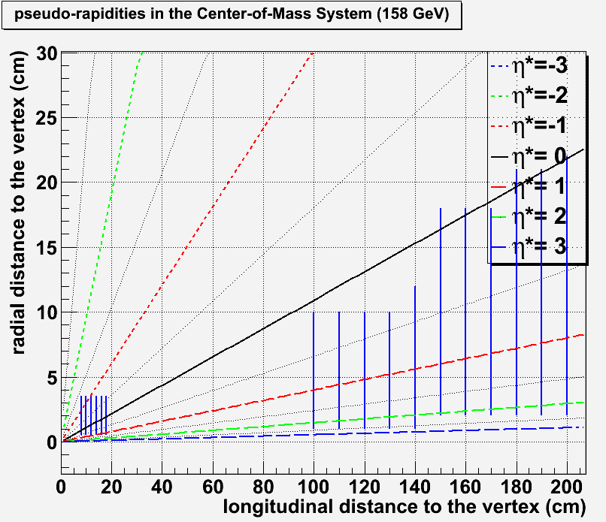
Detector – tracking
Size, position, resolution : tentative design – toy example
B (T) | L (cm) | ΔP/P (%) | ΔM (MeV)
2.5 | 40 | ~ 6 | ~120
2.5 | 60 | ~ 2.7 | ~60
2.5 | 80 | ~ 1.5 | ~30
2.5 | 100 | ~1 | ~20
11 plane spectrometer
@ z_{max} = 120 cm ➔ r_{max}(η*=-0.5)~22 cm
11 planes from z=100 cm to z = 200 cm
← NA60
← CHIC
22
6 plane vertex
@ r_{min} = 0.5 cm ➔ z_{min}(η*=0.5)~7.5 cm
6 planes from z=8 cm to z=18 cm
η∗=-0.5
η∗=0.5
η∗=2
η∗=0.5
Track particles within η*∈[0.5 ; 2]
7.5

Slide 14
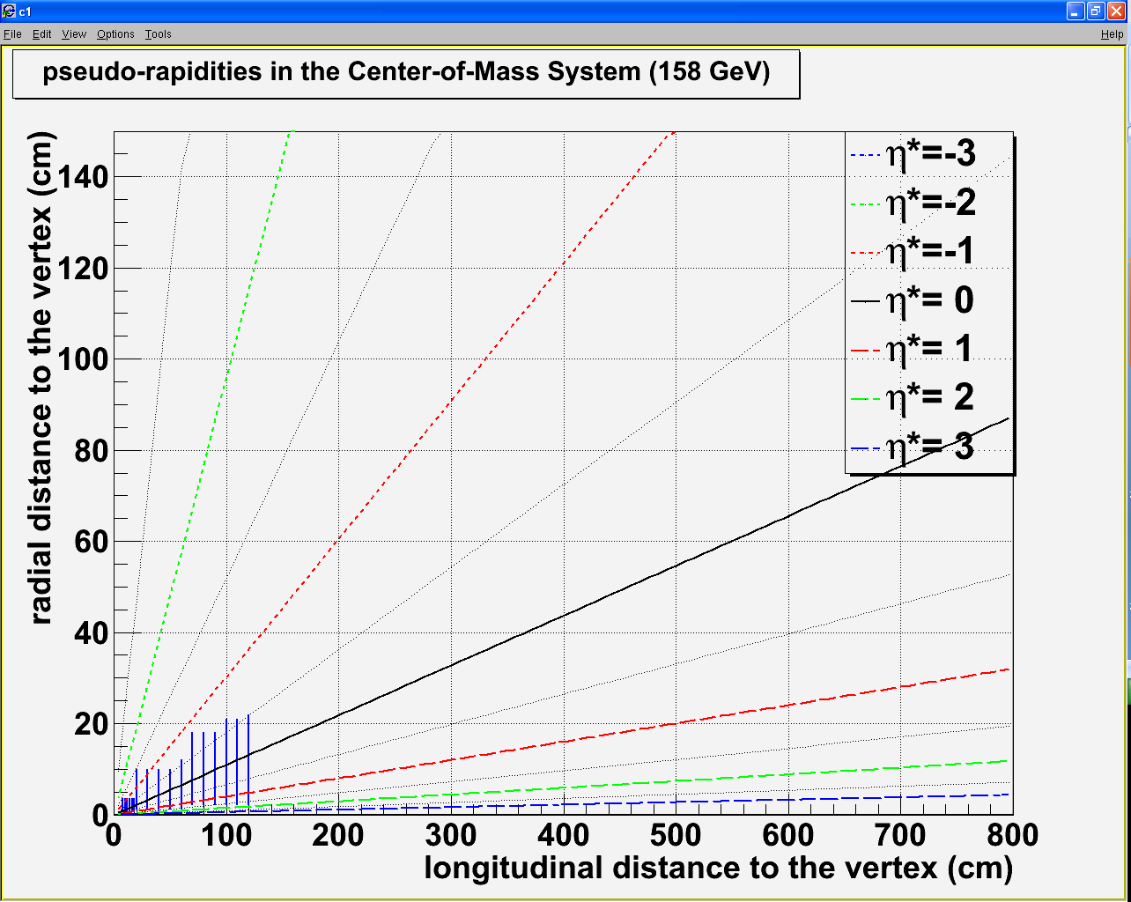
Detector – tentative design
Vertex detector :
Rmin = 0.5 cm Zmin = 7.5 cm
Rmax = 3.5 cm Zmax = 18 cm
120 cm
100 cm
1 m
2 m
3 m
4 m
5 m
6 m
Spectrometer :
Rmin = 1 cm Zmin = 20 (100) cm
Rmax = 22 cm Zmax = 120 (200) cm
80 cm
60 cm
40 cm
20 cm

Slide 15
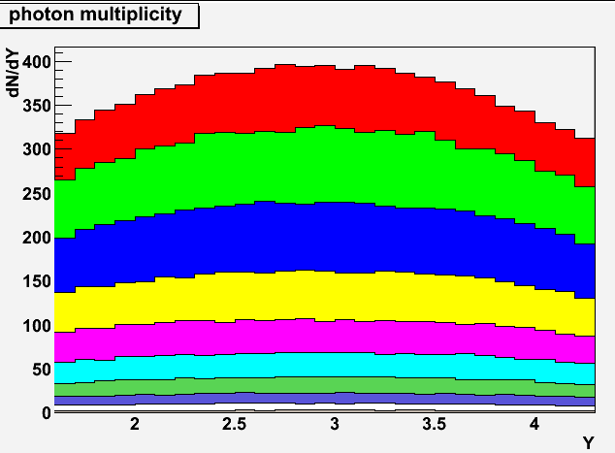
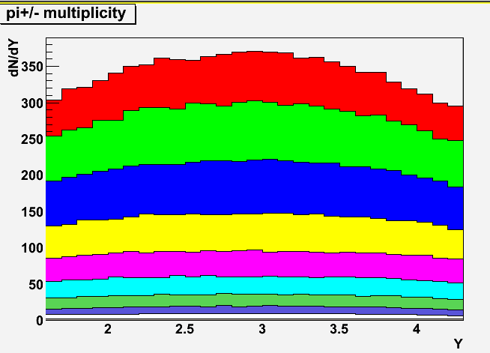
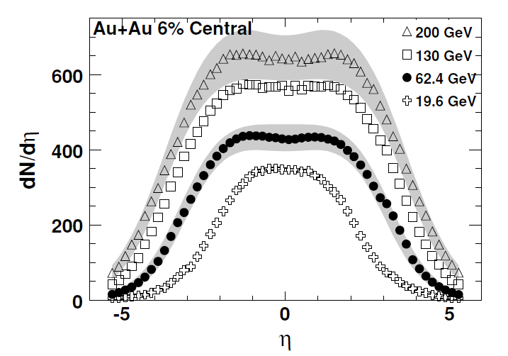
Detector – calorimetry
Goal : measure the photon from χ_{c} → J/Ψ + γ
Issues
Low energy photon (similar to π⁰ → γγ)
High multiplicity of photon from π⁰ /η→ γγ
High multiplicity of charged particles (π^{+/-})
Pythia 6.421 - p+p - √s = 17.2 GeV
<p_{T}>~500 MeV
WA98: Phys. Lett. B458: 422-430, 1999)
Pythia 6.421 - p+p - √s = 17.2 GeV
~500 γ
~340 γ
<E>~3 GeV
~400 γ
~370 π^{+/-}
0 – 5%
0 – 5%
Phobos: Phys. Rev. C74, 021901, 2006
Epos 1.6 : Pb+Pb @ 17.2 GeV
~350 π^{+/-}
0 – 5% Pb+Pb most central ➔ ~500 γ + 400 π^{+/-}
(we don’t need to go that central for χ_{c})

Slide 16
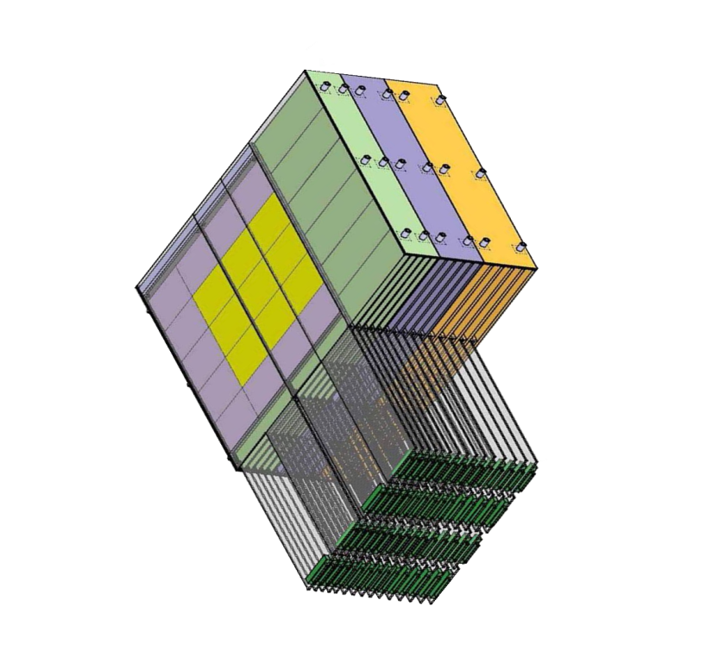
Detector – calorimetry
Need very high segmentation
to separate two electromagnetic showers
To isolate photons from π^{+/-} contamination
W + Si calorimeter à la Calice
30 layers
0.5 x 0.5 cm² pads
24 X₀ in 20 cm
W+Si : two relevant quantities
1st relevant quantity : distance
between two incoming particles
Min. distance between 2 particles at impact
= 1 free pad = 1 cm (for 0.5×0.5 cm²)
distance between two incoming particles
must be > 1 cm
N photons ➔ N/2 neutrals (π⁰ + η)➔ N π^{+/-}
➔ N γ + N π^{+/-} = 2N particles
distance between two photons
must be > 2 cm (1cm×2N/N)
2nd relevant quantity : EM shower transverse size
Moliere Radius R_{M} : 90% of the shower energy
Distance between two photons
must be > 2 cm (2 R_{M})
bad
good
Geometrical condition: in principle
Δγ > 2cm

Slide 17
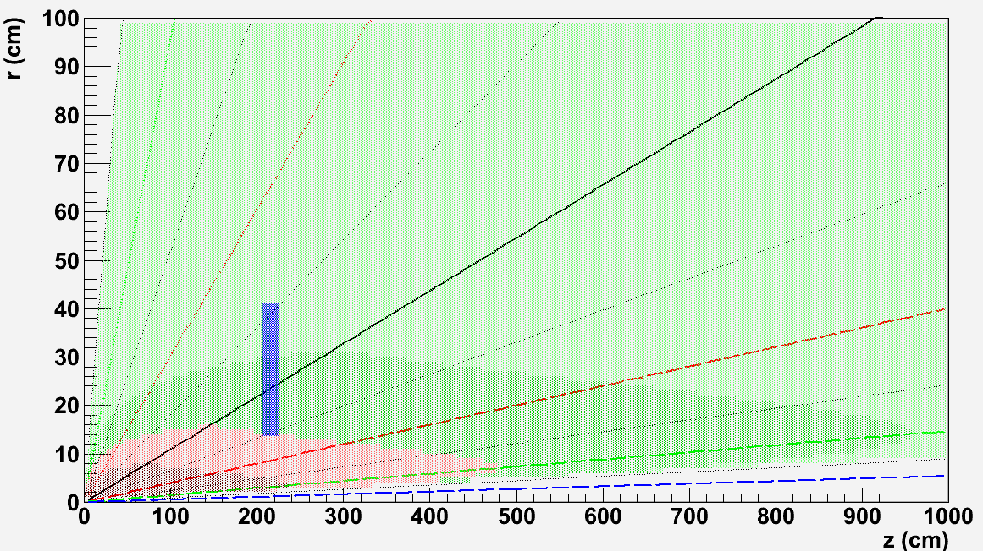
Detector – calorimetry
Size and position : tentative design
0 – 5% most central Pb+Pb events as measured by WA98
Distance between
two photons
[-0.5:0.5]
r_{min}
Δγ>4
Z
Δγ>2
Δγ<1
Δγ<2
r_{max}
Closer position to the target w/ Δγ>2cm:
Z = 205 cm [-0.5:0.5]
R_{min} = 13.6 cm
R_{max} = 40.9 cm
Using 0.5 x 0.5 cm² pads
20 cm

Slide 18
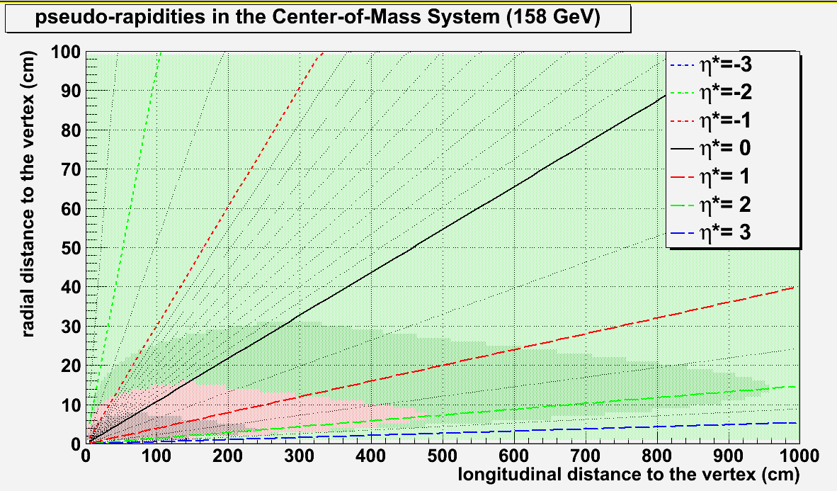
Detector – calorimetry
Size and position : alternative design
r_{min}
Δγ>4
Z
Δγ>2
Δγ<2
r_{max}
Warning : not clear that Δγ>2 cm is large enough; for instance, R_{M} (W+Si) > R_{M}(W). Try alternative design:
taking Δγ>4cm with z = 205 cm, R_{min}=30 cm, R_{max}= 55cm
η* ∈[-0.8, -0.3] ➔ loose some χ_{c} acceptance, but safe !!!
Must check with full simulation what is optimum Δγ !
20 cm

Slide 19
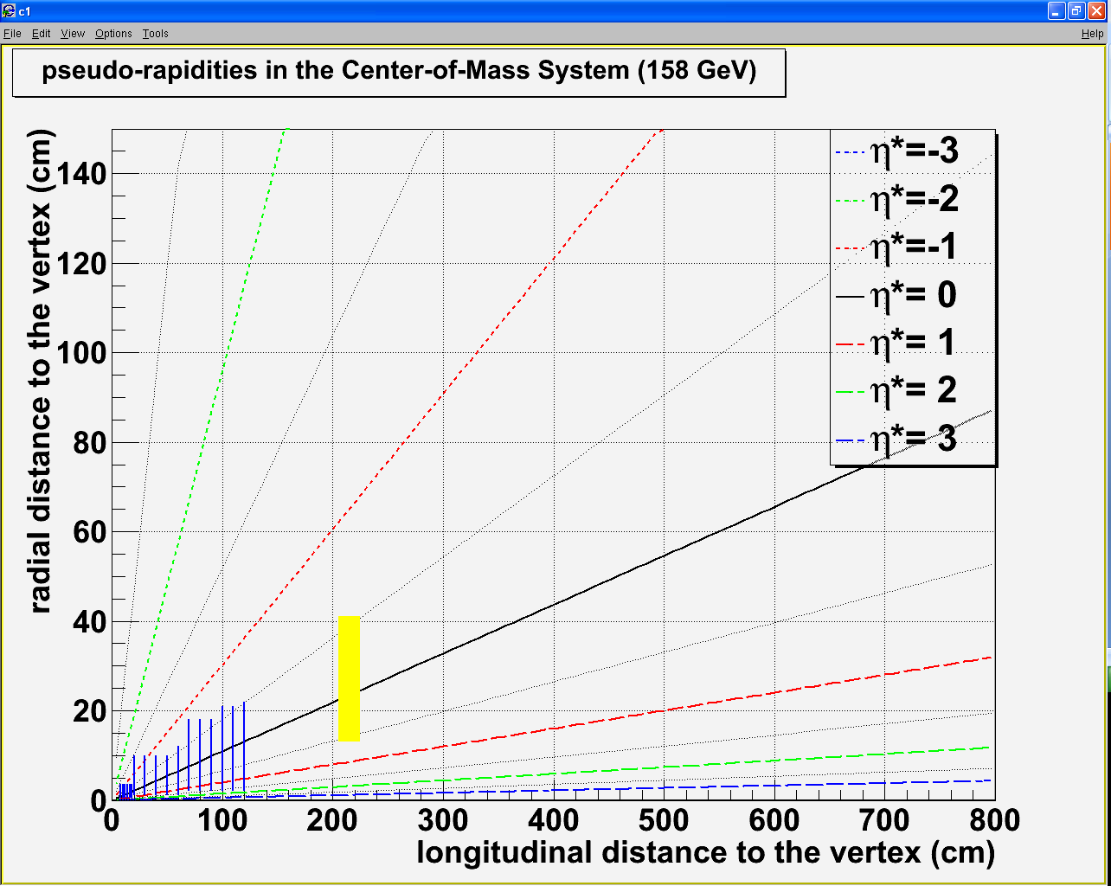
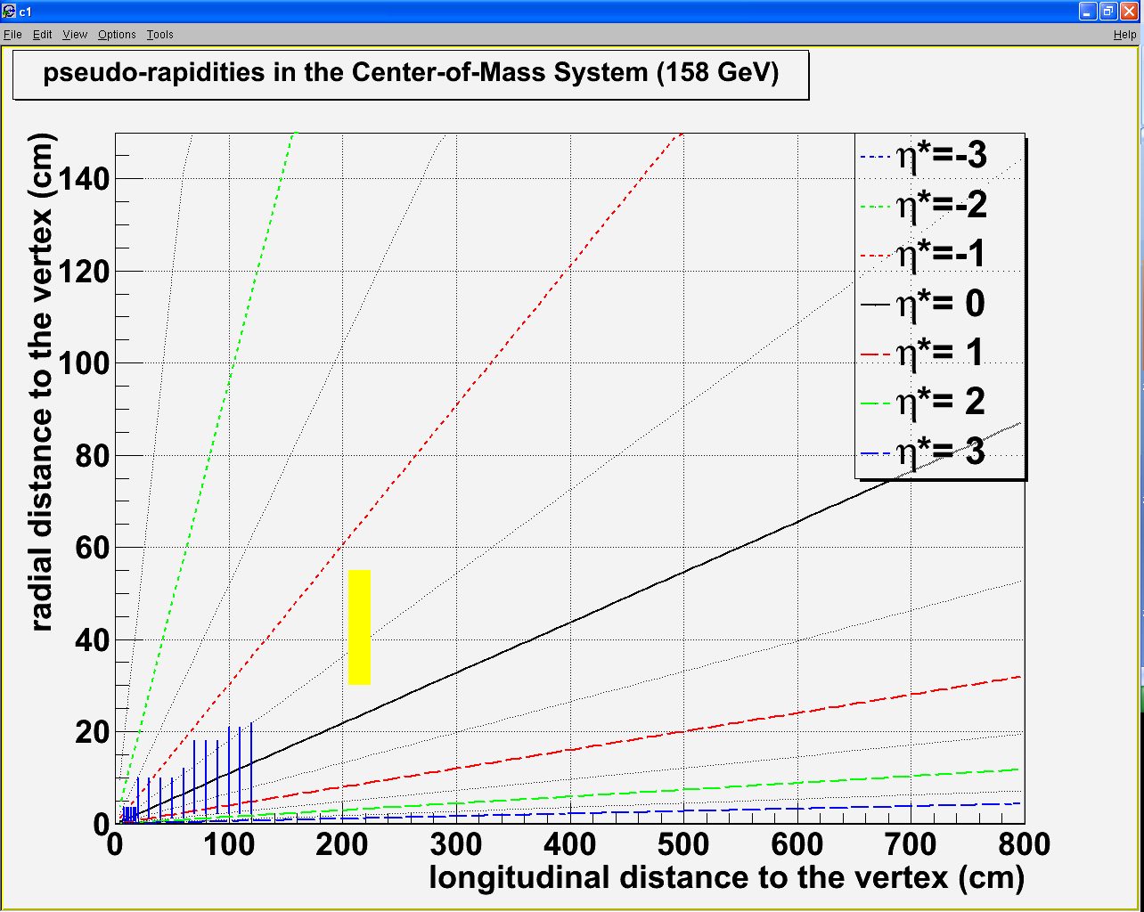
Detector – tentative design
Vertex detector :
Rmin = 0.5 cm Zmin = 7.5 cm
Rmax = 3.5 cm Zmax = 18 cm
120 cm
100 cm
Spectrometer :
Rmin = 1 cm Zmin = 20 (100) cm
Rmax = 22 cm Zmax = 120 (200) cm
80 cm
60 cm
40 cm
20 cm
Calorimeter Δγ>2 cm: acceptance 1
Rmin = 14 cm Zmin = 205 cm
Rmax = 41 cm Zmax = 225 cm
Calorimeter Δγ>4 cm: acceptance 2
Rmin = 30 cm Zmin = 205 cm
Rmax = 55 cm Zmax = 225 cm
η_{γ}* ∈[-0.5, 0.5]
η_{γ}* ∈[-0.8, -0.3]
1 m
2 m
3 m
4 m
5 m
6 m

Slide 20
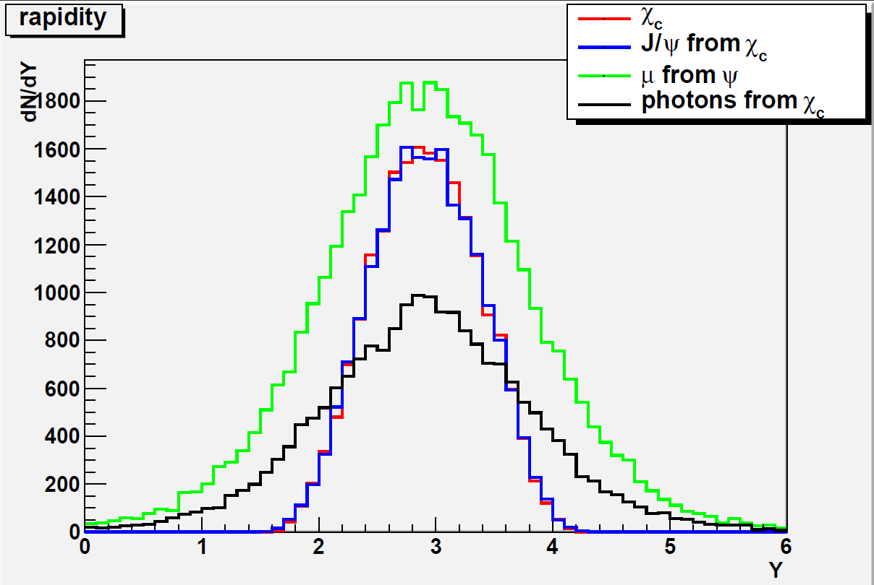
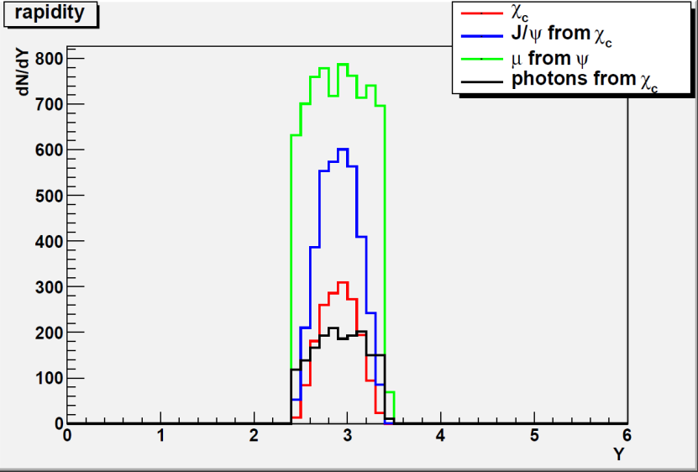
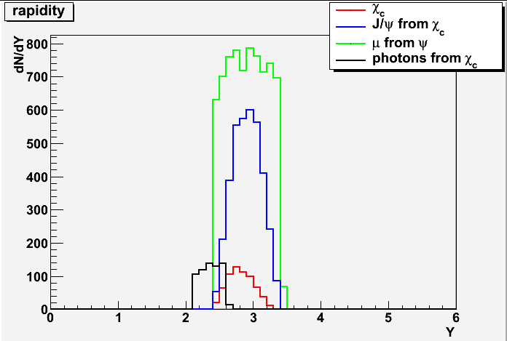
Performances in p+p
Pythia 6.421 – p+p – √s = 17.2 GeV
20 000 generated events
Include ΔP/P=1%
Include ΔE/E=20%/√E
PYTHIA 6.421
20000 events
Y*=0 ⇔ Y_{CMS}~2.92
Acceptance 1
2 μ from J/Ψ
in -0.5<y*<0.5
1 γ from χ_{c}
in -0.5<y*<0.5
Acceptance 2
2 μ from J/Ψ
in -0.5<y*<0.5
1 γ from χ_{c}
in -0.8<y*<-0.3
A_{J/Ψ}~18.4%
A_{J/Ψ}~18.4%
A_{χ}~8.5%
A_{χ}~3.2%

Slide 21
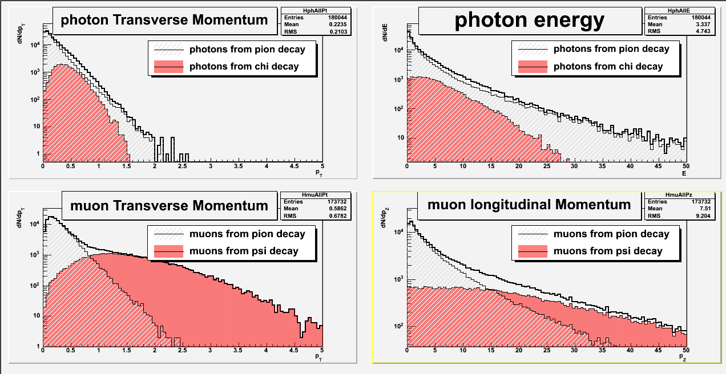
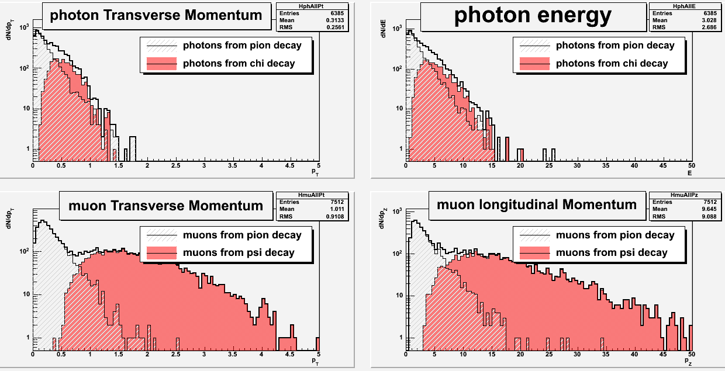
Performances in p+p – acceptance 1
Pythia 6.421 – p+p – √s = 17.2 GeV
20 000 generated events
Include ΔP/P=1%
Include ΔE/E=20%/√E
2 μ from J/Ψ within -0.5<y*<0.5
1 γ from χ_{c} within -0.5<y*<0.5
Signal/background:
J/Ψ (M_{μμ}∈[3.0,3.2]) : S/B~no Bkg
χ_{c} (M_{μμγ}∈[3.45,3.65]) : S/B~2.1
J/Ψ
χ_{c}
Invariant mass – acceptance 1

Slide 22
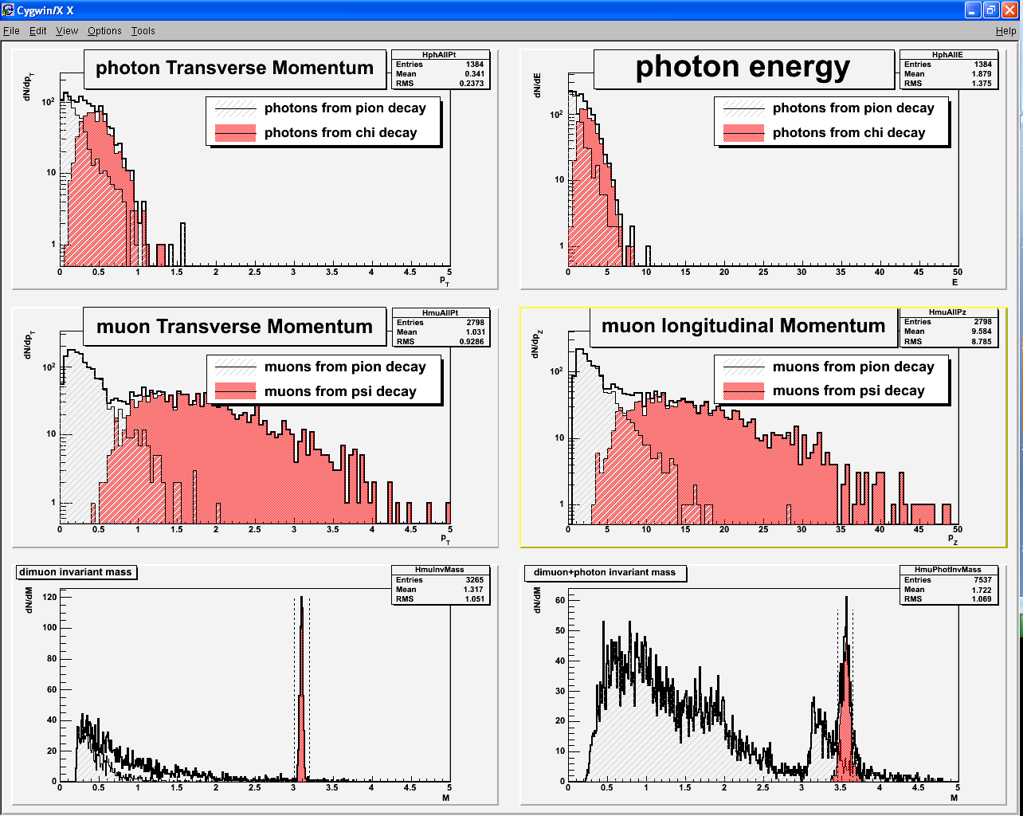
Performances in p+p – acceptance 2
Pythia 6.421 – p+p – √s = 17.2 GeV
20 000 generated events
Include ΔP/P=1%
Include ΔE/E=20%/√E
2 μ from J/Ψ within -0.5<y*<0.5
1 γ from χ_{c} within -0.8<y*<-0.3
Signal/background:
J/Ψ (M_{μμ}∈[3.0,3.2]) : S/B~no bkg
χ_{c} (M_{μμγ}∈[3.45,3.65]) : S/B~4.3
J/Ψ
χ_{c}
Invariant mass – acceptance 2

Slide 23
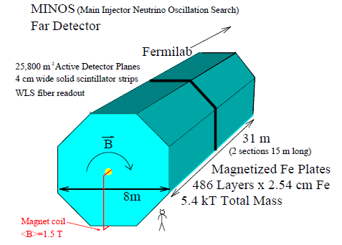
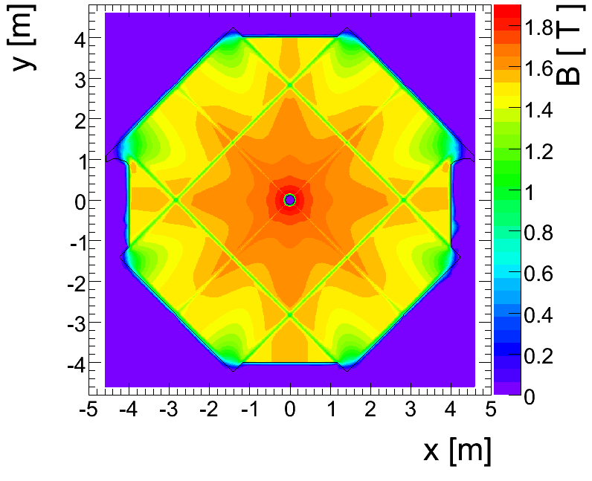
Detector – absorber
Absorber type
NA50/NA60 : measure muon momentum after the absorber
➔ must minimize multiple scattering
Must use low Z material: best = BeO (but expensive)
NA50 : 0.6 m BeO + 4 m C + 0.6 m Fe = 5.2 m
CHIC : measure muon momentum before the absorber
➔ minimization of multiple scattering less crucial
➔ can use Fe material To absorb π^{+/-}
Need to match muon track position between spectrometer and trigger : Use an instrumented Fe absorber
DHCal
μ
π+
http://newsline.linearcollider.org/archive/2010/20101104.html
Can match muon track momentum between spectrometer and trigger : Use magnetized Fe absorber ?
Minos

Slide 24
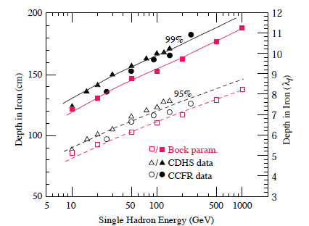
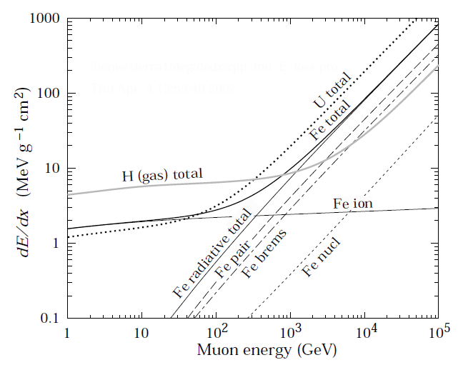
Detector – absorber
At least 2 m Fe length needed
Absorber size and energy loss
Fraction of
hadron energy
absorbed in Fe
0.3
π^{+/-} momentum up to ~50 GeV/c
50 GeV/c
All π^{+/-} stopped with a 2.0 m Fe absorber
but need more Fe to stop muons from pion decay
➔ 2.0 m Fe ➔ ΔE/Δx ~ 15.6 x 200 ~ 3.1 GeV ➔ A_{J/Ψ} ~ 18.4 %
3.2 m Fe ➔ ΔE/Δx ~ 15.6 x 320 ~ 5 GeV ➔ A_{J/Ψ} ~ 18.0 %
3.8 m Fe ➔ ΔE/Δx ~ 15.6 x 380 ~ 6 GeV ➔ A_{J/Ψ} ~ 17.3 %
4.5 m Fe ➔ ΔE/Δx ~ 15.6 x 450 ~ 7 GeV ➔ A_{J/Ψ} ~ 16.1 %
dE/dx ~ 2 MeV g⁻¹ cm²
Fe density ~ 7.8 g cm⁻³
dE/dx ~ 15.6 MeV cm⁻¹
Absorber starts @ 205 cm
π^{+/-} stop decaying after 1 λ_{I} in tungsten (λ_{I}~10cm)
➔ π^{+/-} stop decaying @ 2.15 m
Muon
energy loss
in Fe
3
7
5

Slide 25
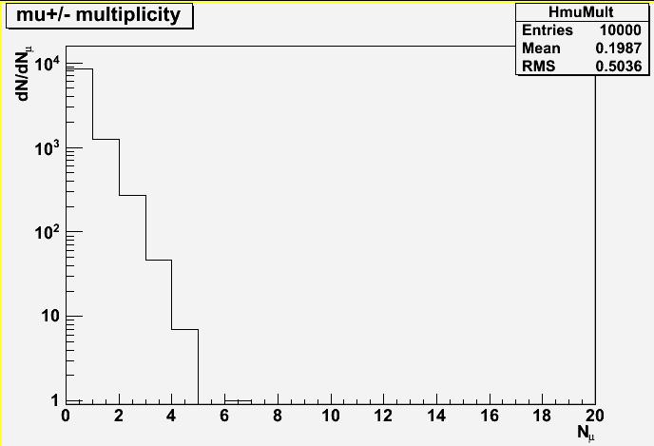
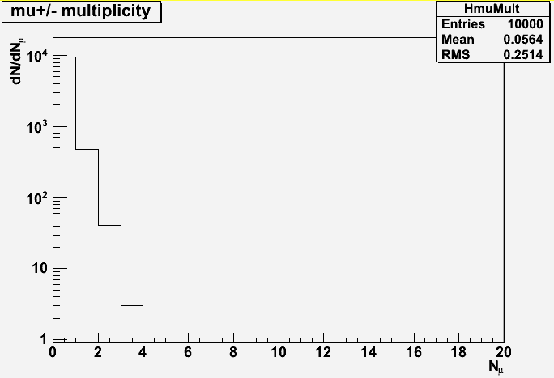
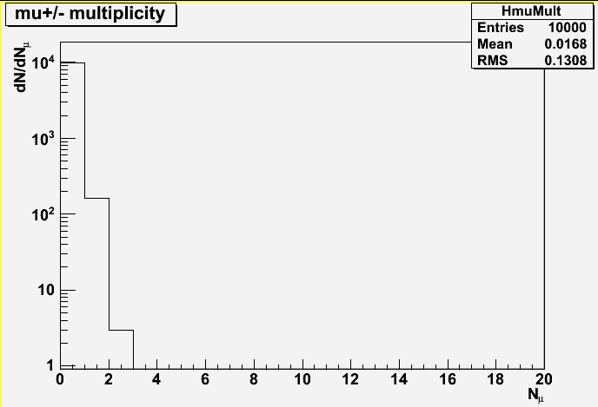
Detector – trigger rate in Pb+Pb
Pb Beam intensity
NA50 → 5.10⁷ ions/bunch ➔ 10⁷ ions/sec (with a bunch time length ~ 5 sec)
Luminosity : L = N_{b} x N_{T} = N_{b} x (ρ x e x N_{A})/A = 10⁷x(11.35 x 1 x 6.02 10²³)/207.19 = 0.3 μb⁻¹s⁻¹
Number of min bias events (for Pb+Pb)
σ_{I}=68.8 x (A^{1/3}_{proj} + B^{1/3}_{targ} – 1.32)² ➔ σ^{PbPb}_{minbias}=68.8 x (208^{1/3} + 207.19^{1/3} – 1.32)²=7.62 barn
Nevents/sec ~ 0.3 10⁶ x 7.62 ~ 2.3 MHz
Event rejection :
10 000 Pb+Pb minbias events
generated with EPOS 1.6
At least 2 μ in the
Detector (329 events)
At least 2 μ in the
Detector (44 events)
At least 2 μ in the
Detector (12 events)
At least 2 μ in the
Detector (3 events)
3.2m Fe abs.: P_{z}>5 GeV/c: Trigger accepts 44/10000 events➔ N_{events}/sec ~ 2.3 MHz x 4.4 10⁻³ ~ 10 kHz
3.8m Fe abs.: P_{z}>6 GeV/c: Trigger accepts 12/10000 events ➔ N_{events}/sec ~ 2.3 MHz x 1.2 10⁻³ ~ 2.8 kHz
4.5m Fe abs.: P_{z}>7 GeV/c: Trigger accepts 3/10000 events ➔ N_{events}/sec ~ 2.3 MHz x 3 10⁻⁴ ~ 700 Hz

Slide 26
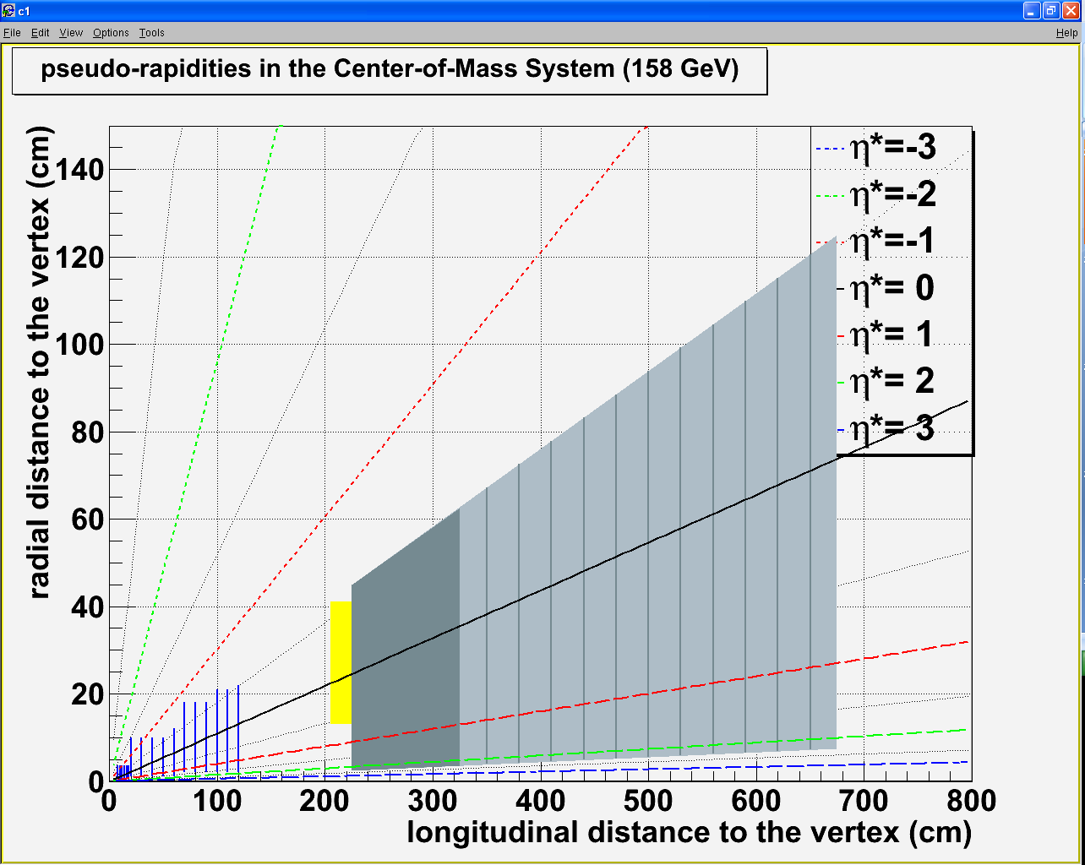
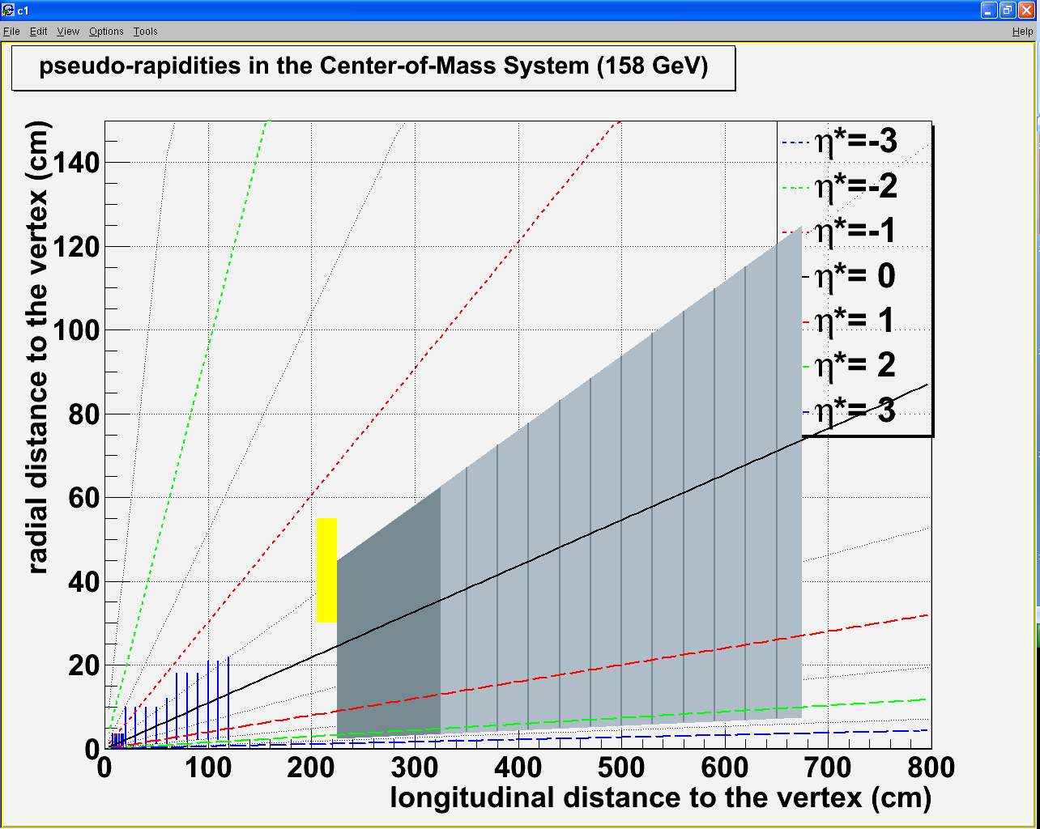
Detector – tentative design
Vertex detector :
Rmin = 0.5 cm Zmin = 7.5 cm
Rmax = 3.5 cm Zmax = 18 cm
120 cm
Spectrometer :
Rmin = 1 cm Zmin = 20 (100) cm
Rmax = 22 cm Zmax = 120 (200) cm
100 cm
80 cm
60 cm
40 cm
7.5 cm
20 cm
2.5 cm
Calorimeter Δγ>2 cm: acceptance 1
Rmin = 14 cm Zmin = 205 cm
Rmax = 41 cm Zmax = 225 cm
Calorimeter Δγ>4 cm: acceptance 2
Rmin = 30 cm Zmin = 205 cm
Rmax = 55 cm Zmax = 225 cm
η_{γ}* ∈[-0.5, 0.5]
η_{γ}* ∈[-0.8, -0.3]
1 m
2 m
3 m
4 m
5 m
6 m
1 m
2 m
3 m
4 m
5 m
6 m

Slide 27
Performances
Test performances with tentative design
Detector design: test two setups
Standard design : -0.5<y*(μ)<0.5 | P_{Z}(μ)>7 GeV | z_{vertex}(μ)<215cm| -0.5<y*(γ)<0.5
Alternative design : -0.5<y*(μ)<0.5 | P_{Z}(μ)>7 GeV | z_{vertex}(μ)<215cm| -0.8<y*(γ)<-0.3
Trig events w/ 2 muons from J/Ψ within acceptance
Event sample : p+p @ √s = 17.2 GeV
20 000 χ_{c2} events generated with Pythia 6.421
Muon momentum smeared with ΔP/P=1%
Photon energy smeared with ΔE/E=20%/√E
Event sample : Pb+Pb @ √s = 17.2 GeV
10 000 minBias events generated with Epos 1.6
1 pythia χ_{c2} (2 μ+ 1γ) embedded in each Pb+Pb event
Muon momentum smeared with ΔP/P=1%
Photon energy smeared with ΔE/E = 20%/√E

Slide 28
Performances in p+p
Standard design
Alternative design
-0.5< y*(μ)<0.5 -0.5<y*(γ)<0.5
P_{z} (μ) > 7 GeV
z_{vertex}(μ)<215 cm
S/B(J/Ψ )~no Bkg S/B(χ_{c} )~1.1
-0.5< y*(μ)<0.5 -0.8<y*(γ)<-0.3
P_{z} (μ) > 7 GeV
z_{vertex}(μ)<215 cm
S/B(J/Ψ )~no Bkg S/B(χ_{c} )~0.8

Slide 29
Improve p+p S/B
Standard design
Alternative design
M_{γγ}
M_{γγ}(π⁰)
M_{γγ}(1 γ from χ_{c})
Apply a cut on M_{γγ}:
Reject all photon pairs belonging to M_{γγ} ∈ [100 MeV, 160 MeV] (M_{π0} = 135 MeV)
S/B(J/Ψ )~no Bkg S/B(χ_{c} )~2.6
S/B(J/Ψ )~no Bkg S/B(χ_{c} )~1.1

Slide 30
Performances in Pb+Pb minBias
Standard design
Alternative design
-0.5< y*(μ)<0.5 -0.5<y*(γ)<0.5
P_{z} (μ) > 7 GeV
z_{vertex}(μ)<215 cm
S/B(J/Ψ )~11 S/B(χ_{c} )~0.015
-0.5< y*(μ)<0.5 -0.8<y*(γ)<-0.3
P_{z} (μ) > 7 GeV
z_{vertex}(μ)<215 cm
S/B(J/Ψ )~11 S/B(χ_{c} )~0.010

Slide 31
Performances in Pb+Pb minBias
Standard design
Alternative design
-0.5< y*(μ)<0.5 -0.5<y*(γ)<0.5
P_{z} (μ) > 7 GeV 100 < M_{γγ} < 160 MeV
z_{vertex}(μ)<215 cm
S/B(J/Ψ )~11 S/B(χ_{c} )~1.1
-0.5< y*(μ)<0.5 -0.8<y*(γ)<-0.3
P_{z} (μ) > 7 GeV 100 < M_{γγ} < 160 MeV
z_{vertex}(μ)<215 cm
S/B(J/Ψ )~11 S/B(χ_{c} )~0.33

Slide 32
Improve S/B in Pb+Pb
Standard design
Alternative design
Opposite
hemisphere
Same
hemisphere
Opposite
hemisphere
Same
hemisphere
J/Ψ
J/Ψ
γ
J/Ψ
J/Ψ
γ
θ
θ
θ
θ
γ
γ
cosθ
cosθ
Apply a cut on cosθ
Reject all photons with cosθ<0
S/B(J/Ψ )~11 S/B(χ_{c} )~2.1
S/B(J/Ψ )~11 S/B(χ_{c} )~0.66

Slide 33
Conclusion
Measuring χ_{c}, J/Ψ, Ψ’, open charm production in Pb+Pb needs :
Very good muon momentum resolution
High granularity calorimeter
Efficient trigger
New technologies used to design a 3rd generation detector
2.5 T magnetic field along 1m
Si vertex detector, Si spectrometer
W+Si EMCal
Fe DHCal
Magnetized Fe absorber
Results
Excellent performances expected for J/Ψ (Ψ’)
χ_{c}:
Good performance in p+p
Good performance in Pb+Pb minBias ➔ ok for peripheral and mid-peripheral
Mid-central and central collisions collisions may be an issue. Need to perform more simulations to optimize the detector and analysis.

Slide 34
Performances in Pb+Pb minBias
Standard design
Alternative design
-0.5< y*(μ)<0.5 -0.5<y*(γ)<0.5
P_{z} (μ) > 7 GeV 100 < M_{γγ} < 160 MeV
z_{vertex}(μ)<215 cm
A(J/Ψ) = 16.0% A(χ_{c}) = 7.3 %
S/B(J/Ψ )~no Bkg S/B(χ_{c} )~5.5
-0.5< y*(μ)<0.5 -0.8<y*(γ)<-0.3
P_{z} (μ) > 7 GeV 100 < M_{γγ} < 160 MeV
z_{vertex}(μ)<215 cm
A(J/Ψ) = 16.1% A(χ_{c}) = 2.8 %
S/B(J/Ψ )~no Bkg S/B(χ_{c} )~7.7

Slide 35
Detector – absorber
Trigger rate in Pb+Pb and J/Ψ acceptance
5

Slide 36
Detector – absorber trigger rate
Pythia 6.421 – √s = 17.2 GeV
20 000 generated χ_{c2} events
Include ΔP/P=1%
Include ΔE/E=20%/√E
Acceptance
2 μ from J/Ψ within -0.5<y*<0.5
1 γ from χ_{c} within -0.5<y*<0.5
events
A(J/Ψ) ~ 18.4%
A(χ_{c})~ 8.5%
Cuts
Z_{vertex}<215 cm
p_{Z}>3.1 GeV/c
A(Ψ)~ 18.4%
J/Ψ
p_{Z}>5 GeV/c
J/Ψ
A(Ψ)~ 18.0%
p_{Z}>6 GeV/c
J/Ψ
A(Ψ)~ 17.3%
p_{Z}>7 GeV/c
J/Ψ
A(Ψ)~ 16.1%

Slide 37
Detector – absorber
Absorber size
0.3
μ^{+/-} momentum up to ~50 GeV/c
50 GeV/c
dE/dx ~ 2 MeV g⁻¹ cm²
Fe density ~ 7.8 g cm⁻³
dE/dx ~ 15.6 MeV cm⁻¹
Absorber position
EMCal @ 205 cm
π^{+/-} stop decaying after 1 λ_{I} in tungsten (λ_{I}~10cm)
➔ π^{+/-} stop decaying @ 2.15 m
2 m Fe length is enough
All π^{+/-} stopped with a 2.0 m long Fe absorber
➔ 2.0 m long Fe absorber ➔ ΔE/Δx ~ 15.6 x 200 ~ 3.1 GeV : cut all muons with P_{lab} < 3.1 GeV
3.2 m long Fe absorber ➔ ΔE/Δx ~ 15.6 x 320 ~ 5 GeV : cut all muons with P_{lab} < 5 GeV
3.8 m long Fe absorber ➔ ΔE/Δx ~ 15.6 x 380 ~ 6 GeV : cut all muons with P_{lab} < 6 GeV
4.5 m long Fe abosrber ➔ ΔE/Δx ~ 15.6 x 450 ~ 7 GeV : cut all muons with P_{lab} < 7 GeV

Slide 38
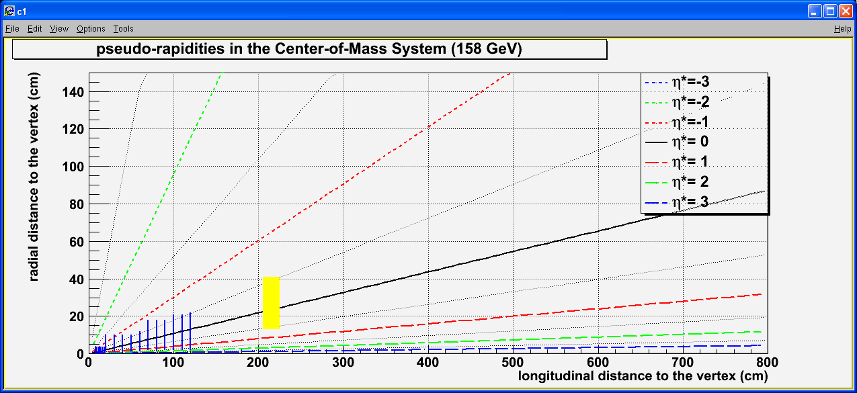
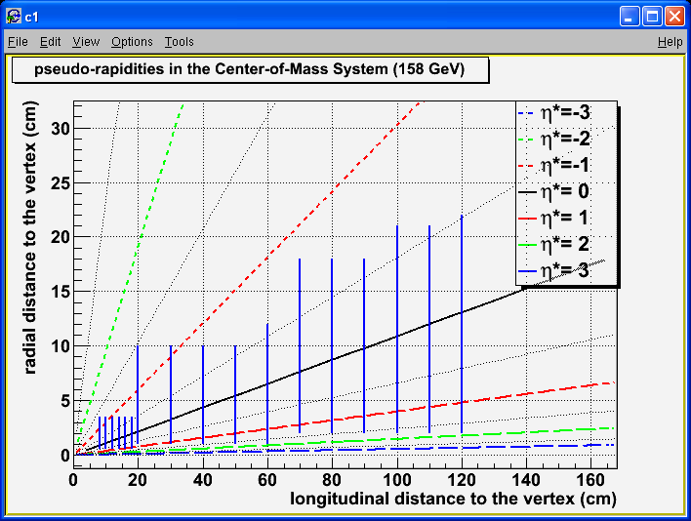
Detector – tentative design
1 m
2 m
3 m
4 m
5 m
6 m
120 cm
100 cm
80 cm
60 cm
40 cm
20 cm
30 cm
20 cm
10 cm
1 m
2 m
3 m
4 m
5 m
6 m
20
60
100

Slide 39
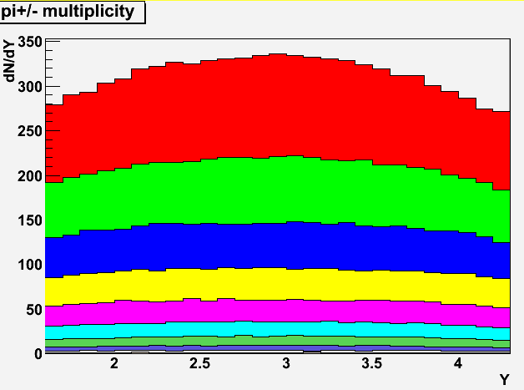
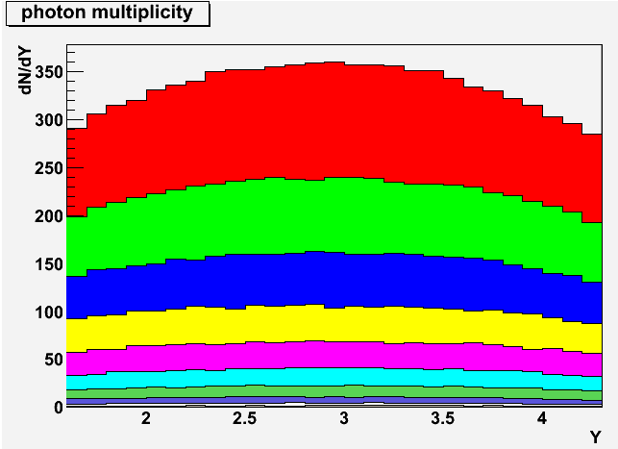
Performances in Pb+Pb
Generated with EPOS 1.6 : 10000 minbias events
Cent (%) | <Npart> | Npart [min,max[
0 – 10 | 333.0 | [277, 402[
10 – 20 | 231.5 | [193, 277[
20 – 30 | 161.2 | [132, 193[
30 – 40 | 109.3 | [89, 132[
40 – 50 | 71.4 | [55, 89[
50 – 60 | 43.0 | [33, 55[
60 – 70 | 24.4 | [17, 33[
70 – 80 | 12.1 | [8, 17[
80 – 90 | 5.8 | [4, 8[
90 – 100 | 2.8 | [2, 4[

Slide 40
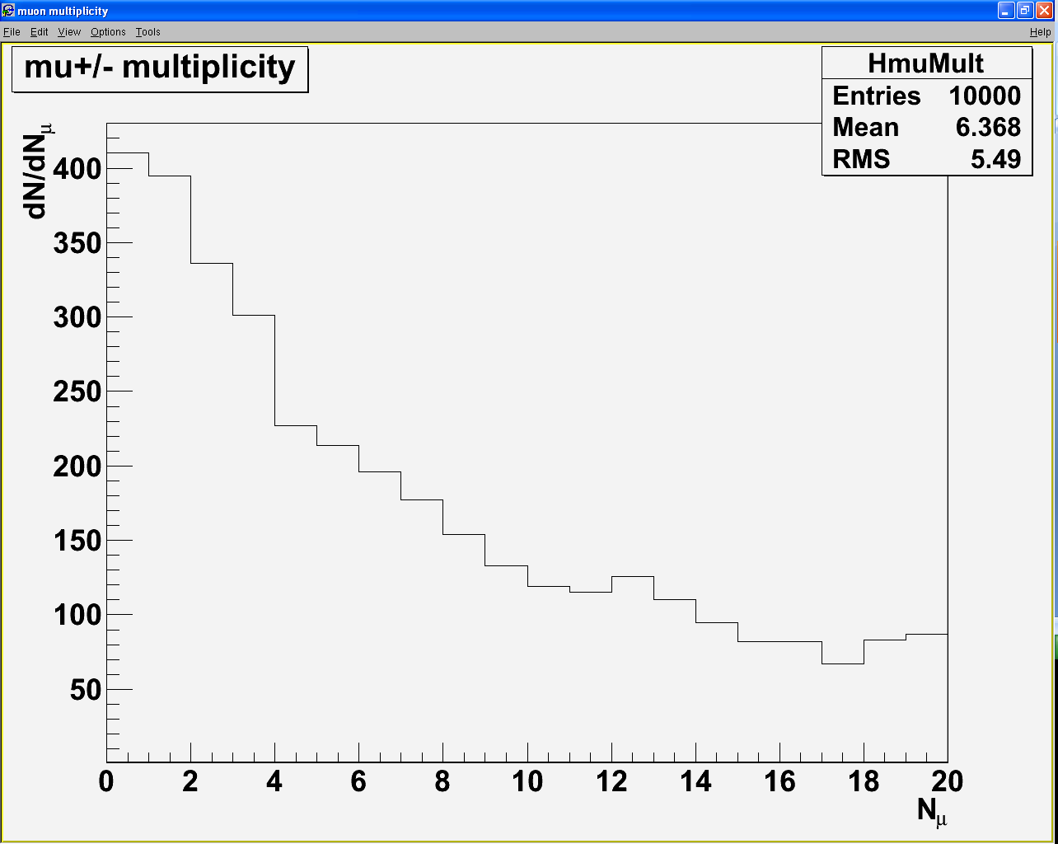
Performances in Pb+Pb
10000 minBias events (EPOS 1.6)

Slide 41
Performances in Pb+Pb
10000 minBias events (EPOS 1.6)
Include
ΔP/P=1%
ΔE/E=20%/√E
Acceptance
Keep μ within -0.5<y*<0.5
keep γ within -0.5<y*<0.5
<γ from π⁰>/event = 96.7
<p_{T}(γ)> = 0.18 GeV/c
<γ from π⁰>/event = 96.7
<p_{L}(γ)>=1.76 GeV/c
<μ^{+/−} from π^{+/-}>/event = 90.1
<p_{T}(μ^{+/−})> = 0.28 GeV/c
<μ^{+/−} from π^{+/-}>/event = 90.1
<p_{L}(μ^{+/−})> = 2.93 GeV/c

Slide 42
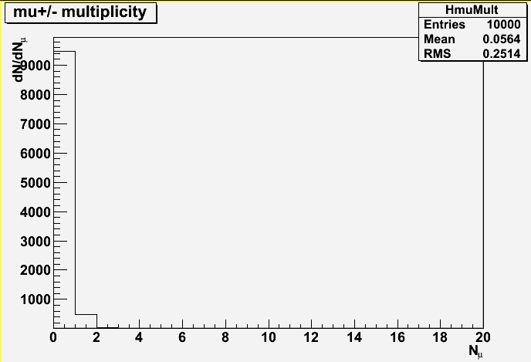
Performances in Pb+Pb
10000 minBias events (EPOS 1.6)
Acceptance
Keep μ within -0.5<y*<0.5
keep γ within -0.5<y*<0.5
Cuts
P_{z}>5 GeV/c and Z_{vertex}<215 cm
At least
2 μ in the
Detector
(9195 events)
10 kevents x A² ~ 43 107 NN collisions
At least
2 μ in the
Detector
(44 events)

Slide 43
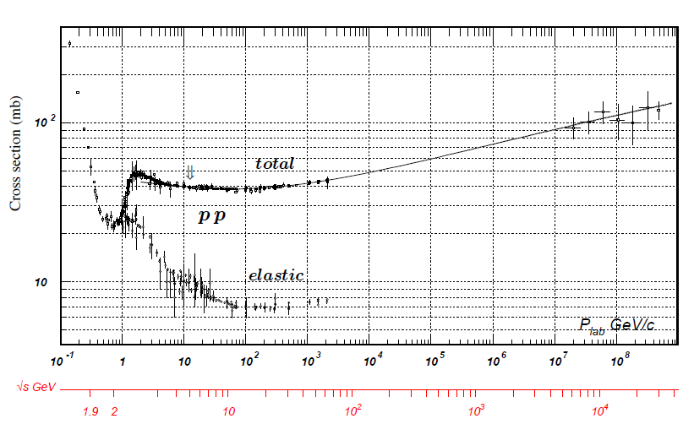
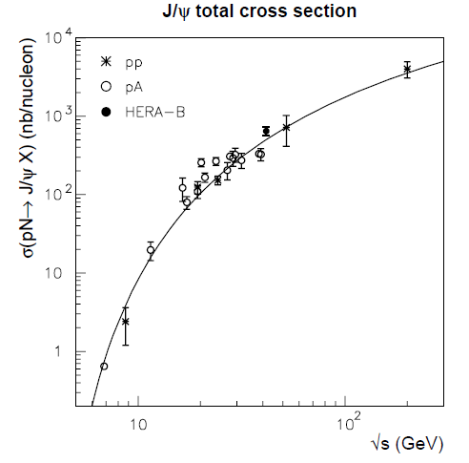
Past experiments
NA50/NA60 performances
Particle Data Group, J. Phys. G 37, 075021 (2010)
Hera-B, Phys.Lett.B638:407-414,2006

Slide 44
Performances
Must check numbers
with full simulation
Results in p+p (pythia 6.421)
20 000 generated events
Include ΔP/P=1%
Include ΔE/E=20%
8594 events w/ (➔ χ_{c} accept.~8%)
2 μ from J/Ψ with -0.5<y*<0.5
1 γ from χ_{c} with -0.5<y*<0.5
Background
All muons from charged π and K decaying at most at z=2 m ➔ ~1.2% (0.025 μ/event)
No muon Pz cut applied.
2.4 photon from π⁰/event
Signal/background:
J/Ψ → no background
χ_{c} → with 3.5<M<3.65 : S/B~4
Note : all assuming perfect trigger
➔ No events with fake χ_{c}

Slide 45
Performances
Must check numbers
with full simulation
Results in p+p (pythia 6.421)
100 000 generated events
Include ΔP/P=1%
Include ΔE/E=20%
8594 events w/ (➔ χ_{c} accept.~8%)
2 μ from J/Ψ with -0.5<y*<0.5
1 γ from χ_{c} with -0.5<y*<0.5
Background
All muons from charged π and K decaying at most at z=2 m ➔ ~1.2% (0.025 μ/event)
No muon Pz cut applied.
2.4 photon from π⁰/event
Signal/background:
J/Ψ → no background
χ_{c} → with 3.5<M<3.65 : S/B~4
Note : all assuming perfect trigger
➔ No events with fake χ_{c}

Slide 46
Performances – background
In p+p collisions
At η*~0, <N_{charged π}> ~ 2.2
<N_{μ}> produced before z=2m : 0.025 μ/event
In 0 – 5% most central Pb+Pb collisions
At η*~0, <N_{charged π}> ~ 500
<N_{μ}> before z=2m : 0.025 × 500/2.2 ~ 6 μ/event (0.4 μ/event w/P_{z}>5GeV)
→ may be an issue for the trigger
→ alternative design to reduce the bkg ?

Slide 47
Benchmark – alternative geometry
Measure cc within -0.5<y*<0.5
In Pb+Pb @ √s ~ 17 GeV
Channel cc → J/Ψ+γ →μ⁺μ⁻+γ
μ measured in y*∈[-0.5:0.5] / γ measured in y* ∈[-1:-0.5]
2837 events
PYTHIA 6.421
10000 events
μ^{+/−} ∈ [-0.5,0.5]
A_{J/Ψ}~18%
γ ∈ [-1,-0.5]
A_{χ}~2.8%
Y*=0 ⇔ Y=2.92

Slide 48
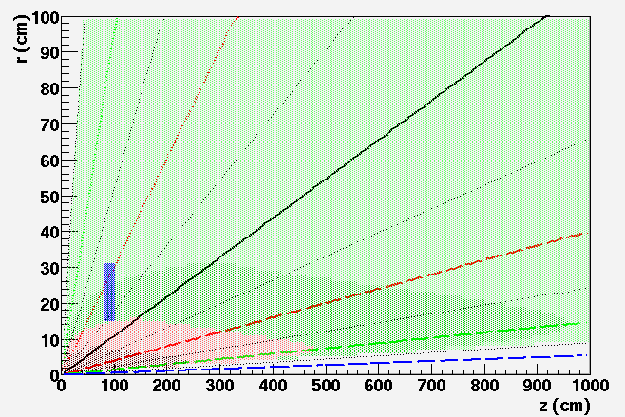
Alternative design – calorimetry
Must check numbers with full simulation
Detector size and position
Benchmark: a detector covering -1<η<-0.5
R_{min}
Z
[-1.0:-0.5]
Δγ>4
Δγ>2
R_{max}
Δγ<2
Δγ<1
The closer position to the target with Δγ>2cm gives:
Z = 103 cm [-1.0:-0.5]
R_{min}=15 cm and R_{max} = 31 cm
20 cm
Should be ok with 0.5 × 0.5 cm² pads

Slide 49
Performances
Must check numbers
with full simulation
Results in p+p (pythia 6.421)
100 000 generated events
Include ΔP/P=1%
Include ΔE/E=20%
2837 events w/ (➔ χ_{c} accept.~3%)
2 μ from J/Ψ with -0.5<y*<0.5
1 γ from χ_{c} with -1<y*<-0.5
Background
All muons from charged π and K decaying at most at z=1 m ➔ ~0.5% (0.01 μ/event)
No muon Pz cut applied.
1.0 photon from π⁰/event
Signal/background:
J/Ψ → no background
χ_{c} → with 3.5<M<3.65 : S/B~9
Reduce μ bkg by a factor ~ 2
Reduce γ bkg by a factor > 2
Note : all assuming perfect trigger
➔ No events with fake χ_{c}

Slide 50
Detector – design
Alternative design
80 cm
2.5 T
Vertex / tracking
EM
Beam
40 cm
20 cm
target
EM
Dipole field
MuID
0
1 m
2 m
4 m
6 m
8 m
Tracking : 100 cm long à la NA60 ➔ ΔP/P ~ 1%
Magnet : 2.5 T dipole / 100 cm long
Calorimetry : 20 cm long calorimeter / inner radius ~ 15cm / outer radius ~ 30 cm ➔ ΔE/E ~ 20%
Absorber à la NA50 : 60 cm BeO + 400 cm C + 80 cm Fe
absorber @ 1m ➔ reduce the bkg by a factor ~ 2

Slide 51
Performances
Must check numbers
with full simulation
Results in p+p (pythia 6.421)
100 000 generated events
Include ΔP/P=1%
Include ΔE/E=20%
2837 events w/ (➔ χ_{c} accept.~3%)
2 μ from J/Ψ with -0.5<y*<0.5
1 γ from χ_{c} with -1<y*<-0.5
Background
All muons from charged π and K decaying at most at z=1 m ➔ ~0.5% (0.01 μ/event)
No muon Pz cut applied.
1.0 photon from π⁰/event
Signal/background:
J/Ψ → no background
χ_{c} → with 3.5<M<3.65 : S/B~9
Reduce μ bkg by a factor ~ 2
Reduce γ bkg by a factor > 2
Note : all assuming perfect trigger
➔ No events with fake χ_{c}

Slide 52
Performances – p+p
Standard design
Alternative design
∈ [-0.5 ; 0.5] γ ∈ [-0.5 ; 0.5]
8594 (100%) J/Ψ 8594 (100%) χ_{c}
2.4 γ_{π0}/evt 1.2% (0.025 μ/evt) S/B ~ 4
μ ∈ [-0.5 ; 0.5] γ ∈ [-1 ; -0.5] z=1m
2837 (100%) J/Ψ 2837 (100%) χ_{c}
1.0 γ_{π0}/evt 0.5% (0.01 μ/evt) S/B ~ 9

Slide 53
Performances – p+p
Must check numbers
with full simulation
Standard design
Alternative design
μ ∈ [-0.5 ; 0.5] γ ∈ [-0.5 ; 0.5] z=2m
8594 (100%) J/Ψ 7045 (82%) χ_{c}
100<M_{γγ}<160 MeV
0.8 γ_{π0}/evt 1.2% (0.025 μ/evt) S/B ~10
μ ∈ [-0.5 ; 0.5] γ ∈ [-1 ; -0.5] z=1m
2837 (100%) J/Ψ 2533 (89%) χ_{c}
100<M_{γγ}<160 MeV
0.6 γ_{π0}/evt 0.5% (0.01 μ/evt) S/B ~ 13

Slide 54
Performances – p+p
Must check numbers
with full simulation
Standard design
Alternative design
μ ∈ [-0.5 ; 0.5] γ ∈ [-0.5 ; 0.5] z=2m
8385 (98%) J/Ψ 6868 (80%) χ_{c}
100<M_{γγ}<160 MeV P_{zμ} > 5 GeV
0.8 γ_{π0}/evt 0.07% (0.002 μ/evt) S/B ~10
μ ∈ [-0.5 ; 0.5] γ ∈ [-1 ; -0.5] z=1m
1000 (100%) J/Ψ 1000 (100%) χ_{c}
100<M_{γγ}<160 MeV P_{zμ} > 5 GeV
0.6 γ_{π0}/evt 0.05% (0.001 μ/evt) S/B ~ 13

Slide 55
Performances – Pb+Pb
Must check numbers
with full simulation
Results in Pb+Pb (epos 1.6) standard design
1000 generated events
Include ΔP/P=1%
Include ΔE/E=20%
1000 events
2 μ from J/Ψ with -0.5<y*<0.5
1 γ from χ_{c} with -1<y*<-0.5
Background
All muons from charged π and K decaying at most at z=2 m ➔ ~1.2% (0.7 μ/event)
No muon Pz cut applied.
92.6 photon from π⁰/event
Signal/background:
J/Ψ → no background
χ_{c} → with 3.5<M<3.65 : S/B~0.14

Slide 56
Performances – Pb+Pb
Must check numbers
with full simulation
Standard design
Alternative design
μ ∈ [-0.5 ; 0.5] γ ∈ [-0.5 ; 0.5] z=2m
1000 (100%) J/Ψ 1000 (100%) χ_{c}
92.6 γ_{π0}/evt 1.2% (0.7 μ/evt) S/B ~0.14
μ ∈ [-0.5 ; 0.5] γ ∈ [-1 ; -0.5] z=1m
1000 (100%) J/Ψ 1000 (100%) χ_{c}
44.3 γ_{π0}/evt 0.5% (0.3 μ/evt) S/B ~ 0.3

Slide 57
Performances – Pb+Pb
Must check numbers
with full simulation
Standard design
Alternative design
μ ∈ [-0.5 ; 0.5] γ ∈ [-0.5 ; 0.5] z=2m
1000 (100%) J/Ψ 193 (19%) χ_{c}
100<M_{γγ}<160 MeV
0.5 γ_{π0}/evt 1.2% (0.7 μ/evt) S/B ~6
μ ∈ [-0.5 ; 0.5] γ ∈ [-1 ; -0.5] z=1m
1000 (100%) J/Ψ 276 (28%) χ_{c}
100<M_{γγ}<160 MeV
0.8 γ_{π0}/evt 0.5% (0.3 μ/evt) S/B ~ 4

Slide 58
Performances – Pb+Pb
Must check numbers
with full simulation
Standard design
Alternative design
μ ∈ [-0.5 ; 0.5] γ ∈ [-0.5 ; 0.5] z=2m
970 (97%) J/Ψ 189 (19%) χ_{c}
100<M_{γγ}<160 MeV P_{zμ} > 5 GeV
0.5 γ_{π0}/evt 0.12% (0.08 μ/evt) S/B ~6
μ ∈ [-0.5 ; 0.5] γ ∈ [-1 ; -0.5] z=1m
980 (98%) J/Ψ 268 (27%) χ_{c}
100<M_{γγ}<160 MeV P_{zμ} > 5 GeV
0.8 γ_{π0}/evt 0.06% (0.04 μ/evt) S/B ~ 4

Slide 59
Summary
Tracking
measure muon momentum before the absorber
OK with a silicon vertex tracking + 1m long 2.5 to 4 T dipole
to check with full simulations
Calorimetry
identify and measure low momentum photons in a very busy environment
➔ OK with Tg+Si calorimeter (see Calice collab.)
➔ To check with full simulations (+ test beam ?)
Absorber
À la NA50, ~ 6m long ➔ OK
A compact (2m long) DHCal ➔ to be investigated (see Calice collab.)
MuID
trigger with good momentum resolution ➔ to be investigated

Slide 60
Detector – design
Alternative compact design : can we do that ?
2.5 T
40 cm
Vertex / tracking
EM
Beam
20 cm
20 cm
target
EM
Dipole field
MuID
0
1 m
2 m
4 m
6 m
8 m
Tracking : 100 cm long à la NA60 ➔ ΔP/P ~ 1%
Magnet : 2.5 T dipole / 100 cm long
Calorimetry : 20 cm long calorimeter / inner radius ~ 15cm / outer radius ~ 30 cm ➔ ΔE/E ~ 20%
Absorber : DHCal, 2m Fe long
absorber @ 1m ➔ reduce the bkg by a factor ~ 2

Slide 61
Rapidity coverage
-0.5< y*<0.5

Slide 62
Rapidity coverage
0.5< y*<1.5

Slide 63
Physics motivations
In A+A : Hot Nuclear Matter effects – test sequential suppression scenario
Measure χ_{c}
Never done before
No current experiment able to do it
Side products :
Measure J/Ψ and Ψ’ (already measured by NA50, NA60)
Measure open charm
In p+A : Cold Nuclear Matter effects – test anti(shadowing)
Measure χ_{c}
Nuclear absorption
Shadowing/antishadowing
Side products :
Measure J/Ψ, Ψ’ suppression by CNM
Only one rapidity unit done by NA50, NA60. Can we do more ?
Measure open charm
In p+p : test pQCD
Measure χ_{c} states
Measure J/Ψ, Ψ’
Measure open charm
Measure η_{c} ?

Slide 64
Detector – calorimetry
η_{min}
η_{max}
θ
Δγ>4
η∗=-2.5
η∗=-2
η∗=-1.5
η∗=-1
Distance between two photons:
η∗=0
The relevant quantity is the distance between two incoming particles :
Minimal distance between 2 particles at impact = 1 free pad = 1 cm (for 0.5 × 0.5 cm² pad)
distance between two incoming particles must be > 1 cm
500 photons ➔ 250 neutrals (π⁰ + η)➔ 500 π^{+/-} ➔ 500 γ + 500 π^{+/-} = 1000 particles
distance between two photons must be > 2 cm (1cm×1000/500)
bad
good

Slide 65
backup

Slide 66
Fixed target experiments
NA38, NA50, NA51: 1st generation
NA60: 2nd generation
+ NA50
Target → absorber → spectrometer → muID
Target → vertex → absorber → spectrometer → muID
CHIC: 3rd generation
target → vertex → spectrometer → calorimeter → absorber → muID
MuID
Muon Filter
(absorber)
target
tracking
tracking
EMCal
Beam
vertex
Dipole field

Slide 67
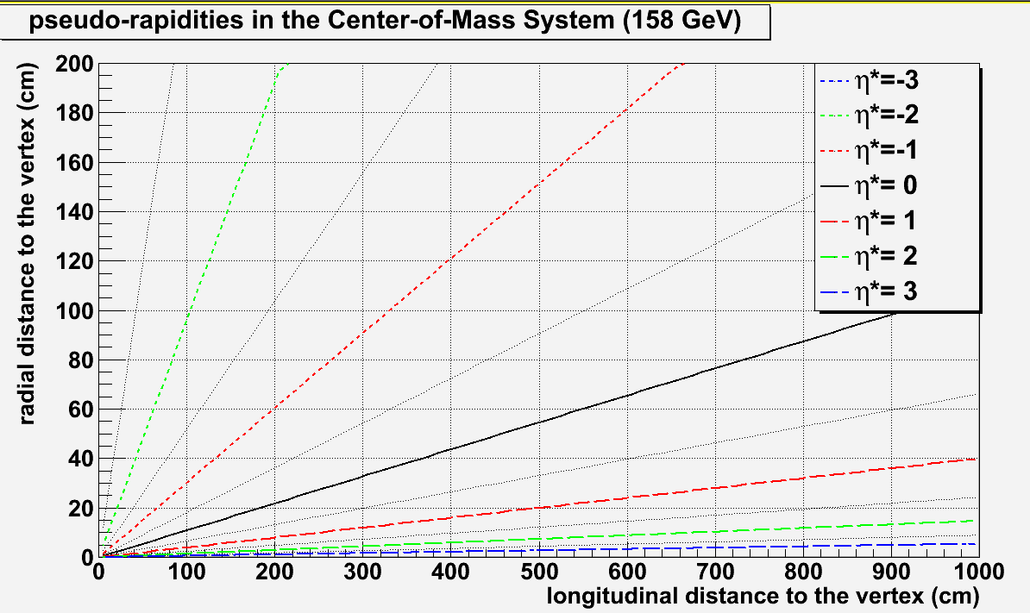
Detector – absorber
Absorber size
0.3
To absorb π^{+/-}
Must use high density material ➔ 2 meters of iron
To minimize multiple scattering
Must use low Z material ➔ best = BeO (but expensive)
NA50 : 0.6 m BeO + 4 m C + 0.6 m Fe = 5.2 m
10⁻⁶
R_{min}~45 cm
R_{max}~135 cm
R_{min}~25 cm
R_{max}~75 cm
NA50 absorber: EMCal @ 2m(+0.2) + 5.2 m: MuID @ 7.4 m
Fe absorber: EMCal @ 2m(+0.2) + 2m: MuID @ 4.2 m
Use a 2 meters instrumented iron absorber ?

Slide 68
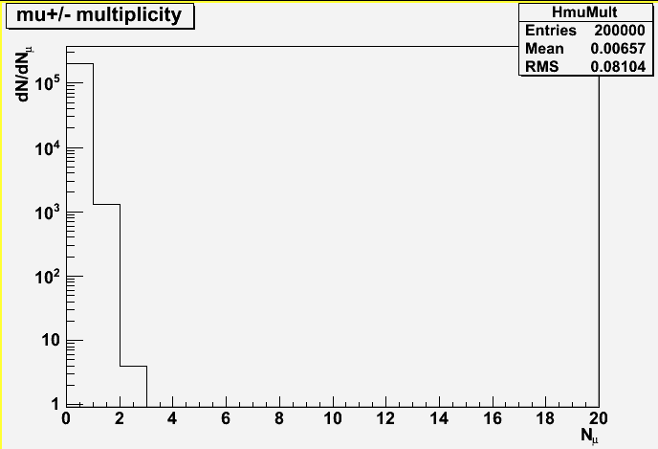
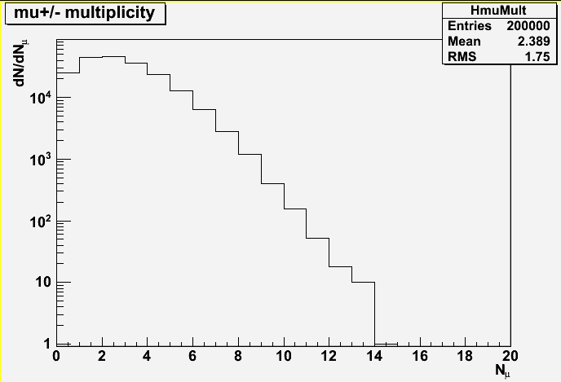
Detector – absorber
μ energy loss
μ vertex
μ^{+/-} momentum up to ~50 GeV/c
dE/dx ~ 2 MeV g⁻¹ cm²
Fe density ~ 7.8 g cm⁻³ ➔ dE/dx ~ 15.6 MeV cm⁻¹
With a 2m long Fe absorber ➔ ΔE/Δx ~ 15.6 x 200 ~ 3 GeV
➔ cut all muons with P_{lab} < 3 GeV.
π^{+/-} stop decaying after 1 λ_{I} in tungsten (λ_{I}~10cm)
➔ π^{+/-} stop decaying @ 2.15 m
0.5
0.3
After cuts
Before cuts
(200 kevents)
At least
2 μ in the
Detector
(4 events)
At least
2 μ in the
Detector
(130 kevents)
10⁻⁶

Slide 69
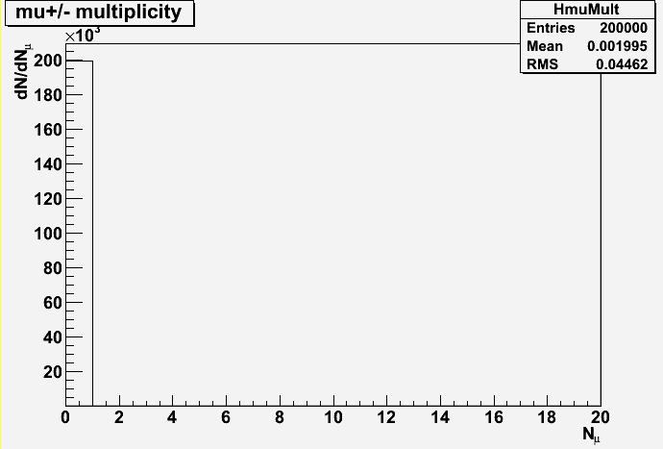
Performances
Pythia 6.421 – √s = 17.2 GeV
20 000 generated χ_{c2} events
Include ΔP/P=1%
Include ΔE/E=20%/√E
Acceptance
2 μ from J/Ψ within -0.5<y*<0.5
1 γ from χ_{c} within -0.5<y*<0.5
events
A(J/Ψ) ~ 18.4%
A(χ_{c})~ 8.5%
Cuts
P_{z}>5 GeV/c and Z_{vertex}<215 cm
A(J/Ψ) ~ 18.0%
A(χ_{c}) ~ 8.4%
5 GeV/c
J/Ψ
χ_{c}
Signal/background:
J/Ψ → no background
χ_{c} → with 3.45<M<3.65 : S/B~2.4
200 k
minBias
events
200 k
minBias
events
At least
2 μ in the
Detector
(130 kevents)
At least
2 μ in the
Detector
(0 events)
At least
2 μ in the
Detector
(130 kevents)

Slide 70
Detector – trigger
Trigger rate in Pb+Pb collisions ?
Muon angle cut
Request single muon pT>0.5 GeV/c
With P_{min}>5 GeV/c (due to absorber)
At least
2 μ in the
Detector
(44 events)
At least
2 μ in the
Detector
(3 events)
At least
2 μ in the
Detector
(9195 events)
– Trigger accepts 3/10000 events ➔ N_{events}/sec ~ 2.3 MHz x 3 10⁻⁴ ~ 700 Hz

Slide 71
CHIC : Experimental benchmark
Measure χ_{c} within -0.5<y*<0.5
In Pb+Pb @ √s ~ 17 GeV
Channel χ_{c} → J/Ψ + γ → μ⁺μ⁻ + γ
Standard design : μ and γ measured in y* ∈ [-0.5;0.5]
PYTHIA 6.421
20000 events
MuID
Muon Filter
(absorber)
target
tracking
tracking
EMCal
Beam
vertex
Y*=0 ⇔ Y_{CMS}~2.92
Dipole field
Y*(μ^{+/−} )∈ [-0.5,0.5]
Y*( γ) ∈ [-0.5,0.5]
Goals:
Tracking : measure muon momentum before the absorber
Calorimetry : identify and measure low momentum photons in a very busy environment
A_{J/Ψ}~18.4%
A_{χ}~8.5%

Slide 72
Detector – calorimetry
Need : very high segmentation
0 – 5% most central Pb+Pb collisions
as measured by WA98
(Phys. Lett. B458: 422-430, 1999)
W+Si calorimeter à la Calice
30 layers
So far 0.5 x 0.5 cm² pads
24 X₀ in 20 cm
W+Si calorimetry : 2 relevant quantities
At most ~ 500 photons/rapidity unit
1st relevant quantity : distance
between two incoming particles
Min. distance between 2 particles at impact
= 1 free pad = 1 cm (for 0.5×0.5 cm²)
distance between two incoming particles
must be > 1 cm
N photons ➔ N/2 neutrals (π⁰ + η)➔ N π^{+/-}
➔ N γ + N π^{+/-} = 2N particles
distance between two photons
must be > 2 cm (1cm×2N/N)
2nd relevant quantity : EM shower transverse size
Moliere Radius R_{M} : 90% of the shower energy
Distance between two photons
must be > 2 cm (2 R_{M})
bad
good
Geometrical condition: Δγ > 2cm

