Slide 1
C H I C Charm in Heavy Ion Collisions @ SPS
J/Ψ – Suppression in A+A
CHIC – Physics motivations
CHIC – Experimental aspects

Slide 2
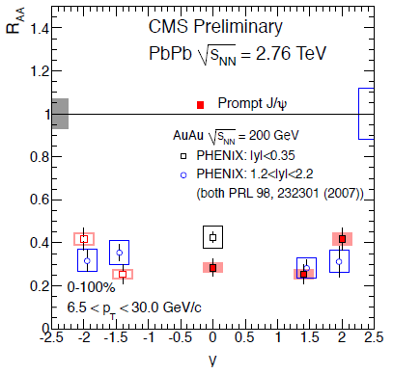
J/Ψ – Suppression in A+A
RHIC (200 GeV) .vs. LHC (2.76 TeV) at forward rapidity
Compare PHENIX vs ALICE
1.2 < |y| < 2.2 at RHIC (PHENIX)
2.5 < y < 4 at LHC (ALICE)
LESS SUPPRESSION at LHC .vs. RHIC
Could be due to recombination effects
RHIC (200 GeV) .vs. LHC (2.76 TeV) at mid-rapidity
Compare PHENIX vs CMS
|y|<0.35 at RHIC (PHENIX)
|y|<1 at LHC (CMS)
MORE SUPPRESSION at LHC .vs. RHIC
p_{T}>6.5 GeV/c ➔ in principle no recombination applies
larger suppression due to QGP effects ?
Hint for sequential suppression ? (J/Ψ melting)
Caution : Need CNM effects comparison
PHENIX
CMS

Slide 3
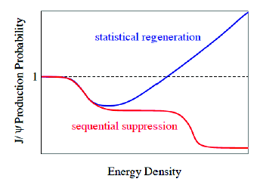
J/Ψ – Suppression in A+A
Overall (simplified) picture
Similar suppression at SPS.vs.RHIC
Larger suppression at LHC
outside recombination regime
CMS results
Hint of sequential suppression ?
(assuming CNM effects are the same or smaller)
Smaller suppression at LHC
inside recombination regime
ALICE results
Hint of recombination?
(assuming CNM effects are the same of larger)
To do:
Understand CNM effects : p+Pb run
Test recombination mechanism : J/Ψ at mid-rapidity at low p_{T}
Test sequential suppression → measure χ_{c} in A+A→ not accessible ➔ CHIC experiment

Slide 4
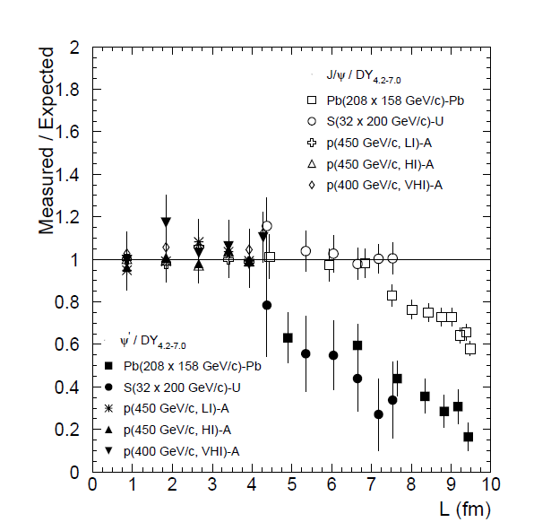
CHIC – Physics motivations
Benchmark: Measure χ_{c} in A+A at SPS
How χ_{c} is suppressed relative to J/Ψ ?
What is the dependence with y, p_{T}, centrality,… ?
Mandatory to draw the whole picture (SPS .vs. RHIC .vs. LHC)
Why SPS ?
First place where anomalous suppression
has been seen.
SPS good place to see full
Sequential suppression : Ψ’, J/Ψ, χ_{c}
No recombination at SPS
Eur.Phys.J.C49:559-567,2007
1
2
3

Slide 5
CHIC – Physics motivations
Quarkonia suppression
At SPS
Eur.Phys.J.C49:559-567,2007
60% direct J/Ψ
+ 30% χ_{c}→J/Ψ+γ
+ 10% Ψ’ → J/Ψ + X
Inclusive J/Ψ yield
p+A
S+U
Two possible scenarios:
sequential suppression (QGP)
comovers (no QGP)
Pb+Pb
Temperature of dissociation
Binding energy
L (fm)
ε (GeV/fm³)
4.37
1.04
4.90
1.24
6.65
2.04
7.65
2.53
8.83
3.19
9.43
3.76

Slide 6
CHIC – Physics motivations
Two possible scenarios
QGP (sequential suppression)
Eur.Phys.J.C49:559-567,2007
p+A
Because ΔE (Ψ’) ~50 MeV
Ψ’ easily suppressed by comovers
Because ΔE(χ_{c})~200 MeV and ΔE(J/Ψ)~600 MeV
χ_{c} and J/Ψ hardly suppressed by comovers
S+U
Pb+Pb
Inclusive J/Ψ
χ_{c}
Ψ’
If χ_{c} suppressed by QGP,
χ_{c} slope strongly steeper than J/Ψ and Ψ’
Measuring
χ_{c} suppression pattern
will (in)validate this
Note that direct J/Ψ can be experimentally estimated
Yield_{incl.J/Ψ} – Yield_{χc→J/Ψ+γ} – Yield_{Ψ’} ~ Yield_{direct J/Ψ}
L (fm)
ε (GeV/fm³)
4.37
1.04
4.90
1.24
6.65
2.04
7.65
2.53
8.83
3.19
9.43
3.76

Slide 7
CHIC – Physics motivations
Two possible scenarios
No QGP (full comovers)
Eur.Phys.J.C49:559-567,2007
p+A
Because σ_{J/Ψ-co} ≤ σ_{χc-co} ≤ σ_{Ψ’-co}
Ψ’ slope slightly steeper than χ_{c}
χ_{c} slope slightly steeper than J/Ψ
S+U
Pb+Pb
direct J/Ψ
Measuring
χ_{c} suppression pattern
will (in)validate this
Ψ’
χ_{c}
Note that direct J/Ψ can be experimentally estimated
Yield_{incl.J/Ψ} – Yield_{χc→J/Ψ+γ} – Yield_{Ψ’} ~ Yield_{direct J/Ψ}
L (fm)
ε (GeV/fm³)
4.37
1.04
4.90
1.24
6.65
2.04
7.65
2.53
8.83
3.19
9.43
3.76

Slide 8
CHIC – Physics motivations
Conclusion : measure χ_{c} in A+A at SPS
Eur.Phys.J.C49:559-567,2007
p+A
measuring
Ψ’, J/Ψ and χ_{c} suppression pattern
S+U
Pb+Pb
No QGP χ_{c}
will answer the question
------ QGP
------ no QGP
QGP χ_{c}
Note that direct J/Ψ can be experimentally estimated
Yield_{incl.J/Ψ} – Yield_{χc→J/Ψ+γ} – Yield_{Ψ’} ~ Yield_{direct J/Ψ}
L (fm)
ε (GeV/fm³)
4.37
1.04
4.90
1.24
6.65
2.04
7.65
2.53
8.83
3.19
9.43
3.76

Slide 9
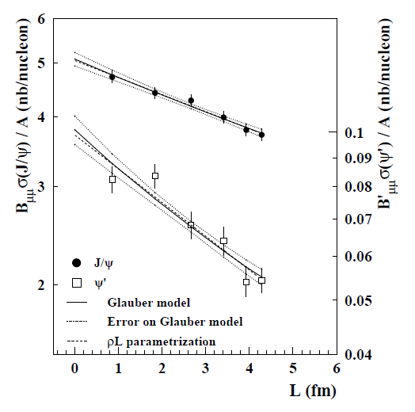
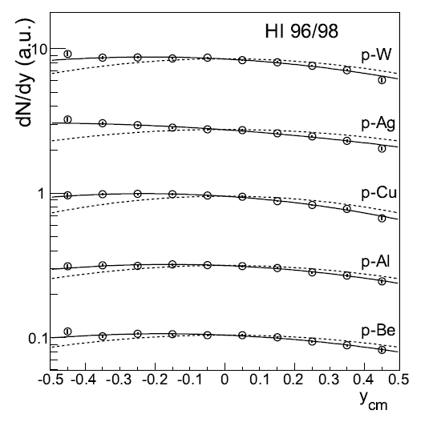
CHIC – Physics motivations
Benchmark: Measure charmonium in p+A at SPS
J/Ψ and Ψ’ suppression in p+A collisions as a function of L
➔ Measuring different charmonium states gives key information on Cold Nuclear Matter and production mechanism.
NA50
J/Ψ
Ψ’
Euro. Phys. J. C48 (2006) 329.
J/Ψ rapidity distribution in p+A collisions (asymetry wrt y_{cm}=0)
➔ Measuring charmonium in a wide x_{F} range is important to identify possible (anti)shadowing effects

Slide 10
CHIC – Physics motivations
Measure charmonium in p+A at SPS
➔ Measuring charmonium in a wide x_{F} range is important to estimate possible (anti)shadowing effects
E866, Phys. Rev. Lett. 84, 3256-3260 (2000)
With M=3.1 GeV/c² and √s=17.2 GeV (158 GeV)
x_{F} = 1 ➔ y_{CMS} = 1.7
With M=3.1 GeV/c² and √s=29.1 GeV (450 GeV)
x_{F} = 1 ➔ y_{CMS} = 2.2
Y_{CMS}=2 ➔ x_{F} = 0.8
Possible to access large x_{F} if measuring charmonia at rapidity up to y_{CMS}~2

Slide 11
CHIC – Physics motivations
Measure χ_{c} production in A+A
How χ_{c} is suppressed relative to J/Ψ ? What is the dependence with y, p_{T}, N_{part},… ?
Mandatory to draw the whole picture (SPS .vs. RHIC .vs. LHC)
Benchmark 1 : Measure χ_{c} production within y_{CMS} ∈ [-0.5, 0.5]
Measure charmonia production in p+A
what is the dependence of charmonia suppression with rapidity ?
Crucial to understand effects due to cold nuclear matter
Benchmark 2 : Measure charmonium states within y_{CMS} ∈ [-0.5, 2]
Other physics subjects
Open charm, low mass resonances, Drell-Yan,…

Slide 12
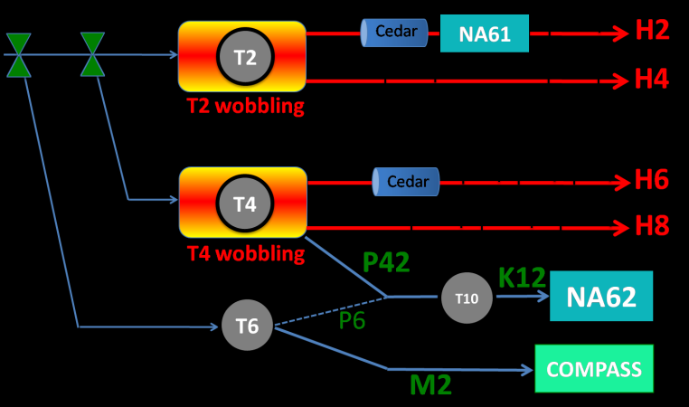
CHIC – Expected yields
Need high intensity p and Pb beams (~ 10⁷ Pb/sec)
NA50/NA60 beam line not available (NA62)
H2 beam line occupied by NA61
H4 and H8 available but need shielding for HI
NA50: European Physical Journal C39 (2005) 335
New measurement of J/ψ suppression in Pb+Pb at 158 GeV/nucleon
35 days of data taking in 2000
~1.10⁷Pb/s over 5s bursts every 20s
4 mm thick Pb target (10%λ_{I})
~ 100 000 J/Ψ→μ⁺μ⁻ within y*∈[0,1] (on disk)
Expect fair amount of χ_{c}: N_{J/Ψ} ~ 60% direct + ~30% from χ_{c} + ~10% from Ψ’
Same conditions as NA50 setup ➔ ~20 000 χ_{c} expected within y_{CMS} ∈ [-0.5,0.5]
Expect more with thicker target (1cm for instance)
North Area Beamlines

Slide 13
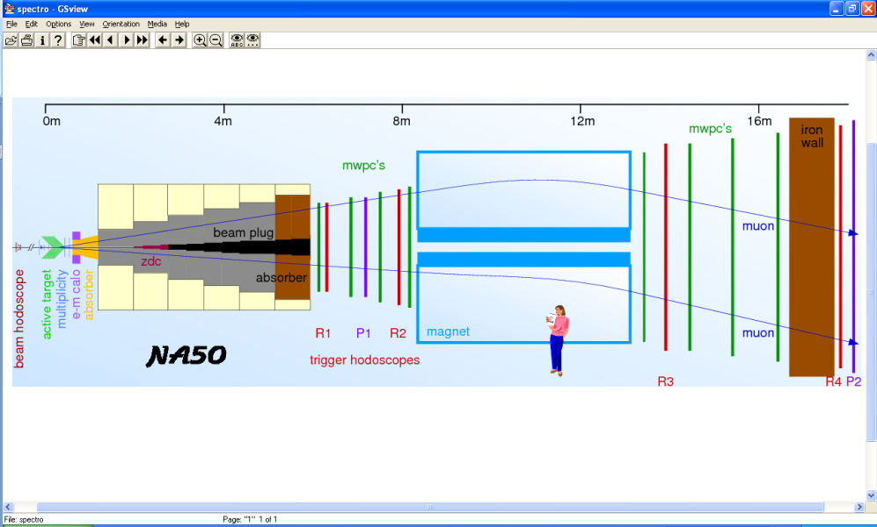
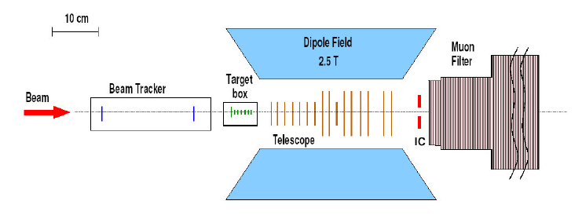
CHIC – detector design
Past experiments
1st generation: NA38,NA50,NA51
Measure dimuons
2nd generation: NA60
Measure dimuons and open charm vertex
Target → absorber → spectrometer → muID
Target → telescope

Slide 14
CHIC – detector design
3rd generation: CHIC
Measure dimuons and photons
Must place the calorimeter in front of the absorber
Must separate photon/electron ➔ tracking in front of the calorimeter.
MuID
Muon Filter
(absorber)
target
tracking
tracking
EMCal
Beam
vertex
Dipole field
Target → vertex → spectrometer → calorimeter → absorber → muID

Slide 15
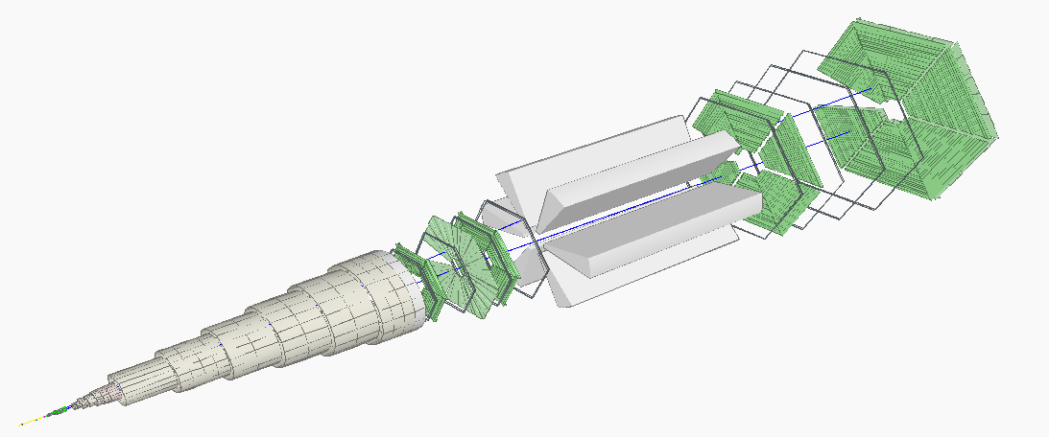
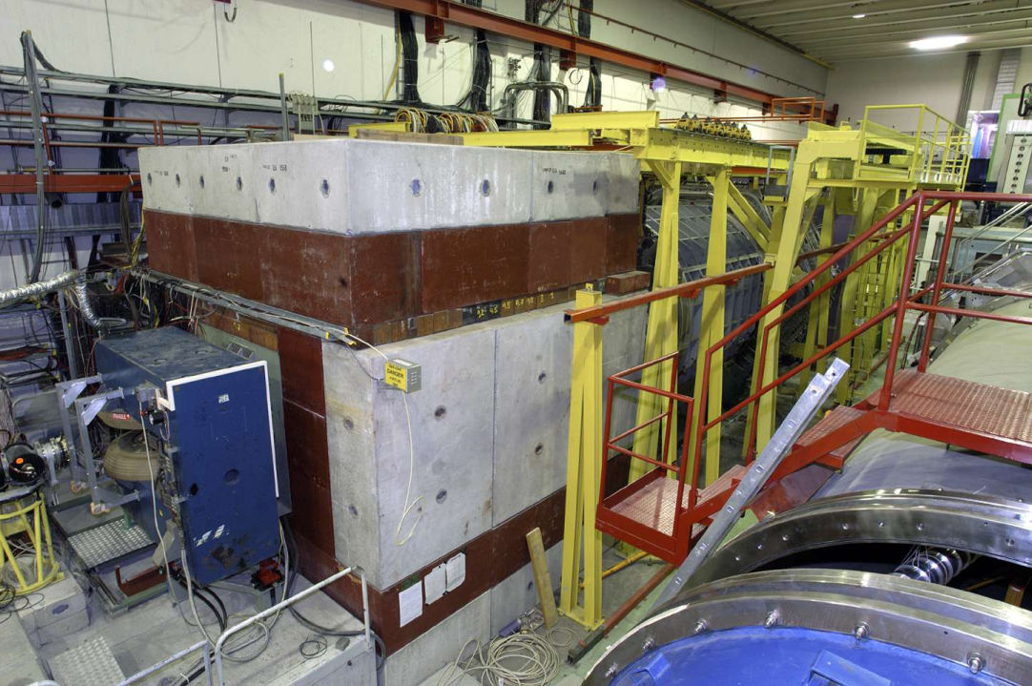
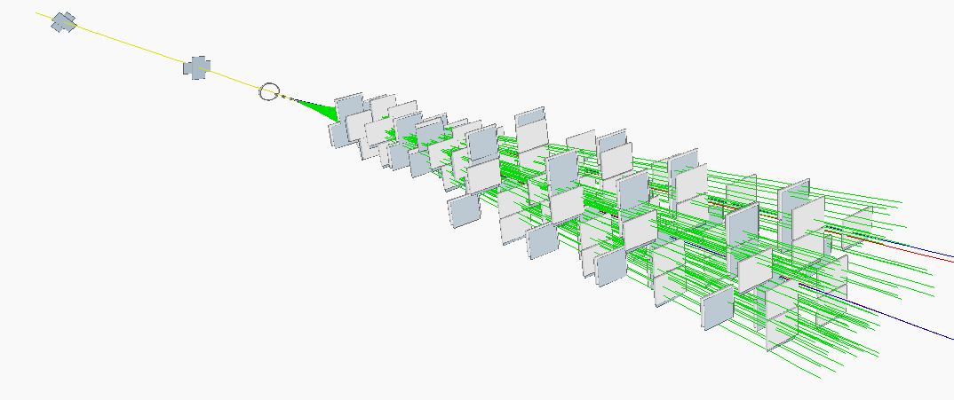
Detector – tracking
The NA60 example
Pixel detector
16 planes – 96 chips total
32 x 256 pixels / chip
Pixel size = 425 × 50 μm²
Magnetic field = 2.5 T × 40 cm
Momentum resolution @J/Ψ mass
(typical p_{μ} ~ 15 GeV/c)
(R. S. priv. Comm.)

Slide 16
Detector – tracking
The NA60 pixel detector
The CHIC pixel detector
~40 cm
L = 0.4 m
~100 cm
L = 1 m

Slide 17
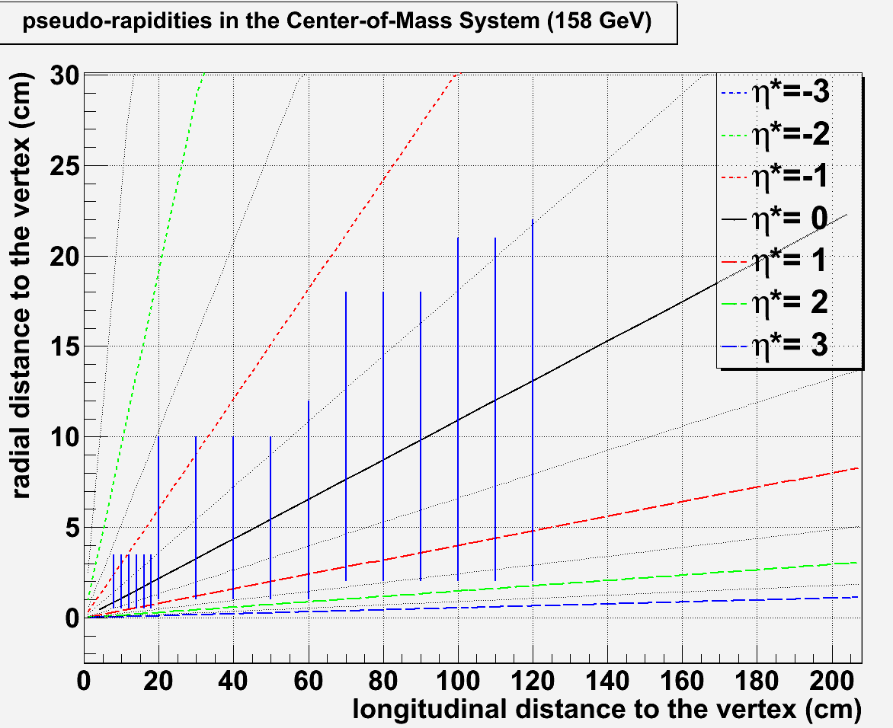
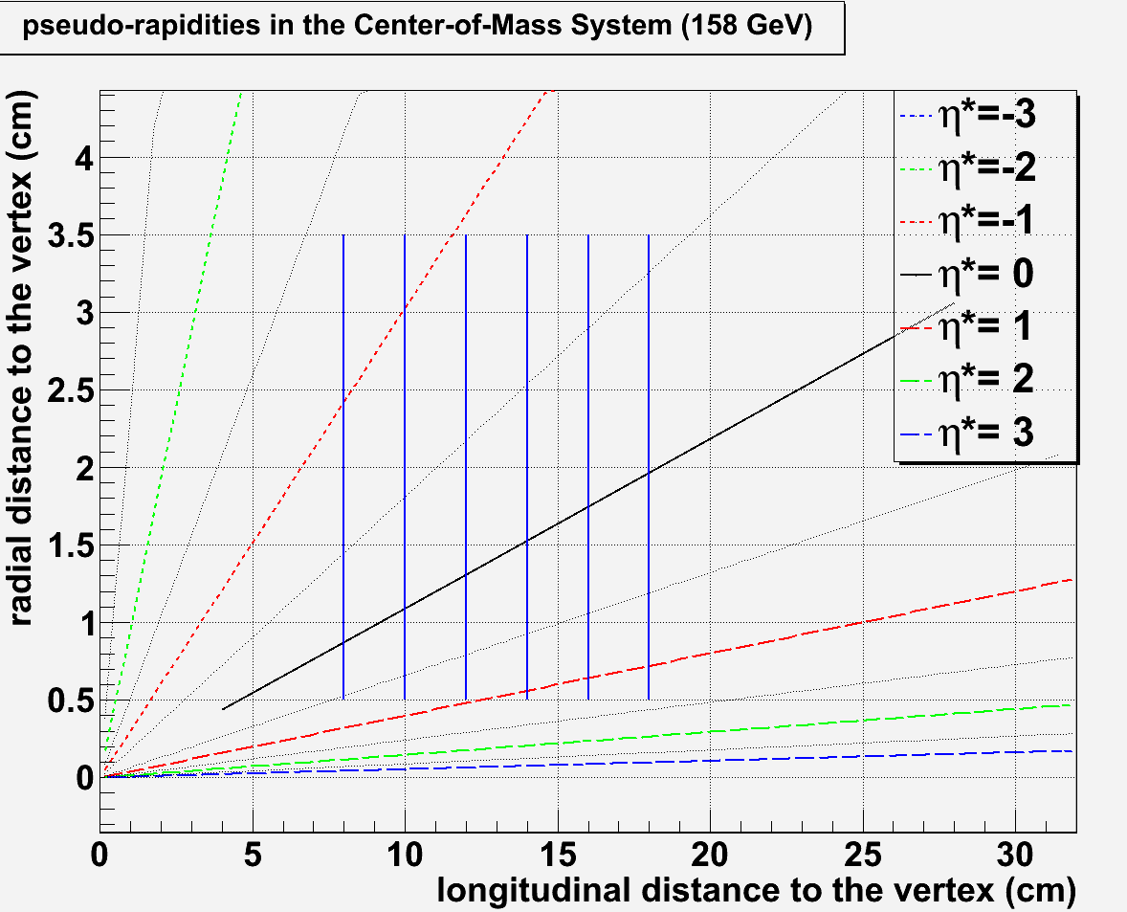
Detector – tracking
Size, position, resolution : tentative design – toy example
B (T) | L (cm) | ΔP/P (%) | ΔM (MeV)
2.5 | 40 | ~ 6 | ~120
2.5 | 60 | ~ 2.7 | ~60
2.5 | 80 | ~ 1.5 | ~30
2.5 | 100 | ~1 | ~20
11 plane spectrometer
@ z_{max} = 120 cm ➔ r_{max}(η*=-0.5)~22 cm
11 planes from z=20 cm to z = 120 cm
← NA60
η∗=-0.5
← CHIC
22
6 plane vertex
@ r_{min} = 0.5 cm ➔ z_{min}(η*=0.5)~7.5 cm
6 planes from z=8 cm to z=18 cm
η∗=0.5
η∗=-0.5
η∗=1
η∗=0.5
Track particles within η*∈[-0.5 ; 1]
7.5

Slide 18
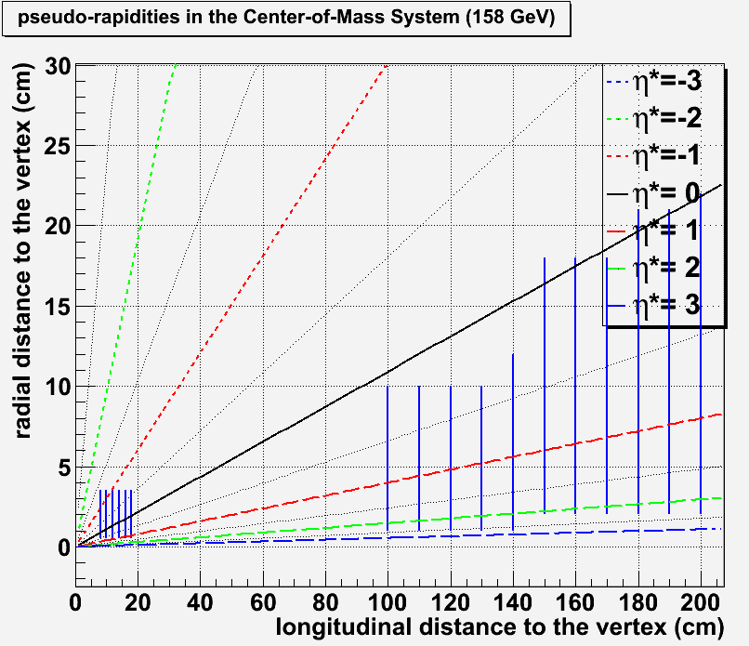
Detector – tracking
Size, position, resolution : tentative design - toy
yexample
B (T) | L (cm) | ΔP/P (%) | ΔM (MeV)
2.5 | 40 | ~ 6 | ~120
2.5 | 60 | ~ 2.7 | ~60
2.5 | 80 | ~ 1.5 | ~30
2.5 | 100 | ~1 | ~20
11 plane spectrometer
@ z_{max} = 120 cm ➔ r_{max}(η*=-0.5)~22 cm
11 planes from z=100 cm to z = 200 cm
← NA60
← CHIC
22
6 plane vertex
@ r_{min} = 0.5 cm ➔ z_{min}(η*=0.5)~7.5 cm
6 planes from z=8 cm to z=18 cm
η∗=-0.5
η∗=0.5
η∗=2
η∗=0.5
Track particles within η*∈[0.5 ; 2]
7.5

Slide 19
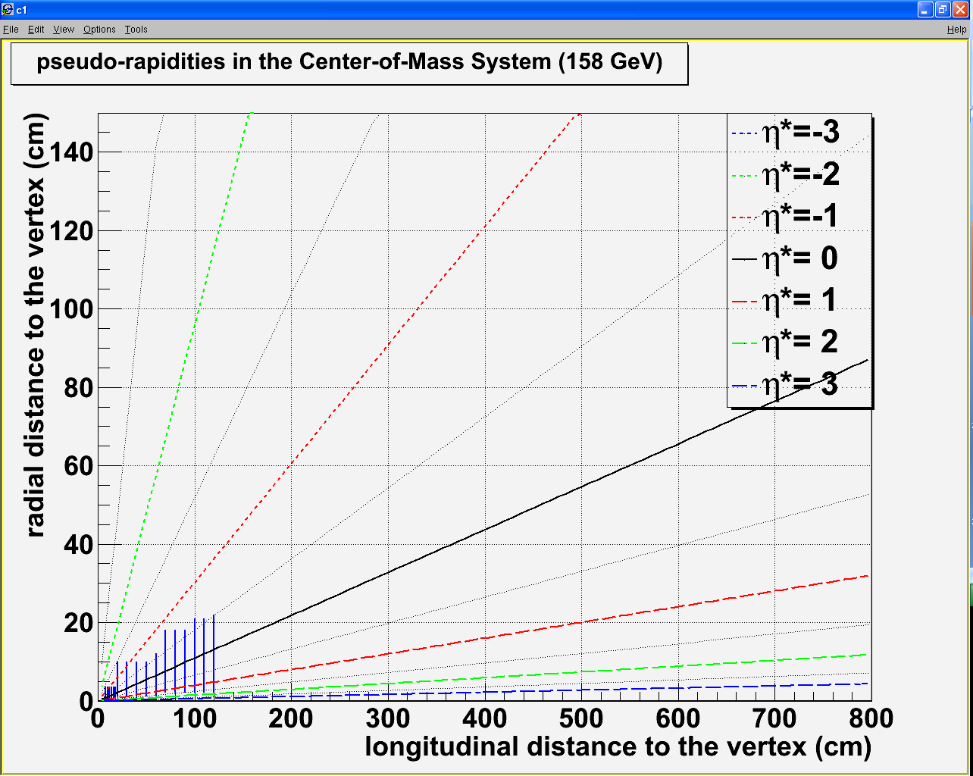
Detector – tentative design
Vertex detector :
R_{min} = 0.5 cm Z_{min} = 7.5 cm
R_{max} = 3.5 cm Z_{max} = 18 cm
120 cm
100 cm
1 m
2 m
3 m
4 m
5 m
6 m
80 cm
Spectrometer :
R_{min} = 1 cm Z_{min} = 20 (100) cm
R_{max} = 22 cm Z_{max} = 120 (200) cm
60 cm
40 cm
20 cm

Slide 20
Detector – calorimetry
Goal : measure χ_{c} → J/Ψ + γ
Issues
Low energy photon (similar to π⁰ → γγ)
High multiplicity of photon from π⁰ /η→ γγ
High multiplicity of charged particles (π^{+/-})
Pythia 6.421 - p+p - √s = 17.2 GeV
<p_{T}>~500 MeV
<E>~3 GeV

Slide 21
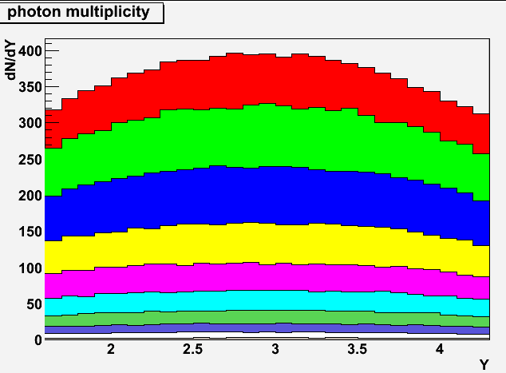
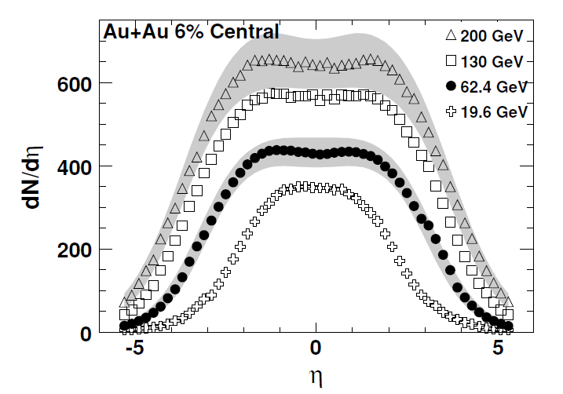
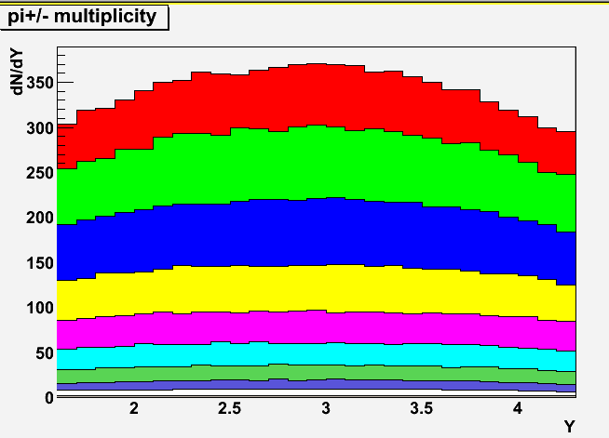
Detector – calorimetry
Goal : measure χ_{c} → J/Ψ + γ
Issues
Low energy photon (similar to π⁰ → γγ)
High multiplicity of photon from π⁰ /η→ γγ
High multiplicity of charged particles (π^{+/-})
WA98: Phys. Lett. B458: 422-430, 1999)
~480 γ
~340 γ
~400 γ
0 – 5%
Phobos: Phys. Rev. C74, 021901, 2006
Epos 1.6 : Pb+Pb @ 17.2 GeV
~350 π^{+/-}
~370 π^{+/-}
0 – 5%
0 – 5% Pb+Pb most central ➔ ~450 γ + 350 π^{+/-}
Epos 1.6 : Pb+Pb @ 17.2 GeV

Slide 22
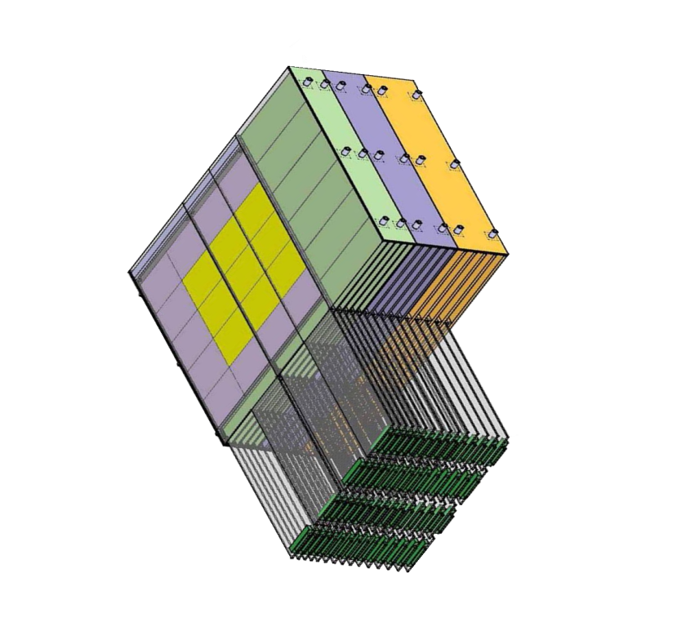
Detector – calorimetry
Need very high segmentation
to separate two electromagnetic showers
To isolate photons from π^{+/-} contamination
W + Si calorimeter à la Calice
30 layers
0.5 x 0.5 cm² pads
24 X₀ in 20 cm
W+Si : two relevant quantities
1st relevant quantity : distance
between two incoming particles
Min. distance between 2 particles at impact
= 1 free pad = 1 cm (for 0.5×0.5 cm²)
distance between two incoming particles
must be > 1 cm
N photons ➔ N/2 neutrals (π⁰ + η)➔ N π^{+/-}
➔ N γ + N π^{+/-} = 2N particles
distance between two photons
must be > 2 cm (1cm×2N/N)
2nd relevant quantity : EM shower transverse size
Moliere Radius R_{M} : 90% of the shower energy
Distance between two photons
must be > 2 cm (2 R_{M})
bad
good
Geometrical condition: in principle
Δγ > 2cm

Slide 23
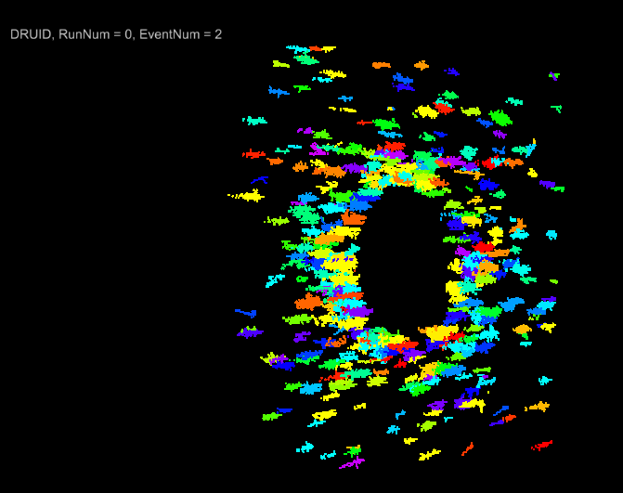
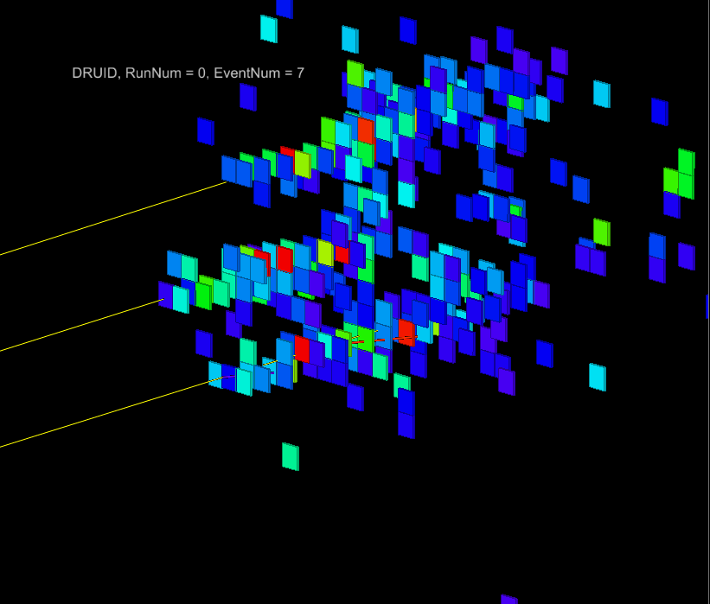
Detector – calorimetry
Full simulation performed with the Calice Ecal proto
<E>~3 GeV
Pb+Pb
3 photons with E~2 GeV
distance between each photon~ 2 cm
0.5 x 0.5 cm² pads
(full simu made by D. Jeans - Calice collab.)

Slide 24
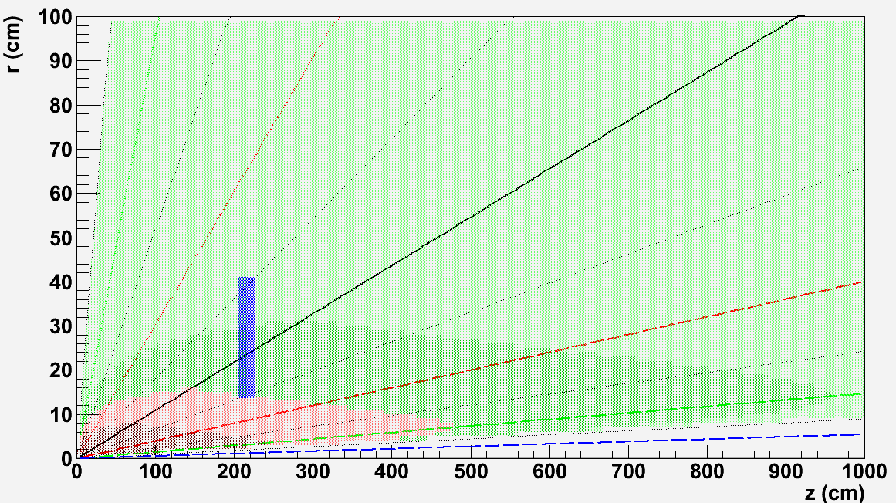
Detector – calorimetry
Size and position : tentative design
0 – 5% most central Pb+Pb events as measured by WA98
Distance between
two photons
[-0.5:0.5]
r_{min}
Δγ>4
Z
Δγ<4
Δγ<1
Δγ<2
r_{max}
Closer position to the target w/ Δγ>2cm:
Z = 205 cm [-0.5:0.5]
R_{min} = 13.6 cm
R_{max} = 40.9 cm
Using 0.5 x 0.5 cm² pads
20 cm

Slide 25
Detector – calorimetry
Size and position : tentative design
0 – 5% most central Pb+Pb events as measured by WA98
Distance between
two photons
[-0.5:0.5]
r_{min}
Δγ>4
Z
Δγ<4
Δγ<1
Δγ<2
r_{max}
Warning : not clear that Δγ>2 cm is large enough.
May need to investigate alternative design, for instance:
taking Δγ>4cm with z = 205 cm ➔ R_{min/max}=30/55 cm ➔ η* ∈[-0.8, -0.3]
taking Δγ>4cm with η* ∈[-0.5, 0.5] ➔ z ~400 cm
Must check with full simulation what is optimum Δγ !
20 cm

Slide 26
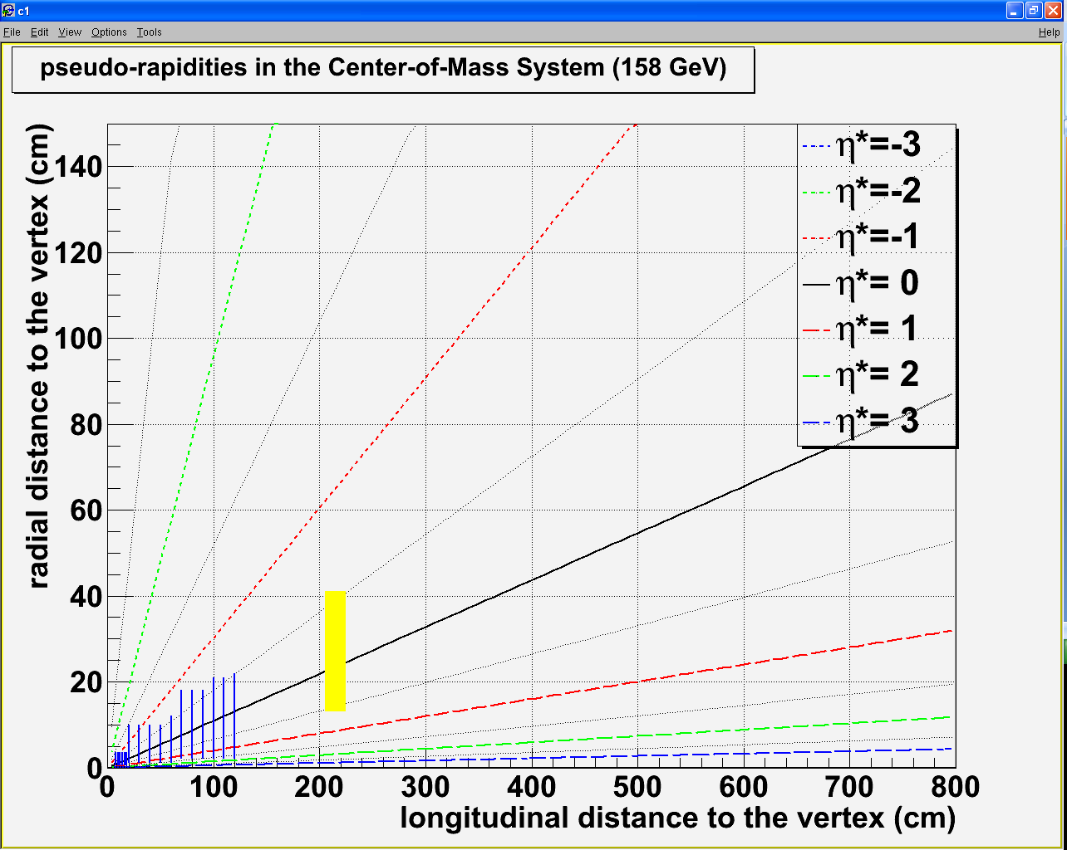
Detector – tentative design
Vertex detector :
R_{min} = 0.5 cm Z_{min} = 7.5 cm
R_{max} = 3.5 cm Z_{max} = 18 cm
120 cm
100 cm
80 cm
Spectrometer :
R_{min} = 1 cm Z_{min} = 20 (100) cm
R_{max} = 22 cm Z_{max} = 120 (200) cm
60 cm
40 cm
20 cm
Calorimeter Δγ>2 cm:
Rmin = 14 cm Zmin = 205 cm
Rmax = 41 cm Zmax = 225 cm
Dipole field
η_{γ}* ∈[-0.5, 0.5]
1 m
2 m
3 m
4 m
5 m
6 m

Slide 27
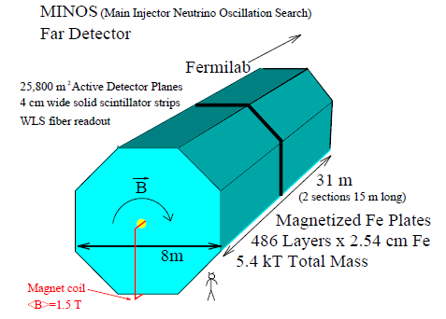
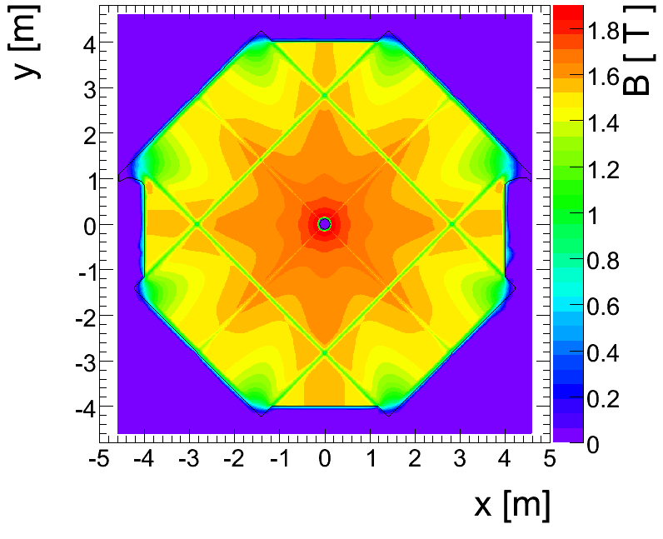
Detector – absorber
Absorber type
NA50/NA60 : measure muon momentum after the absorber
➔ must minimize multiple scattering
Must use low Z material: best = BeO (but expensive)
NA50 : 0.6 m BeO + 4 m C + 0.6 m Fe = 5.2 m
CHIC : measure muon momentum before the absorber
➔ minimization of multiple scattering less crucial
➔ can use Fe material To absorb π^{+/-}
Need to match muon track position between spectrometer and trigger : Use an instrumented Fe absorber
DHCal
μ
π+
http://newsline.linearcollider.org/archive/2010/20101104.html
Can match muon track momentum between spectrometer and trigger : Use magnetized Fe absorber ?
Minos

Slide 28
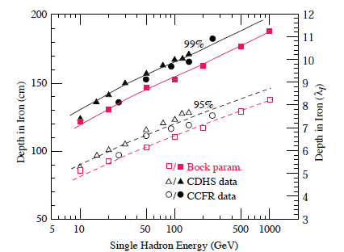
Detector – absorber
Absorber size and energy loss
At least 2 m Fe length needed
Fraction of
hadron energy
absorbed in Fe
0.3
50 GeV/c
π^{+/-} momentum up to ~50 GeV/c
All π^{+/-} stopped with a 2.0 m Fe absorber
but need more Fe to stop muons from pion decay

Slide 29
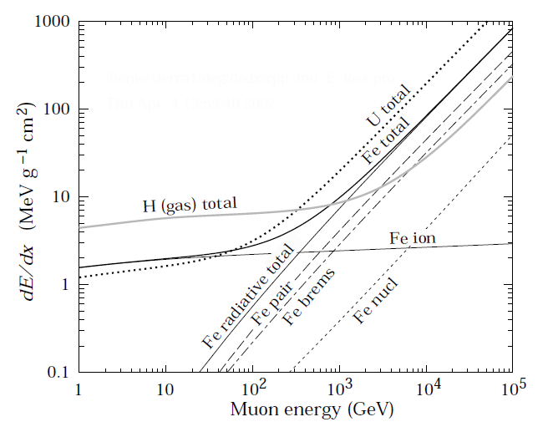
Detector – absorber
Absorber size and energy loss
All π^{+/-} stopped with a 2.0 m Fe absorber
but need more Fe to stop muons from pion decay
➔ 2.0 m Fe ➔ ΔE/Δx ~ 15.6 x 200 ~ 3.1 GeV ➔ A_{J/Ψ} ~ 18.4 %
3.2 m Fe ➔ ΔE/Δx ~ 15.6 x 320 ~ 5 GeV ➔ A_{J/Ψ} ~ 18.0 %
3.8 m Fe ➔ ΔE/Δx ~ 15.6 x 380 ~ 6 GeV ➔ A_{J/Ψ} ~ 17.3 %
4.5 m Fe ➔ ΔE/Δx ~ 15.6 x 450 ~ 7 GeV ➔ A_{J/Ψ} ~ 16.1 %
dE/dx ~ 2 MeV g⁻¹ cm²
Fe density ~ 7.8 g cm⁻³
dE/dx ~ 15.6 MeV cm⁻¹
Muon
energy loss
in Fe
Absorber starts @ 205 cm
π^{+/-} stop decaying after 1 λ_{I} in tungsten (λ_{I}~10cm)
➔ π^{+/-} stop decaying @ 2.15 m
3
5
7 GeV/c

Slide 30
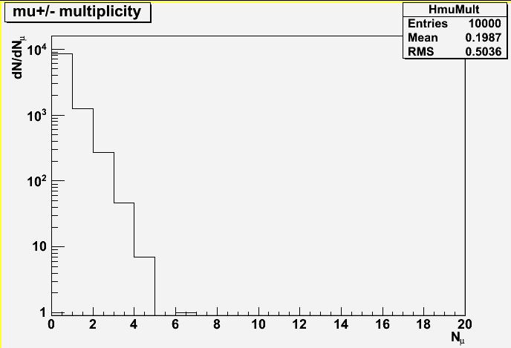
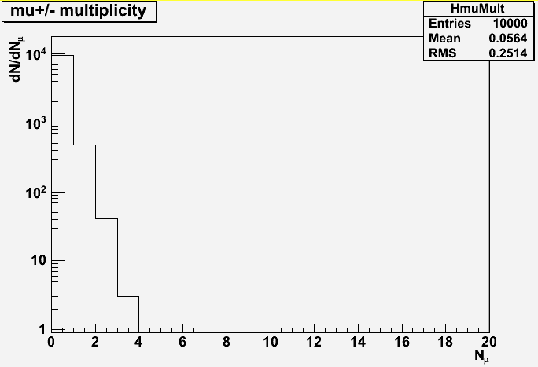
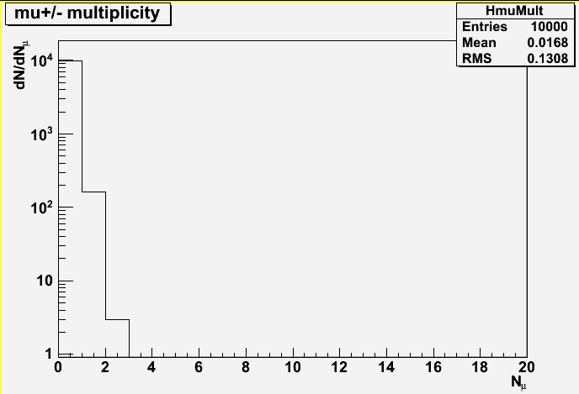
Detector – trigger rate in Pb+Pb
Pb Beam intensity
NA50 → 5.10⁷ ions/bunch ➔ 10⁷ ions/sec (with a bunch time length ~ 5 sec)
Luminosity : L = N_{b}xN_{T} = N_{b} x (ρ x e x N_{A})/A = 10⁷x(11.35 x 0.4 x 6.02 10²³)/207.19=0.12μb⁻¹s⁻¹
Number of min bias events (for Pb+Pb)
σ_{I}=68.8 x (A^{1/3}_{proj} + B^{1/3}_{targ} – 1.32)² ➔ σ^{PbPb}_{minbias}=68.8 x (208^{1/3} + 207.19^{1/3} – 1.32)²=7.62 barn
Nevents/sec ~ 0.12 10⁶ x 7.62 ~ 0.9 MHz
Event rejection :
10 000 Pb+Pb minbias events
generated with EPOS 1.6
At least 2 μ in the
Detector (329 events)
At least 2 μ in the
Detector (44 events)
At least 2 μ in the
Detector (12 events)
At least 2 μ in the
Detector (3 events)
3.2m Fe abs.: P_{z}>5 GeV/c: Trigger accepts 44/10000 events➔ N_{events}/sec ~ 0.9 MHz x 4.4 10⁻³ ~ 4 kHz
3.8m Fe abs.: P_{z}>6 GeV/c: Trigger accepts 12/10000 events ➔ N_{events}/sec ~ 0.9 MHz x 1.2 10⁻³ ~ 1.1 kHz
4.5m Fe abs.: P_{z}>7 GeV/c: Trigger accepts 3/10000 events ➔ N_{events}/sec ~ 0.9 MHz x 3 10⁻⁴ ~ 270 Hz

Slide 31
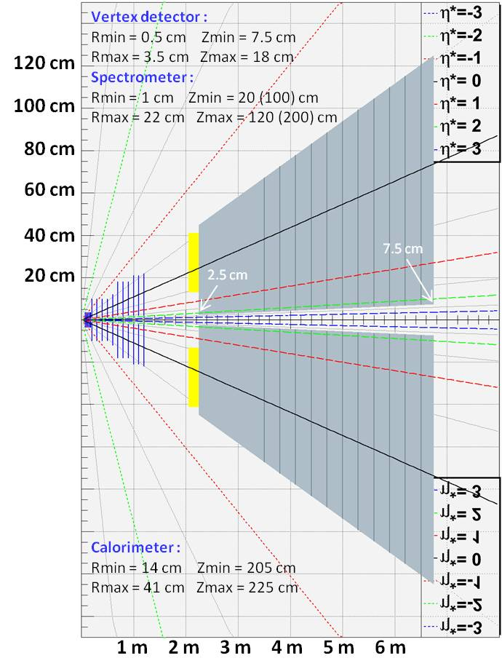
CHIC – Detector design
Primary goals :
χ_{c} → J/Ψ + γ → μ⁺ μ⁻ γ at y_{CMS} = 0
J/Ψ→μ⁺ μ⁻ in large y_{CMS} range
Detector features : very compact
Spectrometer
- Measure tracks before absorber ➔ σ_{M}~20 MeV/c²
- Covers y_{CMS} [-0.5, 2] ➔ need high segmentation
➔ Silicon technologies
Calorimeter
- Measuring γ in high π⁰ multiplicity environment
➔ ultra-granular EMCal (Calice)
Absorber/trigger
- Using 4.5 m thick Fe to absorb π/K and low P μ^{+/-}
- Can use smaller absorber if Fe magnetized
- Trigger to be defined (expected rate = 0.3 kHz)
Expected performances
tracking :
Calorimetry :
Dipole field
Dipole field

Slide 32
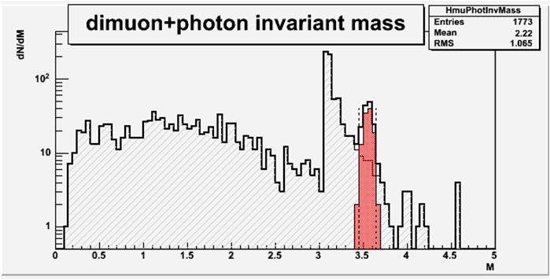
CHIC – Performances
χ_{c2} in p+p collisions at √s=17.8 GeV
Sample:
20 000 events with Pythia 6.421
1 χ_{c2}→J/Ψ γ →μ⁺ μ⁻ γ per event
Smearing ΔP_{μ}/P_{μ} = 1%
Smearing ΔE_{γ}/E_{γ} = 20%/√E_{γ}
Selections :
Keep muons w/ -0.5 < y_{cms} < 0.5
Keep muons w/ P_{z} > 7 GeV
Keep muons w/ z_{vertex} < 215 cm
Keep photons w/ -0.5 < y_{cms} < 0.5
Reject photons w/ M_{γγ} ∈[100, 160] MeV/c²
Results : signal/bkg = 2.8
χ_{c2} in Pb+Pb at √s=17.8 GeV
Sample:
10 000 events minbias with Epos 1.6
1 pythia χ_{c2} embedded in each event
Same selections as in p+p
Reject γ if not in the same emisphere as J/Ψ
Results : signal/bkg = 3.6

Slide 33
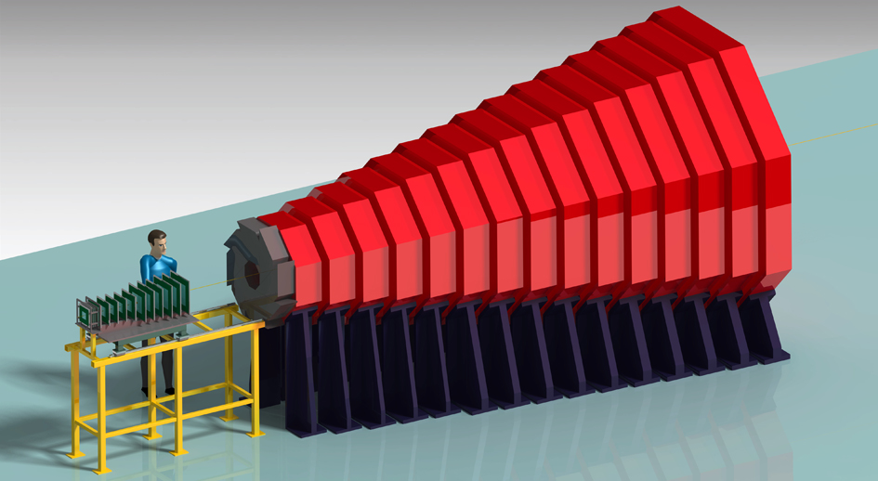
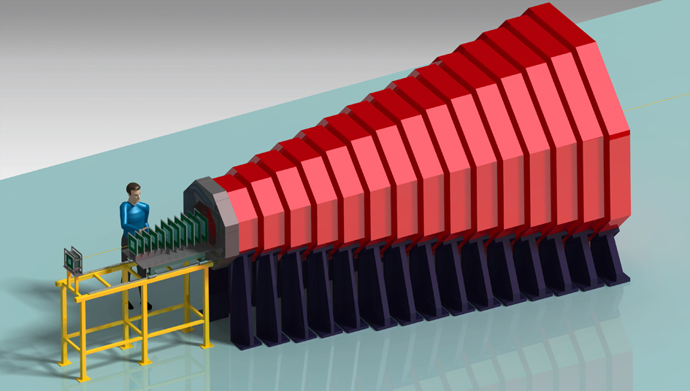
Conclusion
Déjà beaucoup de données sur le J/Ψ à différentes énergies, d’autres à venir
Toujours difficile à comprendre:
A-t-on vu la suppression séquentielle ?
A-t-on vu la régénération ?
La mesure du χ_{c} est une étape essentielle (et nécessaire)
Le SPS est le meilleur endroit pour commencer
C’est aujourd’hui faisable
Programme pour 2012
Promotion du projet : séminaires, conférences
Recherche de partenaires
Première version d’un framework de simulation
Évaluation des technologies (tracking, muons)
Échelle de temps < 10 ans (~3 construction)
Échelle de prix ~3 – 4 M€
Demandes :
Quelques aides ponctuelles
Des encouragements
Dessins produits par Oscar Ferreira

Slide 34
Conclusion

