Slide 1
kinematics
Opportunities and issues

Slide 2
Luminosity
Intensity: expect 5.10⁸ protons.s⁻¹
Beam: 2808 bunches of 1.15x10¹¹ protons = 3.2x10¹⁴ protons
Bunch: Each bunch passes IP: 3.10⁵km.s⁻¹/27 km ~ 11 kHz
Instantaneous extraction: IP sees 2808 x 11000~3.10⁷ bunches passing every second ➔ extract 5.10⁸/3.10⁷ ~ extract 16 protons in each bunch at each pass
Integrated extraction: Over a 10h run: extract 5.10⁸p x 3600s.h⁻¹ x 10h=1.810¹³p.run⁻¹ ➔ extract 1.8 x 10¹³/(3.2 x 10¹⁴)~5.6% of the protons stored in the beam
Instantaneous Luminosity
L = N_{beam} x N_{Target} = N_{beam} x (ρ x e x N_{A})/A
N_{beam}=5 x 10⁸ p⁺/s
e (target thickness) = 1 cm
Integrated luminosity
9 months running/year
➔ 1year ~ 10⁷ s
➔ ∫_{year}L = L_{inst}x10⁷
Targ | ρ (g.cm⁻³) | A | L_{inst} (μb⁻¹.s⁻¹) | ∫_{year}L (pb⁻¹.y⁻¹)
Liq H | 0.068 | 1 | 26 | 260
Liq D | 0.16 | 2 | 20 | 200
Be | 1.85 | 9 | 60 | 600
Cu | 8.96 | 64 | 40 | 400
W | 19.1 | 185 | 30 | 300
Pb | 11.35 | 207 | 16 | 160
Reach few fb⁻¹ with 10cm liq H/D target

Slide 3
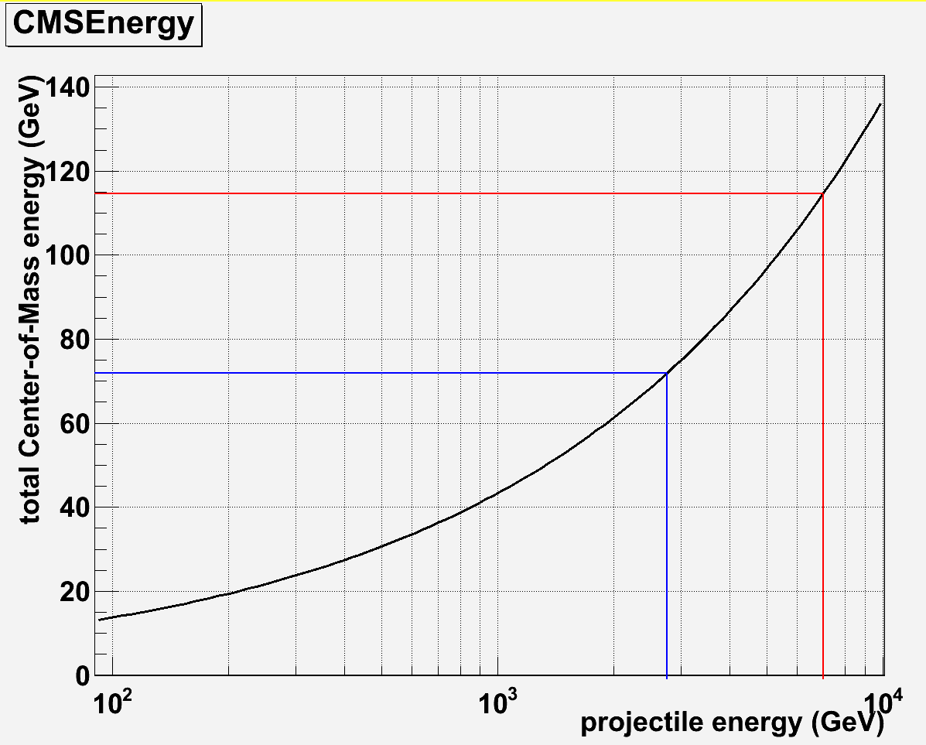
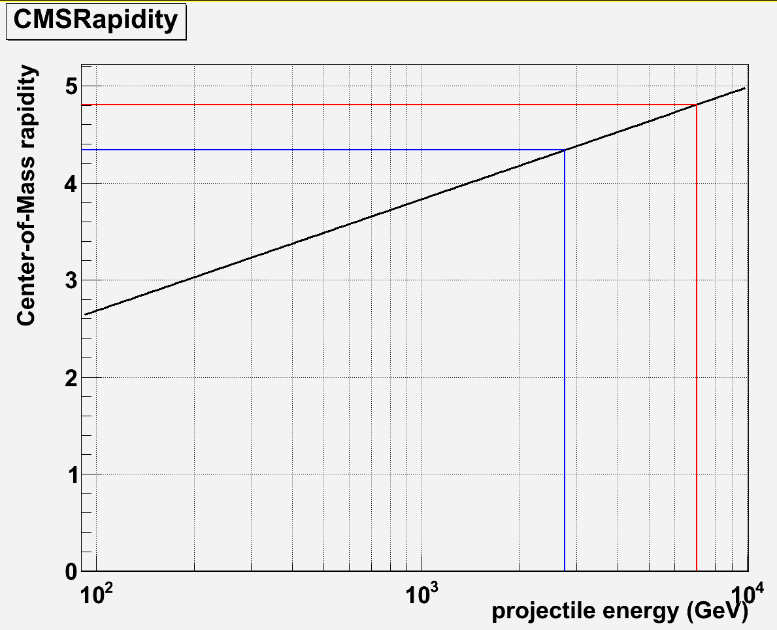
Energy – rapidity
Energy
Rapidity
p+p run : 7 TeV p→p : E_{CMS} = 114.6 GeV
p+p run : 7 TeV p→p : y_{CMS} = 4.8
Pb+Pb run : 2.75 TeV p→p : E_{CMS} = 71.8 GeV
Pb+Pb run : 2.75 TeV p→p : y_{CMS} = 4.3

Slide 4
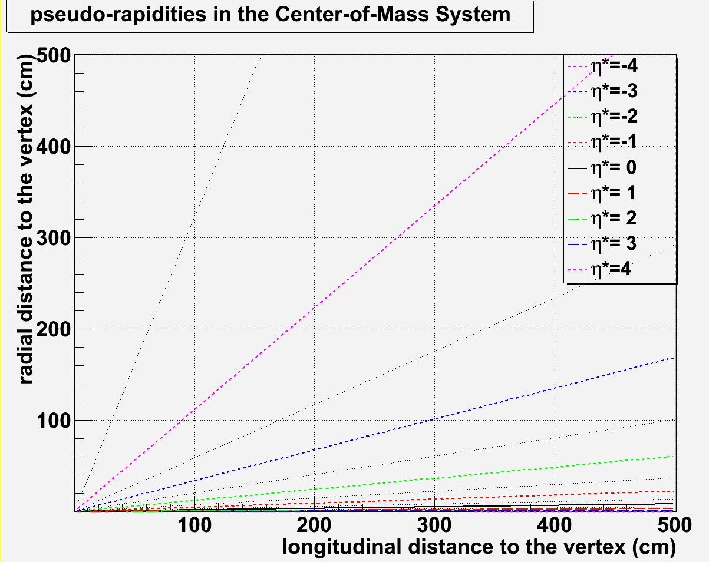
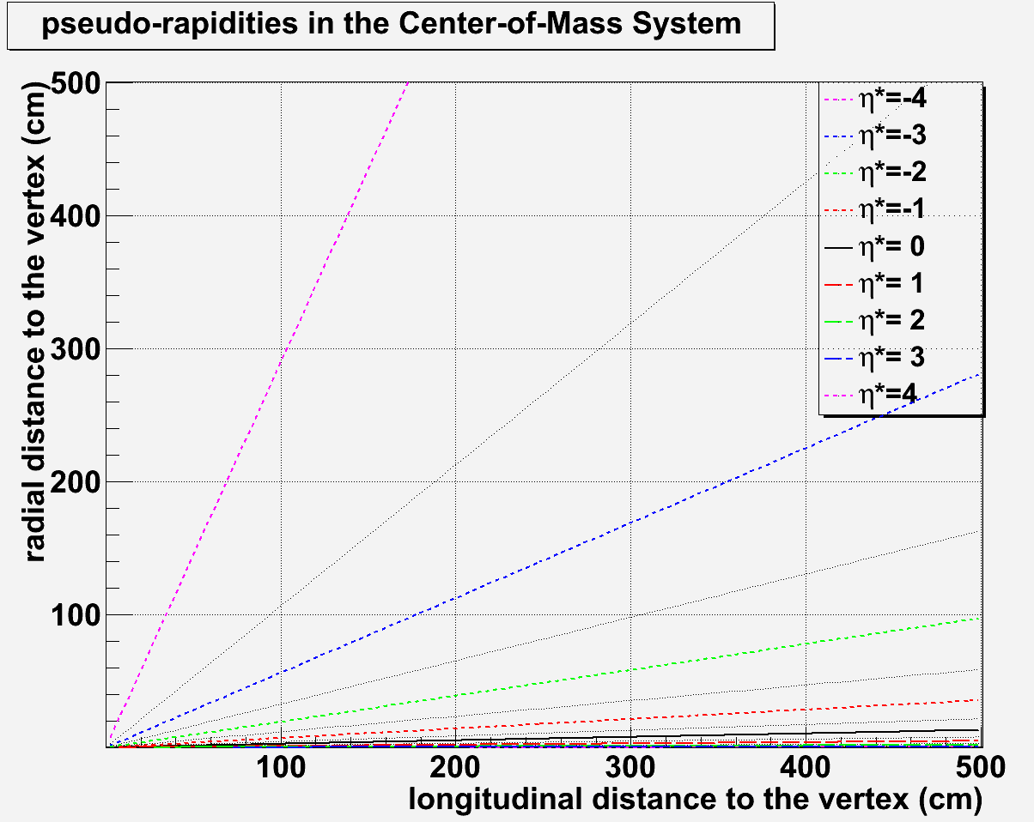
Pseudo-rapidity
η* = η – y_{CMS}
forward region: η*>0
backward region: η*<0
Very high boost:
With 7 TeV beam : γ = 61.1
With 2.75 TeV beam: γ = 38.3
Very well placed to access backward physics
Forward physics difficult to access
η*=-4.5
7 TeV
y_{CMS}= 4.8
η*=-4.8
η*=-4
η*=0
2.75 TeV
y_{CMS}= 4.3
η*=-4.3
η*=-4
η*=-3.5
η*=0

Slide 5
Detector constraint
Geometry
The geometry of the detector is related to the geometry of the magnet
The magnet geometry is constrained by the outgoing particle momentum
In principle
If p_{T} > p_{L} use a solenoid
If p_{L} > p_{T} use a dipole
B
B
solenoid
➔ detector parallel to the beam
dipole
➔ detector transverse to the beam
p_{T}
B
B
p_{L}
large p_{T} particles
➔ Solenoid is better
large p_{L} particles
➔ Dipole is better

Slide 6
Detector constraint
Geometry
In principle : If p_{T} > p_{L} use a solenoid, if p_{L} > p_{T} use a dipole
Converting p_{T}=p_{L} in rapidity frame
p_{T}
p_{T}=p_{L} ➔ θ = 45° ➔
θ
p_{L}
If p_{T} > p_{L}, η*<-4
If p_{T}<p_{L}, η*>-4
⎝ η* = 0.88 – 4.8 ~ -4 ➔
In principle:
one should use a solenoid to access η*<-4
one should use a dipole to access η*>-4

Slide 7
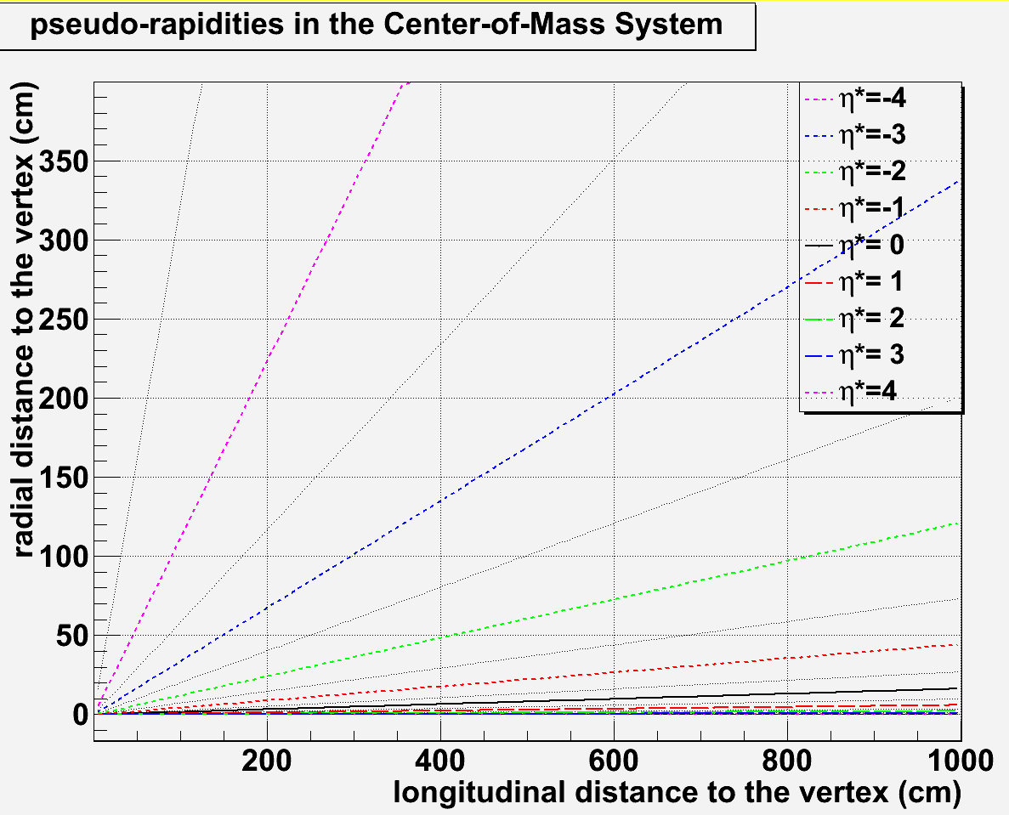
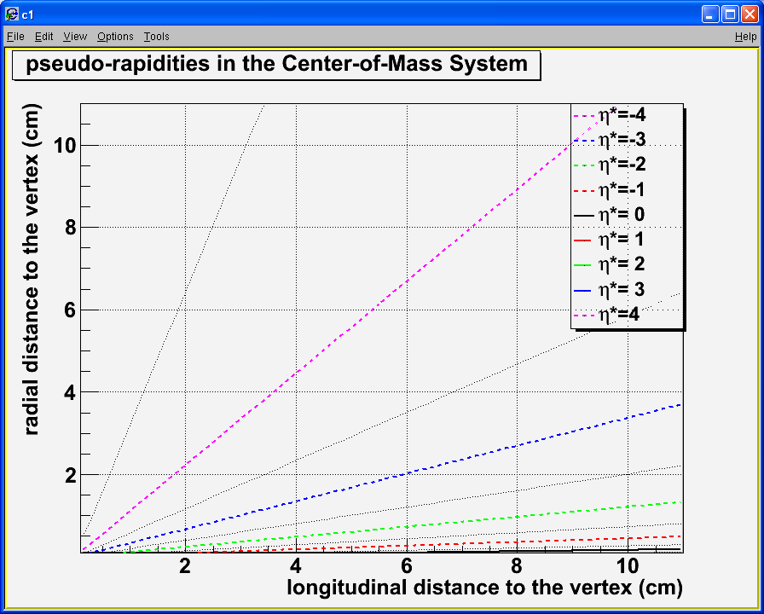
Longitudinal detector
Typical detector :
-4.8 < y* < -3.5
Multipurpose detector
Vertex
Tracking
calorimetry
Compact detector
Because of the high boost, the detector must be as compact as possible
Compact calorimeters (Calice)
EMCal ~ 20 cm long
HCal ~ 1 m long
Vertexing + Tracking
80 cm should be enough
To be checked
η*=-4
solenoid
HCal
EMCal
tracking
vertex

Slide 8
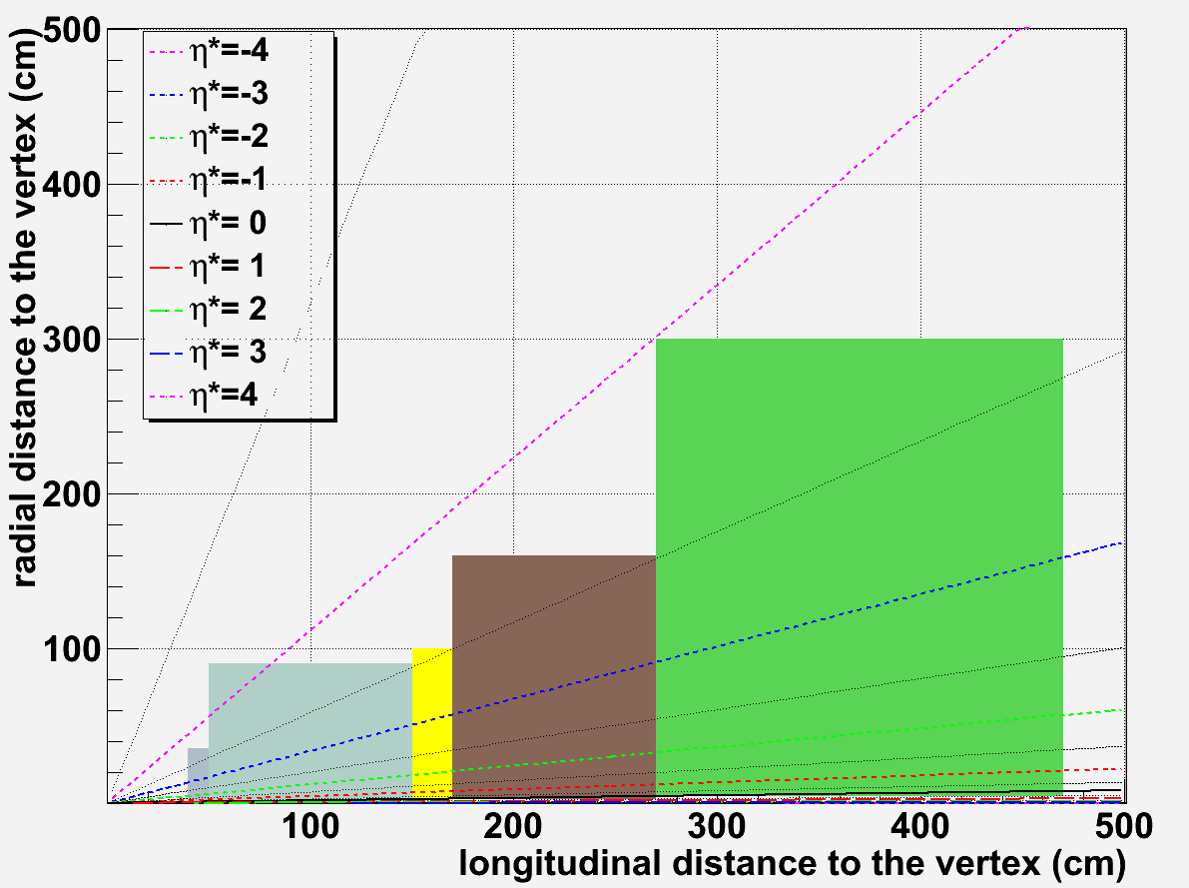
Transverse detector
~0.1 m
~0.2 m
Typical detector: -3.5 < y* < 0
Multipurpose detector:
Vertex
Tracking
Calorimetry
Muons
Compact detector
Because of the high boost, the detector must be as compact as possible
Dimensions
Vertex: z=40 / R_{min}=0.5 / R_{max}=35 cm
Tracker: z=50 / R_{min}=0.8 / R_{max}=90 cm
EMCal: z=150 / R_{min}=2 / R_{max}=100 cm
Hcal: z=170 / R_{min}=2.5 / R_{max}=160 cm
Muons: z = 270 / R_{min}=4 / R_{max}=300 cm
~1 m
~1 m
~2 m
MuID
EMcal
Hcal
η*=0

Slide 9
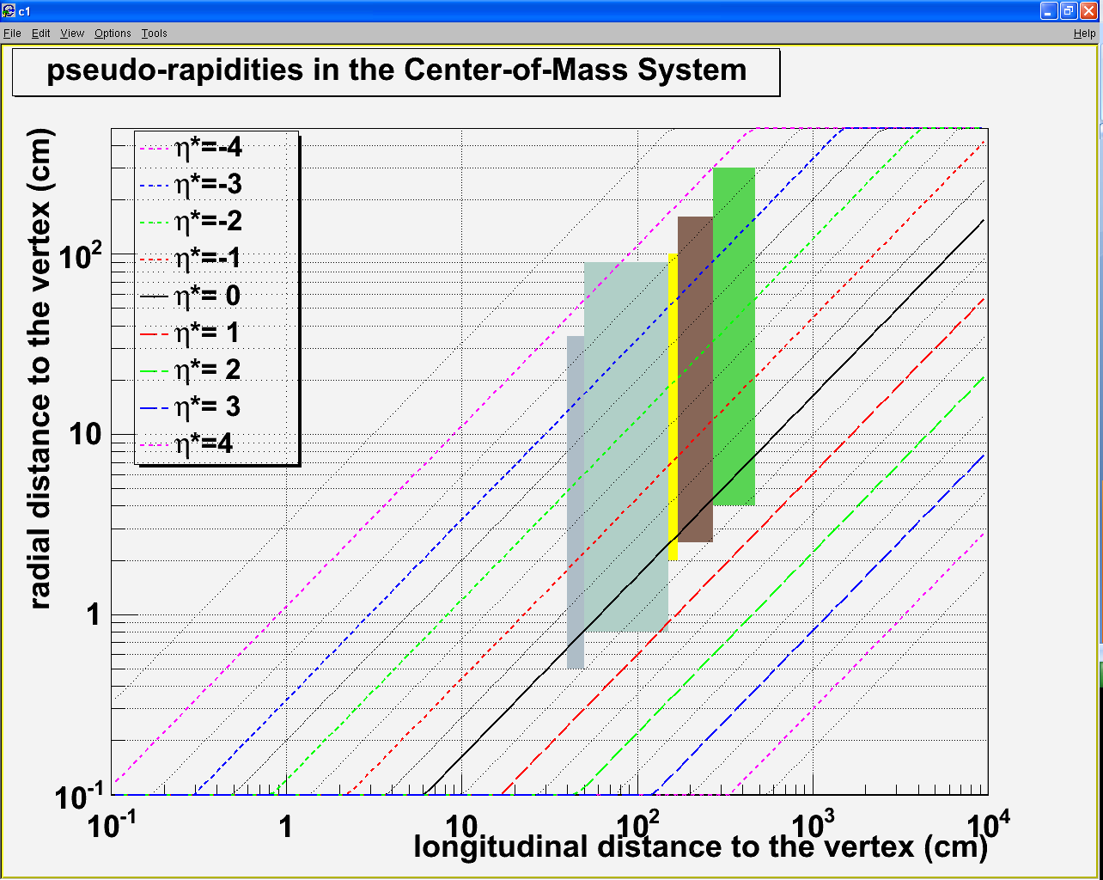
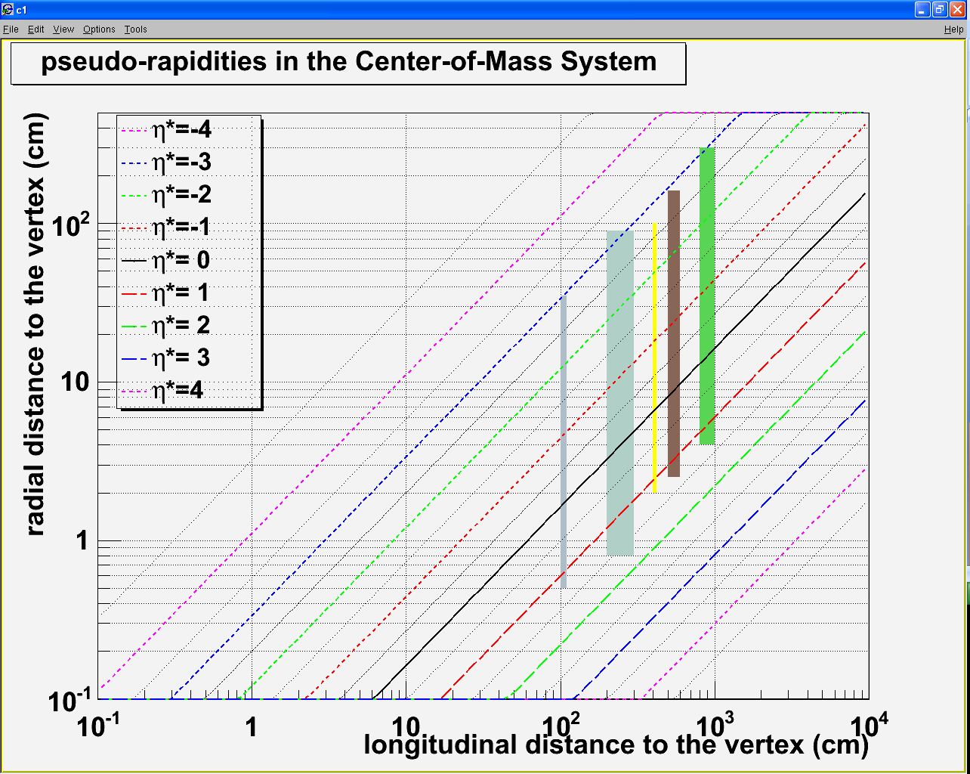
Transverse detector
Go forward ?
Possibility to access y*=1 by shifting the detectors
Detector | Z_{min}/Z_{max} at η*=0 | Z_{min}/Z_{max} at η*=1
Vertex | 40/50 cm | 100/110 cm
Tracker | 50/150 cm | 200/300 cm
EMCal | 150/170 cm | 400/420 cm
Hcal | 170/270 cm | 500/600 cm
muons | 270/470 cm | 800/1000 cm

Slide 10
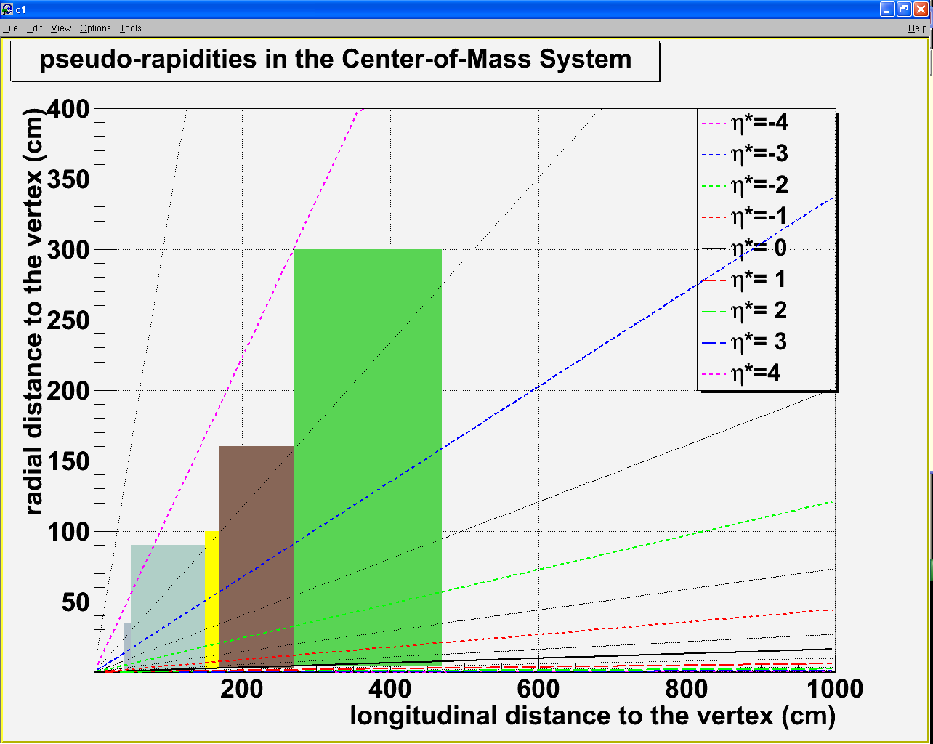
Longitudinal .vs. Transverse
Impossible to deal with the two magnets at the same time
Two options :
limit ourself to -3.5<η*<0 (1)
build two setups
Note that:
solenoid
HCal
EMCal
tracking
Don’t need longitudinal detector !

Slide 11
conclusion
LHC
Very high luminosity accessible : up to fb⁻¹.y⁻¹
E_{CMS} = 114.6/71.8 GeV in p+p/Pb+Pb
y_{CMS}=4.8/4.3 in p+p/Pb+Pb
Detector : two options
Measuring -4.8 < η*<-3.5 ➔ longitudinal/solenoid
Measuring -3.5 < η* < 0 (1) ➔ transverse/dipole
Not possible to run both detectors at the same time, but, in principle, we don’t need to reach η*<-3.5 to access x_{F}=-1.

